Slide 1
SESSION 1 OF 15
From a spreadsheet to data
Most bad analysis is not a technique failure. It is a correct answer to a question nobody asked.
WEEK 1 · FOUNDATIONS · 3 HOURS
Data Analysis with Python, SQL and Power BI · roadmap.sh: What is data analysis; the analyst's workflow
Notes:
Start on time.

Slide 2
THE FIFTEEN SESSIONS
Where tonight sits
1 · FOUNDATIONS
2 · FOUNDATIONS
3 · SQL
4 · SQL
From a spreadsheet to data
Why data lives in several tables
Asking a database for rows
Counting and grouping
5 · SQL
6 · PYTHON
7 · PYTHON
8 · PYTHON
Joining tables, carefully
Your first program
Reading a file, and looking at it
Cleaning, and writing down what you did
9 · PYTHON
10 · STATISTICS
11 · STATISTICS
12 · CHARTS
Grouping and joining in pandas
Describing one column
Comparing groups, and reading time
Charts that answer the question
13 · INVESTIGATION
14 · POWER BI
15 · POWER BI
A whole investigation, end to end
Getting data in, and modelling it
Measures, a dashboard, and presenting it
Notes:
Tonight is session 1 of twelve.

Slide 3
BEFORE WE START
The words for tonight
TERM
WHAT IT MEANS
IN A SPREADSHEET
Data
Recorded facts. Numbers, text and dates that something or somebody wrote down.
no direct equivalent
Dataset
One collection of data that belongs together. Usually one or more files, or one database.
A workbook
Table
Rows and columns where every row is the same kind of thing and every column holds the same kind of value.
A sheet with a header row
Row, or record
One of the things the table is about: one order, one customer, one machine reading.
A row
Column, or field
One fact recorded about every row, with one name and one type.
A column
Cell, or value
One column of one row. The smallest piece.
A cell
Data type
What kind of value a column holds: whole number, decimal, text, date, or true/false. A column has ONE type, all the way down.
Cell format, but enforced rather than cosmetic
Grain
What one row represents. The single most important fact about any table, and the one nobody states.
no direct equivalent

Slide 4
WHAT YOU WILL BE ABLE TO DO
By the end of tonight you can…
1
Name the parts of a table using the words the rest of the field uses, and say what each one is called in Excel.
2
Say what one row of a file represents, in one sentence, before doing anything else with it.
3
Turn a vague request into a question with a number, a population and a time window attached.
Session 1 of 15 · Foundations · From a spreadsheet to data
Notes:
These three are what tonight is marked against, in the sense that the lab checks them.

Slide 5
THE QUESTION TONIGHT ANSWERS
What is the difference between what you were asked
and what you can actually answer?
Most bad analysis is not a technique failure. It is a correct answer to a question nobody asked.
Notes:
Most bad analysis is not a technique failure. It is a correct answer to a question nobody asked.

Slide 6
BLOCK ONE · 50 MINUTES
What you were asked, and what you can answer
Requests against questions. Four real requests from a manager, each rewritten into a question you could actually answer, and one rewritten three different ways to show the original was ambiguous. The rule for the rest of

Slide 7
REQUESTS
Four requests, as they actually arrive
"Can you look at the sales numbers?"
1
Which sales, over what period, compared with what? Three people asking this want three different things.
"Why are sales down?"
2
Are they? Down against last month, last year, or budget? Down in shillings or in units? The question assumes its own answer.
"Send me a dashboard."
3
A dashboard is a delivery format. Nobody wants one. They want to stop asking somebody for a number every Monday.
"How many customers do we have?"
4
The easiest-looking one and the worst. Customers on our books, customers who bought this year, or customers who owe us money? Three numbers from one table.

Slide 8
WHAT YOU BRING
You are not starting from nothing
You already know what a row is
1
You have sorted one, filtered one and deleted one by accident. Tonight it gets a second name, RECORD, and that is most of what changes.
You already write code
2
=IF(B2>1000,"large","small") is a function, two arguments, a condition and a result. Session 6 puts the brackets somewhere else.
You already do joins
3
VLOOKUP is a join. It has one behaviour that differs from a real join, and in session 2 that difference is the whole lesson.
4
You already aggregate
A pivot table is GROUP BY. Session 4 is your pivot table, written down so it runs again next month without you.

Slide 9
DEFINITION
An answerable question
A question with three things attached: a NUMBER you will produce, a POPULATION it covers, and a TIME WINDOW. Without all three, two people can agree on the answer and still disagree about what it meant.
FOR EXAMPLE
Not "why are sales down" but "was delivered revenue in October to December 2025 lower than the same quarter a year earlier, across all four regions, in shillings?" That has an answer, and you can be shown to be wrong.
DO NOT CONFUSE WITH
A KPI. A KPI is a number somebody watches. A question is something you can be wrong about, and this course is about the second kind.
Notes:
A question with three things attached: a NUMBER you will produce, a POPULATION it covers, and a TIME WINDOW. Without all three, two people can agree on the answer and still disagree about what it meant.

Slide 10
DEFINITION
Grain
What one row of a table represents. It is the single most important fact about any table and the one nobody states out loud.
FOR EXAMPLE
In orders, one row is one order: 6,000 rows. In order_items, one row is one product on one order: 20,234 rows. Same business, same two years, two different tables, and a number that is right in one and wrong in the other.
DO NOT CONFUSE WITH
Row count. Two tables about the same thing can have very different row counts and both be complete. What differs is the grain.
Notes:
What one row of a table represents. It is the single most important fact about any table and the one nobody states out loud.

Slide 11
DEFINITION
Data type
What kind of value a column holds: whole number, decimal, text, date, or true/false. A column has ONE type, all the way down.
FOR EXAMPLE
order_date is a date, so the database can sort it, subtract one from another and pull the month out. If it were text, "2025-03-10" and "10/03/2025" would be two unrelated pieces of text and none of that would work.
DO NOT CONFUSE WITH
Cell formatting. Formatting changes how a value LOOKS. A type changes what the value IS, and the software will refuse to break it.
Notes:
What kind of value a column holds: whole number, decimal, text, date, or true/false. A column has ONE type, all the way down.

Slide 12
Break
10 minutes
Stretch, and talk to someone you have not worked with. Be back on time: the longest working block of the session is next.
Notes:
Ten minutes.

Slide 13
BLOCK TWO · 45 MINUTES
The words, on a real table
The words, on a real table. The anatomy figure on the screen and the same five rows open in Excel: row, column, cell, header, primary key, and the Excel word beside each. Then data types, and grain, which is the one that

Slide 14
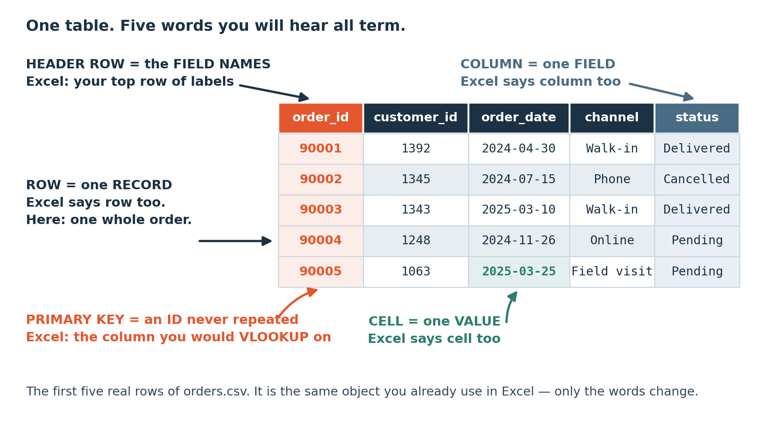
LOOK AT THIS
One table. Five words you will hear all term.
The first five real rows of orders.csv. Everything you already know about a spreadsheet still applies; the words change and one new idea, the primary key, arrives.
Notes:
The first five real rows of orders.csv. Everything you already know about a spreadsheet still applies; the words change and one new idea, the primary key, arrives.

Slide 15
THE DATASET
What you are working with for five weeks
Riverside Distributors
By the end of tonight
A wholesale distributor. Six tables, two years of trading, and it behaves like a real system because it was built to.
The data open on your own machine, in a spreadsheet.
Six sentences: what one row is, in each of the six files.
6,000 orders, 20,234 order lines, 401 customers, 120 products, 12 sales reps, 501 returns.
Three requests rewritten as answerable questions.
Small enough that you can check it by hand, which is why you will trust what you learn on it.
One question from your own work, written down. It is a capstone candidate.

Slide 16
THE SHAPE
How the five weeks go
Week 1 — the words, and getting the data
Week 3 — Python on real files
Tonight and next session have no code at all. Then your first SQL, which is a written-down filter.
Read a file too big for Excel, clean it without destroying it, and get the same answer as your SQL.
Week 2 — SQL, then your first program
Week 4 — what the numbers mean
Grouping, joining, and the report a sales manager would actually ask for. Then Python from the beginning.
Statistics from what a statistic is. Then charts, from what an axis is.
Week 5 — shipping it
A full investigation, then Power BI, then five minutes in front of the room.
Notes:
Reference.

Slide 17
THE MISTAKE THIS SESSION PREVENTS
Starting to compute before agreeing what was asked. It is the most expensive habit in the room and the cheapest to fix.
It is in tonight's lab on purpose.
Session 1 of 15
Notes:
Starting to compute before agreeing what was asked. It is the most expensive habit in the room and the cheapest to fix.

Slide 18
CHECK YOUR UNDERSTANDING
Can you answer these?
A
Your manager says the Eastern region is underperforming. What three things are missing before that is answerable?
B
Somebody asks how many customers we have. Name two defensible answers that differ.
C
orders has 6,000 rows and order_items has 20,234. Is one of them incomplete?
Answers are on the next slide — try first, then look.

Slide 19
ANSWERS
How did you do?
A
"The Eastern region is underperforming"
A number, a population and a window. Underperforming on what measure, against which comparison, over what period. As it stands it is a conclusion with no question underneath it.
B
Two answers to "how many customers"
Everyone in the customers table, which is 401 here, or everyone who placed an order in a given window, which is smaller. Both are right. Which one was wanted is the question you have to go and ask.
C
Different row counts in two tables
No. They have different GRAIN. One row of orders is one order; one row of order_items is one product on one order. Both tables are complete, and a total computed on the wrong one is wrong.

Slide 20
LAB · 50 MINUTES
Say what one row is, six times
Open the six course files in your spreadsheet. For each one, write down three things: what one row represents in a single sentence, how many rows there are, and which column could never repeat. Then take the three requests on your sheet and turn each into an answerable question.
Work these questions in order:
→ One row of this file is ___ .
→ Which column points at another table?
→ How many rows? Write the number down.
→ Then: the three requests, rewritten with a number, a population and a window.
→ Which column never repeats? That is the primary key.
Notes:
Open the six course files in your spreadsheet. For each one, write down three things: what one row represents in a single sentence, how many rows there are, and which column could never repeat. Then take the three requests on your sheet and turn each into an answerable question.

Slide 21
TONIGHT IN THREE LINES
What you can do now
Name the parts of a table using the words the rest of the field uses, and say what each one is called in Excel.
Say what one row of a file represents, in one sentence, before doing anything else with it.
Turn a vague request into a question with a number, a population and a time window attached.

Slide 22
HOMEWORK · 45 TO 60 MINUTES
Before the next session
Write down the last three things somebody asked you for at work. Rewrite each as a question with a number, a population and a window. Bring them: they are capstone candidates.
WHY IT IS ALWAYS OPTIONAL ON YOUR OWN DATA
Homework on a dataset you already care about gets done. Homework on a teaching dataset competes with your job and loses. Either version counts, and the one on your own data is worth more to you.
Notes:
Write down the last three things somebody asked you for at work. Rewrite each as a question with a number, a population and a window. Bring them: they are capstone candidates.

Slide 23
THE ONE THING TO REMEMBER
You now have a question, and the words to describe the data
Everything from here is technique, and technique is teachable in five weeks. Knowing what you are being asked, and what one row means, is the part that separates an analyst from somebody who produces charts.
Next session: why the data is in six tables and not one. Still no code.
Notes:
Everything from here is technique, and technique is teachable in five weeks. Knowing what you are being asked, and what one row means, is the part that separates an analyst from somebody who produces charts.

