Slide 1
SESSION 2 OF 15
Why data lives in several tables
Because one big sheet stores the same fact many times, and every copy is a chance to be wrong.
WEEK 1 · FOUNDATIONS · 3 HOURS
Data Analysis with Python, SQL and Power BI · roadmap.sh: Data modelling basics; relational thinking
Notes:
Start on time.

Slide 2
THE FIFTEEN SESSIONS
Where tonight sits
1 · FOUNDATIONS
2 · FOUNDATIONS
3 · SQL
4 · SQL
From a spreadsheet to data
Why data lives in several tables
Asking a database for rows
Counting and grouping
5 · SQL
6 · PYTHON
7 · PYTHON
8 · PYTHON
Joining tables, carefully
Your first program
Reading a file, and looking at it
Cleaning, and writing down what you did
9 · PYTHON
10 · STATISTICS
11 · STATISTICS
12 · CHARTS
Grouping and joining in pandas
Describing one column
Comparing groups, and reading time
Charts that answer the question
13 · INVESTIGATION
14 · POWER BI
15 · POWER BI
A whole investigation, end to end
Getting data in, and modelling it
Measures, a dashboard, and presenting it
Notes:
Tonight is session 2 of twelve.

Slide 3
BEFORE WE START
The words for tonight
TERM
WHAT IT MEANS
IN A SPREADSHEET
Primary key
A column whose value is never repeated, so it identifies one row exactly.
The column you would VLOOKUP on
Foreign key
A column that holds another table's primary key, which is what links the two.
The lookup value you type into VLOOKUP
One-to-many
One row on one side matches several rows on the other. One order, several order lines.
no direct equivalent
Join
Putting two tables side by side by matching a key, so you can use columns from both.
VLOOKUP, except it returns EVERY match rather than the first
Database
Several related tables kept together, with the types and the keys enforced by the software.
A workbook where the rules are not optional
Duplication
The same fact stored in more than one place. It is why one big sheet goes wrong: change a customer's region and you have to change it in every row.
no direct equivalent

Slide 4
WHAT YOU WILL BE ABLE TO DO
By the end of tonight you can…
1
Explain why a business keeps orders and customers in separate tables instead of one big sheet.
2
Find the key that connects two tables, and predict what happens to the row count when they are joined.
3
Say what one row means in each of the six course tables.
Session 2 of 15 · Foundations · Why data lives in several tables
Notes:
These three are what tonight is marked against, in the sense that the lab checks them.

Slide 5
THE QUESTION TONIGHT ANSWERS
Why is this data in six tables
instead of one big sheet?
Because one big sheet stores the same fact many times, and every copy is a chance to be wrong.
Notes:
Because one big sheet stores the same fact many times, and every copy is a chance to be wrong.

Slide 6
BLOCK ONE · 50 MINUTES
Why not one big sheet
Why not one big sheet. Start from the flat export everybody recognises and break it: a customer changes region, and the same fact now has to be edited in four hundred rows, some of which get missed. Then the same data as

Slide 7
THE PROBLEM
What goes wrong with one big sheet
1
The same fact, stored many times
A customer's region appears on every one of their orders. One customer, dozens of copies of one fact.
Every copy is a chance to disagree
2
The customer moves region. Now you edit dozens of rows, and the ones you miss are still there, still wrong, still being summed.
You cannot record something that has not happened
3
A customer who has not ordered this year has no row at all, so they are invisible to every total. The thing you most want to know is the thing the sheet cannot hold.
Six tables fix all three
4
Each fact is stored once, in the table it belongs to. A region change is one edit. A customer with no orders still exists.

Slide 8
DEFINITION
Primary key
A column whose value is never repeated, so it identifies exactly one row. Every proper table has one.
FOR EXAMPLE
customer_id in the customers table. There is one row for customer 1007 and there will never be another.
DO NOT CONFUSE WITH
A row number. A row number changes when you sort. A primary key belongs to the thing itself and never moves.
Notes:
A column whose value is never repeated, so it identifies exactly one row. Every proper table has one.

Slide 9
DEFINITION
Foreign key
A column that holds another table's primary key. It is what connects the two tables.
FOR EXAMPLE
orders.customer_id holds a value from customers.customer_id. That one column is the whole connection, and 172 orders leave it empty because walk-in trade has no customer.
DO NOT CONFUSE WITH
The lookup value you type into VLOOKUP. Same idea, except the database can refuse a value that does not exist.
Notes:
A column that holds another table's primary key. It is what connects the two tables.

Slide 10
DEFINITION
One-to-many
One row on one side matches several rows on the other. It is the commonest relationship in business data and the reason totals go wrong.
FOR EXAMPLE
One order has several order lines. One customer has many orders. One rep has many customers. 6,000 orders become 20,234 order lines.
Notes:
One row on one side matches several rows on the other. It is the commonest relationship in business data and the reason totals go wrong.

Slide 11
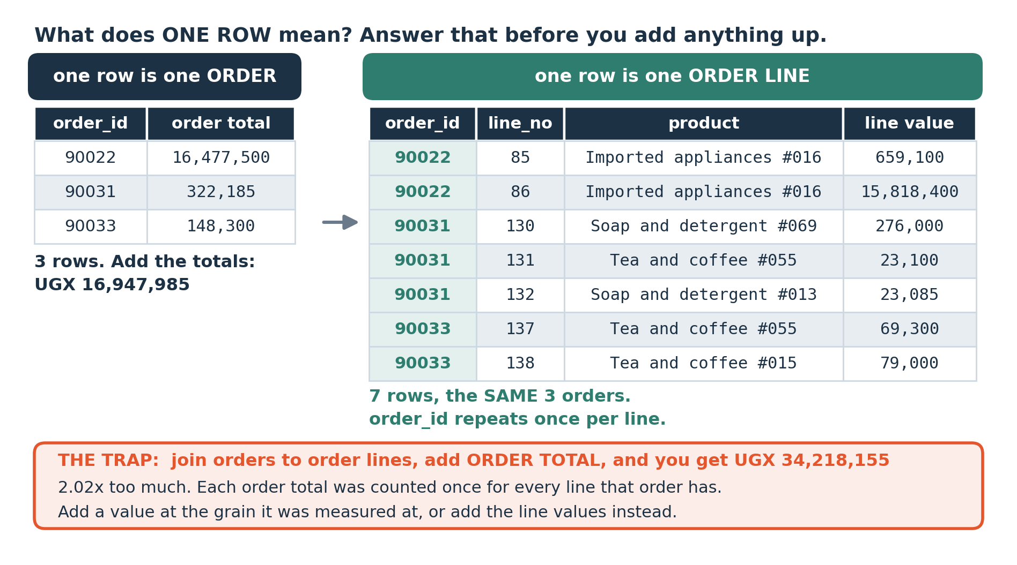
LOOK AT THIS
The same business, two different grains
Left: one row is one order. Right: one row is one order line, so an order appears more than once. Both are real rows from the course data. The caption is the number to remember.
Notes:
Left: one row is one order. Right: one row is one order line, so an order appears more than once. Both are real rows from the course data. The caption is the number to remember.

Slide 12
Break
10 minutes
Stretch, and talk to someone you have not worked with. Be back on time: the longest working block of the session is next.
Notes:
Ten minutes.

Slide 13
BLOCK TWO · 45 MINUTES
Grain, keys, and what a join does
Grain, and what a join does to it. The grain figure: one row is one order against one row is one order line. Then the join figure: INNER against LEFT, and the walk-in orders that disappear from one and survive the other.

Slide 14
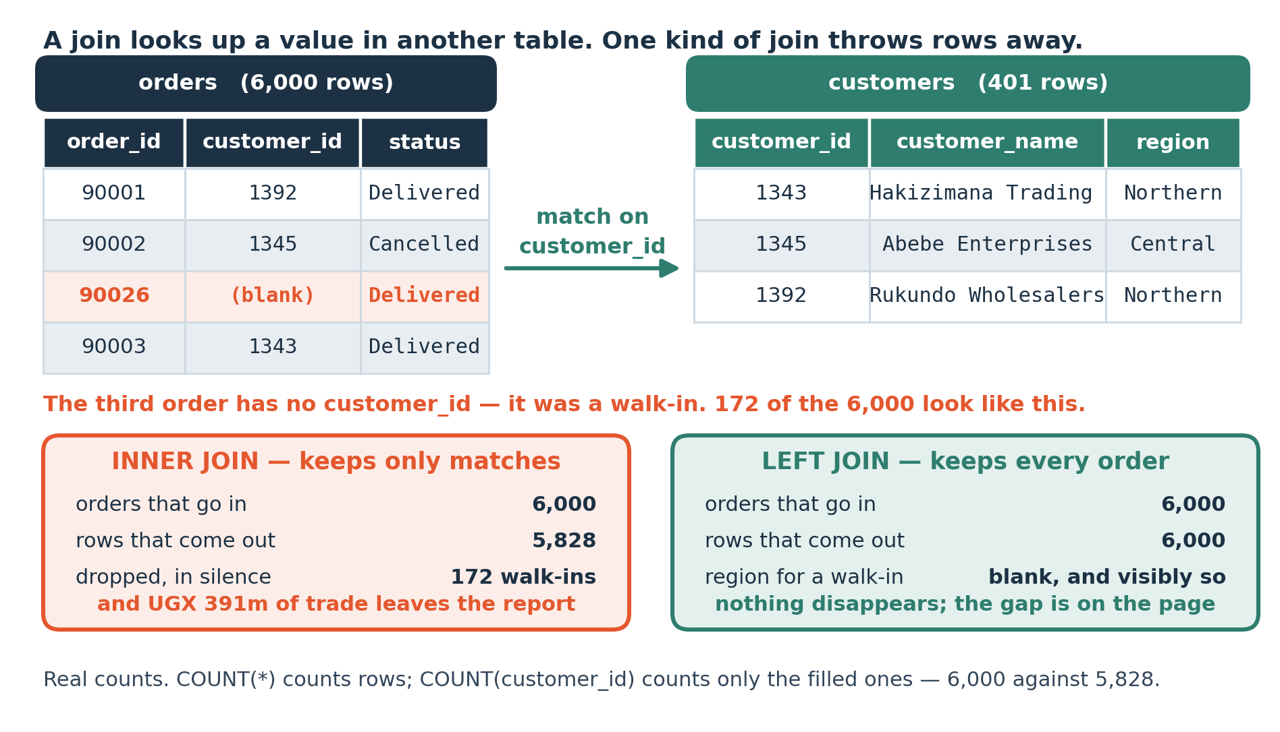
LOOK AT THIS
What a join does, and what an INNER JOIN quietly throws away
Real counts from the course data. The INNER JOIN loses the 172 walk-in orders because they have no customer to match, and nothing in the output says so.
Notes:
Real counts from the course data. The INNER JOIN loses the 172 walk-in orders because they have no customer to match, and nothing in the output says so.

Slide 15
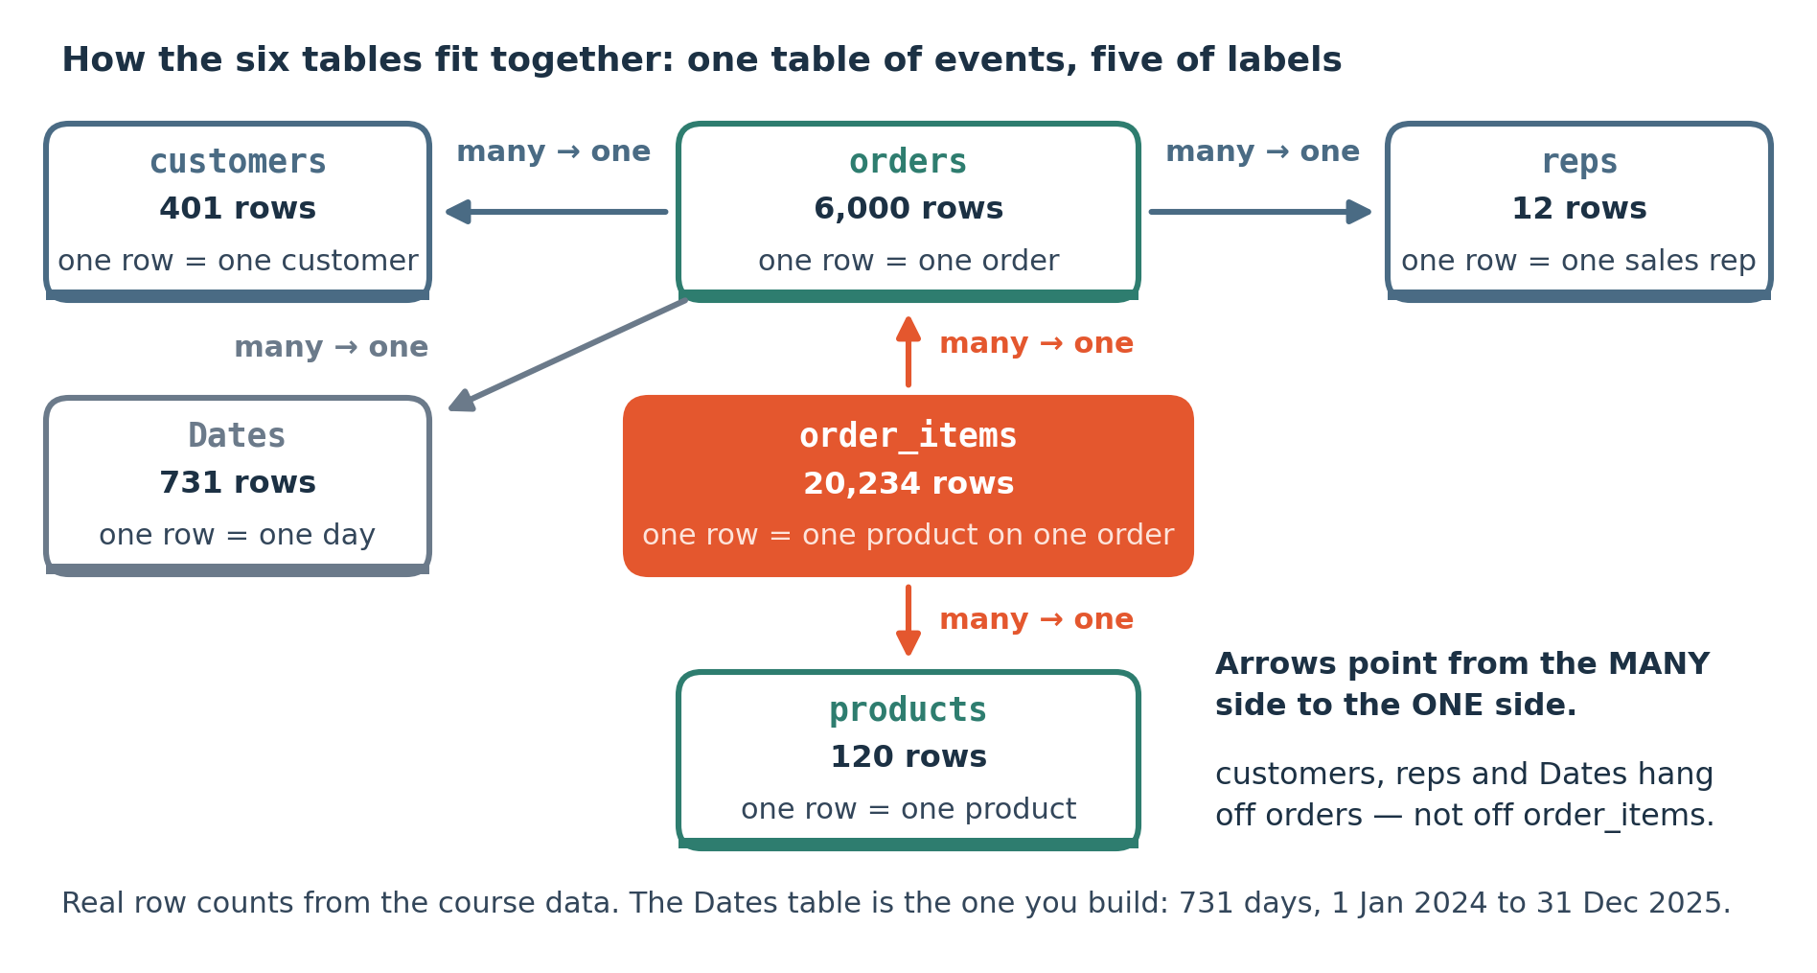
LOOK AT THIS
The six tables, and how they connect
You will build exactly this in Power BI in session 14. Tonight you only need to see that the arrows all point the same way: many orders to one customer.
Notes:
You will build exactly this in Power BI in session 14. Tonight you only need to see that the arrows all point the same way: many orders to one customer.

Slide 16
LAB · NO TYPING
Tonight's lab has no SQL in it
DB Browser, Browse Data tab
For each of the six tables
You will click, not type. Open riverside.db, go to Browse Data, and use the dropdown to look at each of the six tables.
What is the grain? One row is one what?
What is the primary key?
The point is to get the SHAPE of this business into your head before any syntax arrives. Next session the typing starts, and it is much easier when you already know what is in there.
Which columns point at another table?
Then find an order with no customer_id, and write down what you think that means about how this business trades.

Slide 17
THE MISTAKE THIS SESSION PREVENTS
Assuming one row means what you assume it means. Every wrong total later in this course comes from a grain nobody said out loud.
It is in tonight's lab on purpose.
Session 2 of 15
Notes:
Assuming one row means what you assume it means. Every wrong total later in this course comes from a grain nobody said out loud.

Slide 18
CHECK YOUR UNDERSTANDING
Can you answer these?
A
A customer moves from Central to Eastern. How many edits in one big sheet, and how many in six tables?
B
orders.customer_id is empty on 172 rows. Is that a data error?
C
You join orders to order_items. Will the result have more rows, fewer, or the same?
Answers are on the next slide — try first, then look.

Slide 19
ANSWERS
How did you do?
A
One edit or many
One edit in the customers table. In a flat sheet, one edit per order that customer ever placed, and the ones you miss stay wrong and keep being summed.
B
Empty customer_id on 172 orders
No. It is walk-in trade: a real order with real revenue and no customer recorded. It becomes an error only if somebody joins to customers without noticing, which silently removes UGX 390,632,335 from the answer.
C
Row count after joining orders to lines
More. It is one-to-many, so each order appears once per line: 6,000 becomes 20,234. That is correct, and summing an order-level figure on that result is not.

Slide 20
LAB · 50 MINUTES
Map the six tables by clicking
No SQL tonight. In DB Browser's Browse Data tab, work through all six tables and fill in the sheet: grain, primary key, foreign keys. Then draw the six boxes and the arrows between them on paper. Drawing it by hand is what makes it stick.
Work these questions in order:
→ Grain of each table: one row is one what?
→ Draw the six boxes and the arrows, on paper.
→ Primary key of each table.
→ Find an order with no customer and say what it means.
→ Every column that points at another table.
Notes:
No SQL tonight. In DB Browser's Browse Data tab, work through all six tables and fill in the sheet: grain, primary key, foreign keys. Then draw the six boxes and the arrows between them on paper. Drawing it by hand is what makes it stick.

Slide 21
TONIGHT IN THREE LINES
What you can do now
Explain why a business keeps orders and customers in separate tables instead of one big sheet.
Find the key that connects two tables, and predict what happens to the row count when they are joined.
Say what one row means in each of the six course tables.

Slide 22
HOMEWORK · 45 TO 60 MINUTES
Before the next session
Take one report you receive at work and work out how many tables it was probably built from. Name them and the key each would join on. You will be right more often than you expect.
WHY IT IS ALWAYS OPTIONAL ON YOUR OWN DATA
Homework on a dataset you already care about gets done. Homework on a teaching dataset competes with your job and loses. Either version counts, and the one on your own data is worth more to you.
Notes:
Take one report you receive at work and work out how many tables it was probably built from. Name them and the key each would join on. You will be right more often than you expect.

Slide 23
THE ONE THING TO REMEMBER
Say the grain out loud, every time
Nearly every wrong total in the rest of this course comes from a grain nobody stated. Two sessions with no code buys you that habit, and it is the cheapest thing you will learn here.
Next session: the same tables, and your first query.
Notes:
Nearly every wrong total in the rest of this course comes from a grain nobody stated. Two sessions with no code buys you that habit, and it is the cheapest thing you will learn here.

