Slide 1
SESSION 10 OF 15
Describing one column
There are three defensible answers and they differ by a factor of five. Choosing between them is tonight.
WEEK 4 · STATISTICS · 3 HOURS
Data Analysis with Python, SQL and Power BI · roadmap.sh: Descriptive statistics; distributions
Notes:
Start on time.

Slide 2
THE FIFTEEN SESSIONS
Where tonight sits
1 · FOUNDATIONS
2 · FOUNDATIONS
3 · SQL
4 · SQL
From a spreadsheet to data
Why data lives in several tables
Asking a database for rows
Counting and grouping
5 · SQL
6 · PYTHON
7 · PYTHON
8 · PYTHON
Joining tables, carefully
Your first program
Reading a file, and looking at it
Cleaning, and writing down what you did
9 · PYTHON
10 · STATISTICS
11 · STATISTICS
12 · CHARTS
Grouping and joining in pandas
Describing one column
Comparing groups, and reading time
Charts that answer the question
13 · INVESTIGATION
14 · POWER BI
15 · POWER BI
A whole investigation, end to end
Getting data in, and modelling it
Measures, a dashboard, and presenting it
Notes:
Tonight is session 10 of twelve.

Slide 3
BEFORE WE START
The words for tonight
TERM
WHAT IT MEANS
IN A SPREADSHEET
Statistic
One number that summarises many. Every statistic throws information away, which is the point and the danger.
no direct equivalent
Mean
The total divided by the count.
AVERAGE
Median
The middle value when you line them all up. Half are smaller.
MEDIAN
Mode
The commonest value. Useful on categories, where a mean is meaningless.
MODE
Range
Largest minus smallest.
MAX minus MIN
Distribution
The shape you get when you count how many values fall in each band.
A histogram, or a frequency table
Skew
A distribution with a long tail on one side. Business quantities nearly always have one.
no direct equivalent
Percentile
The value below which a given share of the data falls. The 90th percentile is bigger than nine values in ten.
PERCENTILE
Outlier
A value far from the rest. It may be an error and it may be your biggest customer.
no direct equivalent

Slide 4
WHAT YOU WILL BE ABLE TO DO
By the end of tonight you can…
1
Say what a statistic is, and compute a mean, a median and a mode.
2
Read a histogram and say which statistic the shape allows.
3
Use percentiles to describe a business quantity honestly.
Session 10 of 15 · Statistics · Describing one column
Notes:
These three are what tonight is marked against, in the sense that the lab checks them.

Slide 5
THE QUESTION TONIGHT ANSWERS
What is a typical order worth?
There are three defensible answers and they differ by a factor of five. Choosing between them is tonight.
Notes:
There are three defensible answers and they differ by a factor of five. Choosing between them is tonight.

Slide 6
BLOCK ONE · 50 MINUTES
What a statistic is, before any particular one
What a statistic is, before any particular one: one number standing in for many, which always throws something away. Then mean, median and mode computed by hand on ten numbers on the board, so nobody is taking AVERAGE on

Slide 7
DEFINITION
A statistic
One number standing in for many. Every statistic throws information away, which is exactly what makes it useful and exactly what makes it dangerous.
FOR EXAMPLE
6,000 order values become one number. Whichever number you choose, 6,000 minus one facts have been discarded, and which ones were discarded is the whole question.
DO NOT CONFUSE WITH
AVERAGE. You have used it for years; tonight is about when it is the wrong one.
Notes:
One number standing in for many. Every statistic throws information away, which is exactly what makes it useful and exactly what makes it dangerous.

Slide 8
DEFINITION
Mean, median and mode
The mean is the total divided by the count. The median is the middle value when you line them all up. The mode is the commonest value.
FOR EXAMPLE
Order value here: mean UGX 1,793,149, median UGX 374,760. The mean is 4.8 times the median. Both are arithmetically correct and they describe different things.
DO NOT CONFUSE WITH
AVERAGE, MEDIAN and MODE. The functions are the same; choosing between them is the part no spreadsheet helps with.
Notes:
The mean is the total divided by the count. The median is the middle value when you line them all up. The mode is the commonest value.

Slide 9
DEFINITION
Distribution
The shape you get when you count how many values fall in each band. It is the thing you should look at before choosing any statistic at all.
FOR EXAMPLE
The order-value distribution here has one tall bar at the left and a long thin tail to the right, which is what almost every business quantity looks like.
DO NOT CONFUSE WITH
A histogram, or a frequency table built with FREQUENCY. Most people have never drawn one, which is why the mean gets misused so often.
Notes:
The shape you get when you count how many values fall in each band. It is the thing you should look at before choosing any statistic at all.

Slide 10
DEFINITION
Percentile
The value below which a given share of the data falls. The 90th percentile is bigger than nine values in ten.
FOR EXAMPLE
p10 is UGX 38,880, the median is UGX 374,760, p90 is UGX 3,896,620 and the largest single order is UGX 46,552,400. Four numbers, and now you have described the business honestly.
DO NOT CONFUSE WITH
PERCENTILE. Same function, and the reason to reach for it is that it survives a skewed distribution.
Notes:
The value below which a given share of the data falls. The 90th percentile is bigger than nine values in ten.

Slide 11
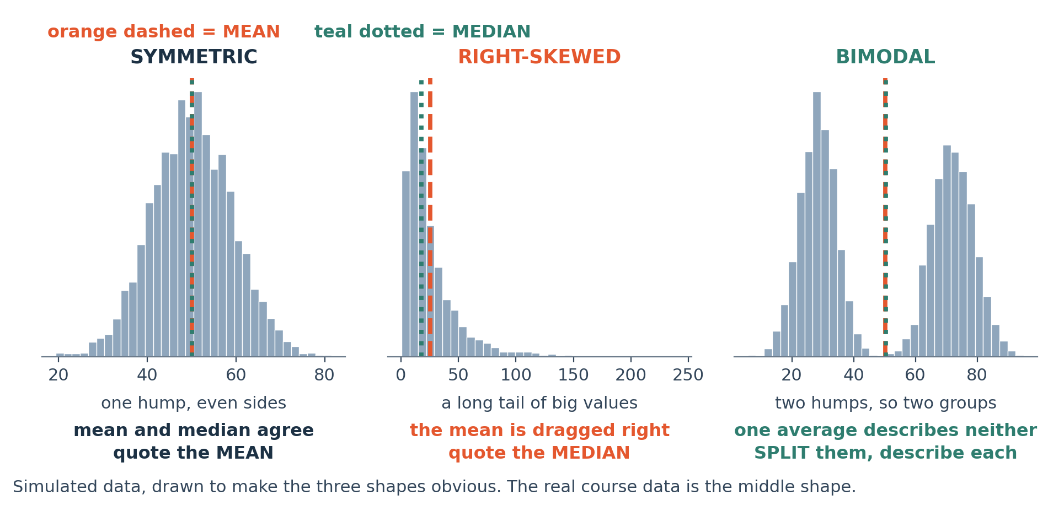
LOOK AT THIS
Three shapes, and what each one allows you to say
Simulated on purpose, so the shapes are clean. Symmetric: the mean is fine. Right-skewed: use the median. Bimodal: you have two populations mixed together and no single statistic describes them.
Notes:
Simulated on purpose, so the shapes are clean. Symmetric: the mean is fine. Right-skewed: use the median. Bimodal: you have two populations mixed together and no single statistic describes them.

Slide 12
JUPYTER OR COLAB
LIVE CODING
Compute all three by hand first, then trust the function
# ten numbers, small enough to check on paper
vals = [2, 3, 3, 4, 5, 6, 8, 9, 40, 120]
print(sum(vals) / len(vals)) # the mean, by hand: 20.0
print(sorted(vals)[4:6]) # the middle two: 5 and 6
print((5 + 6) / 2) # the median, by hand: 5.5
import pandas as pd
s = pd.Series(vals)
print(s.mean(), s.median(), s.mode()[0])
# the mean is 20 and eight of the ten numbers are below it.
NOW BREAK IT ON PURPOSE
Remove the 120. The mean drops from 20.0 to about 4.4 and the median barely moves. One value out of ten moved the mean by a factor of four, which is what a skewed distribution does to it every time.

Slide 13
Break
10 minutes
Stretch, and talk to someone you have not worked with. Be back on time: the longest working block of the session is next.
Notes:
Ten minutes.

Slide 14
BLOCK TWO · 45 MINUTES
The shape decides which statistic is honest
Shape decides which statistic is honest. The distribution figure, then the real order values from the course data: mean well above median, a long tail, and a mean that is bigger than four orders in five. Percentiles as t

Slide 15
JUPYTER OR COLAB
LIVE CODING
The same three on the real order values
order_value = (delivered.groupby("order_id")["revenue"]
.sum())
order_value.describe()
order_value.mean() # 1,793,149
order_value.median() # 374,760
order_value.quantile([0.1, 0.5, 0.9])
# what share of orders are BELOW the mean?
(order_value < order_value.mean()).mean() # about 0.80
NOW BREAK IT ON PURPOSE
That last line is the argument in one number: about 80% of orders are smaller than the mean. A statistic that is bigger than four fifths of the thing it describes is not describing it well.

Slide 16
JUPYTER OR COLAB
LIVE CODING
Draw it before you choose
import matplotlib.pyplot as plt
fig, ax = plt.subplots(figsize=(9, 4))
order_value.plot(kind="hist", bins=60, ax=ax)
ax.axvline(order_value.median(), color="teal")
ax.axvline(order_value.mean(), color="orangered",
linestyle="--")
ax.set_xlabel("Order value, UGX")
ax.set_ylabel("Number of orders")
ax.set_title("Most orders are small; a few are very large",
loc="left")
NOW BREAK IT ON PURPOSE
Now change bins=60 to bins=5. The skew disappears into one bar and the chart says the distribution is fine. The bin count is a choice you are making, and a careless one hides the finding.

Slide 17
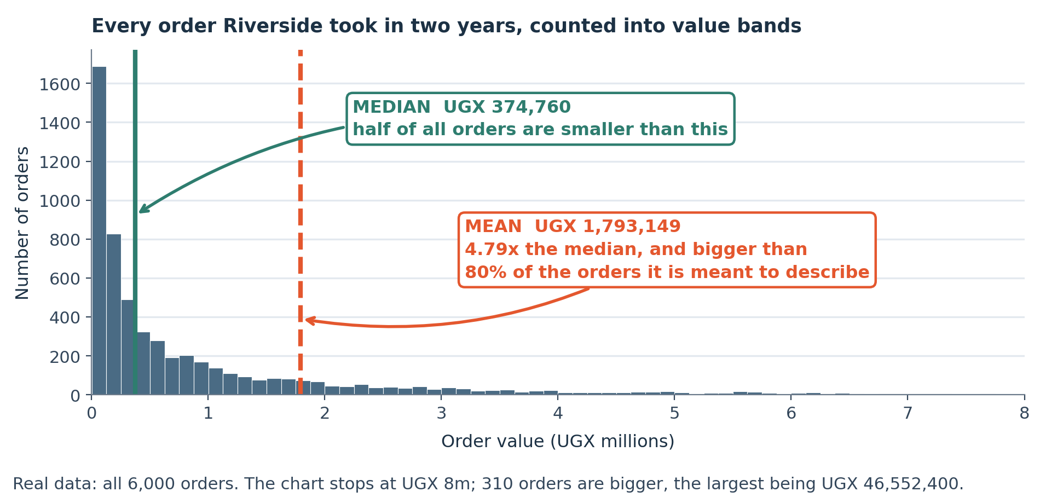
LOOK AT THIS
The real order values, with the mean and the median marked
All 6,000 orders from the course data. The mean sits above four orders in five, which is why it is a poor answer to "what is typical".
Notes:
All 6,000 orders from the course data. The mean sits above four orders in five, which is why it is a poor answer to "what is typical".

Slide 18
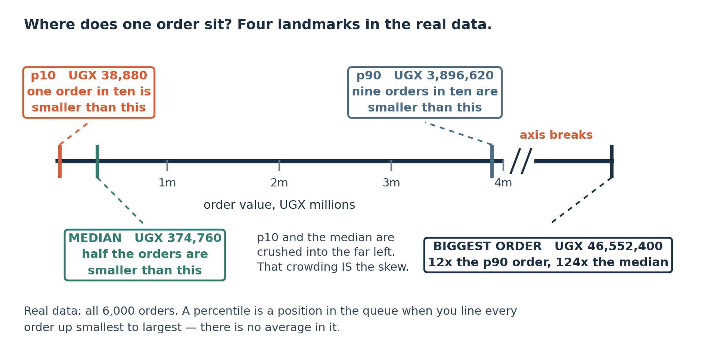
LOOK AT THIS
Four numbers that describe the business honestly
p10, median, p90 and the largest order. Together these say more than any single statistic can, and none of them mislead.
Notes:
p10, median, p90 and the largest order. Together these say more than any single statistic can, and none of them mislead.

Slide 19
THE MISTAKE THIS SESSION PREVENTS
Reporting a mean on a skewed distribution. It is the single commonest misleading number in business reporting.
It is in tonight's lab on purpose.
Session 10 of 15
Notes:
Reporting a mean on a skewed distribution. It is the single commonest misleading number in business reporting.

Slide 20
CHECK YOUR UNDERSTANDING
Can you answer these?
A
When is the mean the right statistic?
B
Is the largest order, UGX 46,552,400, an outlier you should delete?
C
Why look at the distribution before choosing a statistic?
Answers are on the next slide — try first, then look.

Slide 21
ANSWERS
How did you do?
A
When the mean is right
When the distribution is roughly symmetric, or when you genuinely need the total divided by the count, which is what average order value is for pricing and capacity. As a description of typical, on a skewed distribution, it is wrong.
B
Is the largest order an outlier to delete?
You cannot tell from the data alone, and deleting it is a decision about the business rather than about the file. It might be a typo and it might be your most important customer. Go and ask. Describe it either way.
C
Why look at the shape first
Because the shape is what decides whether a statistic is honest. Choosing the statistic first and looking at the shape afterwards is how the mean ends up in board papers where the median belonged.

Slide 22
LAB · 50 MINUTES
Describe three columns properly
Pick three numeric columns from the course data. For each: draw the distribution, choose the right statistic, and write one sentence saying why the alternative would mislead.
Work these questions in order:
→ Draw the histogram first, before choosing anything.
→ One sentence: why would the other one mislead?
→ Mean, median and the three percentiles.
→ Then find a column where the mean IS the right answer, and say why.
→ Which statistic describes this column honestly?
Notes:
Pick three numeric columns from the course data. For each: draw the distribution, choose the right statistic, and write one sentence saying why the alternative would mislead.

Slide 23
TONIGHT IN THREE LINES
What you can do now
Say what a statistic is, and compute a mean, a median and a mode.
Read a histogram and say which statistic the shape allows.
Use percentiles to describe a business quantity honestly.

Slide 24
HOMEWORK · 45 TO 60 MINUTES
Before the next session
Find a number quoted in your organisation and work out which statistic it is. If it is a mean, check whether the distribution justifies one.
WHY IT IS ALWAYS OPTIONAL ON YOUR OWN DATA
Homework on a dataset you already care about gets done. Homework on a teaching dataset competes with your job and loses. Either version counts, and the one on your own data is worth more to you.
Notes:
Find a number quoted in your organisation and work out which statistic it is. If it is a mean, check whether the distribution justifies one.

Slide 25
THE ONE THING TO REMEMBER
Look at the shape, then pick the number
The order is the whole lesson. A mean reported on a skewed distribution is the commonest misleading number in business, and it costs nothing to avoid once you have drawn the histogram.
Next session: comparing groups of different sizes, and reading a number that changes over time.
Notes:
The order is the whole lesson. A mean reported on a skewed distribution is the commonest misleading number in business, and it costs nothing to avoid once you have drawn the histogram.

