Slide 1
SESSION 11 OF 15
Comparing groups, and reading time
The region with the most returns and the region with the highest return rate are different regions. Only one of them is the answer.
WEEK 4 · STATISTICS · 3 HOURS
Data Analysis with Python, SQL and Power BI · roadmap.sh: Rates and proportions; time series basics
Notes:
Start on time.

Slide 2
THE FIFTEEN SESSIONS
Where tonight sits
1 · FOUNDATIONS
2 · FOUNDATIONS
3 · SQL
4 · SQL
From a spreadsheet to data
Why data lives in several tables
Asking a database for rows
Counting and grouping
5 · SQL
6 · PYTHON
7 · PYTHON
8 · PYTHON
Joining tables, carefully
Your first program
Reading a file, and looking at it
Cleaning, and writing down what you did
9 · PYTHON
10 · STATISTICS
11 · STATISTICS
12 · CHARTS
Grouping and joining in pandas
Describing one column
Comparing groups, and reading time
Charts that answer the question
13 · INVESTIGATION
14 · POWER BI
15 · POWER BI
A whole investigation, end to end
Getting data in, and modelling it
Measures, a dashboard, and presenting it
Notes:
Tonight is session 11 of twelve.

Slide 3
BEFORE WE START
The words for tonight
TERM
WHAT IT MEANS
IN A SPREADSHEET
Rate
A count divided by the population it came from. What you need whenever the groups are different sizes.
no direct equivalent
Proportion and percentage
A part of a whole. A percentage is a proportion times a hundred.
no direct equivalent
Percentage point
The unit for the DIFFERENCE between two percentages. From 2% to 3% is one percentage point and a 50% increase, and both are true.
no direct equivalent
Time series
Values recorded in time order.
no direct equivalent
Trend
The direction over the long run, once the wobble is taken out.
no direct equivalent
Seasonality
A pattern that repeats on the calendar. December here is not growth.
no direct equivalent
Moving average
The average of the last few periods, used to see the trend through the noise.
no direct equivalent
Year on year
Comparing a period against the same period a year earlier, which is the honest way to see through seasonality.
no direct equivalent

Slide 4
WHAT YOU WILL BE ABLE TO DO
By the end of tonight you can…
1
Choose between a count and a rate, and say which question each answers.
2
Use percentages and percentage points correctly.
3
Separate a trend from a seasonal pattern.
Session 11 of 15 · Statistics · Comparing groups, and reading time
Notes:
These three are what tonight is marked against, in the sense that the lab checks them.

Slide 5
THE QUESTION TONIGHT ANSWERS
Which region has our worst returns problem?
The region with the most returns and the region with the highest return rate are different regions. Only one of them is the answer.
Notes:
The region with the most returns and the region with the highest return rate are different regions. Only one of them is the answer.

Slide 6
BLOCK ONE · 50 MINUTES
Counts, rates, and the difference that changes the decision
Counts against rates, on the returns data where the two disagree: one region has the most returns and another has the highest rate, and they call for different actions. Then percentages, and percentage points, which get

Slide 7
DEFINITION
A rate
A count divided by the population it came from. What you need whenever the groups you are comparing are different sizes, which is nearly always.
FOR EXAMPLE
Eastern has the most returns, 130. Western has the highest RATE, 2.70% against 2.26% in Eastern. Two regions, two different conversations.
DO NOT CONFUSE WITH
A count is COUNTIF. A rate is COUNTIF divided by COUNT, and the division is the part people skip.
Notes:
A count divided by the population it came from. What you need whenever the groups you are comparing are different sizes, which is nearly always.

Slide 8
DEFINITION
Percentage point
The unit for the DIFFERENCE between two percentages. Going from 2% to 3% is one percentage point and also a fifty per cent increase, and both statements are true.
FOR EXAMPLE
Return rates here run from 2.26% to 2.70%. That is a gap of about half a percentage point, and about a fifth in relative terms. Say which one you mean.
Notes:
The unit for the DIFFERENCE between two percentages. Going from 2% to 3% is one percentage point and also a fifty per cent increase, and both statements are true.

Slide 9
DEFINITION
Seasonality
A pattern that repeats on the calendar. It is not growth and it is not a trend, and confusing either with it produces a confident wrong headline every January.
FOR EXAMPLE
December 2025 was 2.3 times February 2024. December is also the biggest month in BOTH years, which is what tells you it is the calendar rather than the business.
Notes:
A pattern that repeats on the calendar. It is not growth and it is not a trend, and confusing either with it produces a confident wrong headline every January.

Slide 10
DEFINITION
Year on year
Comparing a period against the same period a year earlier. It is the simplest honest way to see through seasonality.
FOR EXAMPLE
December against December removes the December effect. December against November does not, and will tell you the business is booming every single year.
Notes:
Comparing a period against the same period a year earlier. It is the simplest honest way to see through seasonality.

Slide 11
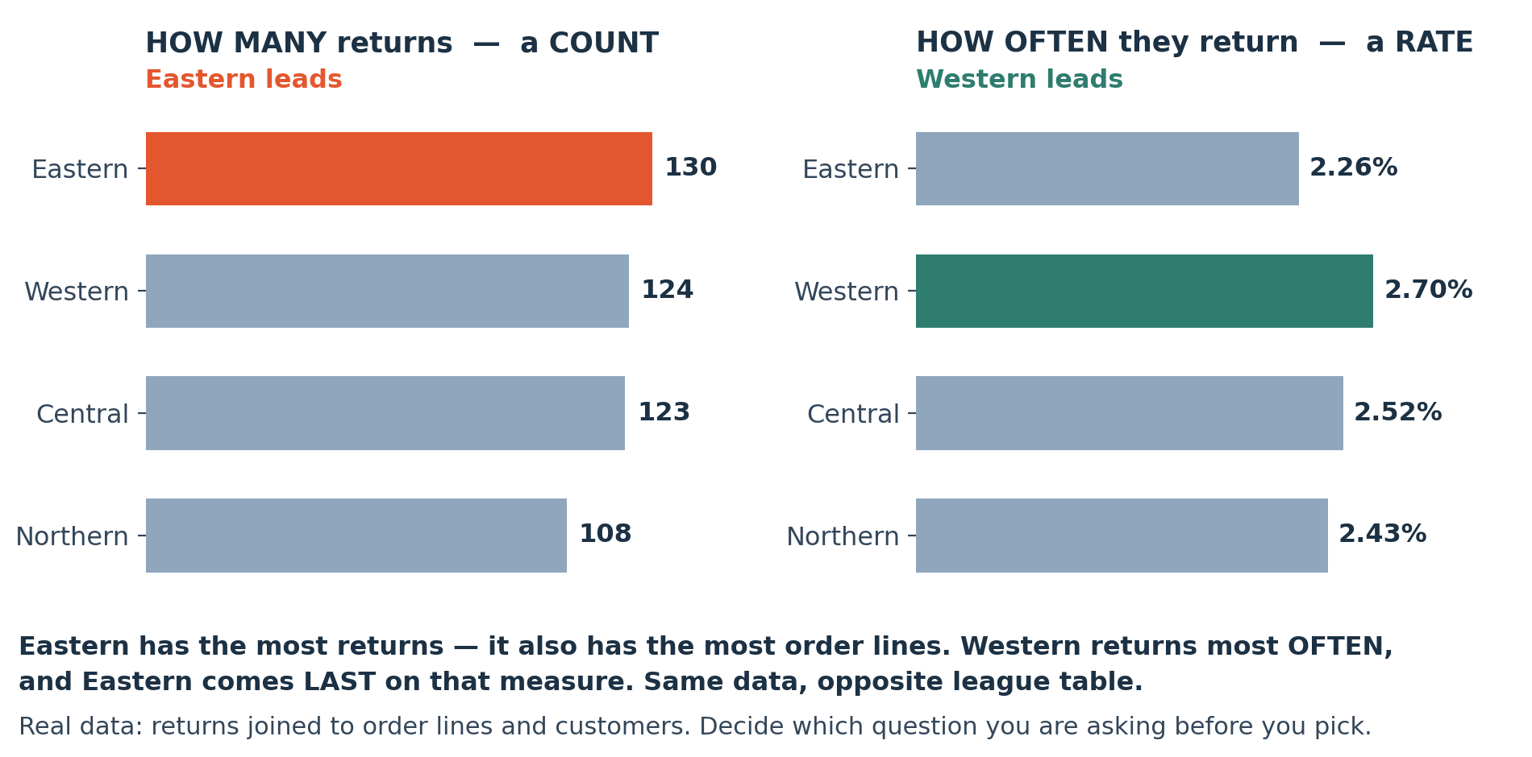
LOOK AT THIS
The most returns and the highest return rate are different regions
Real counts and rates from the course data. Report the counts and somebody is sent to Eastern, which simply has the most orders. The rate points at Western.
Notes:
Real counts and rates from the course data. Report the counts and somebody is sent to Eastern, which simply has the most orders. The rate points at Western.

Slide 12
JUPYTER OR COLAB
LIVE CODING
Counts and rates, side by side
# how many returns per region? A count.
counts = (lines.groupby("region")["returned"]
.sum().sort_values(ascending=False))
# what SHARE of each region's lines came back? A rate.
totals = lines.groupby("region")["returned"].size()
rates = (counts / totals).sort_values(ascending=False)
print(counts) # Eastern leads
print(rates) # Western leads
# both are correct. They answer different questions.
NOW BREAK IT ON PURPOSE
Compute the rate as counts / counts.sum() by mistake and every region's number changes, because you have divided by the total RETURNS rather than by each region's own lines. The result still adds to 100% and is still wrong.

Slide 13
Break
10 minutes
Stretch, and talk to someone you have not worked with. Be back on time: the longest working block of the session is next.
Notes:
Ten minutes.

Slide 14
BLOCK TWO · 45 MINUTES
Growth, or just December?
Time. Resample to a month, then a moving average, then the question that matters: is this growth or is it the calendar? December against February in both years, and year on year as the test. Same data, two arithmetics, o

Slide 15
JUPYTER OR COLAB
LIVE CODING
Percentages against percentage points
best = rates.min() # 2.26%
worst = rates.max() # 2.70%
print((worst - best) * 100) # percentage POINTS
print((worst / best - 1) * 100) # per cent, relative
# the same gap, two units, two very different-sounding
# sentences. Both true. Say which one you mean.
NOW BREAK IT ON PURPOSE
Write the relative figure into a report as "returns are up X per cent" without saying what the base was, and somebody will read it as X percentage points. That is how a half-point gap becomes a crisis in a summary.

Slide 16
JUPYTER OR COLAB
LIVE CODING
Trend, or the calendar?
m = (delivered.set_index("order_date")["revenue"]
.resample("ME").sum())
m.plot() # the raw monthly series
m.rolling(3).mean().plot() # the trend, noise removed
# December 2025 is 2.3x February 2024.
# Growth, or December?
m.groupby(m.index.month).mean() # answer: it is December
m.pct_change(12) # year on year, honestly
NOW BREAK IT ON PURPOSE
Quote month-on-month growth into January and you will report a collapse every year. Quote year-on-year and December stops being news. Both are correct arithmetic and they produce opposite headlines from identical data.

Slide 17
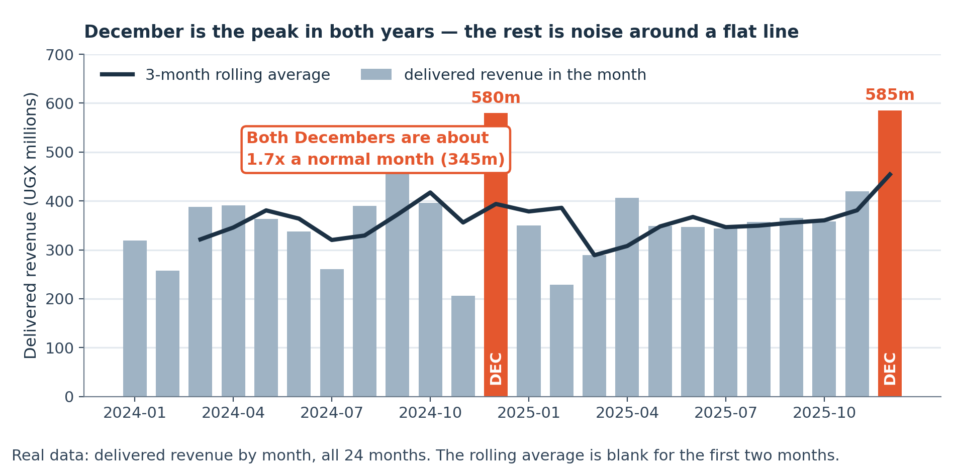
LOOK AT THIS
December is the biggest month in both years
Real monthly revenue with a three-month rolling average. The December peaks are the calendar, not growth, and the rolling average is what lets you see the difference.
Notes:
Real monthly revenue with a three-month rolling average. The December peaks are the calendar, not growth, and the rolling average is what lets you see the difference.

Slide 18
WORKED EXAMPLE
Five statements, five verdicts
For each: supported, unsupported, or unanswerable from this data. Attach a number to every verdict.
1
"A typical order is worth about UGX 1,793,149." UNSUPPORTED. That is the mean of a distribution skewed 4.8x. The median, UGX 374,760, is the honest answer.
2
"Eastern has our worst returns problem." UNSUPPORTED as stated. It has the most returns and the LOWEST rate, 2.26%. Western has the highest rate at 2.70%.
3
"Revenue is growing: December was 2.3x February." UNSUPPORTED. December is the biggest month in both years, so that is the calendar. Year on year is the test.
4
"The largest order, UGX 46,552,400, must be an error." UNANSWERABLE here. Nothing in the data distinguishes a real bulk order from a typo. You go and ask.
5
"Half our orders are under UGX 374,760." SUPPORTED, and true by definition: that is what a median is.
Three of the five were unsupported for the same reason: a statistic that does not fit the shape of the thing it describes.
Notes:
For each: supported, unsupported, or unanswerable from this data. Attach a number to every verdict.

Slide 19
THE MISTAKE THIS SESSION PREVENTS
Reporting a count where the audience will read a rate, and calling a seasonal peak growth.
It is in tonight's lab on purpose.
Session 11 of 15
Notes:
Reporting a count where the audience will read a rate, and calling a seasonal peak growth.

Slide 20
CHECK YOUR UNDERSTANDING
Can you answer these?
A
When would you report a count rather than a rate?
B
Returns went from 2% to 3%. Is that one per cent or fifty?
C
One check that tells you whether December is growth.
Answers are on the next slide — try first, then look.

Slide 21
ANSWERS
How did you do?
A
When a count beats a rate
When the work is proportional to the count: staffing a returns desk, printing labels, answering calls. Eastern needs the people even though Western has the problem. Report both and say which question each answers.
B
2% to 3%: one or fifty?
Both. One percentage POINT, and fifty per cent in relative terms. Neither is wrong and the unit has to be stated, because the two sound completely different to a reader.
C
One check for growth against seasonality
Compare the same month a year apart. If December beats February in both years by a similar factor, it is the calendar rather than the business.

Slide 22
LAB · 50 MINUTES
Five statements, five verdicts, with numbers
On your sheet are five statements about this business. Decide which are supported, which are unsupported and which are unanswerable, and attach a number to every verdict. Unanswerable is a real answer and one of them is.
Work these questions in order:
→ For each: supported, unsupported, or unanswerable?
→ For the unanswerable one: what would you have to go and ask?
→ Which statistic would you have to compute to decide?
→ Then one of your own: a statement about your own work data that you now suspect is unsupported.
→ Compute it. Write the number beside your verdict.
Notes:
On your sheet are five statements about this business. Decide which are supported, which are unsupported and which are unanswerable, and attach a number to every verdict. Unanswerable is a real answer and one of them is.

Slide 23
TONIGHT IN THREE LINES
What you can do now
Choose between a count and a rate, and say which question each answers.
Use percentages and percentage points correctly.
Separate a trend from a seasonal pattern.

Slide 24
HOMEWORK · 45 TO 60 MINUTES
Before the next session
Find a percentage quoted at work and decide whether it should have been a percentage point, a rate, or a count.
WHY IT IS ALWAYS OPTIONAL ON YOUR OWN DATA
Homework on a dataset you already care about gets done. Homework on a teaching dataset competes with your job and loses. Either version counts, and the one on your own data is worth more to you.
Notes:
Find a percentage quoted at work and decide whether it should have been a percentage point, a rate, or a count.

Slide 25
THE ONE THING TO REMEMBER
Rates for how bad, counts for how much work
Both are honest and they answer different questions. Almost every misleading comparison in business reporting is a count presented where the reader will hear a rate.
Next session: charts. Starting from what an axis is.
Notes:
Both are honest and they answer different questions. Almost every misleading comparison in business reporting is a count presented where the reader will hear a rate.

