Slide 1
SESSION 12 OF 15
Charts that answer the question
If it needs narrating, it is a chart for you rather than a chart for them.
WEEK 4 · CHARTS · 3 HOURS
Data Analysis with Python, SQL and Power BI · roadmap.sh: Data visualisation; choosing the right chart
Notes:
Start on time.

Slide 2
THE FIFTEEN SESSIONS
Where tonight sits
1 · FOUNDATIONS
2 · FOUNDATIONS
3 · SQL
4 · SQL
From a spreadsheet to data
Why data lives in several tables
Asking a database for rows
Counting and grouping
5 · SQL
6 · PYTHON
7 · PYTHON
8 · PYTHON
Joining tables, carefully
Your first program
Reading a file, and looking at it
Cleaning, and writing down what you did
9 · PYTHON
10 · STATISTICS
11 · STATISTICS
12 · CHARTS
Grouping and joining in pandas
Describing one column
Comparing groups, and reading time
Charts that answer the question
13 · INVESTIGATION
14 · POWER BI
15 · POWER BI
A whole investigation, end to end
Getting data in, and modelling it
Measures, a dashboard, and presenting it
Notes:
Tonight is session 12 of twelve.

Slide 3
BEFORE WE START
The words for tonight
TERM
WHAT IT MEANS
IN A SPREADSHEET
Axis
The scale down the side or along the bottom. Every axis needs a label and a unit.
no direct equivalent
Data series
One set of values drawn together: one line, one set of bars.
no direct equivalent
Categorical and continuous
Categories are named groups; continuous values are measured numbers. They need different charts.
no direct equivalent
Histogram
A chart of a distribution: values in bands along the bottom, counts up the side. Not a bar chart.
no direct equivalent
Truncated axis
A value axis that does not start at zero, which makes a small change look enormous.
no direct equivalent
Annotation
A note on the chart itself, pointing at the thing you want seen.
no direct equivalent

Slide 4
WHAT YOU WILL BE ABLE TO DO
By the end of tonight you can…
1
Name the parts of a chart, and pick the chart a question implies.
2
Label a chart so it can be read without you standing next to it.
3
Name what your own chart hides.
Session 12 of 15 · Charts · Charts that answer the question
Notes:
These three are what tonight is marked against, in the sense that the lab checks them.

Slide 5
THE QUESTION TONIGHT ANSWERS
Can somebody read your chart
without you standing next to it?
If it needs narrating, it is a chart for you rather than a chart for them.
Notes:
If it needs narrating, it is a chart for you rather than a chart for them.

Slide 6
BLOCK ONE · 50 MINUTES
The parts of a chart, and the four that matter
The anatomy figure first: every part of a chart named, because you cannot be told to label an axis if nobody has said which part is the axis. Then the four charts and the question each answers: line for change over time,

Slide 7
DEFINITION
Axis
The scale down the side or along the bottom. Every axis needs a label and a unit, and a value axis usually needs to start at zero.
FOR EXAMPLE
"Revenue, UGX billions" is a labelled axis. "Revenue" is not, because the reader does not know whether the 2 means two shillings, two million or two billion.
DO NOT CONFUSE WITH
The same thing Excel calls an axis. The difference is that here you have to choose the scale deliberately.
Notes:
The scale down the side or along the bottom. Every axis needs a label and a unit, and a value axis usually needs to start at zero.

Slide 8
DEFINITION
Histogram
A chart of a distribution: values in bands along the bottom, counts up the side. It is not a bar chart, and the difference matters.
FOR EXAMPLE
A bar chart compares named categories. A histogram shows the shape of ONE column of numbers. You met one in session 10; this is the name for it.
DO NOT CONFUSE WITH
Excel will build you a bar chart if you ask for a histogram, and the result looks fine and answers a different question.
Notes:
A chart of a distribution: values in bands along the bottom, counts up the side. It is not a bar chart, and the difference matters.

Slide 9
DEFINITION
A chart title
One line stating the FINDING. Not the variables, not the method: the thing you want the reader to leave with, in words, above the picture.
FOR EXAMPLE
"Eastern is our largest region, at UGX 2.51bn" rather than "Revenue by region". The second is the axis labels read aloud.
DO NOT CONFUSE WITH
The default title Excel gives you IS the variables. Changing it is the single highest-value thing in this session.
Notes:
One line stating the FINDING. Not the variables, not the method: the thing you want the reader to leave with, in words, above the picture.

Slide 10
DEFINITION
What a chart hides
Every chart is a summary and every summary drops something. Naming what yours drops is the difference between a chart and a claim.
FOR EXAMPLE
A monthly revenue line hides the 6,000 individual orders behind it, including whether one order made a month. A regional bar hides that 172 walk-in orders, worth UGX 390,632,335, are in no region at all.
Notes:
Every chart is a summary and every summary drops something. Naming what yours drops is the difference between a chart and a claim.

Slide 11
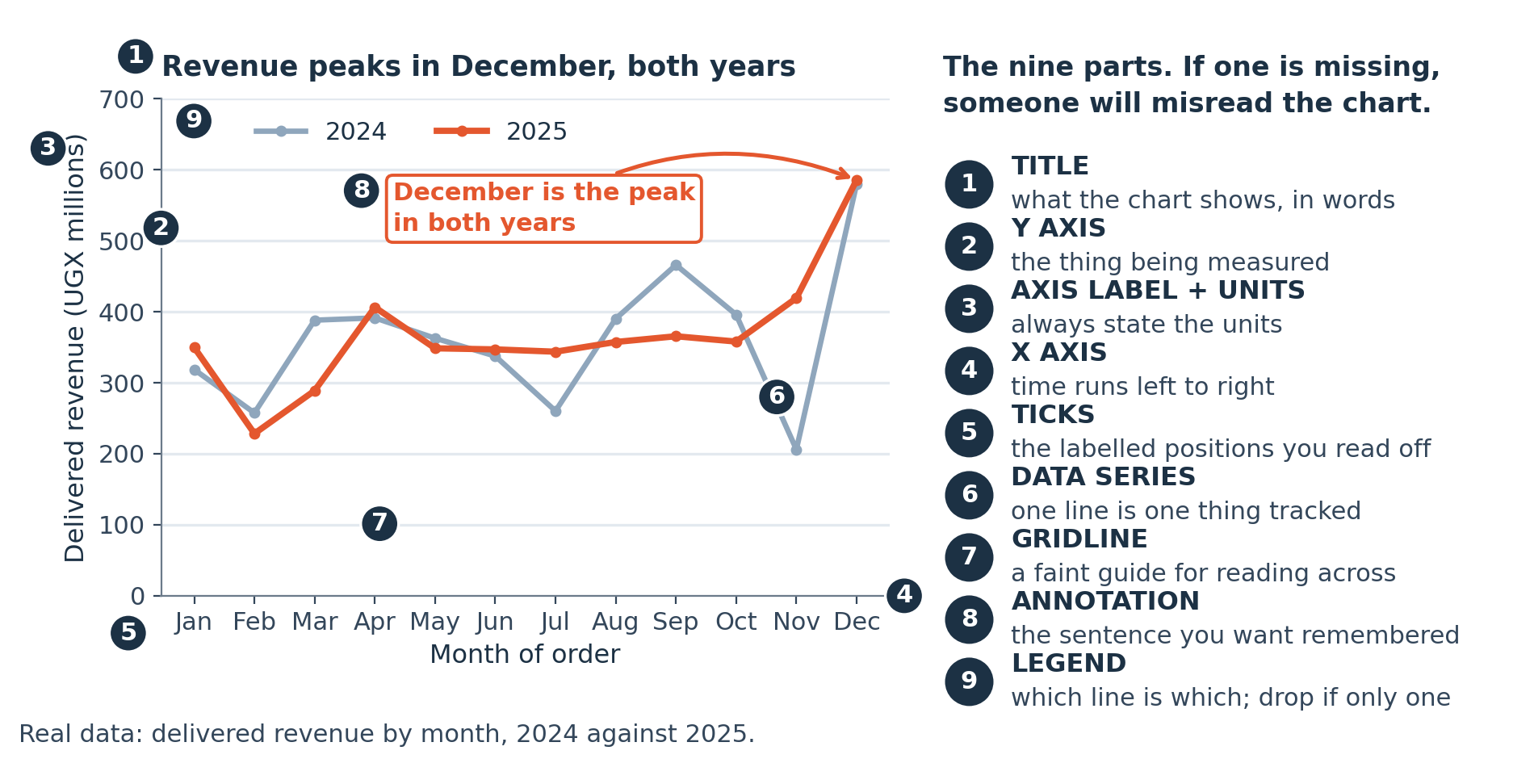
LOOK AT THIS
Every part of a chart has a name
You cannot be told to label an axis if nobody has said which part is the axis. Learn these eight words and every piece of chart advice you ever read becomes actionable.
Notes:
You cannot be told to label an axis if nobody has said which part is the axis. Learn these eight words and every piece of chart advice you ever read becomes actionable.

Slide 12
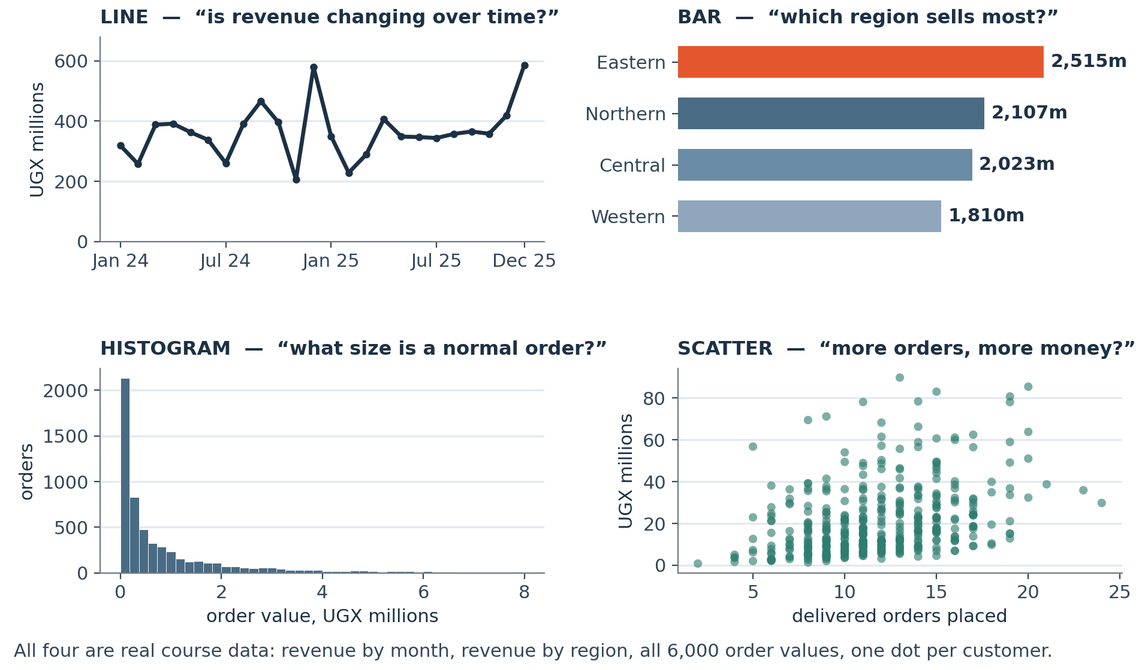
LOOK AT THIS
Four charts, and the question each one answers
Drawn from the real course data. Pick the chart from the QUESTION, not from the menu: change over time, comparison across categories, the shape of one column, or whether two things move together.
Notes:
Drawn from the real course data. Pick the chart from the QUESTION, not from the menu: change over time, comparison across categories, the shape of one column, or whether two things move together.

Slide 13
JUPYTER OR COLAB
LIVE CODING
A line chart nobody has to ask about
import matplotlib.pyplot as plt
fig, ax = plt.subplots(figsize=(10, 4.5))
m.plot(ax=ax, linewidth=2)
ax.set_title("December is the biggest month in both years",
loc="left", fontsize=14, weight="bold")
ax.set_ylabel("Revenue, UGX")
ax.set_xlabel("") # the dates say it already
ax.set_ylim(0) # START AT ZERO
ax.spines[["top", "right"]].set_visible(False)
NOW BREAK IT ON PURPOSE
Remove ax.set_ylim(0). matplotlib starts the axis wherever it likes, and on this series an ordinary month suddenly looks like a collapse. It is the commonest accidental lie in business charting and it is one line to prevent.

Slide 14
Break
10 minutes
Stretch, and talk to someone you have not worked with. Be back on time: the longest working block of the session is next.
Notes:
Ten minutes.

Slide 15
BLOCK TWO · 45 MINUTES
Honesty, and putting the finding in the title
Honesty and its opposite, each shown beside its corrected version: the truncated axis, the dual axis, the pie chart with eleven slices, the bar chart sorted alphabetically. Then the title rule, which is the whole session

Slide 16
JUPYTER OR COLAB
LIVE CODING
A bar chart, sorted by what it is about
rev = (lines.groupby("region")["revenue"].sum()
.sort_values()) # ascending, for barh
fig, ax = plt.subplots(figsize=(9, 4))
ax.barh(rev.index, rev / 1e9)
ax.set_title("Eastern is our largest region",
loc="left", fontsize=14, weight="bold")
ax.set_xlabel("Revenue, UGX billions")
for i, v in enumerate(rev / 1e9):
ax.text(v, i, f" {v:.2f}", va="center")
NOW BREAK IT ON PURPOSE
Sort it alphabetically instead. The chart still looks professional, and the ranking, which is the entire point, now has to be worked out by the reader one bar at a time.

Slide 17
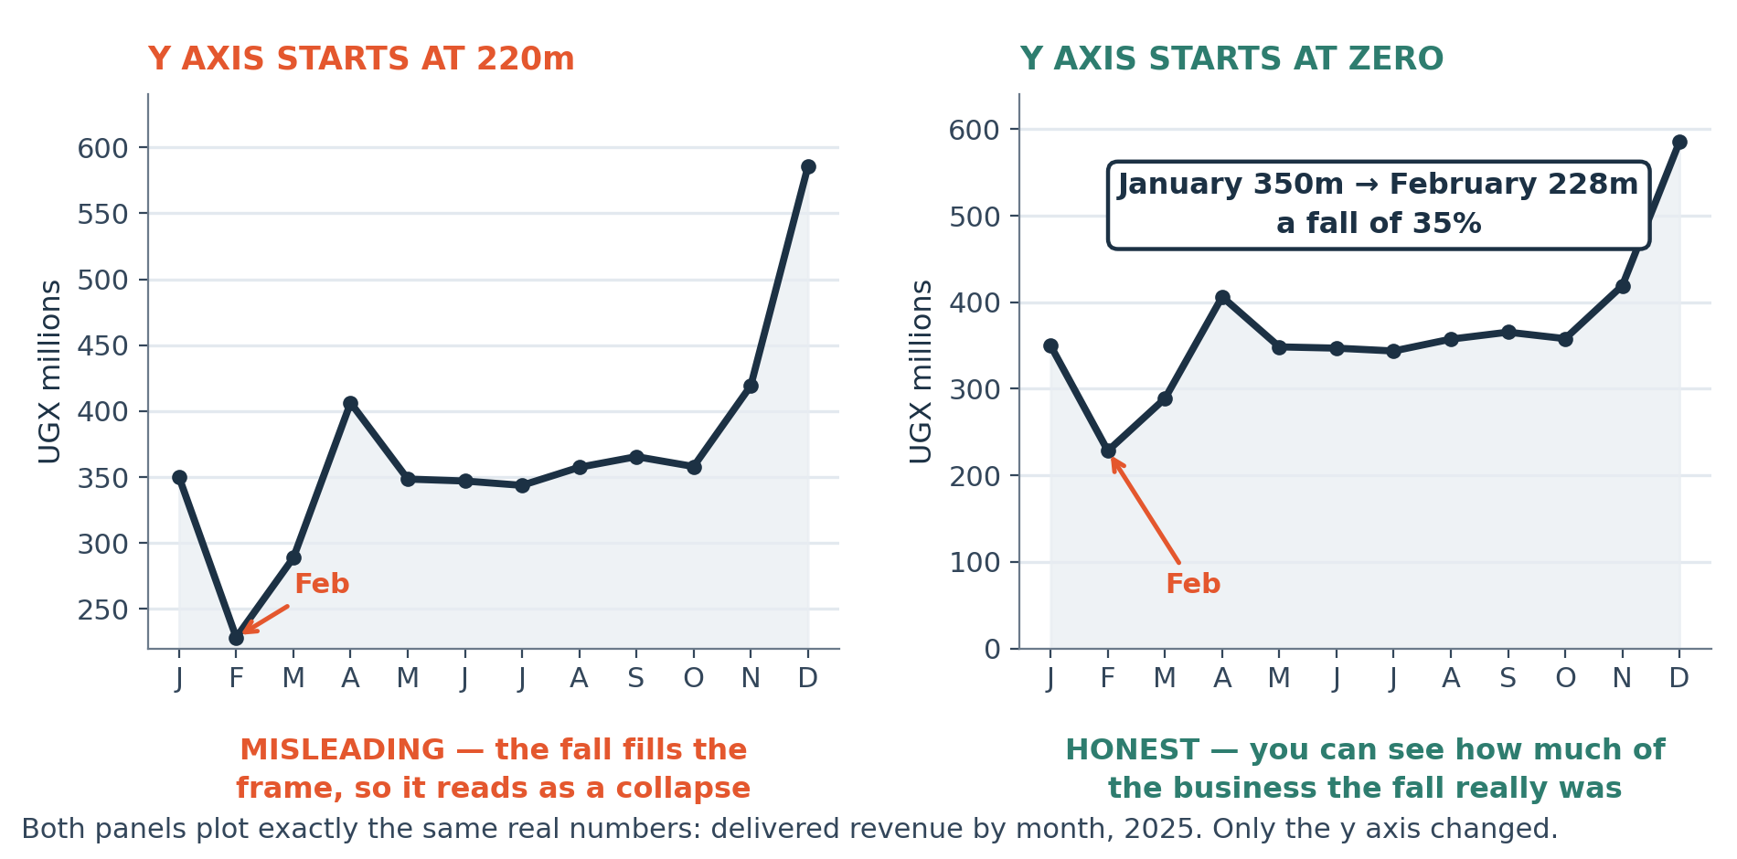
LOOK AT THIS
The same real data, twice, telling two different stories
Identical numbers. The left chart does not start at zero, which turns an ordinary month into a collapse. Neither chart contains a false number.
Notes:
Identical numbers. The left chart does not start at zero, which turns an ordinary month into a collapse. Neither chart contains a false number.

Slide 18
THE MISTAKE THIS SESSION PREVENTS
Titling a chart 'Revenue by month'. That is the axes read aloud, and it leaves the reader to do the work you were paid to do.
It is in tonight's lab on purpose.
Session 12 of 15
Notes:
Titling a chart 'Revenue by month'. That is the axes read aloud, and it leaves the reader to do the work you were paid to do.

Slide 19
CHECK YOUR UNDERSTANDING
Can you answer these?
A
Your chart is titled "Revenue by region". What is wrong with that?
B
When is a truncated y axis legitimate?
C
Name something a monthly revenue line necessarily hides.
Answers are on the next slide — try first, then look.

Slide 20
ANSWERS
How did you do?
A
"Revenue by region" as a title
It is the axes read aloud. It states the method rather than the finding, so the reader has to do the analysis themselves. "Eastern is our largest region, at UGX 2.51bn" is the same chart doing its job.
B
When truncation is legitimate
When zero is not meaningful and the audience knows it: body temperature, an index, a share price over one day. For revenue, volumes or counts, start at zero.
C
What a monthly line hides
The distribution inside each month. One large order can make a month, and the line cannot show you that. The largest single order here is UGX 46,552,400, which is visible in a histogram and invisible in a monthly total.

Slide 21
LAB · 50 MINUTES
Three charts that answer three questions
Take three of the questions from week one and answer each with one chart. Each gets a title that states its finding, labelled axes with units, and one sentence underneath naming what it hides.
Work these questions in order:
→ Which of the four chart types does each question imply?
→ One annotation pointing at the thing you want seen.
→ Title: the finding, in words, not the variables.
→ One sentence under each: what does this chart NOT show?
→ Axis labels with units. Y axis from zero unless you can justify otherwise.
Notes:
Take three of the questions from week one and answer each with one chart. Each gets a title that states its finding, labelled axes with units, and one sentence underneath naming what it hides.

Slide 22
TONIGHT IN THREE LINES
What you can do now
Name the parts of a chart, and pick the chart a question implies.
Label a chart so it can be read without you standing next to it.
Name what your own chart hides.

Slide 23
HOMEWORK · 45 TO 60 MINUTES
Before the next session
Take a chart from a report you receive and redraw it so the title states its finding. Bring both versions.
WHY IT IS ALWAYS OPTIONAL ON YOUR OWN DATA
Homework on a dataset you already care about gets done. Homework on a teaching dataset competes with your job and loses. Either version counts, and the one on your own data is worth more to you.
Notes:
Take a chart from a report you receive and redraw it so the title states its finding. Bring both versions.

Slide 24
THE ONE THING TO REMEMBER
Put the finding in the title
It is the cheapest improvement available to any chart you will ever make, and it forces you to decide what you actually found. A chart you cannot title has not finished being analysed.
Next week: a whole investigation, then Power BI, then five minutes in front of the room.
Notes:
It is the cheapest improvement available to any chart you will ever make, and it forces you to decide what you actually found. A chart you cannot title has not finished being analysed.

