Slide 1
SESSION 14 OF 15
Getting data in, and modelling it
Almost always the model: one relationship pointing the wrong way, or no date table.
WEEK 5 · POWER BI · 3 HOURS
Data Analysis with Python, SQL and Power BI · roadmap.sh: BI tools: loading, transformation, data modelling
Notes:
Start on time.

Slide 2
THE FIFTEEN SESSIONS
Where tonight sits
1 · FOUNDATIONS
2 · FOUNDATIONS
3 · SQL
4 · SQL
From a spreadsheet to data
Why data lives in several tables
Asking a database for rows
Counting and grouping
5 · SQL
6 · PYTHON
7 · PYTHON
8 · PYTHON
Joining tables, carefully
Your first program
Reading a file, and looking at it
Cleaning, and writing down what you did
9 · PYTHON
10 · STATISTICS
11 · STATISTICS
12 · CHARTS
Grouping and joining in pandas
Describing one column
Comparing groups, and reading time
Charts that answer the question
13 · INVESTIGATION
14 · POWER BI
15 · POWER BI
A whole investigation, end to end
Getting data in, and modelling it
Measures, a dashboard, and presenting it
Notes:
Tonight is session 14 of twelve.

Slide 3
BEFORE WE START
The words for tonight
TERM
WHAT IT MEANS
IN A SPREADSHEET
Power Query
The part of Power BI that gets the data and shapes it. Its Applied Steps list is a recipe that runs again next month.
no direct equivalent
Data model
The tables plus the relationships between them. This is what decides whether a total is right.
no direct equivalent
Relationship
A join defined once in the model rather than written in every query.
no direct equivalent
Star schema
One fact table in the middle, dimension tables around it.
no direct equivalent
Fact and dimension
The fact table holds the events; dimensions hold the descriptions you slice by.
no direct equivalent
Date table
A separate table with one row per date. Without one, your months sort alphabetically.
no direct equivalent

Slide 4
WHAT YOU WILL BE ABLE TO DO
By the end of tonight you can…
1
Load several tables and clean them in Power Query without touching the source.
2
Build a star schema whose totals are correct.
3
Check a dashboard total against a number you already trust.
Session 14 of 15 · Power BI · Getting data in, and modelling it
Notes:
These three are what tonight is marked against, in the sense that the lab checks them.

Slide 5
THE QUESTION TONIGHT ANSWERS
Why does a Power BI total come out wrong
when every number behind it is right?
Almost always the model: one relationship pointing the wrong way, or no date table.
Notes:
Almost always the model: one relationship pointing the wrong way, or no date table.

Slide 6
BLOCK ONE · 50 MINUTES
Power Query: get it in, shape it, keep the recipe
Power BI is three products people confuse: Power Query gets and shapes, the model relates, the report shows. Get Data from CSV, then Power Query: promote headers, set types, trim, remove duplicates. The Applied Steps lis

Slide 7
THREE PARTS
Power BI is three products, and people confuse them
Power Query gets the data and shapes it
1
Promote headers, set types, trim, remove duplicates. The Applied Steps list is a recipe that runs again next month on new data. It is your cleaning log from session 8, built by clicking.
The model relates the tables
2
One fact table, dimensions around it, relationships with a direction. This is the part that decides whether your totals are right, and it is the part beginners skip.
The report shows the answer
3
Visuals. This is where everybody starts, and starting here is why the first dashboard most people build has wrong totals.
On a Mac you get the third one only
4
Power BI Desktop is Windows only. The browser Service can build reports on uploaded data, so Mac participants clean in pandas first and upload clean CSVs. Both paths are on the lab sheet.

Slide 8
DEFINITION
A data model
The tables plus the relationships between them, defined once, so you do not write a join in every query.
FOR EXAMPLE
Five relationships for the course data. Define them once and every visual you build afterwards inherits them.
DO NOT CONFUSE WITH
Doing your VLOOKUPs once, at the start, instead of in every sheet.
Notes:
The tables plus the relationships between them, defined once, so you do not write a join in every query.

Slide 9
DEFINITION
A star schema
One fact table in the middle holding the events, with dimension tables around it holding the descriptions you slice by. Every dimension points INTO the fact, one-to-many.
FOR EXAMPLE
order_items is the fact: 20,234 rows, one per product per order. orders, customers, products and reps are dimensions.
DO NOT CONFUSE WITH
A well-organised workbook: one big transaction sheet and several small lookup sheets. You have probably built one without knowing it had a name.
Notes:
One fact table in the middle holding the events, with dimension tables around it holding the descriptions you slice by. Every dimension points INTO the fact, one-to-many.

Slide 10
DEFINITION
A date table
A separate table with one row per date, marked as the date table and related to your fact's date column.
FOR EXAMPLE
731 days, 1 January 2024 to 31 December 2025. Without it, your months sort alphabetically and April comes first.
DO NOT CONFUSE WITH
The helper column of month names you add by hand every time. This one is built once and reused.
Notes:
A separate table with one row per date, marked as the date table and related to your fact's date column.

Slide 11
POWER BI · MODELLING · NEW TABLE
LIVE CODING
The date table, and the step everybody skips
Dates =
ADDCOLUMNS(
CALENDAR(DATE(2024, 1, 1), DATE(2025, 12, 31)),
"Year", YEAR([Date]),
"Month", FORMAT([Date], "mmm"),
"MonthNo", MONTH([Date]),
"YearMonth", FORMAT([Date], "yyyy-mm")
)
-- then, and this is the step people miss:
-- 1. Table tools > Mark as date table > Date
-- 2. relate Dates[Date] to orders[order_date]
-- 3. Column tools > Month > Sort by column > MonthNo
NOW BREAK IT ON PURPOSE
Skip step 3 and your months read April, August, December, February. It looks like a bug in Power BI and it is alphabetical sorting doing exactly what it was told.

Slide 12
Break
10 minutes
Stretch, and talk to someone you have not worked with. Be back on time: the longest working block of the session is next.
Notes:
Ten minutes.

Slide 13
BLOCK TWO · 45 MINUTES
The model, which is where the marks are
The model, which is where the marks are. The star schema figure, then five relationships built by hand after deleting every one Power BI guessed. A deliberately wrong relationship first, so the wrong total is seen before

Slide 14
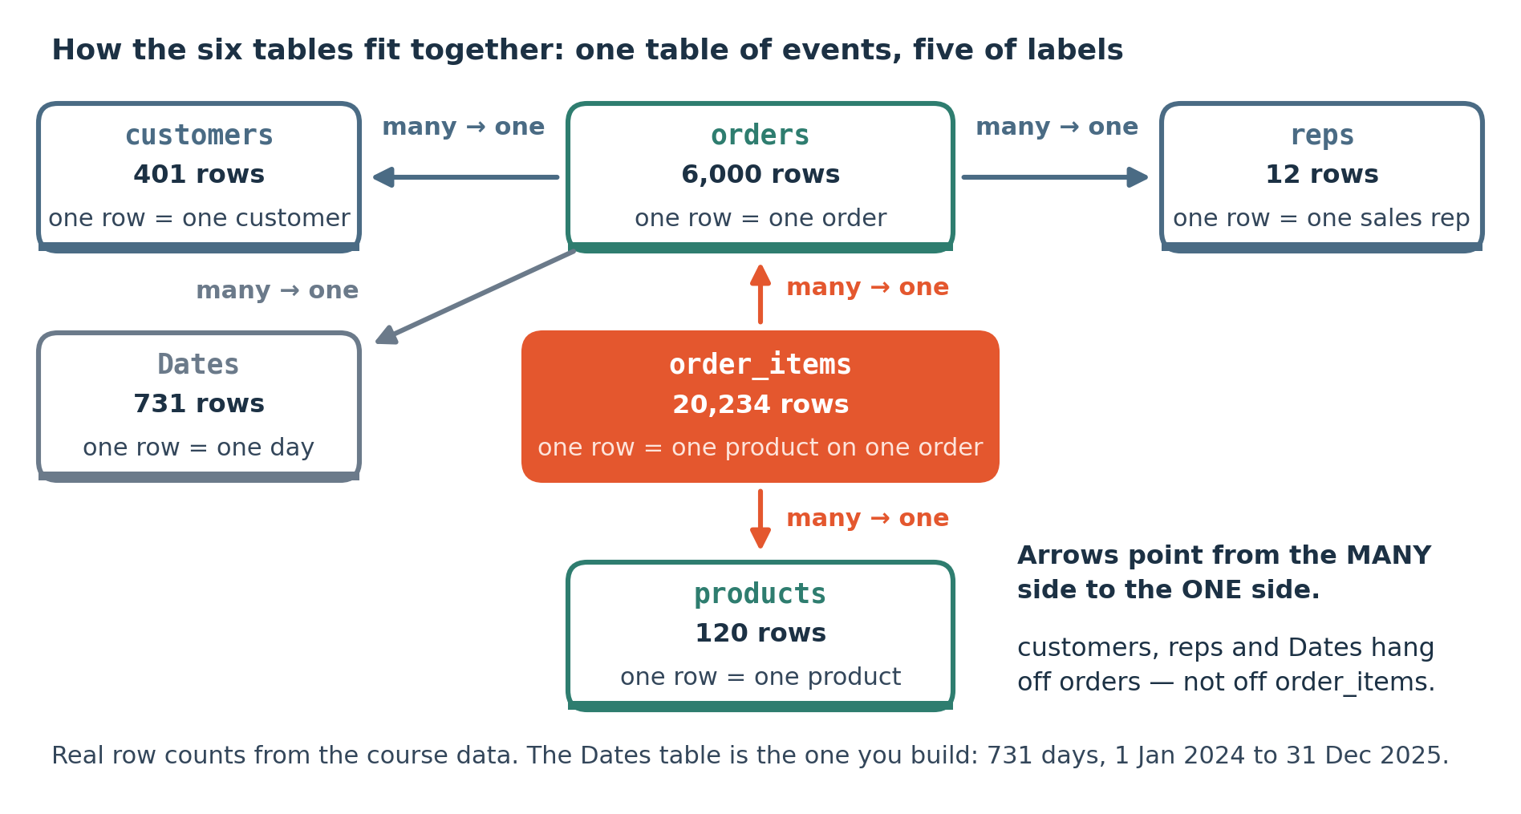
LOOK AT THIS
What you are building tonight
The same six tables you mapped by hand in session 2, now as a model. The arrows all point the same way: many orders to one customer. Row counts are the real ones.
Notes:
The same six tables you mapped by hand in session 2, now as a model. The arrows all point the same way: many orders to one customer. Row counts are the real ones.

Slide 15
THE MODEL
Build these five relationships by hand
The five, all many-to-one
Delete the auto-detected ones first
order_items to orders on order_id
Power BI guesses relationships on load. It is right about most of them and wrong in a way you will not notice until a total is wrong.
orders to customers on customer_id
orders to reps on rep_id
Delete all of them, build these five yourself, and check every arrow direction.
order_items to products on product_id
Dates to orders on order_date
Then check a total against a number you already trust. Delivered revenue is UGX 8,751,705,520. If your card says something else, the model is wrong and the visuals cannot save it.

Slide 16
CHECKING YOUR MODEL
Reconcile against numbers you already have
Why this matters more here than anywhere else
If they do not match
A dashboard is believed. A wrong number in a notebook gets questioned; the same number in a dashboard with a logo on it gets acted on.
The gap usually names the fault. Far too high means fan-out from a relationship pointing the wrong way. Low by about UGX 390,632,335 means the 172 walk-in orders have been dropped by a join to customers.
The three you already know
Revenue over everything: UGX 10,758,894,480. Delivered only: UGX 8,751,705,520. Average delivered order: about UGX 1,809,000.
The rule
Reconcile before you make it look good. A dashboard whose totals do not reconcile is worth less than no dashboard.
Notes:
Reference.

Slide 17
PRACTICAL NOTE
Before you start tonight
Power BI Desktop is Windows only. Mac participants work in the browser Service throughout, loading CSVs they have already cleaned in pandas; the lab gives both paths and names the three things the browser cannot do.
Notes:
Power BI Desktop is Windows only. Mac participants work in the browser Service throughout, loading CSVs they have already cleaned in pandas; the lab gives both paths and names the three things the browser cannot do.

Slide 18
THE MISTAKE THIS SESSION PREVENTS
Trusting the relationships Power BI detects for you. Check every direction, then check a total against a number you already trust.
It is in tonight's lab on purpose.
Session 14 of 15
Notes:
Trusting the relationships Power BI detects for you. Check every direction, then check a total against a number you already trust.

Slide 19
CHECK YOUR UNDERSTANDING
Can you answer these?
A
Why is a single flat table the wrong shape for a report?
B
Your months sort April, August, December. What is wrong?
C
Your revenue total is about three times too big. Where do you look?
Answers are on the next slide — try first, then look.

Slide 20
ANSWERS
How did you do?
A
Why a flat table is wrong
It cannot represent something that did not happen. A customer who bought nothing this quarter and a month with no orders both vanish, because the only rows that exist are rows where something occurred. This is session 2, arriving again.
B
Months sorting alphabetically
The Month column is text and has not been told to sort by MonthNo. Column tools, Sort by column, MonthNo. It is not a bug.
C
Revenue three times too big
Fan-out from a relationship, which is session 5's trap in a new tool. Check the direction and cardinality of every one, especially any you did not build yourself.

Slide 21
LAB · 50 MINUTES
Load it, model it, reconcile it
Five tables in, five relationships built by hand, a date table marked and sorted, and three visuals whose totals match the numbers you already got from SQL and pandas. Matching is the mark.
Work these questions in order:
→ Get Data: the five CSVs, loaded separately.
→ Build the five relationships and check each direction.
→ Power Query: headers, types, trim. Check the date range.
→ Add the date table, mark it, sort Month by MonthNo.
→ Delete every auto-detected relationship.
→ Three visuals, each total reconciled against your own earlier answer.
Notes:
Five tables in, five relationships built by hand, a date table marked and sorted, and three visuals whose totals match the numbers you already got from SQL and pandas. Matching is the mark.

Slide 22
TONIGHT IN THREE LINES
What you can do now
Load several tables and clean them in Power Query without touching the source.
Build a star schema whose totals are correct.
Check a dashboard total against a number you already trust.

Slide 23
HOMEWORK · 45 TO 60 MINUTES
Before the next session
Add the Uganda Healthsites file and put a map visual on it. Notice what that file makes easy and what it makes impossible.
WHY IT IS ALWAYS OPTIONAL ON YOUR OWN DATA
Homework on a dataset you already care about gets done. Homework on a teaching dataset competes with your job and loses. Either version counts, and the one on your own data is worth more to you.
Notes:
Add the Uganda Healthsites file and put a map visual on it. Notice what that file makes easy and what it makes impossible.

Slide 24
THE ONE THING TO REMEMBER
The model decides whether the report is true
Visuals are half an hour of work. The model is the difference between a dashboard and a liability. Get the arrows right, then make it look good.
Next session: three measures, a dashboard, and five minutes in front of the room.
Notes:
Visuals are half an hour of work. The model is the difference between a dashboard and a liability. Get the arrows right, then make it look good.

