Slide 1


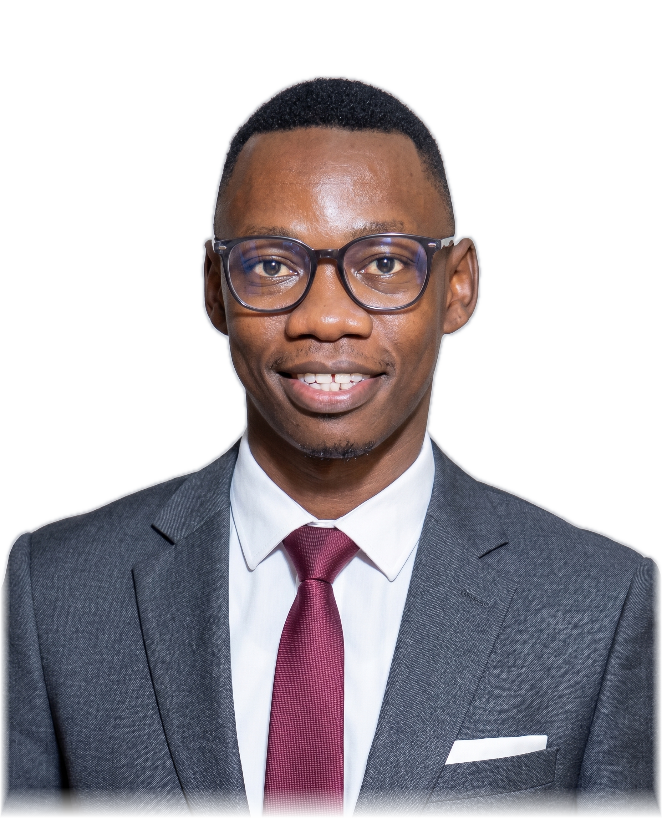



















D E C E M B E R 2 0 2 6 I N T A K E
HOLIDAY
DATA
&
AI
CAMP
Practical skills. Real projects.
Greater opportunities.
Skills today.
Jotham Martin Wambi
Greater opportunities tomorrow.
Main Tutor · Data Scientist & ML/AI Engineer
Lecturer, AI & Machine Learning, IUEA
DATA ANALYSIS
MACHINE LEARNING
Turn real data into
useful insights
Teach computers to find patterns
& make predictions
Python
pandas
SQL
Python
pandas
scikit-learn
Python (programming basics)
Python
SQL (querying data)
Machine learning concepts
Data Cleaning & Preparation
Model training
Data Visualization (dashboards & charts)
Prediction & evaluation
Basic statistics
Real-world datasets
BUILD: A data analysis project
BUILD: A prediction model
e.g. sales, customer or social media data
e.g. house prices, classification
or recommendation
By the end of the camp, learners will have:
Built a practical
portfolio project
Analysed
real datasets
Created data
visualisations
Built a
prediction model
Machine Learning track
8 weeks
Max. 5
learners/group
No coding
experience needed
Only 15
places
(whole programme)
Programme fee (per learner)
Reserve your place →
UGX 800,000
UGX 1,000,000
+256 750 990 718
Small group · exactly 5 learners
Private / semi-private
1–4 learners
jothammartin.wambi@gmail.com
For S.4, S.5 & S.6 students and school leavers.
Scan to WhatsApp
Notes:
# Blended portrait revision
The visible portrait uses the original organiser-supplied JPEG. RGB pixels were copied directly from that photograph; only the alpha channel changed. A non-generative Apple Vision foreground mask removes the grey background. The mask boundary is contracted by three source pixels and softened by a 1.4-pixel blur. A short alpha fade at the photo's side and bottom edges prevents a hard rectangular cutoff. The face, clothing, pose and original 1856:2292 proportions are preserved. No face or body was generated, reshaped or retouched.
Classroom, desk and decorative background artwork is retained from the prior original-style reconstruction. All copy, learning ticks, illustrated outcomes, library logos, fees and QR are unchanged from the outcomes edition. Source icon URLs and license notices are included in assets. The QR points to https://wa.me/256750990718.
Compact edition: the desk, books, mug and repeated footer slogan are removed. The eligibility line is retained beneath the booking block. All other content and the portrait asset are unchanged. Canvas: 1024 × 1664.

