Slide 1
SCHOOL TRACK
1 / 7
FOR PARENTS
This holiday,
your child could
build their first
data project.
A guided start in Data Analysis
and Machine Learning.
For S.4, S.5 & S.6 students
and school leavers
HOLIDAY DATA & AI CAMP
DEC 2026
Notes:
UNESCO: https://www.unesco.org/en/articles/ai-competency-framework-students
OECD: https://www.oecd.org/en/publications/oecd-digital-education-outlook-2026_062a7394-en.html
NCDC: https://ele.ncdc.go.ug/course/section.php?id=9
Icons: Font Awesome, https://fontawesome.com/license/free; Tabler, https://tabler.io/icons. Licenses included. Camp details supplied by Jotham Martin Wambi. No organisational endorsement implied.

Slide 2



SCHOOL TRACK
2 / 7
WHY START BEFORE UNIVERSITY?
Give curiosity
a practical outlet.
Help your learner practise skills
they can use across subjects.
Work with real datasets
Explain what the numbers show
Question AI-generated answers
An opportunity to explore their interests early.
HOLIDAY DATA & AI CAMP
DEC 2026
Notes:
UNESCO: https://www.unesco.org/en/articles/ai-competency-framework-students
OECD: https://www.oecd.org/en/publications/oecd-digital-education-outlook-2026_062a7394-en.html
NCDC: https://ele.ncdc.go.ug/course/section.php?id=9
Icons: Font Awesome, https://fontawesome.com/license/free; Tabler, https://tabler.io/icons. Licenses included. Camp details supplied by Jotham Martin Wambi. No organisational endorsement implied.

Slide 3
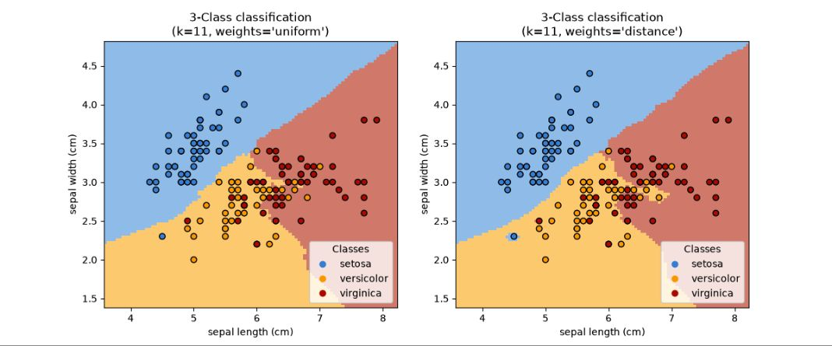
SCHOOL TRACK
3 / 7
A REAL PUBLIC DEMONSTRATION
Can a computer
identify a flower?
This example predicts the flower type
using measurements from the Iris dataset.
Dots: measured flowers. Colours: model predictions.
Published scikit-learn example using the UCI Iris dataset.
HOLIDAY DATA & AI CAMP
DEC 2026
Notes:
UNESCO: https://www.unesco.org/en/articles/ai-competency-framework-students
OECD: https://www.oecd.org/en/publications/oecd-digital-education-outlook-2026_062a7394-en.html
NCDC: https://ele.ncdc.go.ug/course/section.php?id=9
Icons: Font Awesome, https://fontawesome.com/license/free; Tabler, https://tabler.io/icons. Licenses included. Camp details supplied by Jotham Martin Wambi. No organisational endorsement implied.
Actual screenshot of https://scikit-learn.org/stable/_images/sphx_glr_plot_classification_001.png from https://scikit-learn.org/stable/auto_examples/neighbors/plot_classification.html . Copyright scikit-learn developers, BSD-3-Clause. Screenshot unchanged apart from fitting to slide. Dataset: https://archive.ics.uci.edu/dataset/53/iris . This external example is illustrative and is not a promised exact camp project or learner work.

Slide 4

SCHOOL TRACK
4 / 7
WHAT YOUR CHILD WILL BUILD
A project to show.
Findings to explain.
DATA ANALYSIS
Analyse a dataset, create clear charts
and present a portfolio project.
MACHINE LEARNING
Build a prediction model, test it
and explain where it makes mistakes.
HOLIDAY DATA & AI CAMP
DEC 2026
Notes:
UNESCO: https://www.unesco.org/en/articles/ai-competency-framework-students
OECD: https://www.oecd.org/en/publications/oecd-digital-education-outlook-2026_062a7394-en.html
NCDC: https://ele.ncdc.go.ug/course/section.php?id=9
Icons: Font Awesome, https://fontawesome.com/license/free; Tabler, https://tabler.io/icons. Licenses included. Camp details supplied by Jotham Martin Wambi. No organisational endorsement implied.

Slide 5
SCHOOL TRACK
5 / 7
GUIDANCE YOU CAN ASK ABOUT
A guided start.
A small group.
No coding experience needed.
Begin with Python programming basics.
Maximum 5 learners per group
YOUR TUTOR
Jotham Martin Wambi
Lecturer in AI & Machine Learning, IUEA
Data Scientist & ML/AI Engineer
Master’s, Yamaguchi University, Japan
HOLIDAY DATA & AI CAMP
DEC 2026
Notes:
UNESCO: https://www.unesco.org/en/articles/ai-competency-framework-students
OECD: https://www.oecd.org/en/publications/oecd-digital-education-outlook-2026_062a7394-en.html
NCDC: https://ele.ncdc.go.ug/course/section.php?id=9
Icons: Font Awesome, https://fontawesome.com/license/free; Tabler, https://tabler.io/icons. Licenses included. Camp details supplied by Jotham Martin Wambi. No organisational endorsement implied.

Slide 6
SCHOOL TRACK
6 / 7
PLAN THEIR DECEMBER LEARNING
8 weeks of
practical learning
UGX 1,000,000
per learner
Same fee per learner for groups of 1–5.
3 learning days each week
2 in person at The National ICT Innovation Hub,
Nakawa. 1 online. Other days: project work.
Bring a Windows or Mac laptop.
Start date and session times: to be confirmed.
HOLIDAY DATA & AI CAMP
DEC 2026
Notes:
UNESCO: https://www.unesco.org/en/articles/ai-competency-framework-students
OECD: https://www.oecd.org/en/publications/oecd-digital-education-outlook-2026_062a7394-en.html
NCDC: https://ele.ncdc.go.ug/course/section.php?id=9
Icons: Font Awesome, https://fontawesome.com/license/free; Tabler, https://tabler.io/icons. Licenses included. Camp details supplied by Jotham Martin Wambi. No organisational endorsement implied.

Slide 7

SCHOOL TRACK
7 / 7
DECEMBER 2026 REGISTRATION
Give your child
a place to begin.
15 places
across the whole programme
Register one or more learners
through the parent/guardian option.
REGISTER YOUR CHILD
forms.gle/n8XLwbK1QxcUsRnx5
Calls & WhatsApp: +256 750 990 718
Programme capacity: 15. Availability confirmed after enquiry.
HOLIDAY DATA & AI CAMP
DEC 2026
Notes:
UNESCO: https://www.unesco.org/en/articles/ai-competency-framework-students
OECD: https://www.oecd.org/en/publications/oecd-digital-education-outlook-2026_062a7394-en.html
NCDC: https://ele.ncdc.go.ug/course/section.php?id=9
Icons: Font Awesome, https://fontawesome.com/license/free; Tabler, https://tabler.io/icons. Licenses included. Camp details supplied by Jotham Martin Wambi. No organisational endorsement implied.

