Slide 1
Flink-1.10

Slide 2
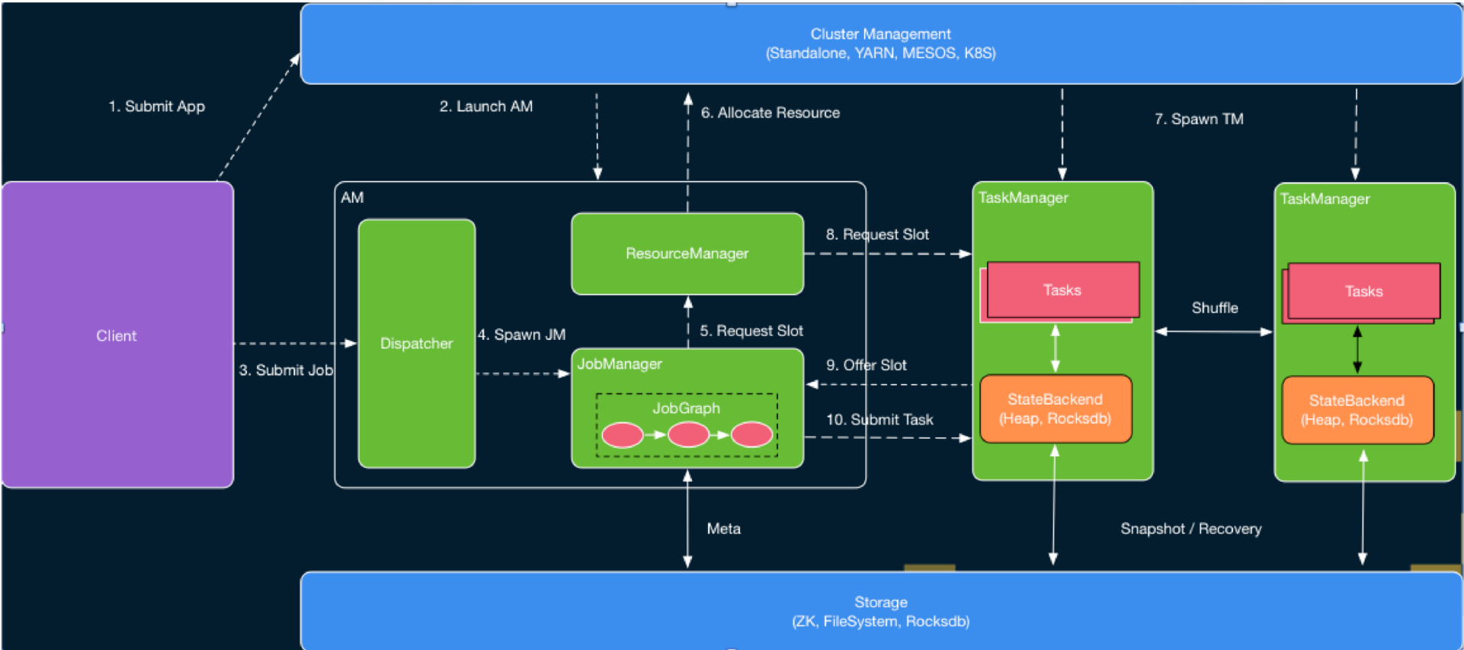
A little bit information about Runtime
https://www.alibabacloud.com/blog/advanced-apache-flink-tutorial-1-analysis-of-runtime-core-mechanism_595686
Notes:
This blog describes the runtime of Flink very well, so I utilizes this figure to show the logic and more information you can find in this URL.
https://www.alibabacloud.com/blog/advanced-apache-flink-tutorial-1-analysis-of-runtime-core-mechanism_595686

Slide 3
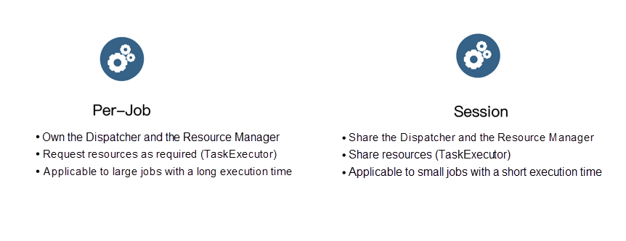
Two execution mode in Flink
we are using session cluster for code explain.

Slide 4
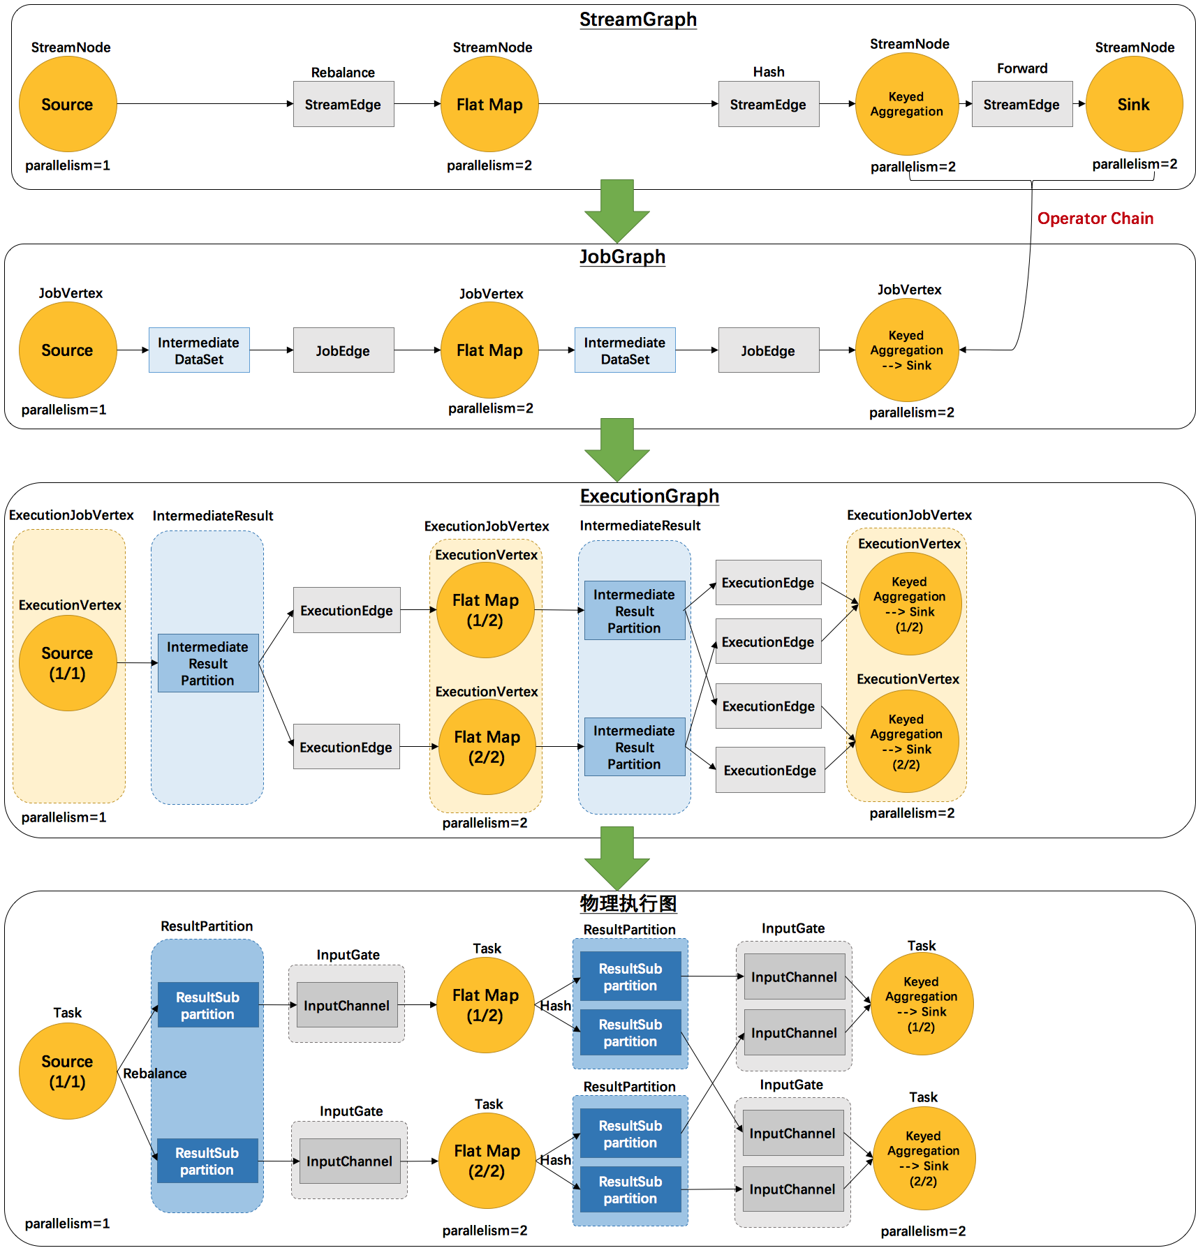
4 levels of Graph

Slide 6
Source code structure in session cluster mode
StandaloneSessionClusterEntryPoint.java
A session cluster entry point which is to start Dispatcher, ResourceManager services.
TaskManagerRunner.java
Class to run TaskManager service.
CliFrontend.java
Class to run a client and compile user code to Streamgraph and then from StreamGraph to JobGraph, and submit job request to Dispatcher in session cluster.

Slide 7
Steps for launching a session cluster and submit jobs
Launch StandaloneSessionClusterEntryPoint.
Launch TaskManagerRunner.
Config job jar path in CliFrontend, then submit job by using CliFrontend.
Dispatcher receives a submit job request with a JobGraph, it will then spawn a JobManager, and request resources and build ExecutionGraph for it. Finally, it will submit task context to TaskManager.
Task executes in TaskManager.
CheckpointCoordinator will periodically trigger checkpoints for all tasks.
There are 6 diagrams that correspond to those 6 steps logic.
Our consideration - StreamGraph construction, JobGraph construction, ExecutionGraph construction and checkpoint logic are mainly inside 4(StreamGraph&JobGraph)-5(ExecutionGraph)-6(Physical Execution)

Slide 8
Launching StandaloneSessionEntryPoint
Please see the pdf standaloneSessionCluster.
The diagram is mainly shows how to start Dispatcher and ResourceManager services.

Slide 9
Launching TaskManager
Please see the pdf TaskManager.
The logic is relatively simple.

Slide 10
Job submission from Client to Cluster
Please see the pdf JobSubmissionClientToCluster

Slide 11
Job Submission from JobManager to TaskManager
Please see the pdf JobSubmissionJMToTM

Slide 12
Job physical execution on TaskManager
Please see the pdf JobExecutionOnTM

Slide 13
Checkpoint mechanism
Please see the pdf CheckpointCoordinator

Slide 14
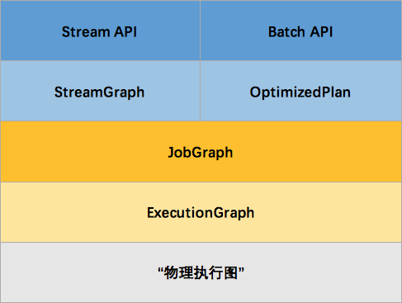
Blog that introduces those 4 layer logic
http://wuchong.me/blog/2016/05/03/flink-internals-overview/ This blog is from a PMC member of Flink.

Slide 15
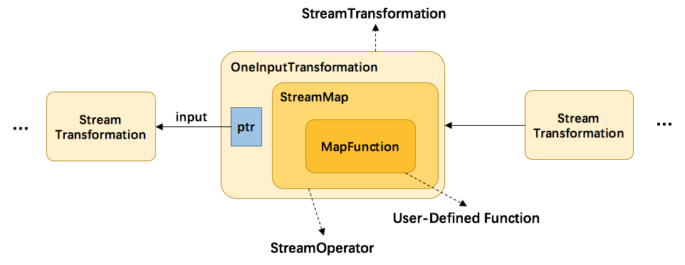
UserProgram
UserProgram will be constructed by a Tree of StreamTransformations.
Transformations contains StreamOperator that defind by users.
Some Transformations such as ‘KeyBy’ which is a channel selector and don’t have StreamOperator.
Source
Flat Map
KeyBy
Sum
Sink
PartitionTransformation
StreamPartitioner
Notes:
Corresponding class diagram is Model2::UserProgramArchitecture

Slide 16
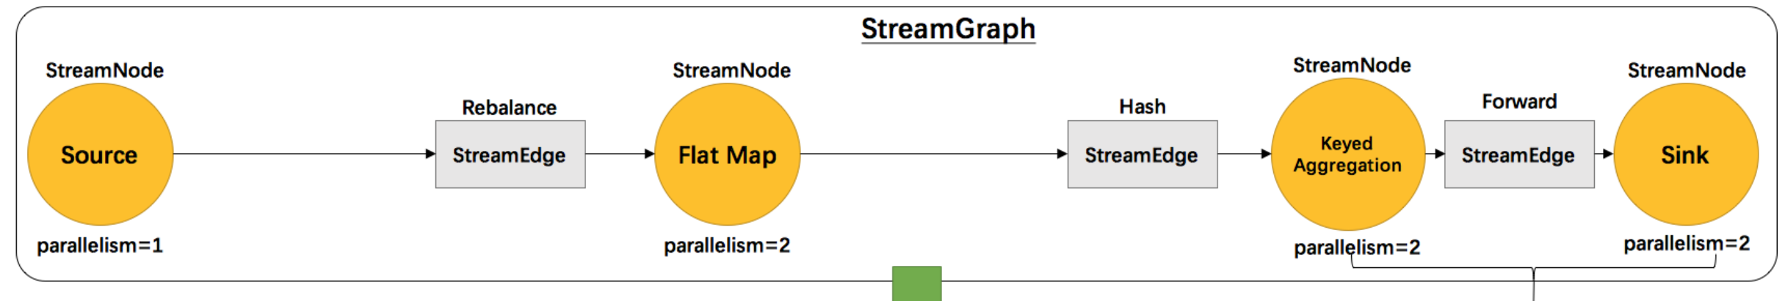
StreamGraph
StreamGraph is translated from UserProgram, it traverses Transformations, and convert Transformations into StreamNodes and StreamEdge.
Transformations such as KeyBy will be combined within upstream StreamNode as an out Edge partitioner.
Source
Flat Map
KeyBy
Sum
Sink
Notes:
Corresponding class diagram is Model2::StreamGraphBuild

Slide 17
StreamGraph – details
StreamNode: the main runnable Task context is defined here.
JobVertexClass that is a class parameter, the class refers to is a StreamTask.class and mainly used to run Task at TaskManager. OperatorChain is a chain of StreamOperator instances.
OperatorFactory is a factory to create StreamOperator instance. And will be used in TaskManager to create OperatorChain.
StreamEdge: mainly contains partitioner logic.
StreamNode
JobVertexClass
OperatorFactory
StreamEdge
StreamEdge
StreamTask
StreamOperator
partitioner
partitioner
OperatorChain
UDF

Slide 18
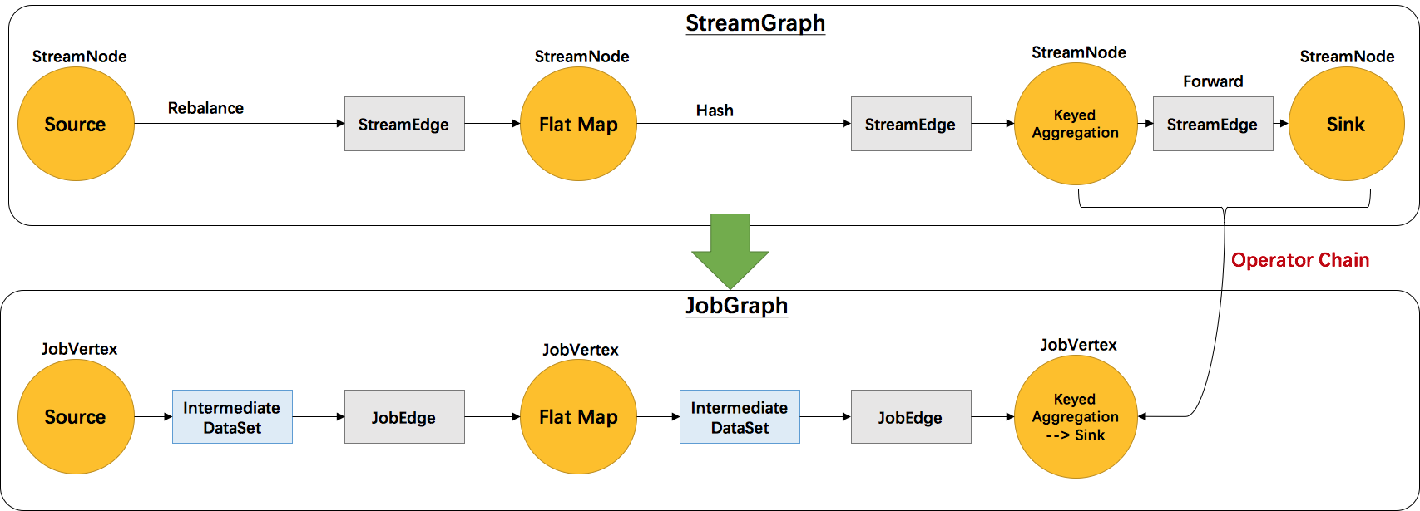
JobGraph
The main logic in JobGraph is to chain the StreamNodes and create JobVertices. Every JobVertex contains a StreamConfig that serialized the operatorFactory, StreamEdge and etc.
Reading a StreamConfig needs a UserCodeLoader.
Notes:
Corresponding class diagram is Model2::JobGraphBuild

Slide 19
JobGraph - details
JobVertex
Contains one or more OperatorIDs.
invokaleClassName is the name of JobVertexClass. (e.g. OneInputStreamTask)
StreamConfig contains SerializedUDF which is OperatorFactory, and outputStreamEdges that is StreamEdge from StreamGraph.
JobEdge
JobEdge contains a DistributionPattern, either be ALL_TO_ALL or POINTWISE.
shipStrategyName is the the name of partitioner.
IntermediateDataSet is the dataset produced by JobVertex.
JobVertex
JobEdge
StreamConfig
DistributionParttern
InvokableClassName
IntermediateDataSet
SerializedUDF
ResultPartitionType
shipStrategyName
OperatorIDs
outputStreamEdges

Slide 20
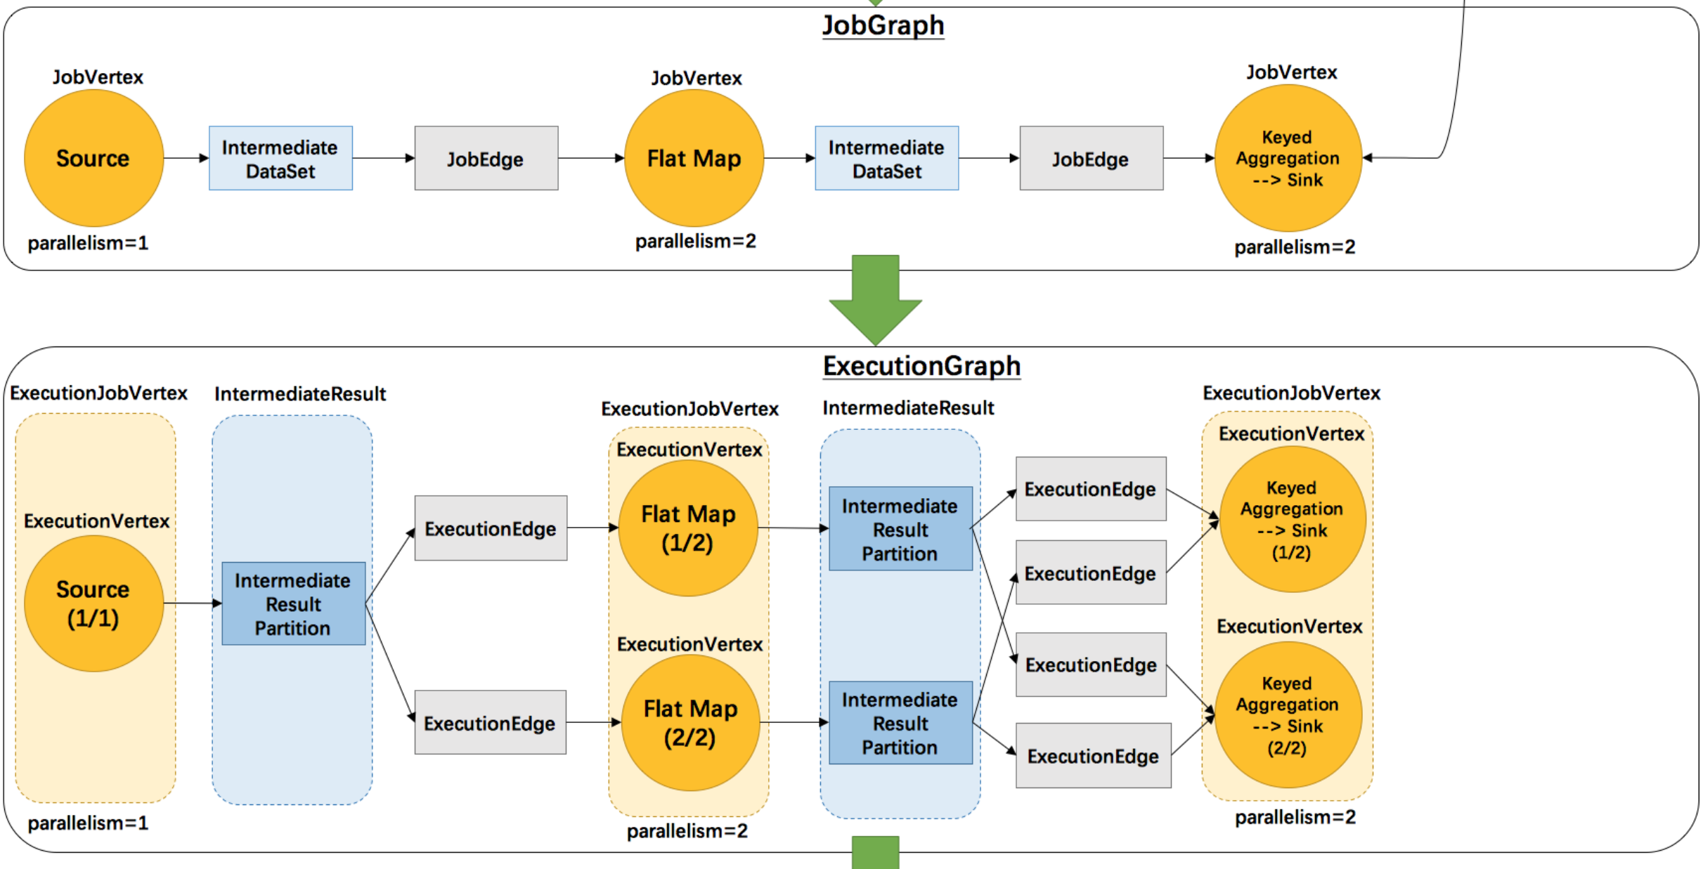
ExecutionGraph
ExecutionGraph is the parallel version of JobGraph.
Each ExecutionJobVertex contains a corresponding JobVertex and creates ExecutionVertex instance for Task submission and deployment.
ExecutionEdge is constructed from JobEdge based on DistributionPattern.
IntermediateResult is created from intermediateDataSet.
Notes:
Corresponding class diagram is Model2::ExecutionGraphBuild

Slide 21
ExecutionGraph-details
ExecutionJobVertex:
It contains a corresponding JobVertex which contains the StreamConfig.
It contains ExecutionVertices that created based on num of parallelism.
ExecutionVertex contains Execution which is able to submitTask to TaskManager with a StreamConfig and a descriptor.
ExecutionJobVertex
JobVertex
ExecutionVertex
ExecutionVertex
Execution
Execution

Slide 22
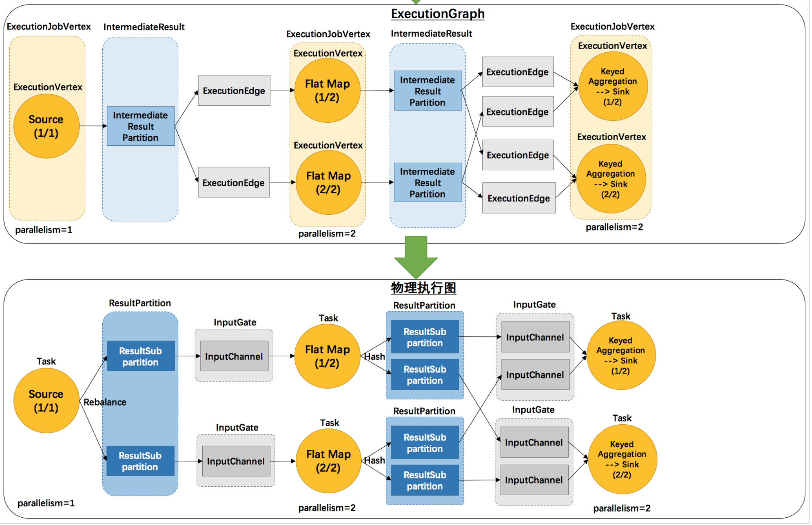
Physical Execution Layer
Every Execution will submit a TaskDescriptor to TaskManager, and TaskManager will run the Task with a slot.
Task is instantiated from operatorFactory and run as a StreamTask. All those informations have been stored into StreamConfig.

Slide 23
StreamTask Details
StreamTask:
InputGate pulls buffer from upstream ResultSubPartition.
StreamInputProcessor processes input elements by using an OperatorChain, and writes the results to corresponding channels based on partitioner(channelselector).
StreamTask
InputGate
StreamInputProcessor
ResultPartition
RecordWritter
InputChannel
Stream
Operator
Stream
Operator
ResultSubPartition
ChannelSelector
InputChannel
ResultSubPartition

Slide 24
Flink components remote invocation methods
Netty HTTP:
DispatcherRestEndpoint: providing Web UI related request handlers and client job submission handler. (localhost:8081)
RestClient: submit Job requests to DispatcherRestEndpoint.
Akka RPC:
services in AM: akka.tcp://flink@localhost:6123/user/XXX e.g. dispatcher:
Dispatcher: get requests from DispatcherRestEndpoint and spawn jobMasters.
ResourceManager: Requesting resources for JobMasters from TaskExecutors.
JobMaster: deploying tasks to TaskExecutors and handling heartbeat from TaskExecutors.
services in TaskExecutors: akka.tcp://flink@localhost:port/user/taskmanager
TaskExecutor: handling resources request from ResourceManager and sending heartbeat to JobMasters.

Slide 25
Flink RPC
Flink has encapsulated its RPC framework into rpcGateway, and currently Flink is using Akka as its implementation.
Every component below is a rpcEndpoint and has a rpcGateway, where defines methods to be invoked by other components.
When one component wants to invoke another component’s methods, it needs build a connection between each other at first(get the rpcGateway of the remote component), and call methods by using the rpcGateway.
Dispatcher
ResourceManager
JobMaster
Dispatcher
Gateway
ResourceManager
Gateway
JobManager
Gateway
TaskExecutor
TaskExecutor
Gateway

Slide 26
Remote connections in Flink
During cluster initialization and job initialization, there are four RPC connections need to be built:
1. Client to DispatcherRestEndpoint connection. (HTTP)
2. JobMaster to ResourceManager connection. (Akka RPC)
3. TaskExecutor to ResourceManager connection. (Akka RPC)
4. TaskExecutor to JobMaster connection. (Akka RPC)
Dispatcher
RestEndpoint
Dispatcher
JobMaster
ResourceManager
1. Netty HTTP
Single direction
Akka RPC
Spawn
2, Akka RPC
Client
Rest
Gateway
Dispatcher
Gateway
JobManager
Gateway
ResourceManager
Gateway
4. Akka RPC
3. Akka RPC
TaskExecutor
TaskExecutor
Gateway

Slide 27
Connection mechanism
TaskExecutor：
ResourceManager’s address is already known, because host and port name is known, so it can get gateway from it and invoke registerTaskExecutor to register its gateway to ResourceManager.
JobMaster has non-deterministic address, and the address is unknown for TaskExecutor at first, but it can get the JobMaster’s address via ResourceManager. When ResourceManager requests resources from one TaskExecutor, it will notify the TaskExecutor with the JobMaster’s address, then TaskExecutor will connect to the JobMaster.
RestClient:
DispatcherRestEndpoint’s host and port are already known, and netty HTTP connection only needs host and port information.
DispatcherRestEndpoint:
It will keep a gateway of dispatcher during initialization because it is created by clusterEntrypoint.

Slide 28
Example: TaskExecutor connects to ResourceManager
Every component(rpcEndpoint) has its own URL which is configured during initialization,
e.g. Dispatcher: akka.tcp://flink@localhost:6123/user/dispatcher.
e.g. TaskExecutor: akka.tcp://flink@localhost:XXX/user/taskmanager. (port number is randomly selected)
For Dispatcher and ResourceManager, their URLs has already known in configuration, and remote components get the gateway by using their URLs.
TaskExecutor’s rpc server creates on a randomized port, so when setting up the connection between TaskExecutor and ResourceManager, TaskExecutor connects to ResourceManager at first, and then ResourceManager will call back to TaskExecutor and get its rpcGateway.
TaskExecutor
ResourceManager
TaskExecutor
Gateway
ResourceManager
Gateway

Slide 29
Example: TaskExecutor connects to ResourceManager
1. TaskExecutor get a reference of ResourceManagerGateway by using the URL: akka.tcp://flink@localhost:6123/user/resourcemanager.
2. TaskExecutor then informs ResourceManager the URL of TaskExecutor by using the ResourceManagerGateway.
3. ResourceManager receives the URL of TaskExecutor, and will use the same logic to get a reference of TaskExecutorGateway, and save it locally.
TaskExecutor
ResourceManager
TaskExecutor
Gateway
ResourceManager
Gateway
1. get ResourceManagerGateway ref
ResourceManager
Gateway

Slide 30
Example: TaskExecutor connects to ResourceManager
1. TaskExecutor get a reference of ResourceManagerGateway by using the URL: akka.tcp://flink@localhost:6123/user/resourcemanager.
2. TaskExecutor then informs ResourceManager the URL of TaskExecutor by using the ResourceManagerGateway.
3. ResourceManager receives the URL of TaskExecutor, and will use the same logic to get a reference of TaskExecutorGateway, and save it locally.
TaskExecutor
ResourceManager
TaskExecutor
Gateway
ResourceManager
Gateway
2. Connect to ResourceManage
1. get ResourceManagerGateway ref
ResourceManager
Gateway

Slide 31
Example: TaskExecutor connects to ResourceManager
1. TaskExecutor get a reference of ResourceManagerGateway by using the URL: akka.tcp://flink@localhost:6123/user/resourcemanager.
2. TaskExecutor then informs ResourceManager the URL of TaskExecutor by using the ResourceManagerGateway.
3. ResourceManager receives the URL of TaskExecutor, and will use the same logic to get a reference of TaskExecutorGateway, and save it locally.
TaskExecutor
ResourceManager
TaskExecutor
Gateway
ResourceManager
Gateway
2. Connect to ResourceManage
1. get ResourceManagerGateway ref
3. get TaskExecutorGateway ref
ResourceManager
Gateway
TaskExecutor
Gateway

Slide 32
Client connects to DispatcherRestEndpoint
1. Client submit Job via netty HTTP connection, client first find the restful server’s host and port from configuration, and then submit its JobGraph to the server(DispatcherRestEndpoint).
2. DispatcherRestEndpoint keeps a gateway of Dispatcher, and it will analysis the request and submit the JobGraph to Dispatcher via Akka RPC.
3. When Dispatcher receives the request, it will spawn a JobMaster to deploy the execution.
1. JobGraph
requests
Dispatcher
RestEndpoint
2. Submit
JobGraph
3. spawn
Client
Dispatcher
JobMaster

Slide 33
TaskExecutor connects to JobMaster
1. When JobMaster initialized, it will connect to ResourceManager via the same logic as that in TaskExecutor.
2. ResourceManager get the connection request and will allocate resources for it, so it will send slot request to TaskExecutor with JobMaster’s address.
3. TaskExecutor receives the address of JobMaster, and will connect to JobMaster.
JobMaster
ResourceManager
1. Connect to ResourceManager
JobManager
Gateway
ResourceManager
Gateway
2. Inform with JobMaster address
3. Connect to JobMaster with provided address
TaskExecutor
TaskExecutor
Gateway

Slide 34
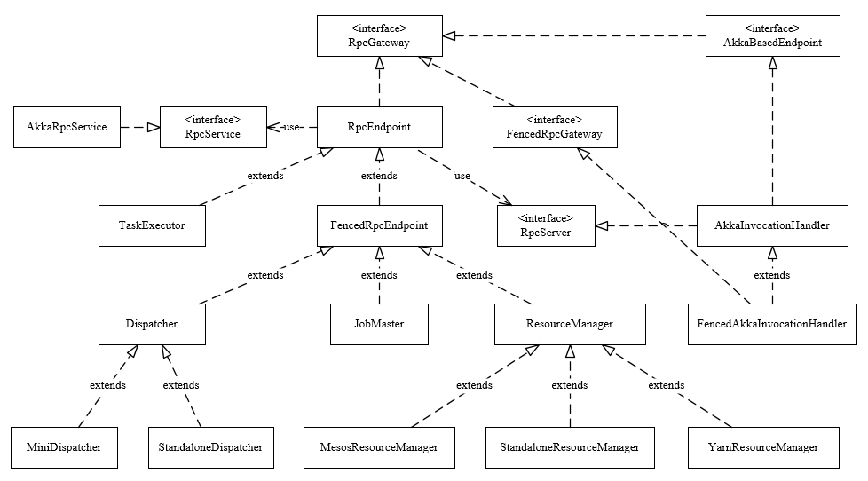
Flink RPC framework internal
Every components extend a rpcEndpoint, which is the main class used to communicate with each other, and all classes are the implementation of a rpcGateway:
rpcService is the main class used to 1. create rpcServer and 2. connect to other rpcServers.
rpcEndpoint uses rpcService to create a rpcServer for itself, which contains the handler for remote calls.
rpcEndpoints connect to each other by using rpcService with a specific URL to connect, and will return another rpcEndpoint’s rpcServer reference for invocation.

Slide 35
StreamManager Dispatcher
Stream
Manager 1
JobGraph requests
StreamManager
Dispatcher
Stream
Manager 2
…
Stream
Manager N

Slide 36
Design of network framework in StreamManager
1. JobGraph requests
StreamManager
Dispatcher
Client
StreamManager
Dispatcher
RestEndpoint
2.spawn
StreamManager
3. Send JobGraph request with StreamManager address
Dispatcher
RestEndpoint
5. Connect to StreamManager
4. spawn
Dispatcher
JobMaster

Slide 37
Design of network framework in StreamManager
1. JobGraph requests
Respond with
StreamManager URL
StreamManager
Dispatcher
Client
3. JobGraph requests wth URL
StreamManager
Dispatcher
RestEndpoint
2.spawn
StreamManager
Dispatcher
RestEndpoint
5. Connect to StreamManager
4. spawn
Dispatcher
JobMaster

Slide 38
Design of network framework in StreamManager
1. JobGraph requests
StreamManager
Dispatcher
Client
3. JobGraph requests
StreamManager
Dispatcher
RestEndpoint
2.spawn
StreamManager
5. Connect and get
JobMaster address via Dispatcher
Dispatcher
RestEndpoint
6. Connect to StreamManager
4. spawn
Dispatcher
JobMaster

Slide 39
Overview of StreamManager
StreamManager communicates with JobMaster via Akka RPC connection.
StreamManager stays outside of runtime and maintains the StreamGraph as its state.
JobMaster stays at runtime layer and can deploy the execution plan modified by StreamManager.
StreamManager
StreamSwitch
Operator 1
StreamSwitch
Operator 2
…
StreamSwitch
Operator n
StreamSwitch
Adaptor
JobMaster
StreamGraph
Updater
ExecutionPlan
Coordinator
Send converted JobGraph or delta of JobGraph to JobMaster
newExecutionPlan
Executor

Slide 40
TODO: use figures to show the connection mechanisms.

Slide 41
TaskExecutor connects to ResourceManager
TaskExecutor
1. Connect to ResourceManager by Get ResourceManagerGateway
ResourceManager
TaskExecutor
Gateway
2. Connect to TaskExecutor by Get TaskExecutorGateway
ResourceManager
Gateway

Slide 42
JobManager connects to ResourceManager
TaskExecutor
1. Connect to ResourceManager by Get ResourceManagerGateway
ResourceManager
TaskExecutor
Gateway
2. Connect to TaskExecutor by Get TaskExecutorGateway
ResourceManager
Gateway

Slide 43
Client connects to DispatcherRestEndpoint
TaskExecutor
1. Connect to ResourceManager by Get ResourceManagerGateway
ResourceManager
TaskExecutor
Gateway
2. Connect to TaskExecutor by Get TaskExecutorGateway
ResourceManager
Gateway

Slide 44
TaskExecutor connects to JobMaster
TaskExecutor
1. Connect to ResourceManager by Get ResourceManagerGateway
ResourceManager
TaskExecutor
Gateway
2. Connect to TaskExecutor by Get TaskExecutorGateway
ResourceManager
Gateway

