Slide 1
Partition

Slide 2
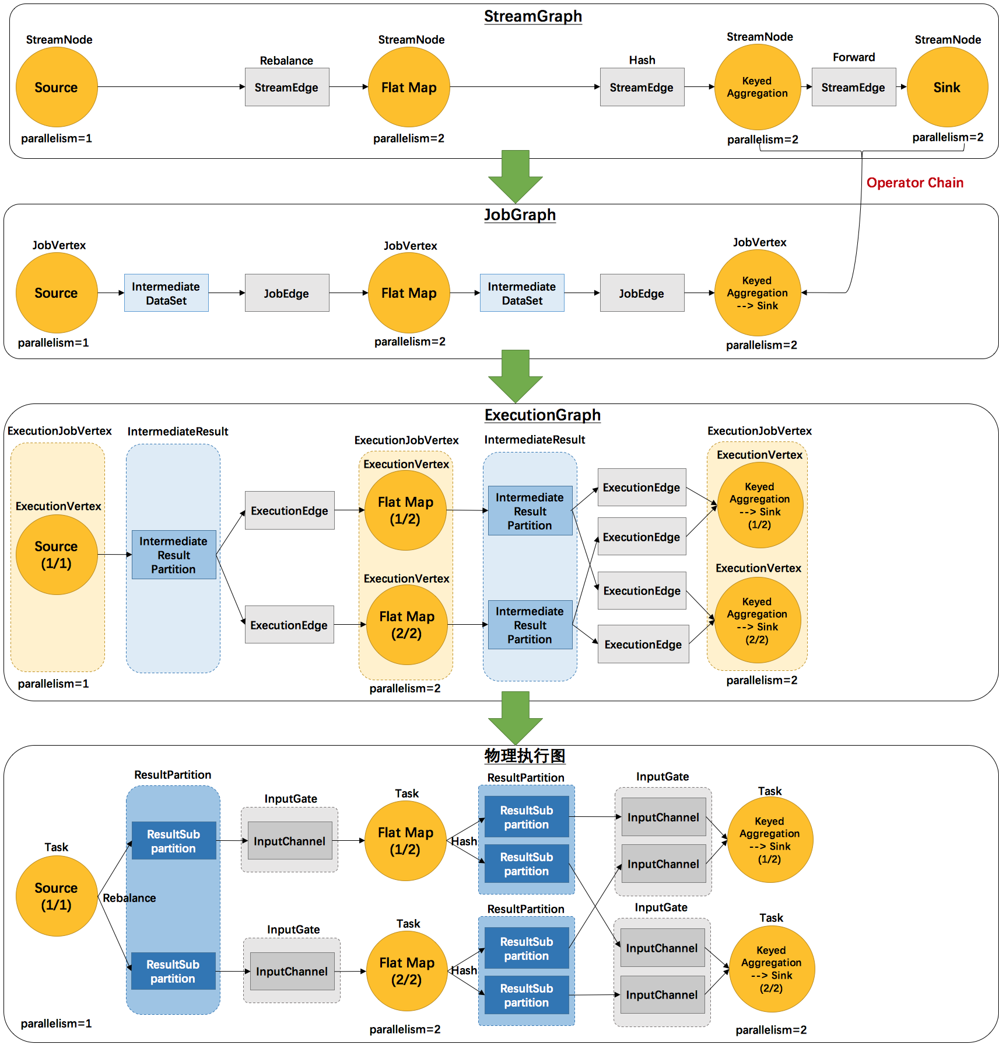
4 levels of Graph

Slide 4
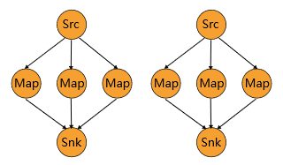
User-level: Partitioner
ForwardPartitioner: assigned by Flink by default for connections where the number of upstream parallelism is equal to downstream parallelism. (Pointwise connection is created if Flink uses ForwardPartitioner).
RescalePartitioner: need to be called by user explicitly.

Slide 5
User-level: Partitioner
RebalancedPartitioner: assigned by Flink by default for connection where the parallelism didn't equal between upstream and downstream. (This chooses physical connection in a round-robin style).
BroadcastPartitioner: need to assign manually in user code. Broadcast records to all connected physical link.
... some other partitioners
CustomPartitioner: user defined partitioner.

Slide 6
Physical Link
pointwise
only used in ForwardPartition and RescalePartition
all to all
each downstream subtask connects all upstream partitions

Slide 7
Communication

Slide 8
Discussion
Do we need to update JobGraph & ExecutionGraph globally? If not, may become inconsistent when tasks fails.
How to update ResultPartition and InputGate at runtime?

