Slide 1

Part-of-Speech Tagger Comparison Suite
DSA0308 - NATURAL LANGUAGE PROCESSING
PRESENTED BY
Jothika M (192324235)
A.Gayathri Shanmukhi (192324315L)
Monika R (192324235)
GUIDED BY
Dr.Saravanan.M.S

Slide 2


INDEX
ABSTRACT
INTRODUCTION
PROBLEM STATEMENT AND OBJECTIVES
EXISTING SYSTEM AND PROPOSED SYSTEM
MODULES

Slide 3
ABSTRACT
This project develops a POS Tagger Comparison Suite to evaluate three different Natural Language Processing techniques: Rule-Based Tagging, Hidden Markov Model (HMM), and Brill Transformation-Based Tagging.
The system uses Python and the NLTK library to analyze sentences and assign appropriate grammatical labels to each word using standard linguistic datasets.
Purpose of the Project
Based on the tagging results, the system compares the performance of all three techniques using accuracy, unknown-word handling, and confusion matrices.
A Streamlit dashboard visualizes the results, helping users understand tagging performance, identify common errors, and compare the strengths and limitations of each method.
This system helps identify an effective POS-tagging approach and supports better understanding of grammatical analysis in NLP applications.

Slide 4
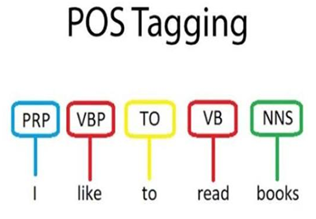
INTRODUCTION
The Part-of-Speech (POS) Tagger Comparison Suite is designed to analyze and compare different POS-tagging techniques using Natural Language Processing.
It identifies the grammatical role of each word using Rule-Based, HMM, and Brill Tagging techniques.
Importance:
This system:
Analyzes sentence structure and grammatical roles.
Compares different POS-tagging techniques.
Identifies tagging errors and grammatical ambiguities.
Evaluates accuracy and unknown-word handling.
It helps identify the strengths and limitations of different POS-tagging methods.
Applications:
Used in NLP applications such as text processing and language analysis.
Helps improve speech recognition, machine translation, and information extraction.

Slide 5
PROBLEM STATEMENTS AND OBJECTIVES
Different POS-tagging techniques use different approaches to identify grammatical categories, making their performance difficult to compare effectively.
This project aims to develop a unified system to compare Rule-Based, HMM, and Brill taggers using accuracy, unknown-word handling, and error analysis through an interactive dashboard.
Objectives
1.Rule-Based POS Tagger: To develop a rule-based POS tagger using predefined grammatical rules and evaluate its tagging accuracy on a standard NLP corpus.
2.HMM-Based POS Tagger: To implement an HMM-based POS tagger using the Viterbi algorithm to predict the most probable sequence of grammatical tags from the input text.
3.Brill Tagger and Comparison Dashboard: To implement Brill transformation-based tagging and develop a dashboard to compare all three taggers using accuracy, unknown-word accuracy, confusion matrices, and tagging errors.

Slide 6
EXISTING SYSTEM AND PROPOSED SYSTEMS
Existing System
Rule-based taggers use predefined grammatical rules.
HMM taggers use probabilities to predict grammatical tags.
Hybrid and ML methods learn tagging patterns.
Existing methods face unknown-word and grammatical ambiguity challenges.
Most systems lack unified comparison and error visualization.
Rule-Based POS Tagger: Assigns grammatical tags using predefined rules and regular expressions.
HMM-Based POS Tagger: Uses transition and emission probabilities with the Viterbi algorithm to predict POS tags.
Brill Tagger and Comparison Dashboard: Corrects tagging errors and compares all three taggers using accuracy, confusion matrices, and Streamlit visualization.
Proposed System

Slide 7
MODULES
Module 1: Rule-Based POS Tagger
Develop a POS tagger using predefined grammatical rules and regular expressions.
Assign Penn Treebank tags and evaluate tagging accuracy.
Module 2: HMM-Based POS Tagger
Implement a Hidden Markov Model (HMM) using transition and emission probabilities.
Apply the Viterbi algorithm to predict the most probable sequence of POS tags.
Module 3: Brill Tagger and Comparison Dashboard
Implement Brill transformation-based tagging to correct initial tagging errors.
Compare all three taggers using accuracy, unknown-word accuracy, confusion matrices, and a Streamlit dashboard.

Slide 8
THANK YOU

Slide 9
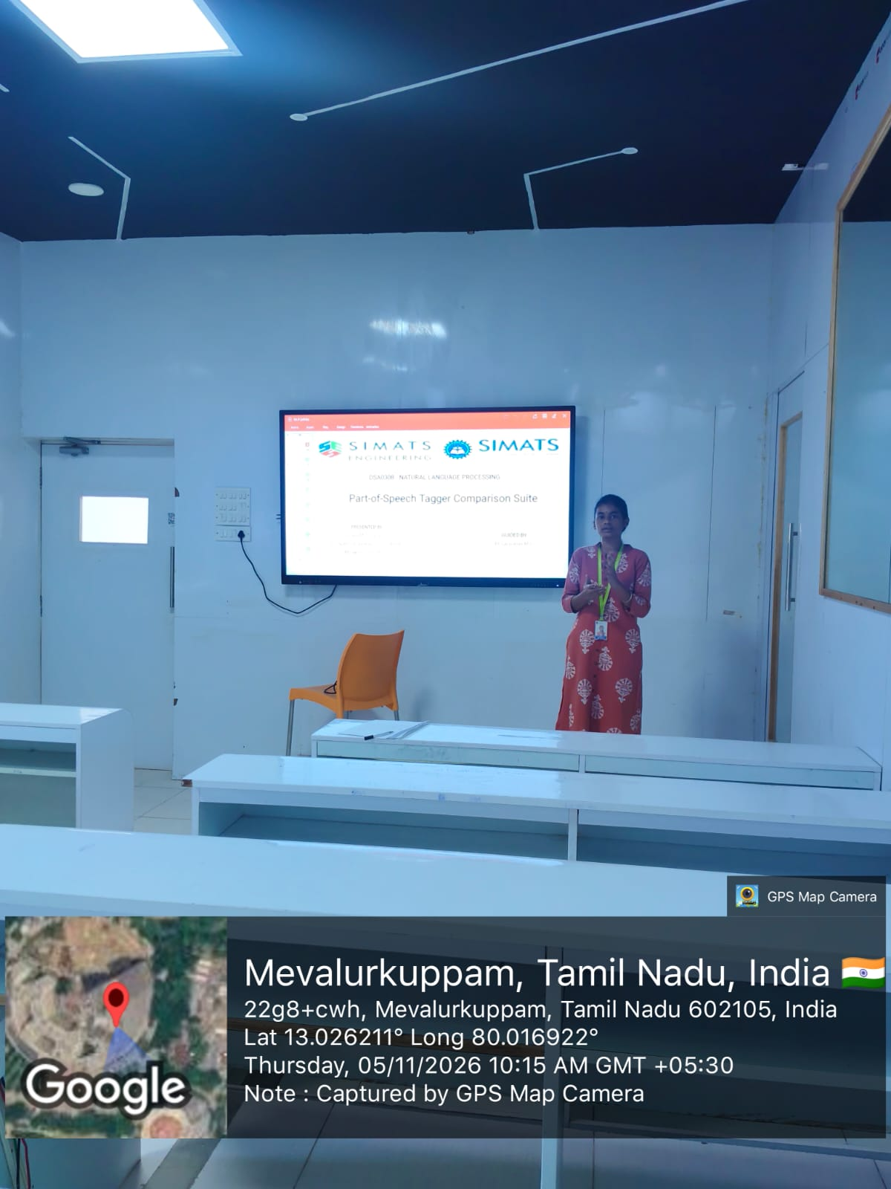
GEOTAG

