Slide 1
Employee Data Analysis using Excel
STUDENT NAME: R. JOTHI PRIYA
REGISTER NO: 312200067
DEPARTMENT: BACHELOR OF COMMERCE
COLLEGE: Rajeswari vedachalam government arts and science college , chengalpattu

Slide 2
PROJECT TITLE
Employee Performance Analysis using Excel

Slide 3


AGENDA
Problem Statement
Project Overview
End Users
Our Solution and Proposition
Dataset Description
Modelling Approach
Results and Discussion
Conclusion
3/21/2024 Annual Review

Slide 4

PROBLEM STATEMENT
The reason to analyse the data is to evaluate the performance of the workers and to
motivate them. By doing this analysis we can encourage or give bonus to high
performed employees and can encourage the low performed employees , which will
Help the company to grow.

Slide 5

PROJECT OVERVIEW
Employee performance analysis tells you the analysis of the performance of the employee of different department by using excel sheets and bar chart which will help us to understand the project well.

Slide 6
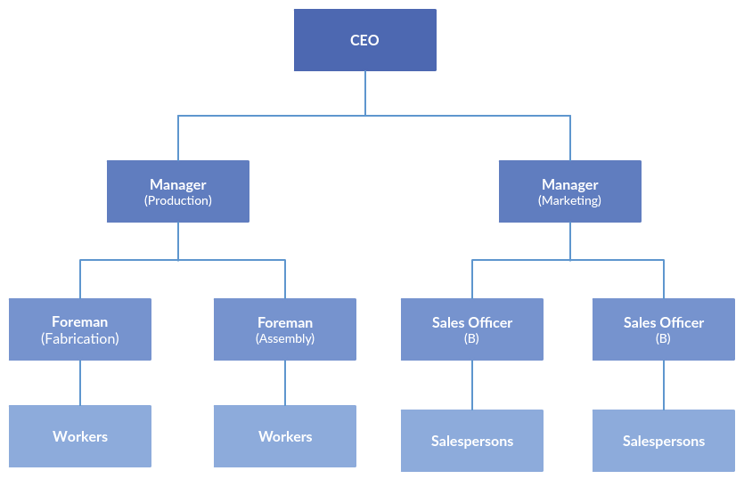

WHO ARE THE END USERS?

Slide 7

OUR SOLUTION AND ITS VALUE PROPOSITION
Pivot - summary
Graph - data visualization
Excel - data preparation

Slide 8
Dataset Description
Employee – kaggle
Performance level
Gender – male, female
Employee rating – numericals
Department
4- features

Slide 9

THE "WOW" IN OUR SOLUTION
Graph
Pivot chart
Employee performance
Latest trends
3/21/2024 Annual Review
9

Slide 10
MODELLING
Summary
Pivot table
Chart
Graph
Visualization
Graph
Rows
column
10

Slide 11
RESULTS
11

Slide 12
conclusion
From the data we can conclude that the number of employees higher in number are average performed employee , so we can level up the average performed employees by motivating them and increase their performance and we can trained the lowly performed employees which will give us better result and we can give bonus and incentive to the high performed employee to keep the pace.

