Slide 2
ABOUT DATA

Slide 3
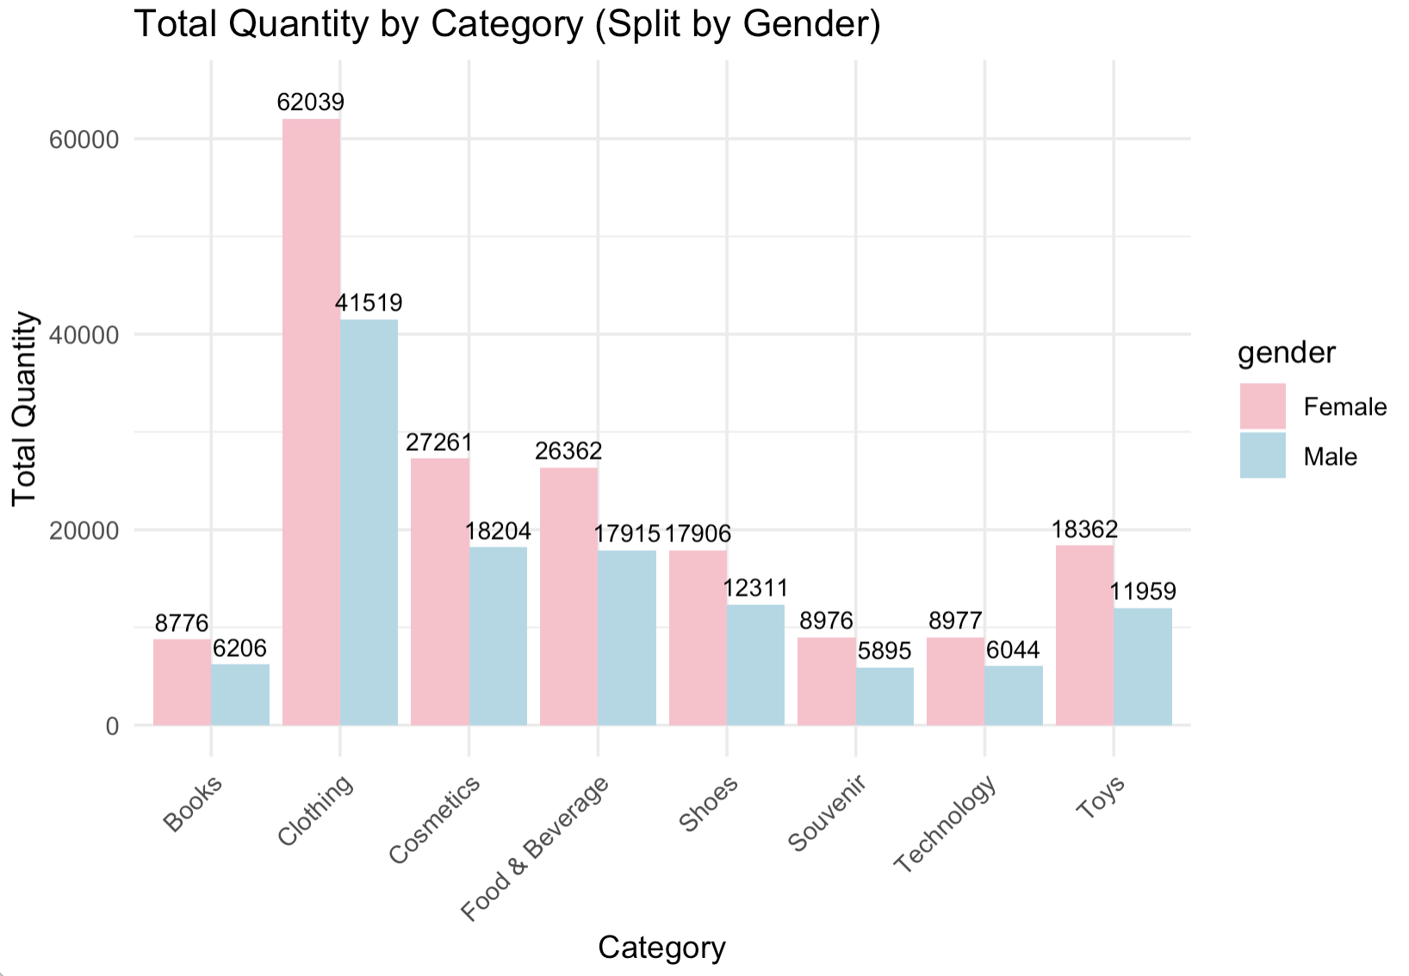
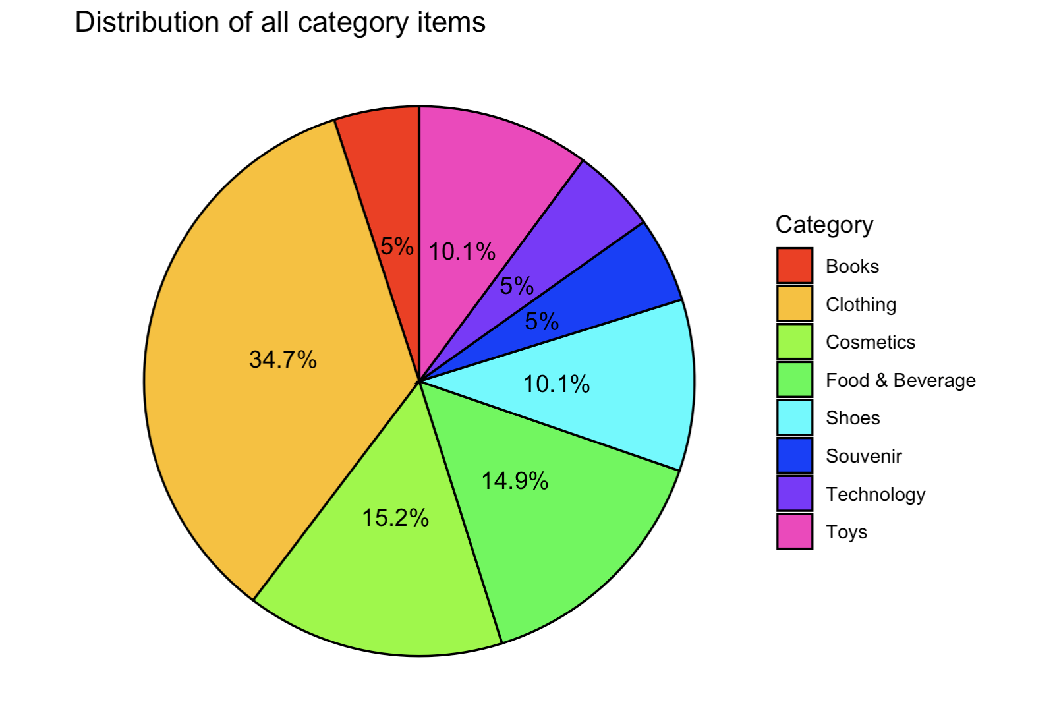
DATA EXPLORATION

Slide 4
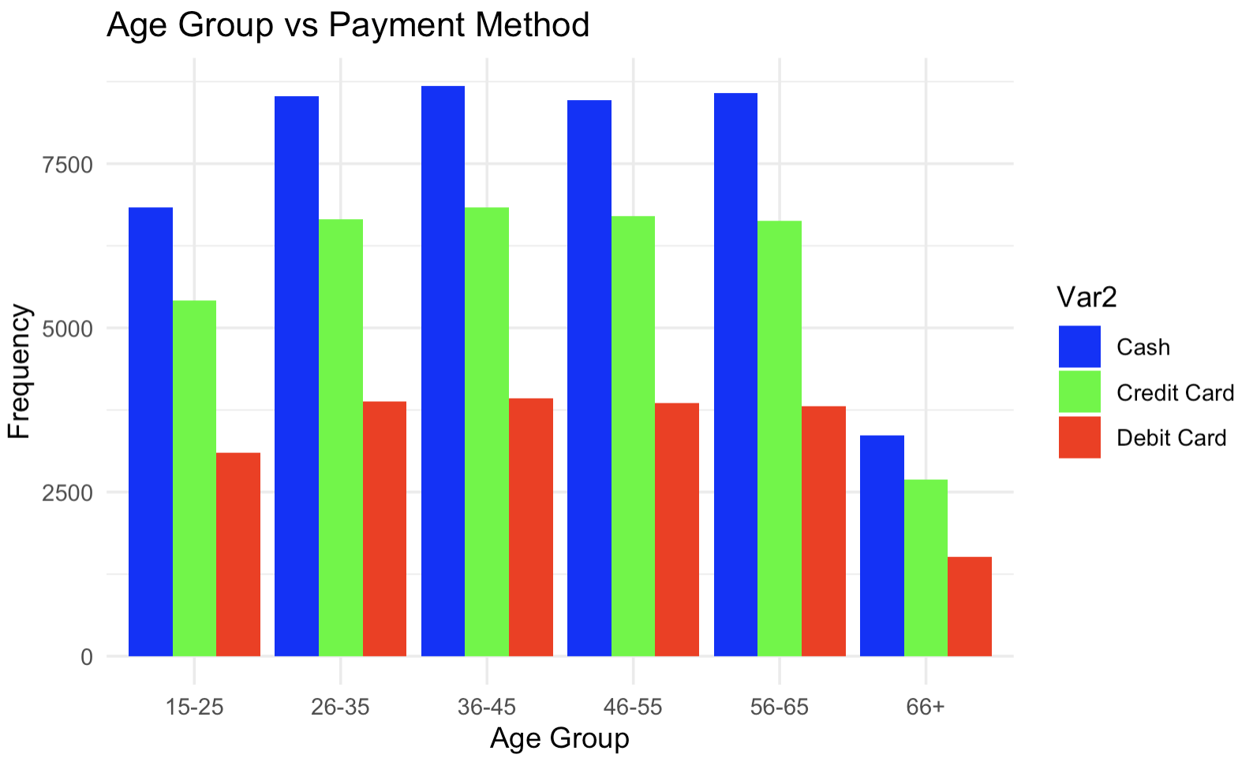
DATA EXPLORATION

Slide 5
ASSOCIATION RULE

Slide 10
CLASSIFICATION
Classification refers to the process of categorizing data into classes or groups based on certain features or attributes. It's a fundamental task in data analysis and machine learning where the goal is to predict the category or class of a given dataset based on its characteristics.
The R code sets up and compares two different machine learning models for a classification task using customer shopping data: Random Forest model (rf_model) and Naive Bayes model (nb_model).

Slide 11
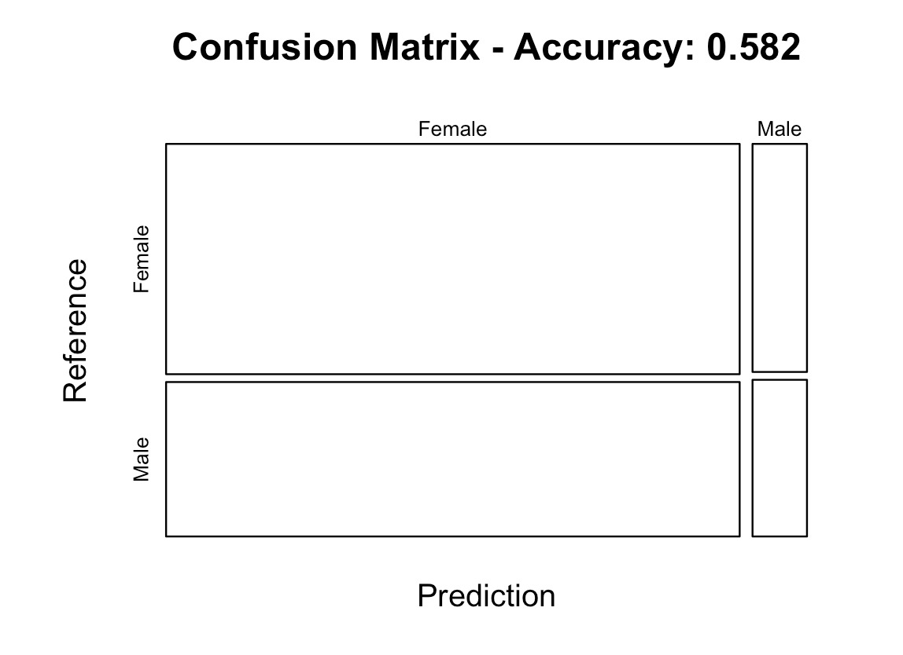
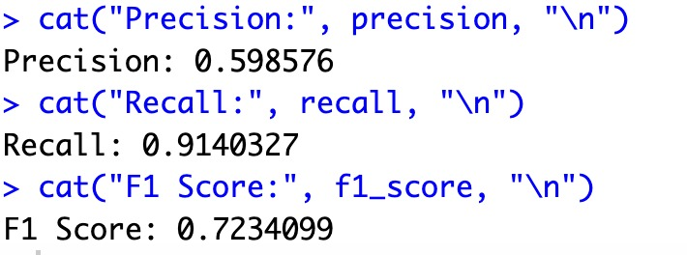
RANDOM FOREST MODEL EVALUATION

Slide 12
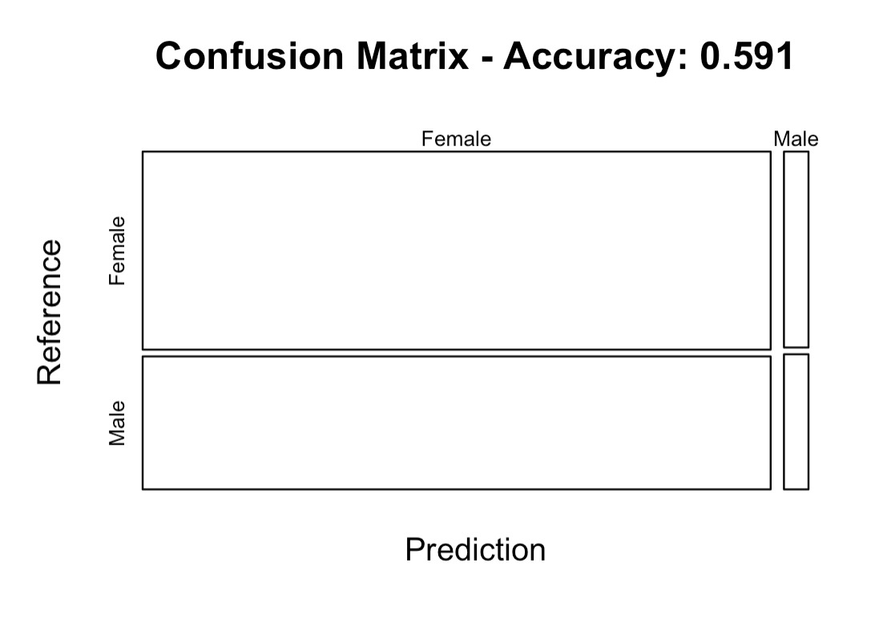
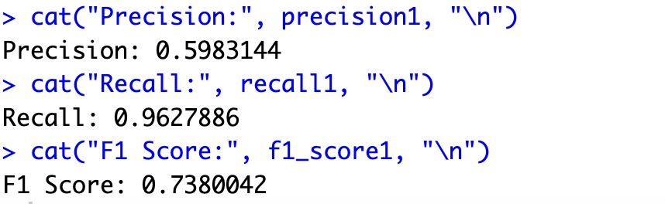
NAIVE BAYES MODEL EVALUATION

Slide 13
CLUSTERING
Clustering is the process of grouping similar data points together based on certain characteristics or features they share. It's an unsupervised learning technique used to find hidden patterns or structures within a dataset.
Selects specific columns ("age," "quantity," "price") from the shopping_data dataset to be used for clustering.
DBSCAN:
Applies the DBSCAN algorithm to the selected features. eps specifies the maximum distance between two points for them to be considered part of the same neighborhood, and minPts is the minimum number of points required to form a dense region.

Slide 14
Displays the distribution of clusters formed by DBSCAN (table()) and provides information about the resulting clusters (dbscan_result).
Creates a new data frame (cluster_data) combining the selected features with the assigned cluster labels from the DBSCAN results.
Utilizes ggplot2 to create a scatter plot visualizing the clusters formed by DBSCAN. Each data point is represented by a point on the plot, where the x-axis is "quantity," the y-axis is "age," and the color of the points represents different clusters identified by DBSCAN.

