Slide 1

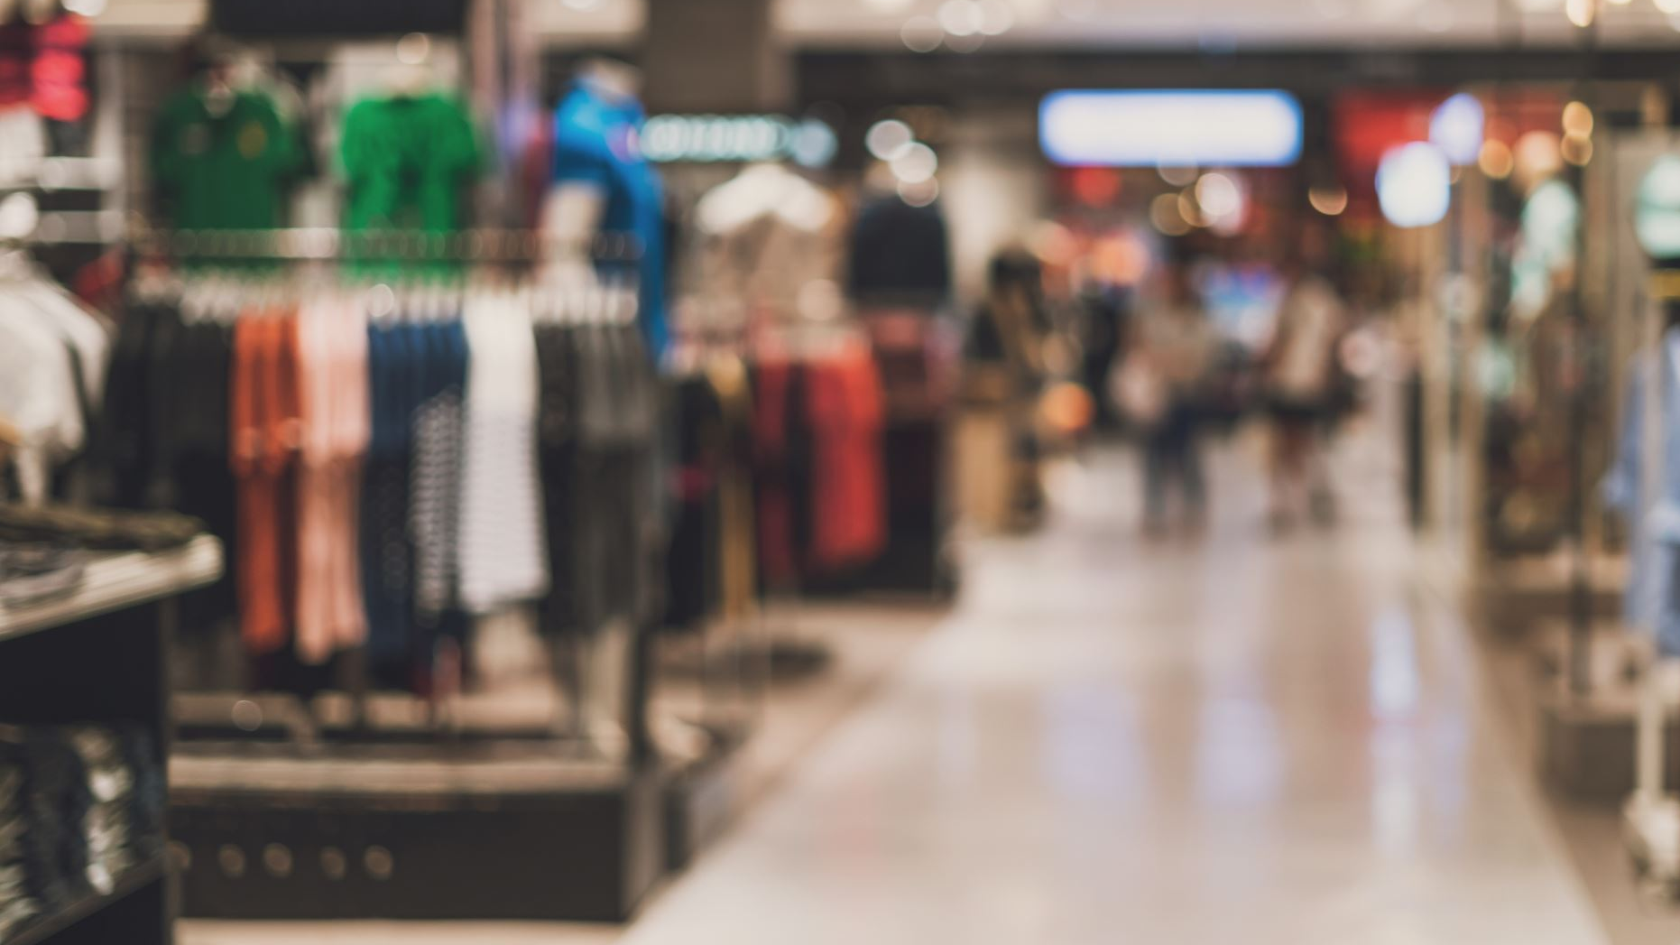
Istanbul Shopper's Atlas: Unveiling Trends Across 10 Malls
A Comprehensive Exploration of Shopping Patterns from 2021 to 2023 by Age, Gender, and Location
By
Group-4
Jothish Kumar Polaki
Rohit vatsava Kalakala
Vidhyananth Sivashanmugam

Slide 2

ABOUT DATA
The dataset encompasses shopping data from 10 distinct shopping malls in Istanbul between 2021 and 2023.
It includes information gathered from various age groups and genders to provide a comprehensive view of shopping habits in the city.
Key data points within the dataset consist of invoice numbers, customer IDs, age groups, genders, payment methods, product categories, quantities, prices, order dates, and shopping mall locations.
This dataset is aimed at serving as a valuable resource for researchers, data analysts, and machine learning enthusiasts interested in exploring shopping trends and patterns specific to Istanbul.
Researchers and analysts can leverage this dataset to gain insights into the diverse shopping behaviors prevalent in Istanbul over the specified period.

Slide 3

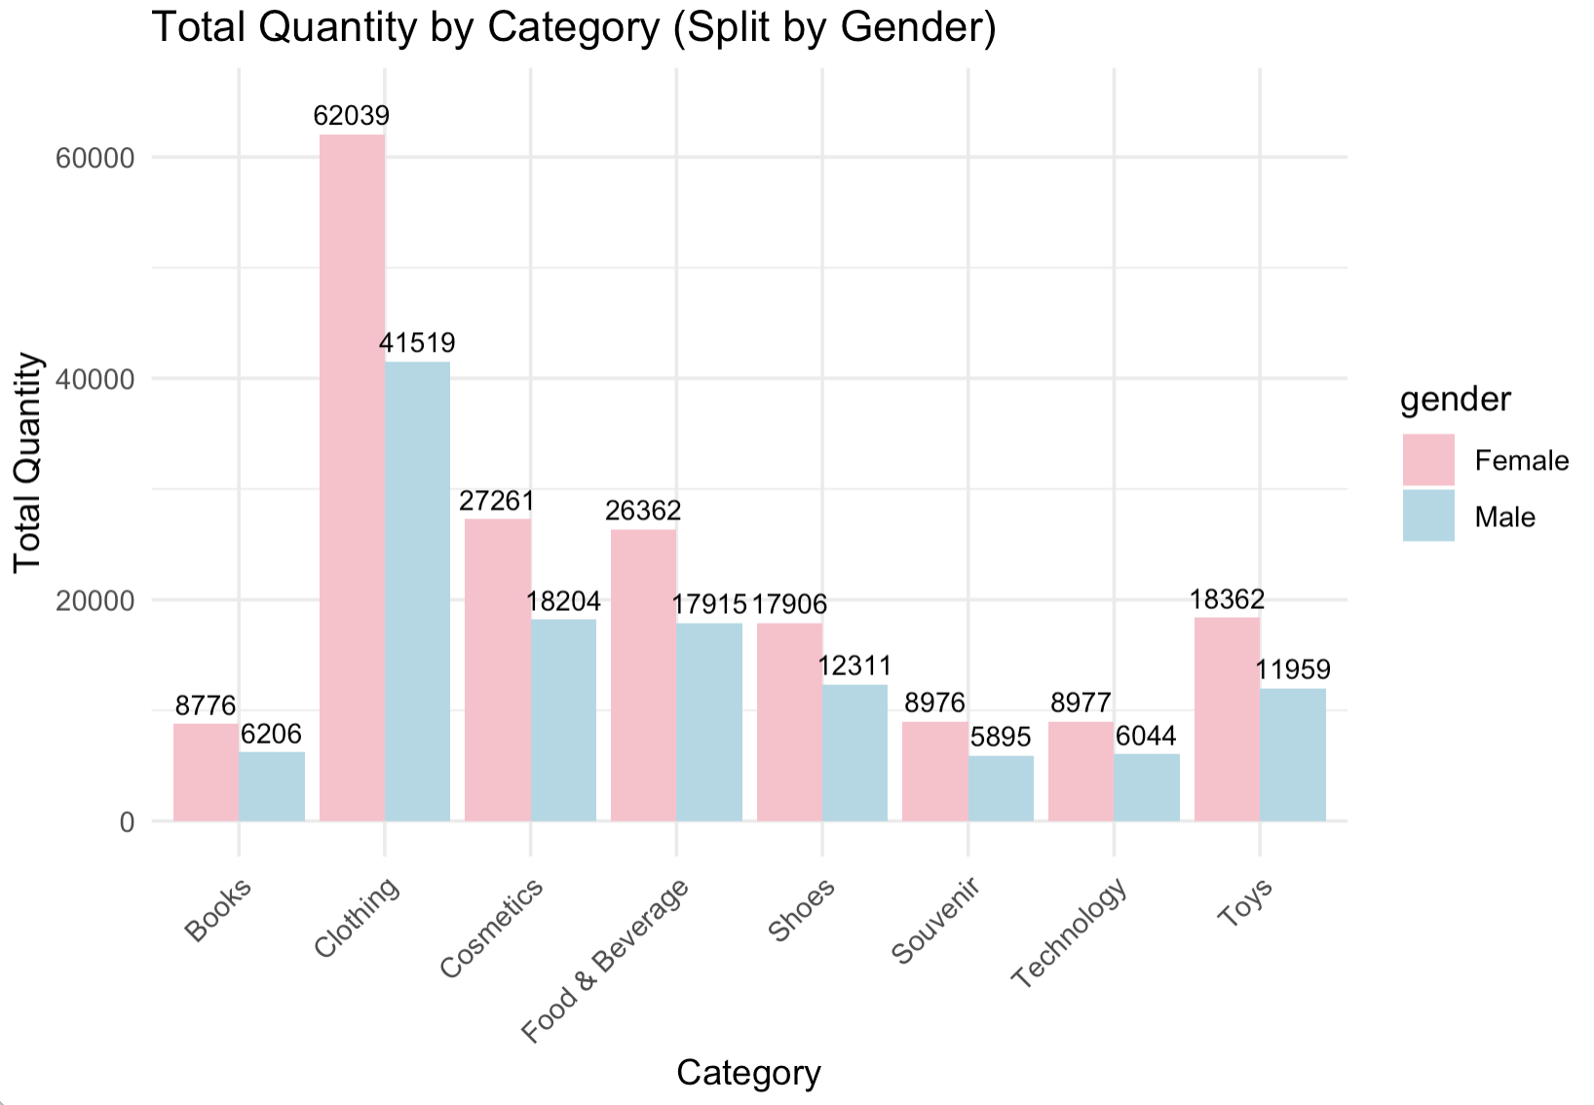
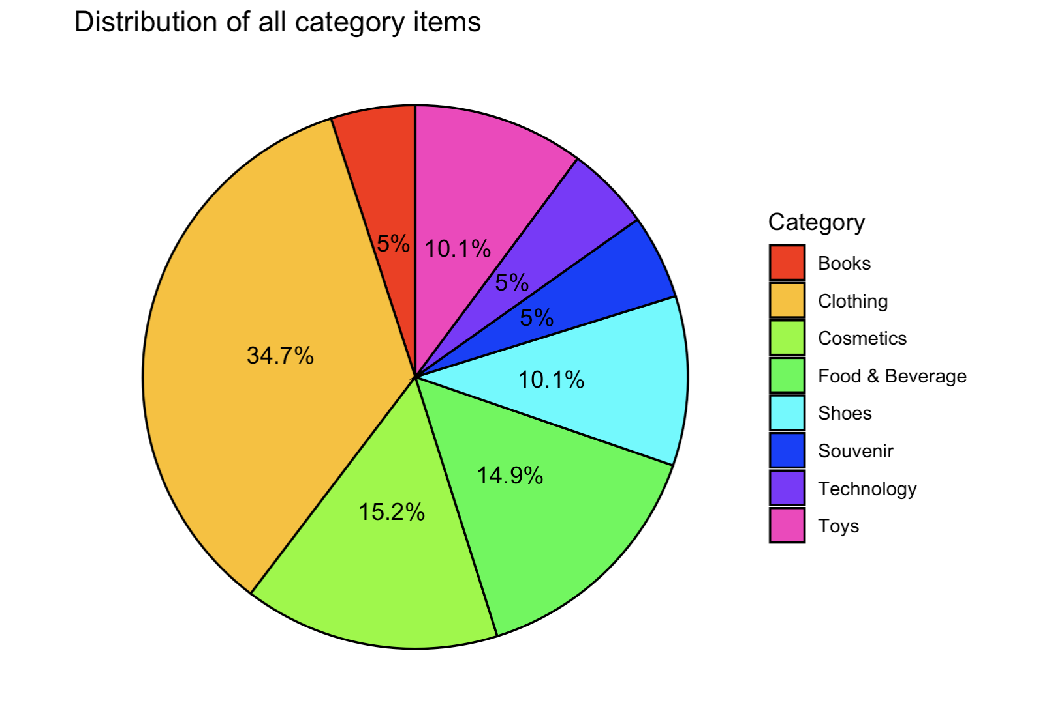



DATA EXPLORATION

Slide 4
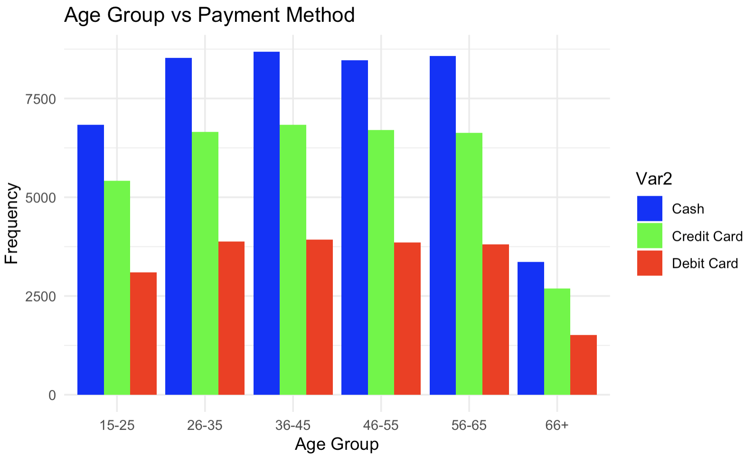
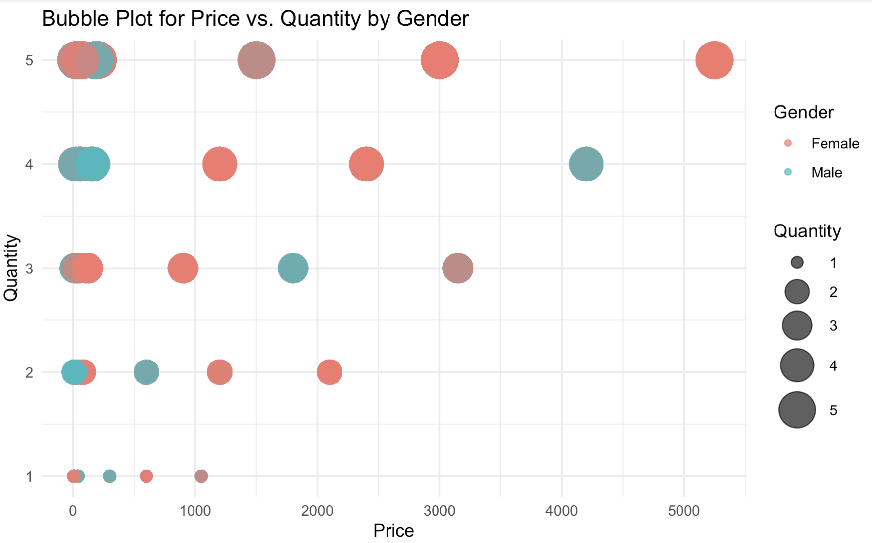
DATA EXPLORATION

Slide 5
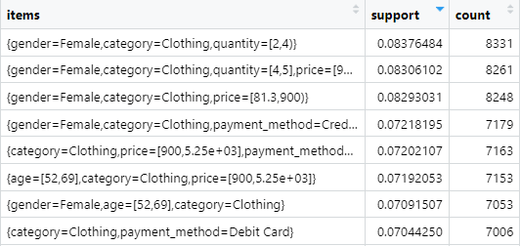
ASSOCIATION RULE
Maximal Rules associated with Clothing category
Shopping Mall Preferences: Different shopping malls exhibit varying associations with clothing purchases. Metrocity, Kanyon, and Mall of Istanbul show significant connections with customers buying clothing items.
Payment Method Usage : There's a notable preference for payment methods when purchasing clothing. Debit cards emerge as a favored payment mode among customers.
Quantity and Price Range Associations: Patterns in the quantity of clothing items bought (e.g., 1-2 items) and their price ranges (e.g., $81.3 to $900) shed light on customer preferences and spending habits.

Slide 6
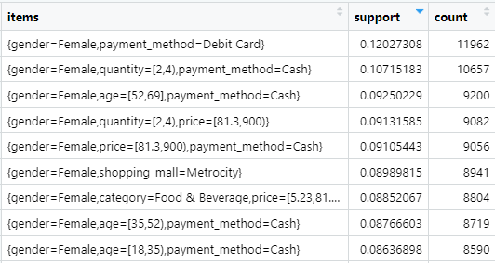
ASSOCIATION RULE
Maximal Rules associated with Female Gender
Shopping Mall Preferences for Females: There is a strong association of females with specific shopping malls. Metrocity, Istinye Park, and Metropol AVM indicate a significant correlation with female shoppers, portraying preferences among this demographic for these malls.
Payment Method Preference: Female customers exhibit a distinct preference for payment methods. Debit cards emerge prominently as the favored payment mode among female shoppers.
Age Group Preferences: The analysis highlights particular age groups within females that show consistent associations with shopping patterns. Females between 18-35, 35-52, and 52-69 exhibit diverse preferences in purchasing behavior, especially in terms of item categories and price ranges.
Category-Specific Preferences: Female shoppers exhibit strong associations with specific categories such as Clothing, Shoes, Toys, Cosmetics, and Food & Beverage, showcasing distinct preferences for these product categories.

Slide 7
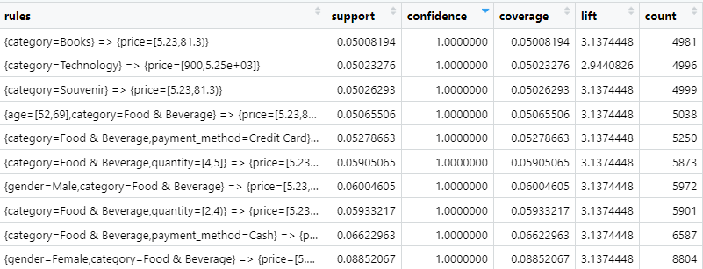
ASSOCIATION RULE
Top Association rules mined using Apriori Algorithm
Association between Product Categories and Price Ranges: Certain categories like Books, Technology, and Souvenir are associated with specific price ranges (e.g., Books tend to be within the price range of 5.23 to 81.3)
Shopping Mall Preferences and Gender : There are gender preferences observed in certain shopping malls. For instance, at Istinye Park, there's a higher tendency for female shoppers.
Association between Product Categories and Price Ranges with Gender: Shoes and Toys categories have associations with price ranges and gender. Females tend to purchase Shoes within the price range of 900 to 5250 and Toys within the price range of 81.3 to 900
Age Group Preferences and Shopping Patterns: Different age groups exhibit distinct shopping patterns. For instance, individuals aged 18 to 35 are inclined towards Clothing within the price range of 900 to 5250, while those aged 52 to 69 exhibit a similar preference but with a wider price range of 81.3 to 900. Moreover, certain age groups, like 35 to 52, exhibit preferences for Food & Beverage within a specific price range.

Slide 8
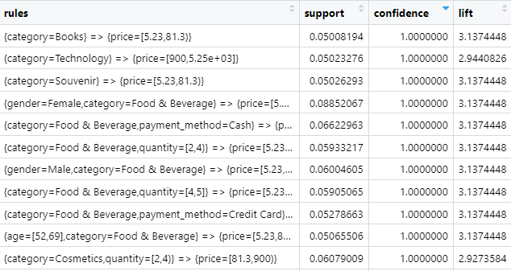
ASSOCIATION RULE
Top association rules mined using Eclat Algorithm
Category-Price Range Associations: Books, Technology, Souvenir, and Food & Beverage categories exhibit associations with specific price ranges. For instance, Books are typically priced between 5.23 to 81.3 units, while Technology items are commonly within the price range of 900 to 5250 units.
Gender-Category Associations: There are gender-specific preferences observed within certain product categories. For instance, there's a clear association between Female shoppers and categories like Food & Beverage, Clothing, Cosmetics, and Toys within various price ranges.
Age Group Preferences and Categories: Different age groups show distinct preferences for specific categories. For instance, individuals aged 52 to 69 tend to favor Clothing items priced between 900 to 5250 units, whereas those aged 18 to 35 exhibit preferences for Clothing within a wider price range of 81.3 to 900 units.
Payment Method and Gender Associations: There's a discernible relationship between payment methods and gender. Female shoppers tend to use specific payment methods, such as Cash or Credit Card, for certain categories like Clothing, Cosmetics, and Food & Beverage across varied price ranges.

Slide 9
CLASSIFICATION
Classification refers to the process of categorizing data into classes or groups based on certain features or attributes. It's a fundamental task in data analysis and machine learning where the goal is to predict the category or class of a given dataset based on its characteristics.
In this project, we set up and compare two different machine learning models for a classification task using customer shopping data: Random Forest model and Naive Bayes model.
RANDOM FOREST MODEL: Random Forest is an ensemble learning method that constructs multiple decision trees during training and outputs the mode of the classes (classification) of the individual trees.
NAIVE BAYES MODEL: Naive Bayes is a probabilistic classifier based on Bayes' theorem. It assumes independence among features given the class and calculates the probability of a class based on the feature values.

Slide 10
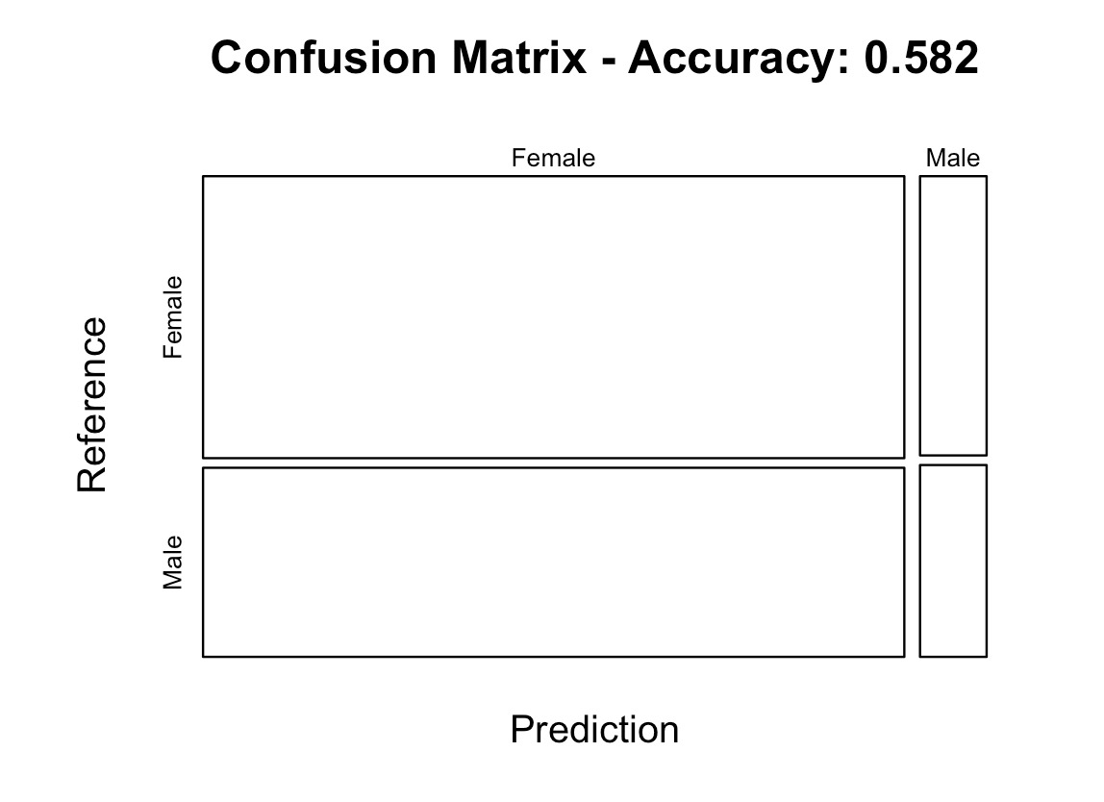
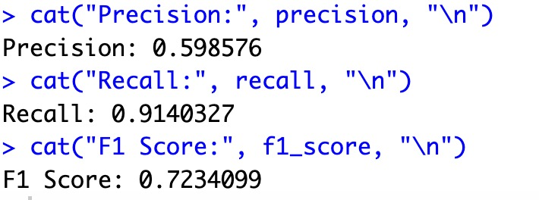
RANDOM FOREST MODEL EVALUATION

Slide 11
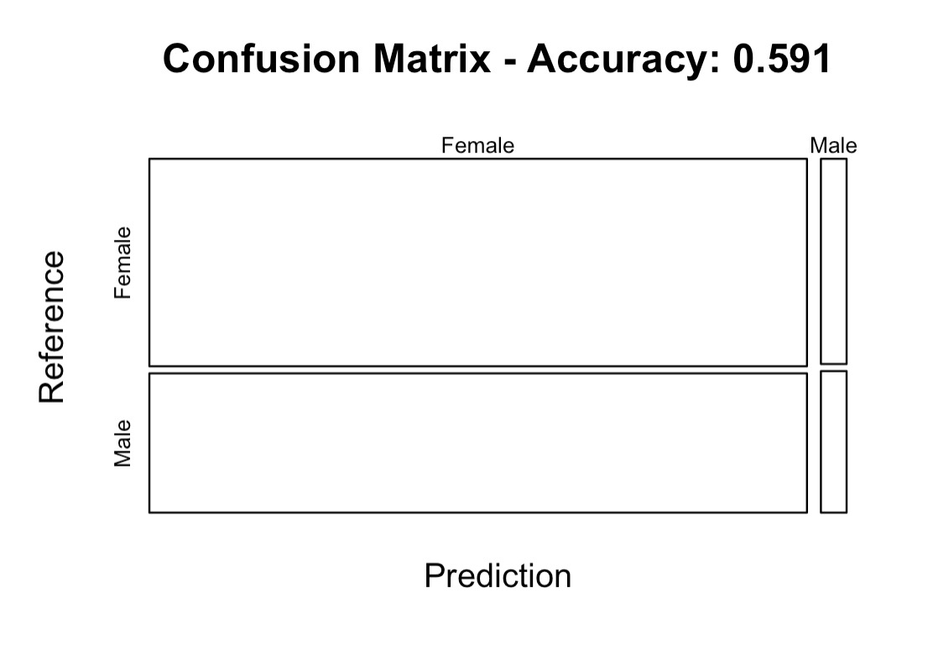
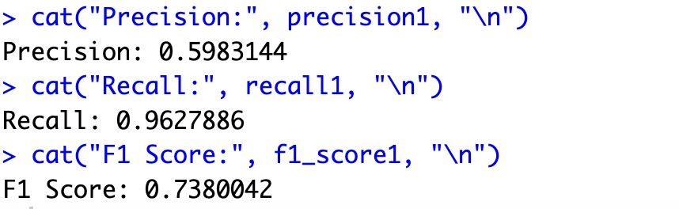
NAIVE BAYES MODEL EVALUATION

Slide 12
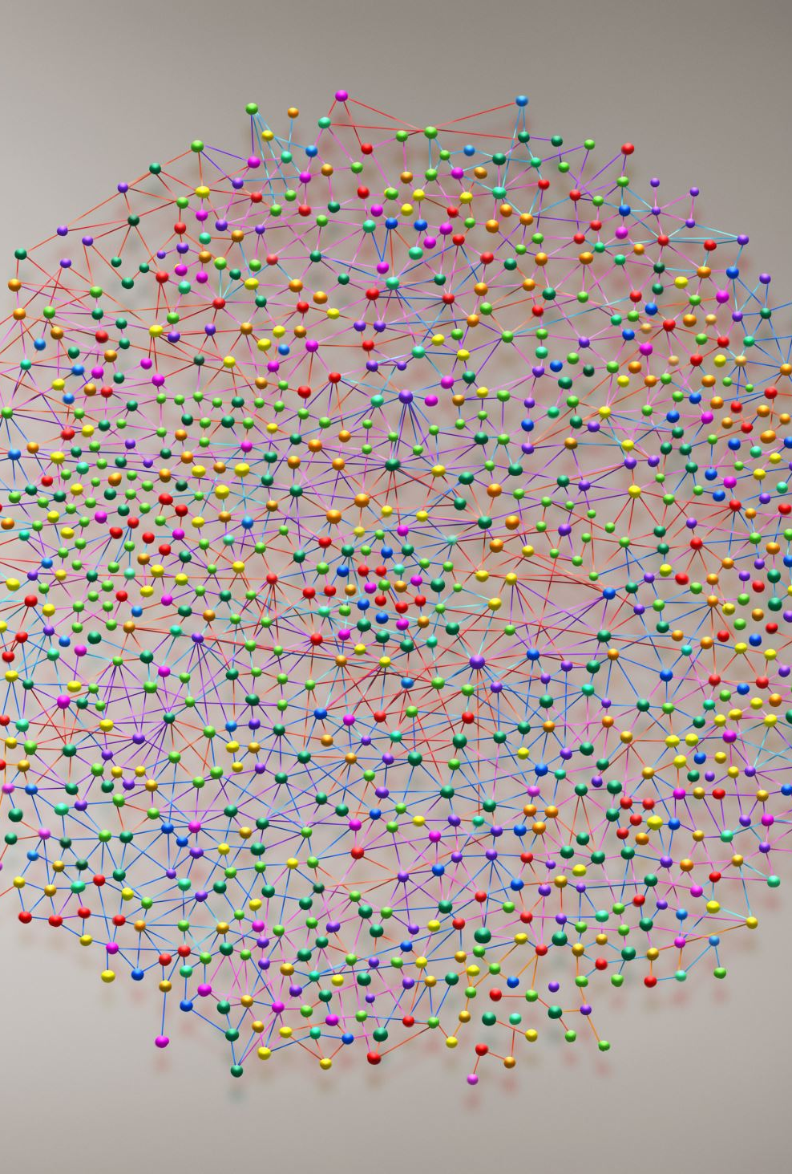
CLUSTERING
Clustering is the process of grouping similar data points together based on certain characteristics or features they share. It's an unsupervised learning technique used to find hidden patterns or structures within a dataset.
The clustering models that are involved in this are Density based spatial clustering of applications with Noise (DBSCAN) and k-Means.

Slide 13
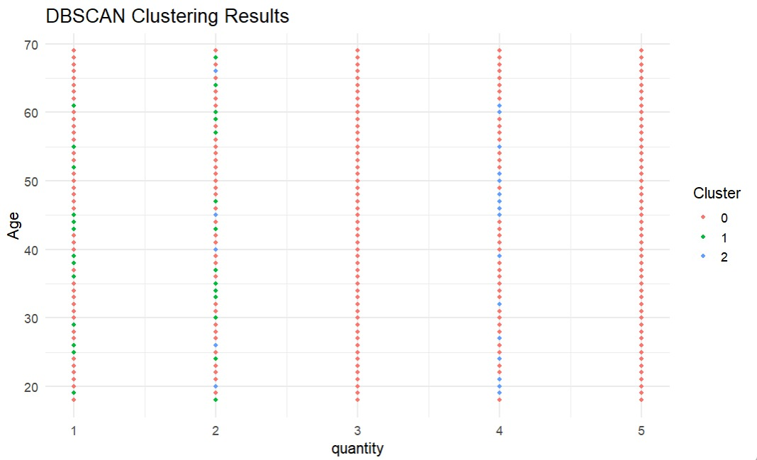
DBSCAN:
Density-Based Spatial Clustering of Applications with Noise is a density-based clustering algorithm used in machine learning for grouping points in a dataset based on their spatial density. It's particularly effective at identifying clusters of arbitrary shapes and handling noise within the data.

Slide 14
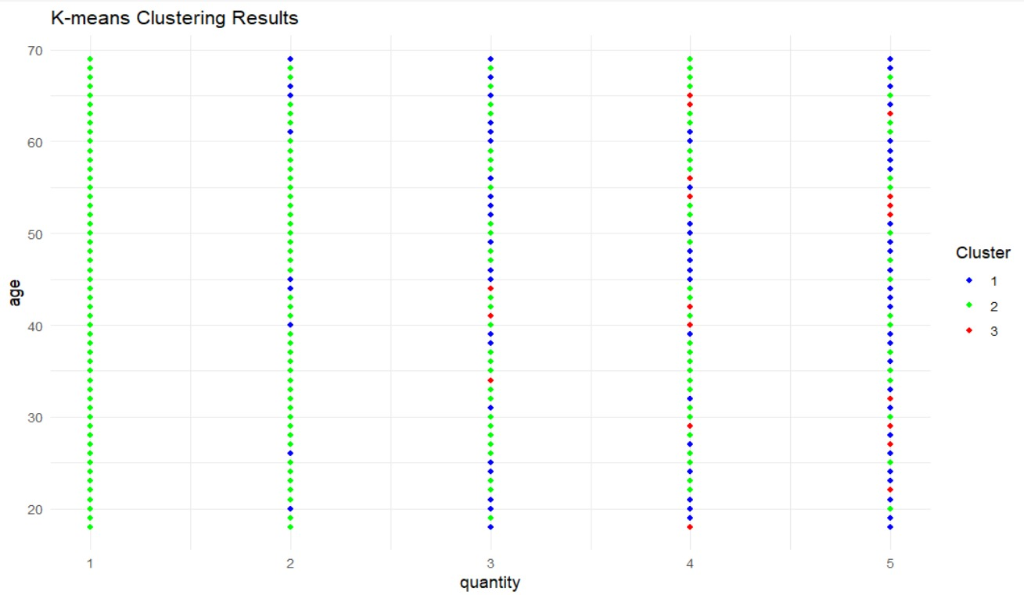
K-means:
k-means clustering aims to partition data into k clusters by iteratively updating centroids and assigning data points to the nearest centroid until convergence, providing insights into the inherent structure of the data.

Slide 15

Conclusion
In this data analysis and modeling process, we conducted a comprehensive exploration and manipulation of customer shopping data to derive valuable insights and build predictive models.
This analysis provides a foundational understanding of customer behavior and preferences, offering actionable insights for business strategies and future research directions.

Slide 16



