Slide 2
ABOUT DATA

Slide 3
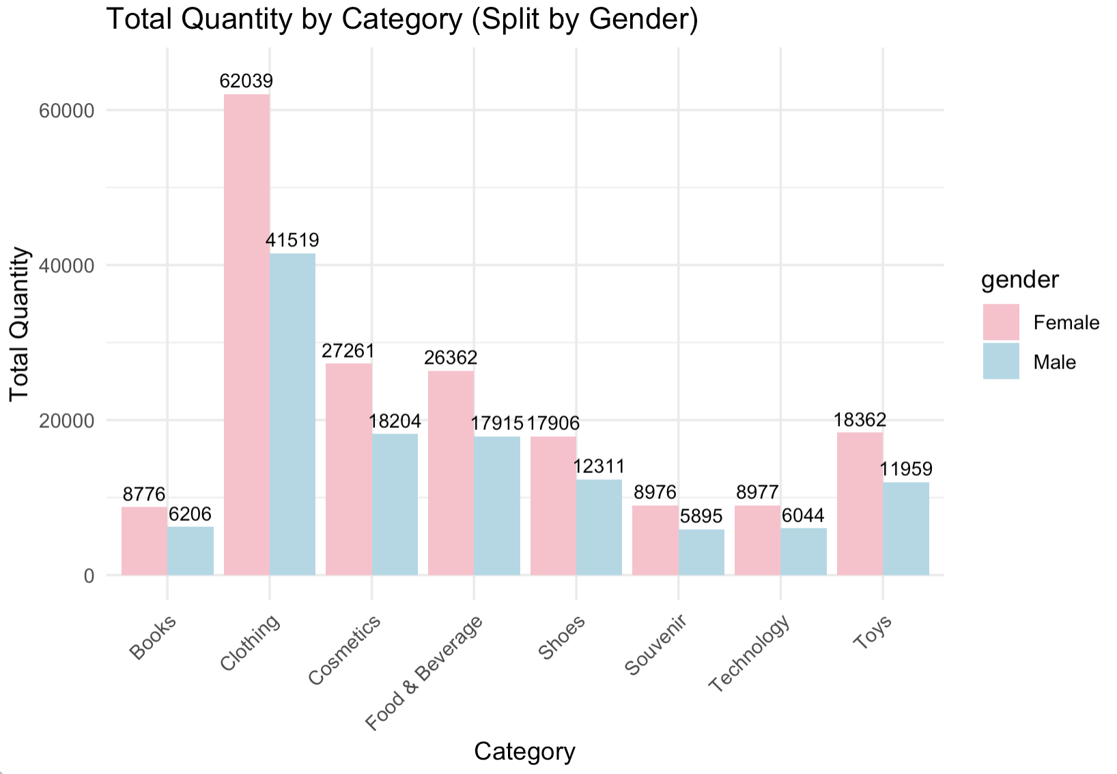
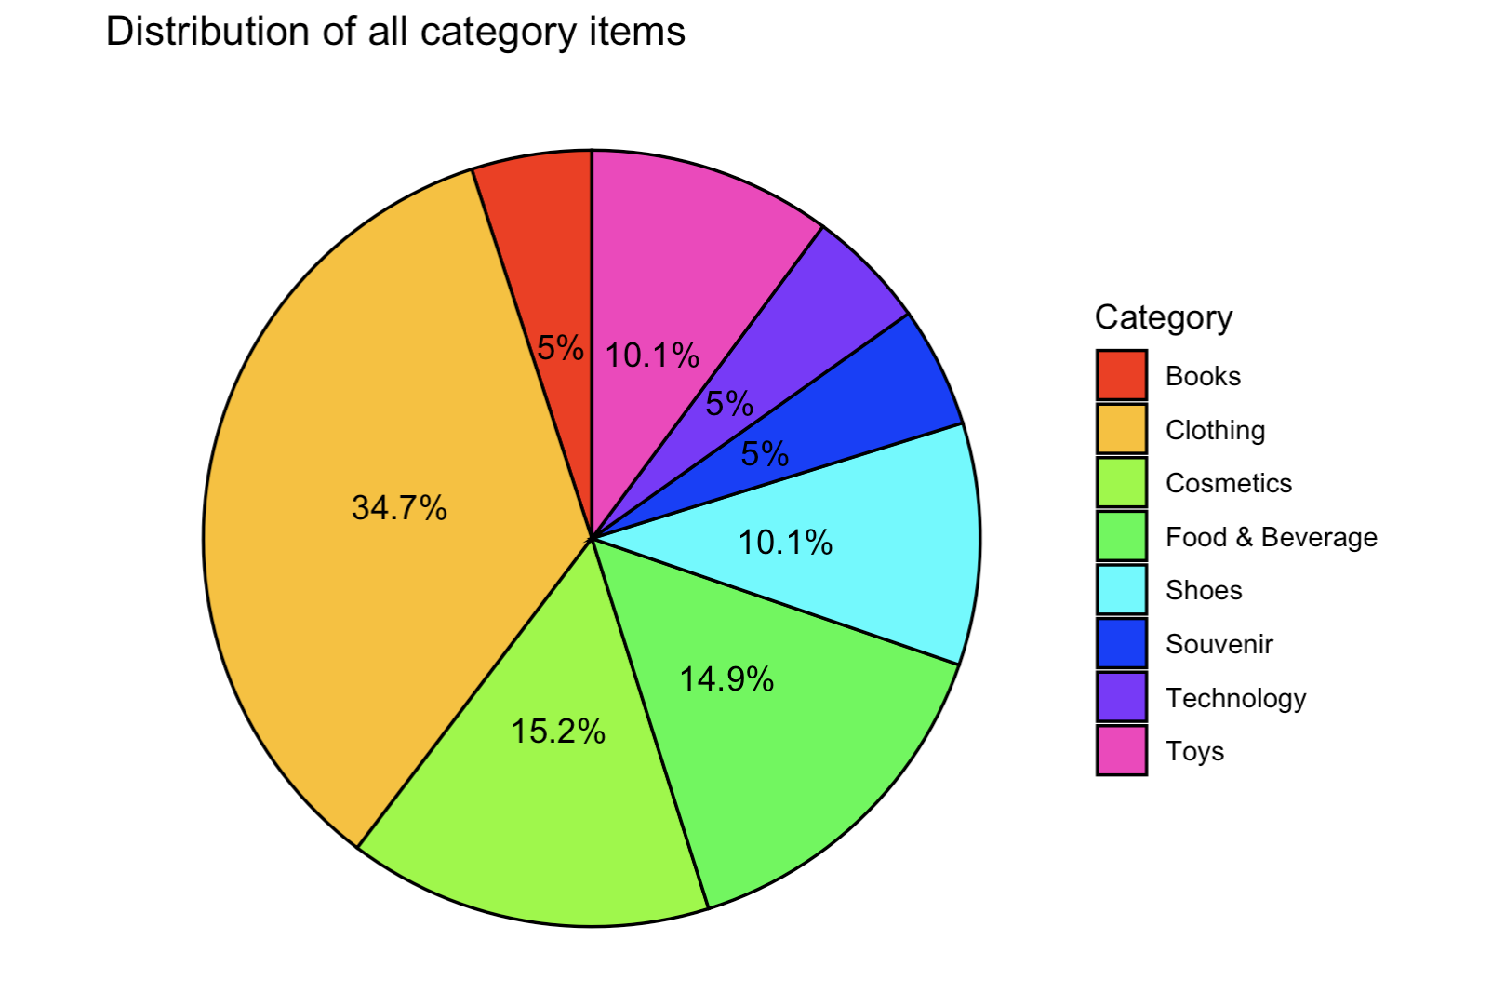
DATA EXPLORATION

Slide 4
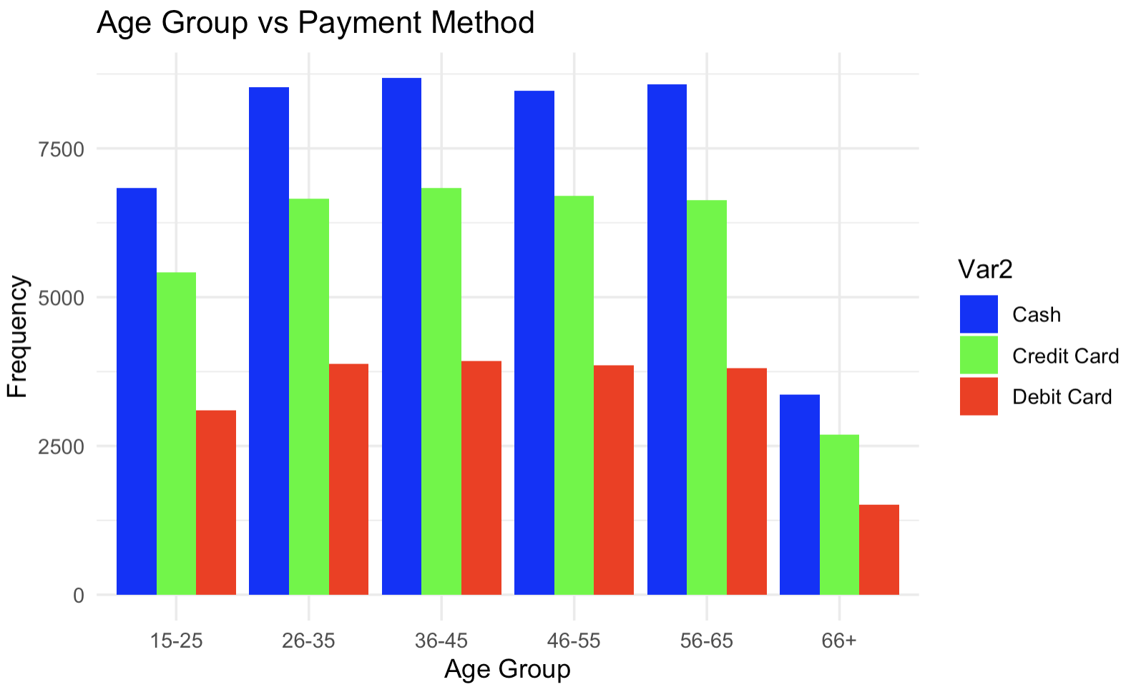
DATA EXPLORATION

Slide 5
ASSOCIATION RULE

Slide 10
CLASSIFICATION

