Slide 1

Decoding Diabetes: Analyzing Key Health Indicators
By Jothish Kumar Polaki
12/10/2024

Slide 2
Public Health Questions
Main Questions:
What is the relationship between socioeconomic factors like Income, Education and Healthcare access and the prevalence of prediabetes or diabetes?
How do Comorbid conditions like High Blood Pressure, High Cholesterol and Heart Diseases relate to the risk of prediabetes or diabetes?
Importance:
Diabetes has reached epidemic levels globally and is a major cause of mortality and morbidity.
Socioeconomic factors such as income, education and access to proper healthcare plays an important role in the risk of developing diabetes.
Scientific studies are being conducted to establish a connection between the prevalence of diabetes and associated comorbidities.

Slide 3
Literature Review:
According to studies from CDC (Centers for Disease Control and Prevention), individuals with low socioeconomic status are at high risk of developing diabetes due to limited access to healthy food, healthcare and physical activity.
In an article in National Library of Medicine, the relationship between comorbid conditions and diabetes risk is well documented.
As per a paper by CDC, it discusses on incidence of end stage disease attributed to diabetes among persons with diagnosed diabetes in USA and Puerto Rico.

Slide 4
Dataset Overview:
Dataset Source: BRFSS 2015 (Behavioral Risk Factor Surveillance System)
Downloaded from: Kaggle (link)
Data Description:
Key Variables:
Diabetes Status (binary: 0 = No, 1 = Yes)
Socioeconomic Variables (Income, Education)
Health-related factors (High BP, High Cholesterol, BMI)
Healthcare access variables (Any Health coverage, NoDocbccost).
Data Preprocessing:
Variables are transformed for clarity.
Converted binary values to “Yes” and “No” labels.
Updated Income and Education levels for better understanding.

Slide 5
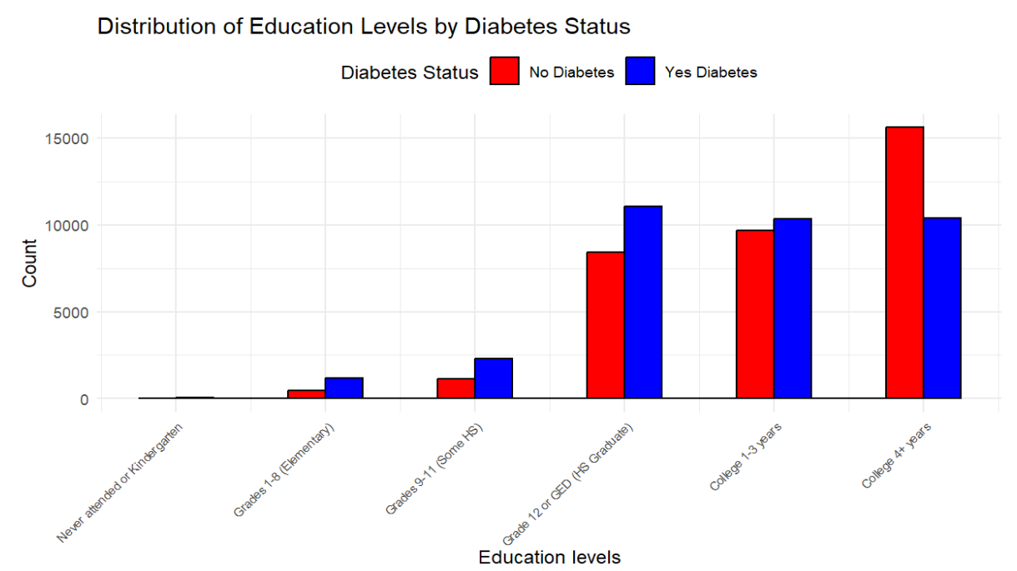
EDA – Socioeconomic factors:
Education and Diabetes:
Education levels were found to significantly correlate to diabetes risks.
Higher education levels are associated with lower likelihood of diabetes.

Slide 6
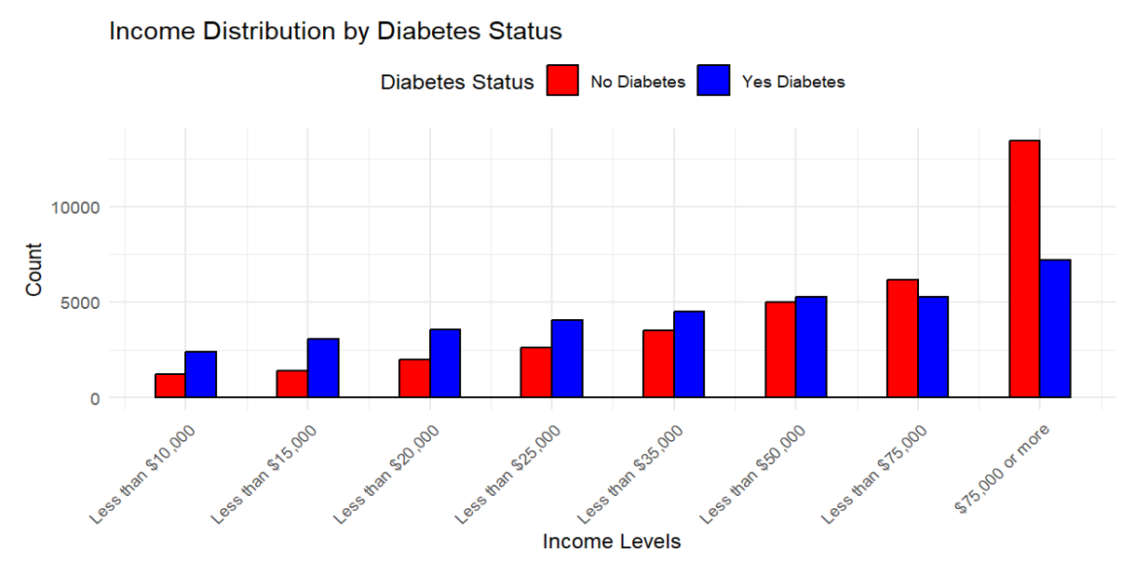
EDA – Socioeconomic factors:
Income and Diabetes status:
Lower Income levels were linked to higher diabetes prevalence.
People in lower-income brackets are more vulnerable to diabetes due to factors like limited healthcare access and unhealthy lifestyles.

Slide 7
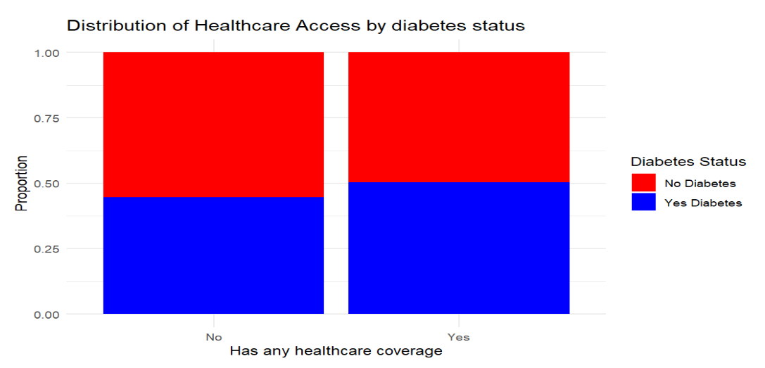
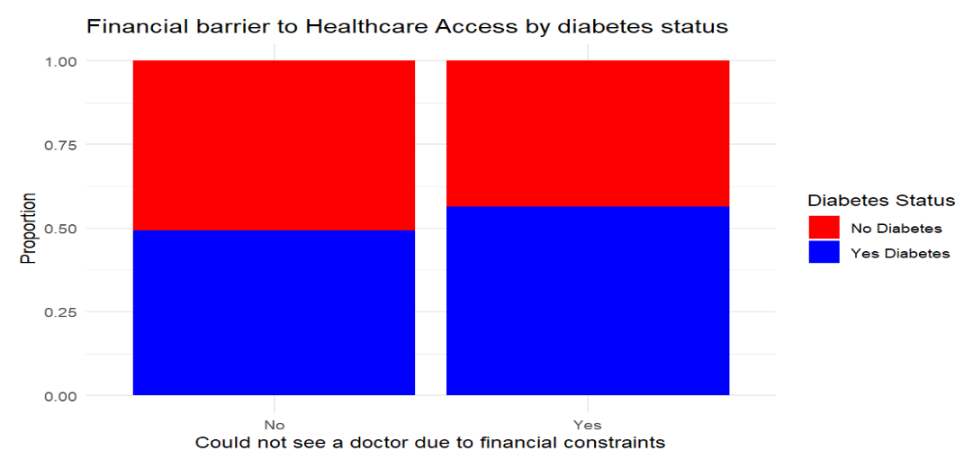
EDA – Socioeconomic factors:
Healthcare Access:
Those with health care coverage were less likely to have diabetes.
Financial barriers to seeing a doctor increase diabetes risk, which highlights the importance of healthcare access in preventing diabetes.

Slide 8
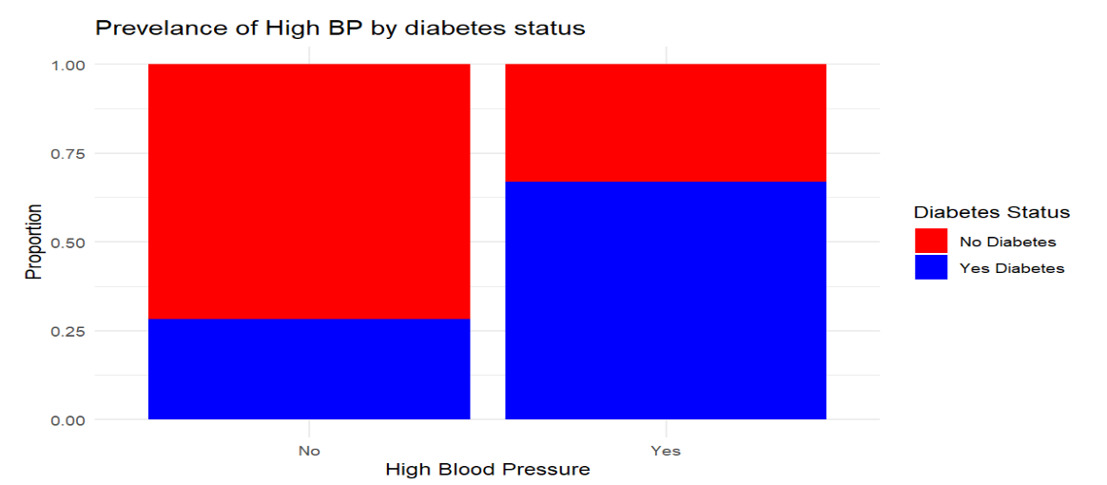
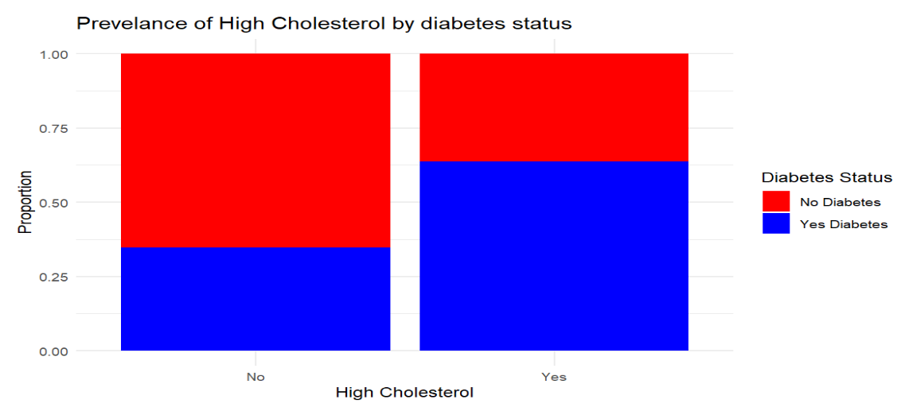
EDA – Comorbidities and Diabetes Risk
High Blood Pressure and High Cholesterol
The presence of high BP is strongly correlated with diabetes status with higher proportions of people with High blood pressure also having diabetes.
Similar trend is found with high cholesterol, as individuals with this condition have a higher prevalence of diabetes.

Slide 9
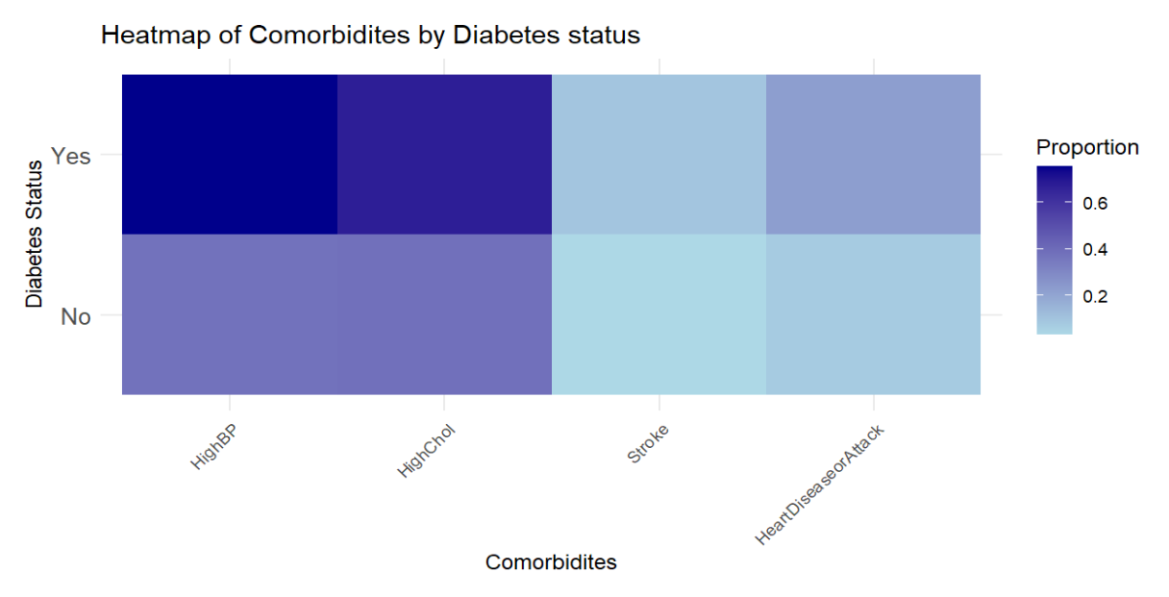
EDA – Comorbidities and Diabetes Risk
Heatmap of Comorbidities.
A heatmap is created to visualize the relationship between high blood pressure, high cholesterol, stroke and heart disease across different diabetes statuses. This highlights how comorbidities compound the risk of developing diabetes.
We can see higher proportions of prevalence of Diabetes with High BP and the lower is with stroke from the heatmap.

Slide 10
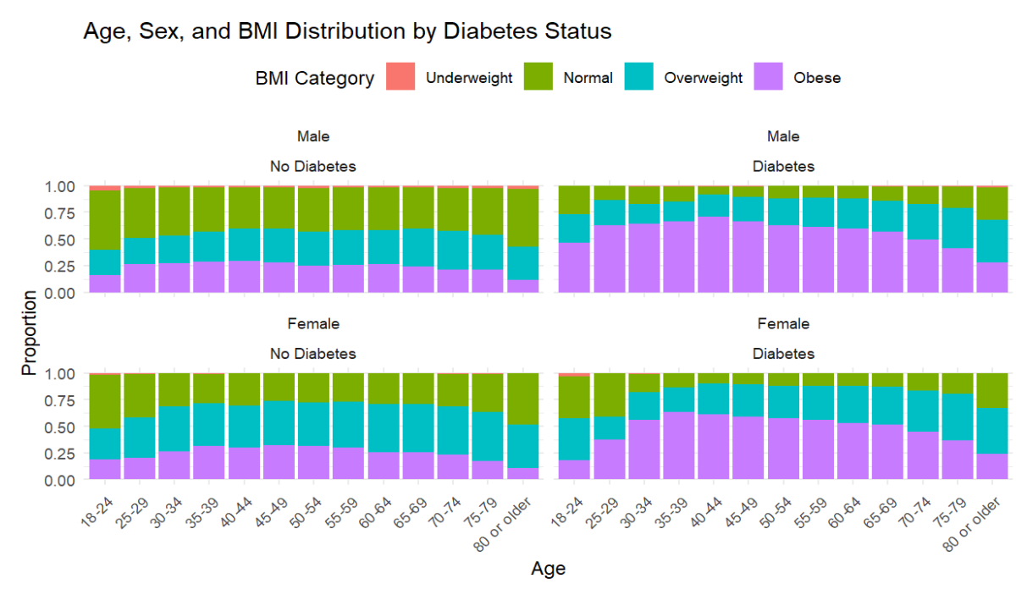
EDA – Confounding factors
Age, Sex and BMI
Factors like Age and BMI were found to be important confounders, with older age and higher BMI being key risk factors for diabetes.
Diabetes prevalence varies by sex, with gender specific patterns can be seen.

Slide 11
Predictive Modeling – Logistic Regression
Objective: Predict diabetes status based on demographic and health related predictors.
Predictors:
Demographic: Age, Sex, Income, Education.
Health-Related: BMI, HighBP, HighChol, AnyHealthcare, NoDocbcCost
Dataset split:
Training set: 56, 554 observations (80%)
Testing set: 14, 138 observation (20%)
Model Performance:
Confusion Matrix: TP – 5346, TN – 4966, FP – 2103, FN – 1723
Evaluation Metrics: Accuracy – 72.94%, Sensitivity – 75.63%, Specificity – 70.25%, Precision – 71.77%, Balanced Accuracy – 72.94%
ROC AUC – 0.803

Slide 12
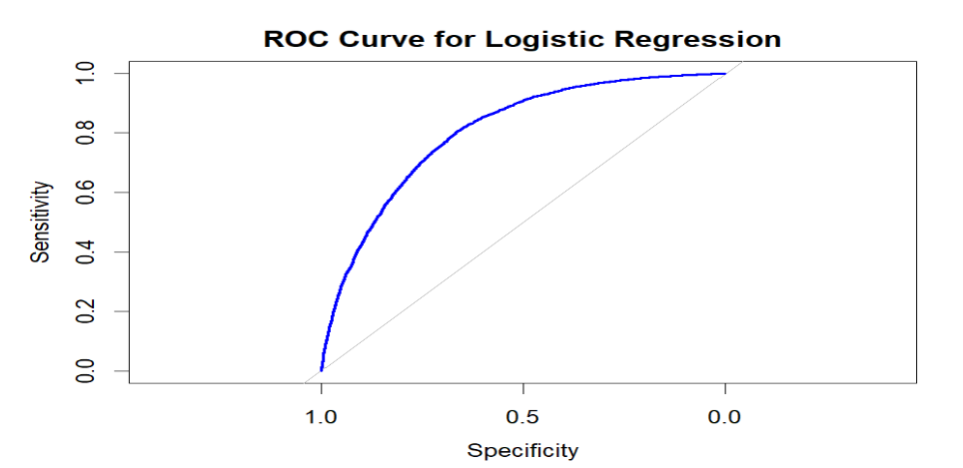
Predictive Modeling – Logistic Regression
The Model has achieved an accuracy of approximately 73%.
The Model successfully identifies individuals with diabetes 75.63%.
Model correctly classifies individuals without diabetes 70.25 % of time.
ROC-AUC of 0.803 suggests that the model performs well overall in distinguishing between diabetes and non-diabetes cases.
Improvements: Potential improvement can be by including additional features.

Slide 13
Predictive Modeling – Random Forest
Objective: Predict diabetes status using an ensemble based random forest classifier.
Model Configuration:
Number of trees: 500
Number of predictors at each split: 3
Model Performance:
Out-of-Bag (OOB) error rate: 27.76%
Confusion matrix: TP – 5400, TN – 4806, FP – 2263, FN – 1669
Evaluation Metrics: Accuracy – 72.19%, Sensitivity – 76.38%, Specificity: 67.99%, Precision – 70.47%, Balanced Accuracy – 72.19%
Feature Importance:
Top contributing feature: BMI, HighBP, Age, HighChol, Income.

Slide 14
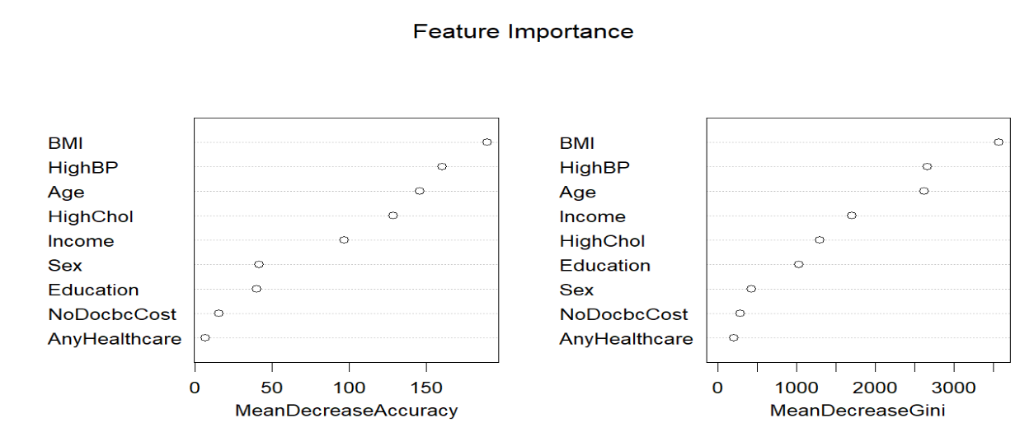
Predictive Modeling – Random Forest
Higher sensitivity indicated the model is great at identifying individuals with diabetes correctly.
Slightly lower specificity suggests room for improvement in correctly identifying non-diabetes cases.
The balanced accuracy is similar to logistic regression model, showing consistent model performance.
Below is a plot showing important features contributing to the model.

Slide 15
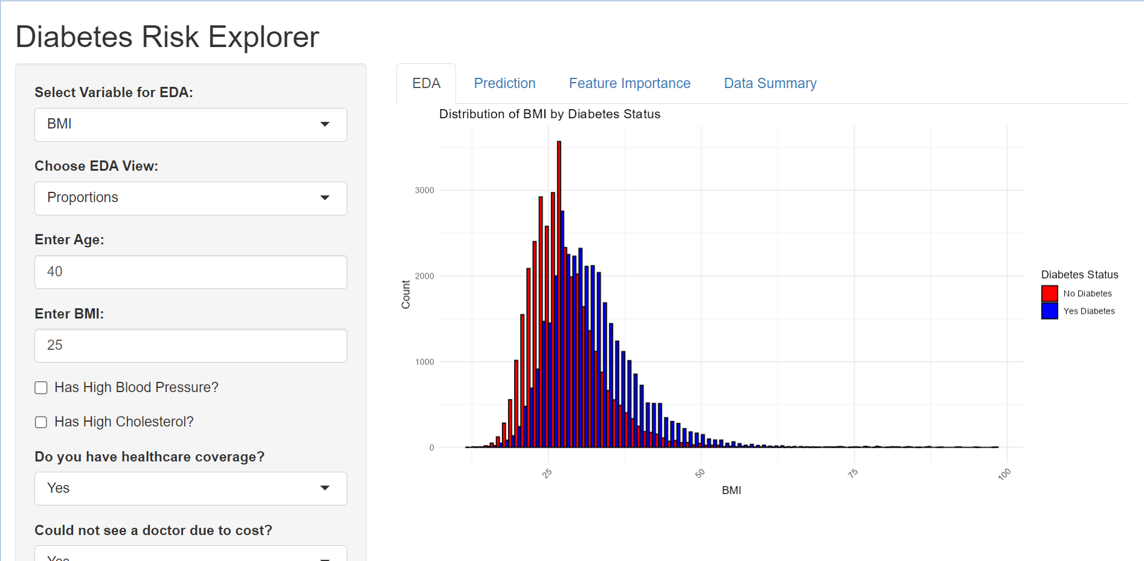
SHINY APP for Interactive Exploration
Purpose: Interactive tool for diabetes exploration and risk predition.
Features:
EDA: Visualize data distributions and proportions by diabetes status.
Prediction: Calculate diabetes risk from user inputs using logistic regression.
Feature importance: Identifying key predictors using Random Forest.
Data Summary: A view of dataset statistics.
A user- friendly app for data exploration and personalized diabetes risk assessment, integrating machine learning insights with interactivity.

Slide 16
Conclusion and Future Improvements
Key factors such as Age, BMI, Health care access and comorbid conditions play a major role in determining diabetes risk.
The logistic regression model and Random Forest model provided a reliable foundation for predicting diabetes risk, with Random Forest highlighting the most impactful features.
The Shiny App offers an interactive platform for users to explore their diabetes risk based on personal health data.
Will incorporate additional features such as genetic predispositions, lifestyle factors, etc. to improve model accuracy.
Will use more advanced algorithms like XGBoost, Neural Networks to further refine risk predictions.
Will improve the usability of Shiny App with advanced visualizations and user-friendly design.

Slide 17
Reference:
Dataset Download link: Link
Dataset Source: Link
UCI archive: Link
CDC Official website: https://www.cdc.gov/

Slide 18

Thank you

