Slide 1
DB_Final_Project
Food Delivery Platform

Slide 2
Scenario
George wants to built up a food delivery platform. The order establishment process of this delivery platform is as follows:
After the member logs in to the system and confirm the location of the member, the system will display restaurants within a radius of 20 distances.
The member starts to select the desired meals, input the coupon code selectively and sends out the order
(note that we only provide cash payment)
The establishment of an order requires confirmation of two things:
a. Confirm that the store accepts the order
b. Confirm the deliveryman of the order
Members may leave reviews on the order (comment on the restaurant and the deliveryman),
The scoring range is 1-5 points

Slide 3
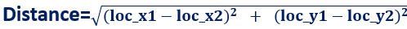
Scenario
Delivery fee : The delivery fee is calculated based on the location of the member's location and the location of the store. Different distances will have different delivery fee.The formula is as follow:
(the value of x and y is between 1 and 100)
distance < =5 : 15 NTD
5 < distance < =10 : 20 NTD
10 < distance <= 20 : 30 NTD
System must check whether the store is open before ordering and before sending the order
the order has four status: order established, meals preparing, delivering, meal served
The coupons provided by our platform are limited for a period of time. Members only need to enter the promotion code to use, note that each member can only use one kind of coupons once. The content of the coupons are 30 NTD off.
This delivery platform does not provide customer service

Slide 4
Entities
User
User_credential
Restaurant
Meals
Deliveryman
Ordered-details
Order
Coupon

Slide 5
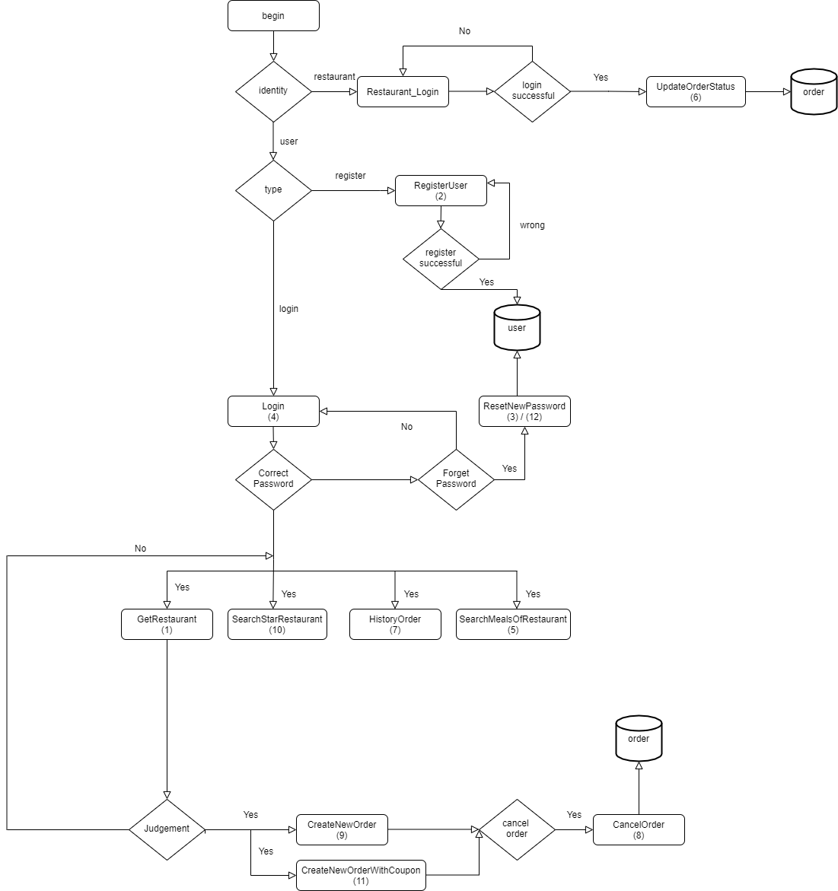
Flow Chart

Slide 6
Business logics
A user is associateted with one user account
Users must login to create orders
The delivery range is within 20 distances from the user
Orders can only be created when the restaurant’s business shows the open status
An order can only order meals from the same restaurant
A user can place many orders
An order can include many meals
An order can have only one order id
Different restaurants can sell the same meal
A meal is associated with one price at any given time (The price of the meal will not change)
A meal in an order can be ordered in multiple quantities

Slide 7
Business logics
Update order status can only be updated forward instead of backward
ex. update status 1 to 2 but cannot update status 2 to 1
The order can only be deleted when the order status is 1.
A kind of coupons can only be used once by each member
Coupon can only be used within the time specified by the coupon
An order can only use one coupon
The coupon can only be used if the order+shipping fee amount is more than (>=) the coupon amount
Each user can comment its completed orders
There are two types of comment: the comment on the restaurant and the comment on the deliveryman
Notes:
餐點加外送費
還是餐點

