Slide 1
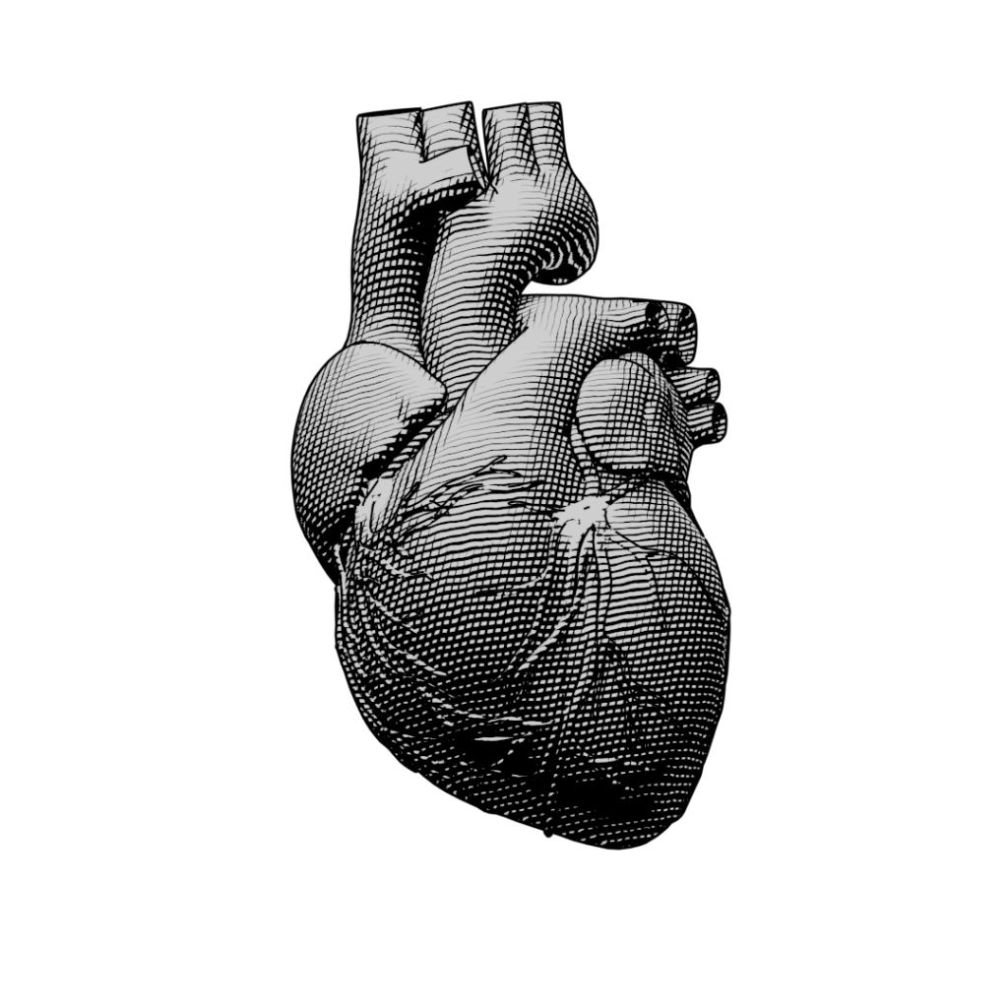
Predicting Heart Attack Disease
AML Final Project

Slide 2
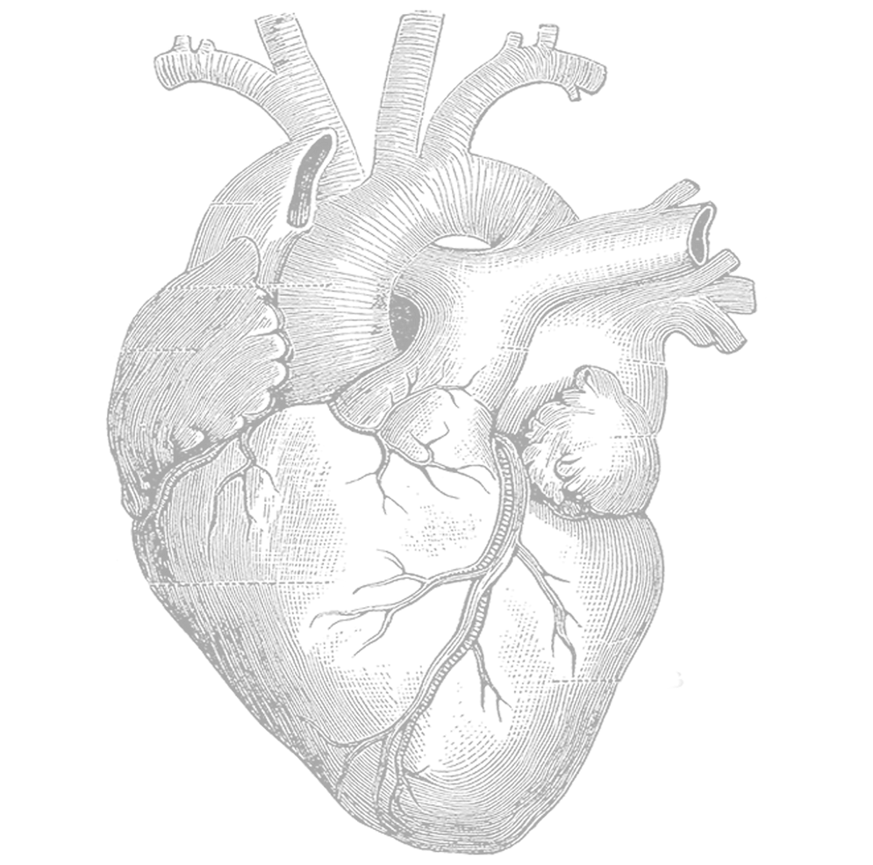
Prepared BY : Mashael Alshehri: 2006205 Joud Alahmari: 2008071 Afraa Farhan: 1808552 Manar Bagabas: 2005686
Prepared For :
Dr. Lobna Alhassairi

Slide 3
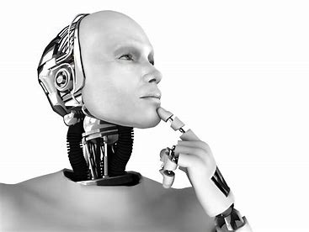
Introduction:
Heart disease is a major health issue that affects millions of people worldwide. Early diagnosis of heart disease is crucial for effective treatment and management. In this project, we use a publicly available dataset called heart.csv to analyze and predict the presence of heart disease in patients.
Objectives:
The main objectives of this project are to:
Understand the data and its features
Perform data analysis to identify patterns and relationships between features
Train and evaluate a machine learning model (SVM) to predict the presence of heart disease in patients
Visualize the results and interpret the findings

Slide 4
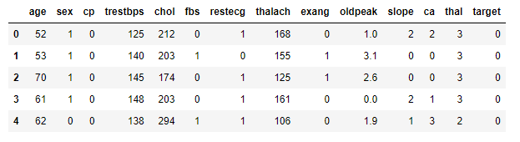
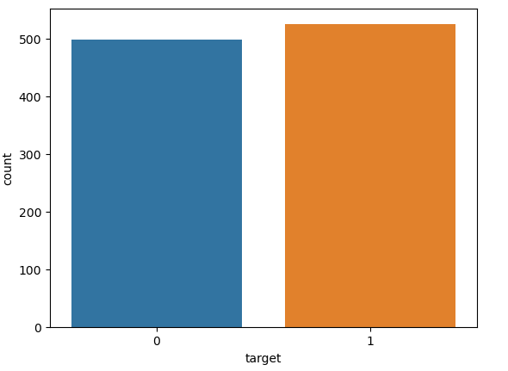
About the Dataset
Dataset:
The heart.csv dataset consists of 14 features that describe various aspects of the health of patients such as age, sex, blood pressure, cholesterol levels, exercise induced angina, and more. The dataset includes 303 observations of patients, where each observation represents a patient and their associated features. The goal is to use this data to predict whether a patient has heart disease or not.
Why heart.csv dataset:
Heart disease is a critical issue and requires accurate and reliable predictions to support early diagnosis and treatment. The heart.csv dataset provides comprehensive and well-structured information about patients and their health, making it a suitable dataset for this project. Additionally, the availability of the dataset and its popularity in the machine learning community make it a suitable choice for this project.

Slide 5
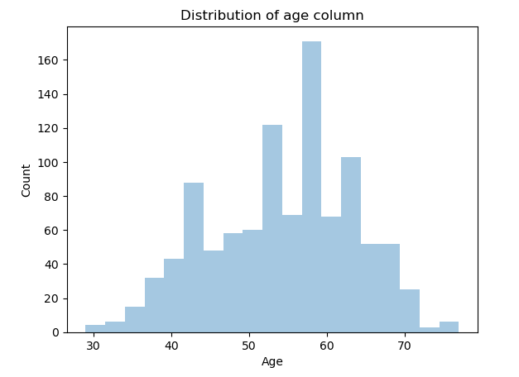
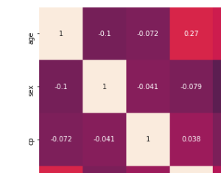
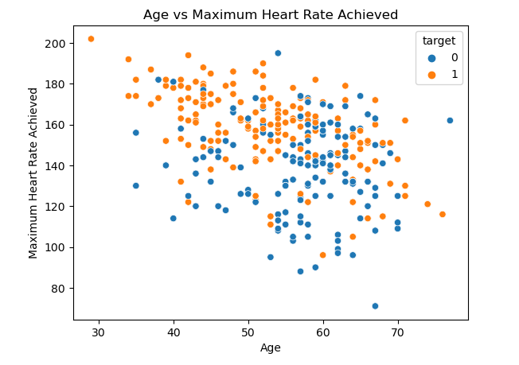
Data Analysis
Data Analysis is a process of cleaning, transforming, and modeling data with the goal of discovering useful information, informing conclusions, and supporting decision-making. In this project, data analysis was performed on the heart.csv dataset to gain insights into the various features and their relationships. The following steps were performed:
Data Cleaning: Missing values were checked and handled if necessary. Duplicates were removed if any.
Exploratory Data Analysis (EDA): Distribution of each feature was visualized using histograms, box plots, and scatter plots. Correlations between features were identified using a correlation matrix. Descriptive statistics were also obtained to summarize the central tendency, dispersion, and shape of each feature.
Feature Engineering: The data was transformed as needed to make it suitable for modeling. This involved scaling or normalizing the data, transforming categorical variables into numerical variables, and creating new features if necessary.
By performing these steps, a better understanding of the data was obtained, which will inform the development of the machine learning model.

Slide 6
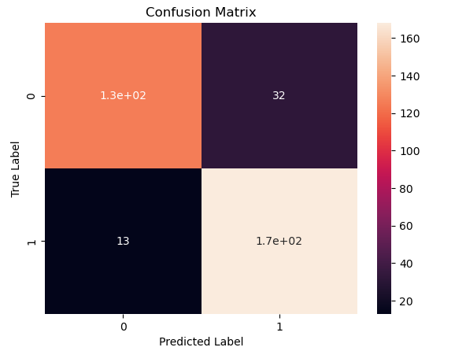
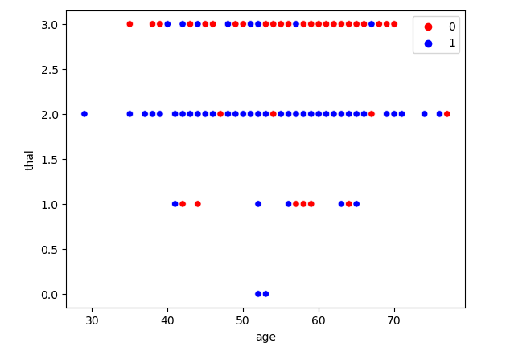
Machine Learning Model
In this slide, we discussed the machine learning model that was selected for this project, which was Support Vector Machine (SVM). SVM is a popular supervised learning algorithm that is used for classification and regression tasks.
The reason for choosing SVM for this project is that it is a powerful and effective method for solving binary classification problems, which is exactly what we have in our heart.csv dataset. SVM works by finding the optimal hyperplane that separates the data points into two classes. This hyperplane is chosen in such a way that it maximizes the margin between the two classes, providing us with the most robust and accurate predictions.
SVM is also effective in handling non-linearly separable data, which is a common issue in many real-world datasets. The algorithm uses kernel functions to transform the data into a higher dimensional space, making it possible to find a linear separator in this space. This capability makes SVM a versatile and flexible model that can handle a wide range of problems.

Slide 7

Ethical and Professional Responsibilities
When developing machine learning models, it is important to consider the ethical and professional responsibilities associated with the use of such models.
Explainability: The predictions made by machine learning models should be understandable and transparent to those who use them.
Bias and Fairness: It is important to ensure that the training data used to build the models is representative of the population and free from any biases that could lead to unfair or discriminatory predictions.
Privacy and Security: Sensitive personal information used to train the models must be protected and kept confidential.
Responsibility: The developers of machine learning models have a responsibility to ensure that their models are used for ethical and legal purposes.
By following these ethical and professional responsibilities, machine learning developers can help ensure that their models are used to improve the lives of individuals and communities, rather than causing harm.

Slide 8
Thank you
Any question?

