Slide 1

The Effect of Natural Language Morphology on The Structure of NLP Systems
Jouman Hmeid
211410033

Slide 2

Research Question Overview: With different transformer models designed and and specialised to complete tasks (morphological analysis, semantic analysis, machine translation etc.) for different languages, by exploring the linguistic features and more specifically differences between languages of 3 widely different language families, what can we learn about its impact on the tuning and specialization of NLP models?

Slide 3
Methodology:1 POS Tagging (with SPACY) -Turkish not available
我 PRON PN
喜欢 VERB VV
学习 VERB VV
自然 NOUN NN
语言 NOUN NN
处理 VERB VV
I PRON
love VERB
natural ADJ
language NOUN
processing NOUN

Slide 4
METHOD 2: Dependency trees with udpipe (r)
Sentences of different structure types, all conveying the same meaning in each of the chosen languages, were used for generating dependency trees and the resulting dependency trees were compared

Slide 5
我在吃

Slide 6
如果你有时间，我们可以一起吃饭

Slide 7
一道美味的菜被廚師煮了

Slide 8
現在是幾點

Slide 9
Stanza syntactic trees were also generated on some sample sentences for an alternative analysis of the linguistic structural differences in the languages

Slide 10
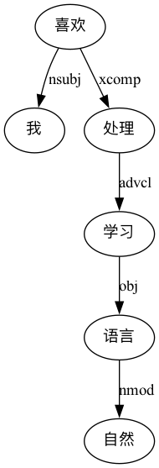
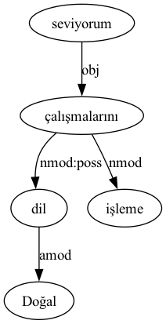
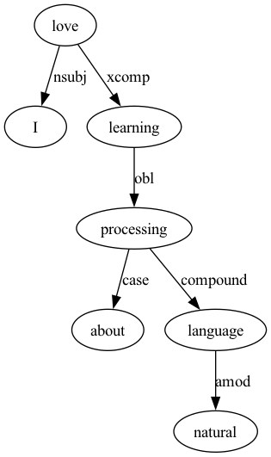

Slide 11
Methodology 3: BERT ATTENTION HEADS THE 3rd layer is used for demonstration, and the selected token is the verb for each of the following examples

Slide 12
