Slide 1
DEVOIR DE PROGRAMMATION
UE - OUV
M1 - STL
Joumana ELDAKAR

Slide 2
Polynomes
Structure du Polynome : liste des monomes
Le monôme c . xd est un couple (c, d) ∈ Z x N.
(** Strucutre de données pour manipuler des polynomes (coef, puissance de x) *)
type monome = int * int;;
type polynome = monome list;;
# type monome = int * int
# type polynome = monome list

Slide 3
La Forme Canonique
(** tri par insertion O(N2) complexité *)
let rec insere (elem : monome) (liste : polynome) : polynome =
match liste with
| [] -> elem::[]
| tete::queue ->
if snd elem > snd tete then elem :: liste
else if snd elem = snd tete then (fst tete + fst elem, snd elem):: queue
else tete :: insere elem queue
;;
let rec canonique (l : polynome) : polynome =
match l with
| [] -> []
| h::t -> if (fst h == 0) then canonique t else
insere h (canonique t)
;;
# val insere : monome -> polynome -> polynome = <fun>
# val canonique : polynome -> polynome = <fun>

Slide 4
Test de la fonction canonique
let listetest : polynome = [(120,3); (-2,2); (10,14); (-5,2); (0,2)];;
let l : polynome = [];;
let l2 : polynome = [(10,14)];;
canonique(listetest);;
canonique(l);;
canonique(l2);;
# - : polynome = [(10, 14); (120, 3); (-7, 2)]
# - : polynome = []
# - : polynome = [(10, 14)]

Slide 5
Test
(** val poly_add : polynome -> polynome -> polynome *)
let rec poly_add (l1 : polynome) (l2 : polynome) : polynome =
match l1, l2 with
| [], _ -> l2
| _,[] -> l1
| h1::q1, h2::q2 ->
if snd h1 > snd h2 then (h1 :: poly_add q1 l2) else
if snd h1 = snd h2 then (fst h1 + fst h2, snd h1):: poly_add q1 q2
else (h2 :: poly_add l1 q2)
;;
val poly_add : polynome -> polynome -> polynome = <fun>

Slide 6
La fonction poly_add
(** des tests pour tester la fonction poly_add *)
let ltest1 : polynome = [(3,3); (5,2); (3,1)];;
let ltest2 : polynome = [(10,4); (2,3); (2,2); (1,1)];;
(** polynome = [(10, 4); (5, 3); (7, 2); (4, 1)] *)
poly_add ltest1 ltest2;;
poly_add [] ltest2;;
poly_add ltest1 [];;
# - : polynome = [(10, 4); (5, 3); (7, 2); (4, 1)]
# - : polynome = [(10, 4); (2, 3); (2, 2); (1, 1)]
# - : polynome = [(3, 3); (5, 2); (3, 1)]

Slide 7
La fonction poly_prod
(** val poly_prod : polynome -> polynome -> polynome *)
let rec poly_prod (l1 : polynome) (l2 : polynome) : polynome =
let rec produit (e : monome) (lp : polynome) : polynome =
match lp with
| [] -> []
| h1::q1 -> (fst h1 * fst e, snd h1 + snd e)::produit e q1
in match l1, l2 with
| l1, [] -> l1
| h1::[], l2 -> produit h1 l2
| [], l2 -> l2
| h1::q1, h2::q2 -> poly_add (produit h1 l2) (poly_prod q1 l2)
;;
# val poly_prod : polynome -> polynome -> polynome = <fun>

Slide 8
Test
let ltest3 : polynome = [(1,1); (2,2)];;
let ltest4 : polynome = [(5,0);(3,1); (-4,2)];;
poly_prod ltest3 ltest4;;
poly_prod [(123,0)] [(1, 1)];;
poly_prod [] [(2, 10)];;
poly_prod ltest3 [];;
poly_prod [(1, 13)] [];;
poly_prod [] [];;
# - : polynome = [(10, 2); (6, 3); (-8, 4); (5, 1); (3, 2); (-4, 3)]
# - : polynome = [(123, 1)]
# - : polynome = [(2, 10)]
# - : polynome = [(1, 1); (2, 2)]
# - : polynome = [(1, 13)]

Slide 9
Expression Arborescent
type arbre =
| NodeInt of int
| NodePower of int
| NodePlus of arbreP list
| NodeMulti of arbreM list
and arbreP =
| NodeIntP of int (* int est positif ou negatif *)
| NodePowerP of int (**x^int+, int est positif *)
| NodeMultiP of arbreM list
and arbreM =
| NodeIntM of int (* int est positif ou negatif *)
| NodePowerM of int (**x^int+, int est positif *)
| NodePlusM of arbreP list
E = int | E∧ | E+ | E∗
E∧ = x ∧ int+
E+ = (E \ E+) + (E \ E+) + . . .
E∗ = (E \ E∗) ∗ (E \ E∗) ∗ . . .

Slide 10
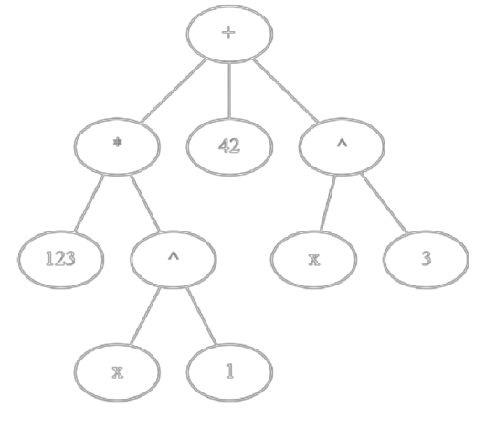
Construire un arbre
+
/ | \
* 42 ^
/ \ / \
123 ^ x 3
/ \
x 1
let contruireArbre = NodePlus([
NodeMultiP([ NodeIntM 123; NodePowerM 1 ]);
NodeIntP 42;
NodePowerP 3
])
;;

Slide 11
Arbre -> polynome
let rec arbM2poly (a: arbreM list) : polynome =
match a with
| [] -> []
| NodeIntM x :: t-> poly_prod [(x,0)] (arbM2poly t)
| NodePowerM x :: t-> poly_prod [(1, x)] (arbM2poly t)
| NodePlusM l :: t -> (arbP2poly l) @ (arbM2poly t)
and arbP2poly (a: arbreP list) : polynome =
match a with
| [] -> []
| NodeIntP x :: t -> poly_add [(x,0)] (arbP2poly t)
| NodePowerP x :: t -> poly_add [(1, x)] (arbP2poly t)
| NodeMultiP l :: t -> (arbM2poly l) @ (arbP2poly t)
;;
let arb2poly (a: arbre) : polynome =
match a with
| NodeInt x -> [(x,0)]
| NodePower x -> [(1, x)]
| NodeMulti [] -> []
| NodePlus [] -> []
| NodeMulti l -> canonique (arbM2poly l)
| NodePlus l -> canonique (arbP2poly l)
;;
TEST :
arb2poly contruireArbre ;;
# - : polynome = [(1, 3); (123, 1); (42, 0)]

Slide 12
Synthése
let rec remove (x: int) (i: int) (l: int list) : int list * int =
match l with
| [] -> failwith "liste vide"
| h :: t -> if x=i then (t,h) else h::(fst (remove x (i+1) t)), snd (remove x (i+1) t)
# val remove : int -> int -> int list -> int list * int = <fun>
let extraction_alea (m: int list) (p: int list) : int list * int list =
let l = List.length m in let _ = Random.self_init () and r = Random.int l in
match m with
| [] -> ([],p)
| h::t -> let c = (remove r 0 m) in
fst c, snd c :: p
;;
extraction_alea [0;1;2;3;4] [5;6;7;8;9]
([0; 1; 2; 3], [4; 5; 6; 7; 8; 9])
([0; 1; 3; 4], [2; 5; 6; 7; 8; 9])

Slide 13
La fonction gen_permutation
# val insere_liste : int -> int list -> int list = <fun>
# val create_liste : int -> int list = <fun>
let gen_permutation n =
let rec permutation (m: int list) (p: int list) : int list =
match m with
| [] -> p
| h::t -> let (a, b) = (extraction_alea m p) in permutation a b
in
permutation (create_liste n) [];;
gen_permutation 5;;
# val gen_permutation : int -> int list = <fun>
# - : int list = [3; 4; 2; 5; 1]

Slide 14
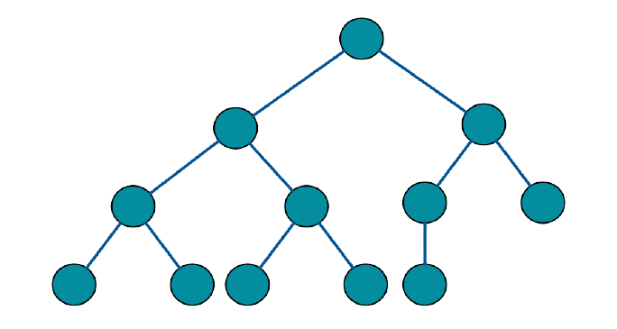
Arbre Binaire de Recherche
type abr =
| Feuille
| Noeud of int * abr * abr
;;
let rec insert l a =
match a with
| Feuille -> Noeud(l,Feuille,Feuille)
| Noeud(k, fg, fd) -> if l < k then
Noeud(k, (insert l fg), fd )
else Noeud(k,fg, (insert l fd))
;;
let rec construireARB l a =
match l with
| [] -> a
| h::t -> construireARB t (insert h a)
;;

Slide 15
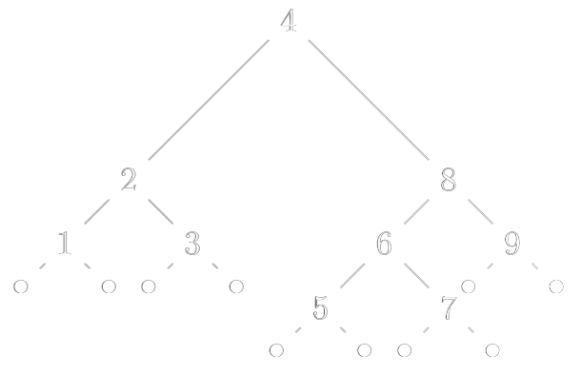
Construire ABR
construireARB [4;2;3;8;1;9;6;7;5] Feuille;;
# - : abr =
Noeud (4,
Noeud (2, Noeud (1, Feuille, Feuille), Noeud (3, Feuille, Feuille)),
Noeud (8,
Noeud (6, Noeud (5, Feuille, Feuille), Noeud (7, Feuille, Feuille)),
Noeud (9, Feuille, Feuille)))

Slide 16
Arbre Etiquetage
let rec etiquetage a =
match a with
| Feuille -> if Random.bool() then Noeud(int_of_char 'x', Feuille, Feuille) else Noeud(Random.int (201+201)-201, Feuille, Feuille)
| Noeud(l, fg, fd) ->
match fd, fg with
| Feuille, Feuille ->
if (l mod 2 == 1) then
let _ = Random.self_init () and r = Random.int (201+201)-201 in
Noeud(int_of_char '*', Noeud(r, Feuille, Feuille), Noeud(int_of_char 'x', Feuille, Feuille))
else let _ = Random.self_init () and r = Random.int 100 in
Noeud(int_of_char '^', Noeud(int_of_char 'x', Feuille, Feuille), Noeud(r, Feuille, Feuille))
| _, _ -> if (Random.bool() && Random.bool()) then
Noeud(int_of_char '*', etiquetage fg, etiquetage fd)
else Noeud(int_of_char '+', etiquetage fg, etiquetage fd)
;;

Slide 17
Construire arbre Etiquetage à partir de l’arbre précédent
etiquetage (construireARB [4;2;3;8;1;9;6;7;5] Feuille);;
Noeud (42,
Noeud (43,
Noeud (42, Noeud (15, Feuille, Feuille), Noeud (120, Feuille, Feuille)),
Noeud (42, Noeud (-177, Feuille, Feuille), Noeud (120, Feuille, Feuille))),
Noeud (42,
Noeud (43,
Noeud (42, Noeud (-59, Feuille, Feuille), Noeud (120, Feuille, Feuille)),
Noeud (42, Noeud (129, Feuille, Feuille), Noeud (120, Feuille, Feuille))),
Noeud (42, Noeud (176, Feuille, Feuille), Noeud (120, Feuille, Feuille))))

Slide 18
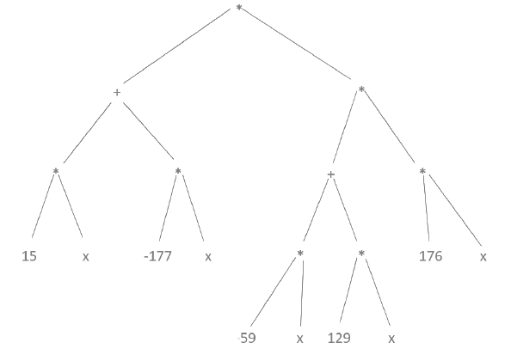
Noeud (42,
Noeud (43,
Noeud (42, Noeud (15, Feuille, Feuille), Noeud (120, Feuille, Feuille)),
Noeud (42, Noeud (-177, Feuille, Feuille), Noeud (120, Feuille, Feuille))),
Noeud (42,
Noeud (43,
Noeud (42, Noeud (-59, Feuille, Feuille), Noeud (120, Feuille, Feuille)),
Noeud (42, Noeud (129, Feuille, Feuille), Noeud (120, Feuille, Feuille))),
Noeud (42, Noeud (176, Feuille, Feuille), Noeud (120, Feuille, Feuille))))

Slide 19
MERCI

