Slide 1
ankus Analyzer G Build Guide
version 1.0
2017.08
onycom

Slide 2
Table of Contents
01.
02.
Build in Command Line Interface
Build in Eclipse

Slide 3
01. Build in command Line Interface
Command Line 에서 Maven 빌드
Maven Clean
$ cd /home/ankus/ankus-g/ankus-web-service/
$ mvn clean
…
[INFO] ------------------------------------------------------------------------
[INFO] Building Ankus Web Services 0.4.0
[INFO] ------------------------------------------------------------------------
[INFO]
[INFO] --- maven-clean-plugin:2.5:clean (default-clean) @ ankus-web-services ---
[INFO] Deleting \home\ankus\ankus-g\ankus-web-services\target
[INFO] ------------------------------------------------------------------------
[INFO] BUILD SUCCESS
[INFO] ------------------------------------------------------------------------
[INFO] Total time: 3.482 s
[INFO] Finished at: 2017-08-07T09:35:27+09:00
[INFO] Final Memory: 7M/121M
[INFO] ------------------------------------------------------------------------

Slide 4
01. Build in command Line Interface
Command Line 에서 Maven 빌드
Maven Build
$ mvn install –Dmaven.test.skip=true
…
[INFO] Packaging webapp
[INFO] Assembling webapp [ankus-web-services] in [\home\ankus\ankus-g\ankus-web-services\target\ankus-web-services-0.4.0]
[INFO] Processing war project
[INFO] Copying webapp webResources [\home\ankus\ankus-g\ankus-web-services\target/min] to [C:\web\ankus-g\ankus-web-services\target\ankus-web-services-0.4.0]
[INFO] Copying webapp webResources [\home\ankus\ankus-g\ankus-web-services/src/main/webapp/WEB-INF] to [\home\ankus\ankus-g\ankus-web-services\target\ankus-web-services-0.4.0]
[INFO] Copying webapp resources [\home\ankus\ankus-g\ankus-web-services\src\main\webapp]
[INFO] Webapp assembled in [16083 msecs]
[INFO] Building war: \home\ankus\ankus-g\ankus-web-services\target\ankus-web-services-0.4.0.war
…
[INFO] ------------------------------------------------------------------------
[INFO] BUILD SUCCESS
[INFO] ------------------------------------------------------------------------
[INFO] Total time: 49.317 s
[INFO] Finished at: 2017-08-07T09:41:34+09:00
[INFO] Final Memory: 52M/319M
[INFO] ------------------------------------------------------------------------

Slide 5
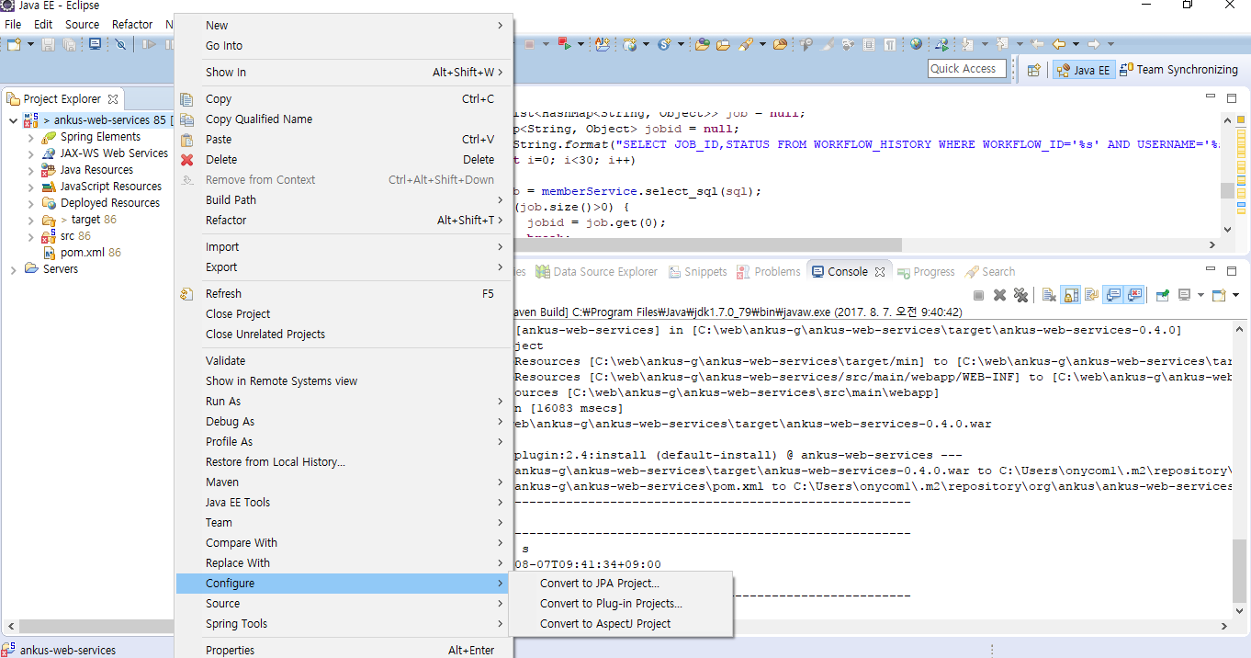

02. Build in Eclipse
Eclipse 에서 Maven 빌드
Check Out 받은 프로젝트를 Maven 프로젝트로 변환함

Slide 6
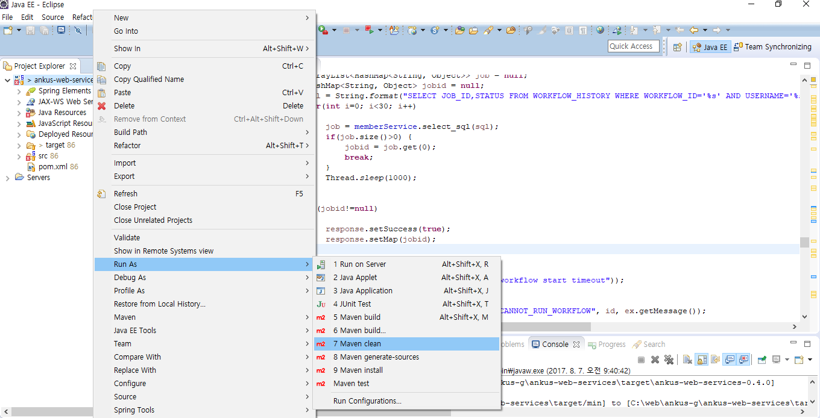
02. Build in Eclipse
Eclipse 에서 Maven 빌드
프로젝트에서 마우스 오른쪽 클릭 > Run As > Maven Clean 을 클릭하여 기본에 생성된 빌드를 삭제함

Slide 7
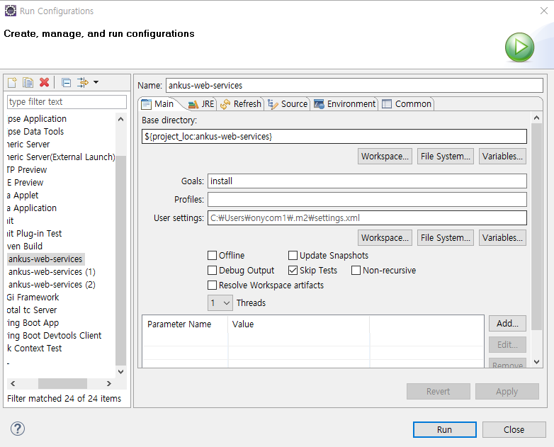
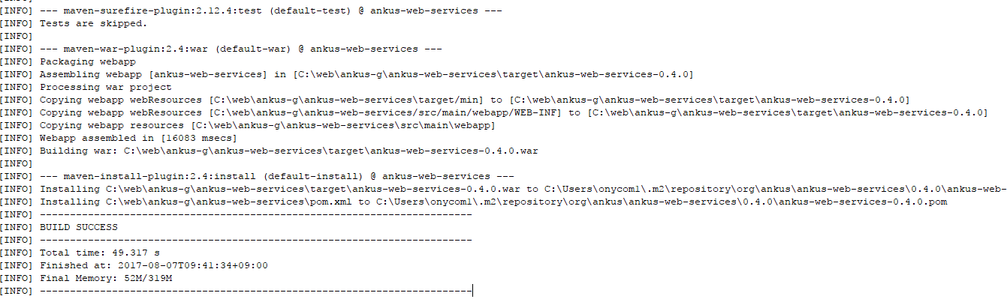
02. Build in Eclipse
Eclipse 에서 Maven 빌드
프로젝트에서 마우스 오른쪽 클릭 > Run As > Maven Build 을 클릭하여 Goals에 아래와 같이 install를 입력 후 Skip Tests 체크박스를 클릭 실행(성공 시 /target경로에 war파일이 생성)

Slide 8
감사합니다.
http://www.openankus.com
http://www.onycom.com
ankus@onycom.com

