Slide 1
Analog to Digital Conversion
오디오 데이터(연속)
오디오 데이터(불연속)
디지털 데이터(불연속)
진폭
6
4
표본화
양자화
2
시간
0
-2
-4
-6
0
2
4
6
4
2
0
-2
-4
-6
-4
-2
0
시간축

Slide 2
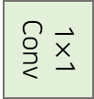
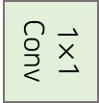

…
512
256
Residual Block
512
1$×$1 Conv
256
512
$$∑$$
Residual Block
512
1$×$1 Conv
256
256
1$×$1 Conv
256
1$×$1 Conv
256
ReLU
ReLU
Softmax
Output
512
512
1$×$1 Conv
256
Residual Block
512
256
Residual Block
512
1$×$1 Conv
512
…
Input
Skip Connection

Slide 3






Digital Wave Data
범위 : ($−2^{7} \sim 2^{7}+1)$
812
$μ$-law Reconstruction
Model Output 범위 : ($−122 \sim 123)$
12
Max Probability Value Selection
Model Output Category Distribution
0
1
2
3
…
255
0
1
2
3
…
255
t 시점
…
Residual Block
t 시점
WaveNet
$$∑$$
Residual Block
Residual Block
Model Input 범위 : ($−122 \sim 123)$
0
1
4
6
4
2
0
-2
-4
-6
-4
-2
0
Input
$μ$-law Companding Transformation
Digital Wave Data
범위 : ($−2^{7} \sim 2^{7}+1)$
0
72
45
63
41
23
0
-27
-45
-69
-41
-22
0
t-1 시점

Slide 4


…
t 시점
512
…
…
Residual Block
512
512
…
…
Residual Block
512
512
…
512
…
Dilated Conv
Residual Block
512
…
512
$$tanh$$
$$σ$$
Residual Block
Dilated Conv
512
…
…
0
72
45
63
41
23
0
-27
-45
-69
-41
-22
0
Input
t-1 시점

Slide 5
Causal Convolution
Dilated Causal Convolution
t 시점
t 시점
…
…
Hidden Layer
Dilation = 8
…
…
Hidden Layer
Dilation = 4
Dilated
추가
…
…
Hidden Layer
Dilation = 2
Hidden Layer
Dilation = 1
…
0
72
45
63
41
23
0
-27
-45
-69
-41
-22
0
…
0
72
45
63
41
23
0
-27
-45
-69
-41
-22
0
t-1 시점
t-1 시점

Slide 6


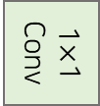

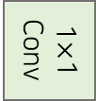


…
…
512
Residual Block
512
1$×$1 Conv
$$+$$
Residual
1×1 Conv
512
Residual Block
512
1$×$1 Conv
1$×$1 Conv
$$×$$
512
$$tanh$$
$$σ$$
Residual Block
512
1$×$1 Conv
Conv
Conv
512
Residual Block
512
1$×$1 Conv
Dilated Conv
512
…
Input
…

Slide 7




…
…
512
Residual Block
512
1$×$1 Conv
$$+$$
Residual
1×1 Conv
512
Residual Block
512
1$×$1 Conv
1$×$1 Conv
$$×$$
512
$$tanh$$
$$σ$$
Residual Block
512
1$×$1 Conv
Conv
Conv
512
Residual Block
512
1$×$1 Conv
Dilated Conv
512
…
Condition Input
Input
…

Slide 8


…
512
1×1 Convs Set
Residual Block
512
1$×$1 Conv
512
1×1 Convs Set
Residual Block
512
1$×$1 Conv
Residual
512
$$+$$
1×1 Conv Set
1×1 Conv
Residual Block
512
1$×$1 Conv
$$tanh$$
$$×$$
$$σ$$
512
1×1 Conv
512
1$×$1 Conv
$$+$$
$$+$$
Residual Block
1×1 Conv
Conv
Conv
Dilated Conv
512
…
Condition
Input

Slide 9
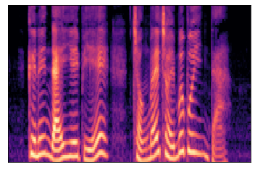


Fourier
Transform
변환
Spectrogram Data
Audio Digital Data
$$y=f(h)$$
Upsampling
Conditioning Data(길이 : Audio 크기)

