Slide 1
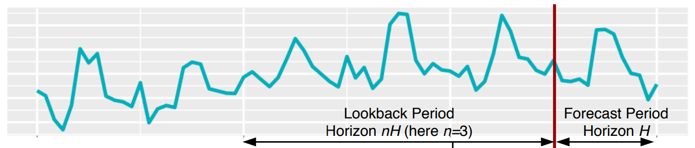
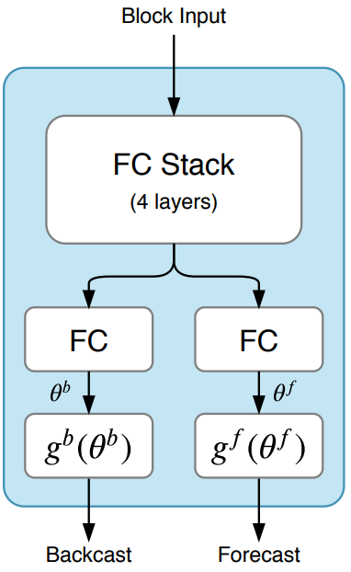


Block Input = 15 data points
예측구간 = 5 data points
FC[ 15 -> 256 ]
Relu
FC[ 256 -> 256 ]
FC Stack
(4 layers)
Relu
FC[ 256 -> 256 ]
Relu
FC[ 256 -> 256 ]
Relu
FC
FC[ 256 -> 20 ]
FC[ 256 -> 20 ]
$$g^{b}$$
FC[ 20 -> 15 ]
FC[ 20 -> 5 ]
$$g^{f}$$
Backcast
Forecast

Slide 2
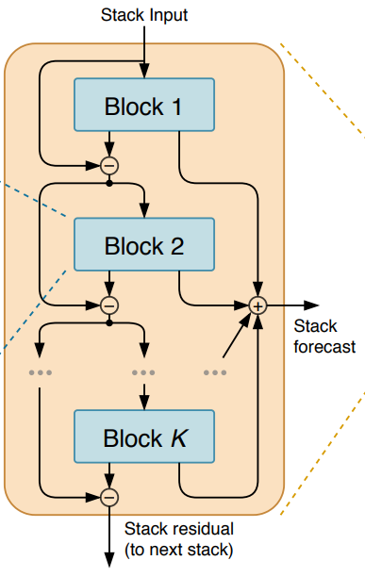
Block Input = 15 data points
예측구간 = 5 data points
FC[ 15 -> 256 ]
Backcast[15]
Forecast[5]
-
Block 2
-
+
Stack
forecast
Block K
-
Stack residual
(to next stack)

Slide 3
Lookback window
(model input)
Global forecast
(model input)
Stack 1
+
Stack 1
Stack residual
(to next stack)
Stack M

Slide 4
Lookback window
(model input)
Lookback window
(model input)
Global forecast
(model input)
Trend Block 1
Trend
forecast
Trend Stack
-
+
+
Trend Block K
Stack residual
(to next stack)
-
Seasonal Block 1
Seasonal
forecast
Seasonal
Stack
-
+
Seasonal Block K
-

Slide 5









Block Input = 15 data points
예측구간 = 5 data points
FC[ 15 -> 256 ]
Relu
FC Stack
(4 layers)
FC[ 15 -> 256 ]
Relu
FC
FC[ 256 -> 20 ]
FC[ 256 -> 20 ]
$$θ^{b}$$
$$θ^{f}$$
$$\text{[20}×\text{1]}$$
$$\text{[20}×\text{1]}$$
$$g^{b}$$
$$g^{f}$$
$$\text{[}\text{15}×\text{20}\text{]}$$
$$\text{[}\text{5}×\text{20}\text{]}$$
Backcast
Forecast
$$\text{[}\text{15}×\text{1}\text{]}$$
$$\text{[}\text{5}×\text{1}\text{]}$$

Slide 6


Block Input = 15 data points
예측구간 = 5 data points
FC[ 15 -> 256 ]
Relu
FC Stack
(4 layers)
FC[ 15 -> 256 ]
Relu
FC
FC[ 256 -> 20 ]
FC[ 256 -> 20 ]
$$θ^{b}$$
$$θ^{f}$$
$$\text{[20}×\text{1]}$$
$$\text{[20}×\text{1]}$$
$$g^{b}$$
$$g^{f}$$
$$\text{[}\text{15}×\text{20}\text{]}$$
$$\text{[}\text{5}×\text{20}\text{]}$$
Backcast
Forecast
$$\text{[}\text{15}×\text{1}\text{]}$$
$$\text{[}\text{5}×\text{1}\text{]}$$

