Slide 1
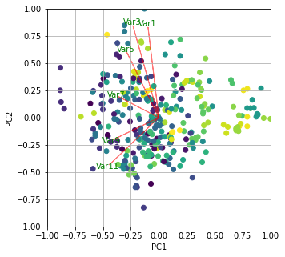

Kernel-PCA
Linear-SVM
Neural Network
Class1 score
1
942
Class2 score
Linear Layer
Linear Layer
-1
521
Class3 score
777
-1
Raw Image
Feature Extraction
Feature Vector
Classification
Class Score
Normalization
Output

Slide 2
Label
1
-1
-1
•••
-1
Output
0.8
-1.2
-0.5
•••
-2.1
Fully Connected Layer + Tanh activation
Fully Connected Layer + Tanh activation
Score
942
254
77
•••
3
•••
SVM(1)
SVM(2)
SVM(3)
SVM(N)
feature

Slide 3
