Slide 1
Android Phone
GPS and Magnet Sensor
Jouni Virtanen Consulting
23.12.2015

Slide 2
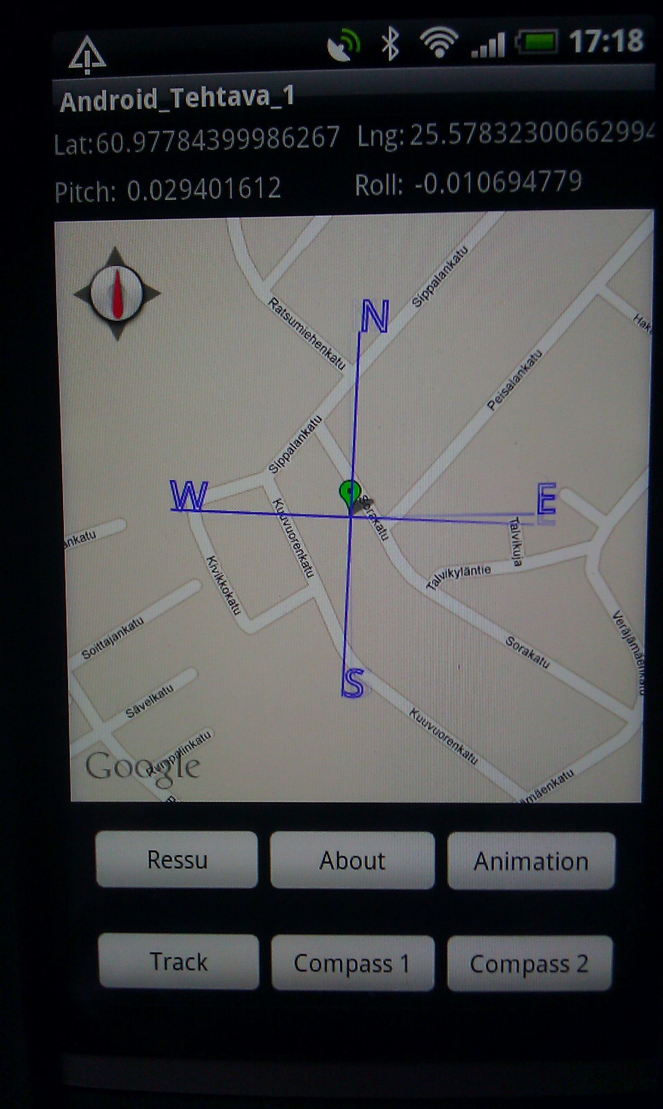

Slide 3
Content
Overview
Drawing of a self-made compass on Google Maps
Displaying of pitch and roll tilts
Drawing of a track on Google Maps about the user movements
Drawing of Google Maps internal compass

Slide 4
Overview
The purpose of this presentation is to describe on high-level :
  How to use magnet sensor information for drawing of a self-made compass on Google Maps
  How to use magnet sensor information for displaying of pitch and roll tilts
  How to use GPS sensor information for drawing of a track on Google Maps
  How to draw Google Maps internal compass

Slide 5
Drawing of a self-made compass on Google Maps
Create an instance of SensorManager class
  Get SensorManager’s accelometer sensor
  Get SensorManager’s magnetic field sensor
Create an instance of MapView class
Create an instance of ItemizedOverlay class
Implement SensorEventListener interface
Enable sensor manager updates
Implement onSensorChanged method and read azimuth angle
Rotate canvas towards North according to azimuth angle and draw the compass in the draw method of ItemizedOverlay class

Slide 6
Displaying of pitch and roll tilts
Create an instance of SensorManager class
  Get SensorManager’s accelometer sensor
  Get SensorManager’s magnetic field sensor
Implement SensorEventListener interface
Enable sensor manager updates
Implement onSensorChanged method, read pitch and roll tilts
Display pitch and roll tilts

Slide 7
Drawing of a track on Google Maps about the user movements
Create an instance of LocationManager class
Create an instance of LocationListener class
Create an instance of ItemizedOverlay class
Create an instance of MapView class
Enable GPS location updates
Store GeoPoints to dynamic data structure like to ArrayList about the user movements
Convert GeoPoints to pixels
Draw a line between GeoPoints in the draw method of ItemizedOverlay class

Slide 8
Drawing of Google Maps internal compass
Create an instance of MyLocationOverlay class
  Enable MyLocationOverlay’s compass
Create an instance of MapView class
Add MyLocationOverlay to MapView

