Slide 1
HOWTO create a culture
of hardware sharing
in the sciences?
Luis Felipe R. Murillo
Data Science Institute
University of Virginia

Slide 2
/dev/joh
One of many possible ways: create an academic journal!
  # makedev -v joh
What are the benefits? Or, why should we care?
  For community projects:
  Provide peer-review for HW documentation, long-term preservation in a public, indexed repository to generate “prior-art” (with persistent IDs)
  For scientific instrumentation projects:
  Create strong incentive for academics to release their hardware as a peer-reviewed publication, guiding solid documentation practices for wider reproducibility
  To create interfaces:
  Between academic and community-based OH projects

Slide 3

/dev/joh: Journal of Open Hardware
Created at the “Gathering for Open Science Hardware” developers at CERN in 2016
Meant primarily as a forum for Free and Open Source researchers, community members, and hardware designers
Dedicated OA publication format for Open Hardware projects
Community control over its governance, content, pricing, and platform development in fair partnership with:

Slide 4
/dev/joh: documentation guidelines
Draw from community-vetted OH definitions and documentation guidelines
Four freedoms + four orientations for hardware documentation:
  Accessible: clearly documented + open licensed;
  Sufficient: provide all the conditions for studying and replication;
  Findable: privilege long-term, indexed repos;
  Open in process, not only end-product!
We publish in 4 categories of academic + community interest:
  0. HW metapapers
  1. Socioeconomic studies on OH development
  2. Educational OH projects
  3. Reviews (of books, events...)

Slide 5
/dev/joh: HW metapaper
What is in a “HW metapaper” ?
  Overview
  (introduction, description of design and implementation)
  Quality control
  (safety, calibration, testing)
  Application
  (use case(s), reuse potential and adaptability)
  Build details
  (availability, difficulty of build, sources, links)
  Discussion
  (conclusion, future work)
[… plus, persistent IDs linking to HW and SW sources + build instructions]

Slide 6
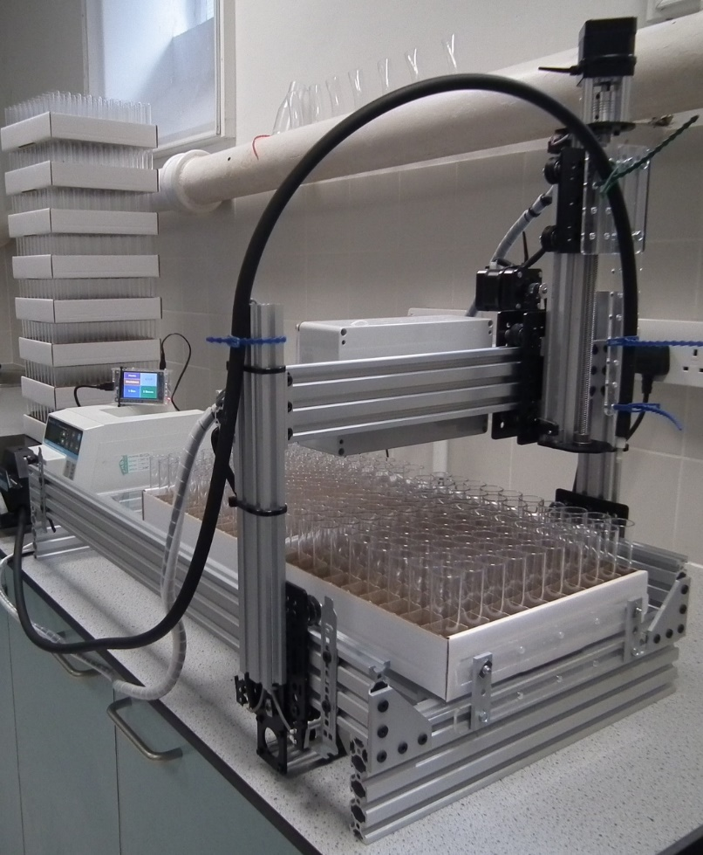
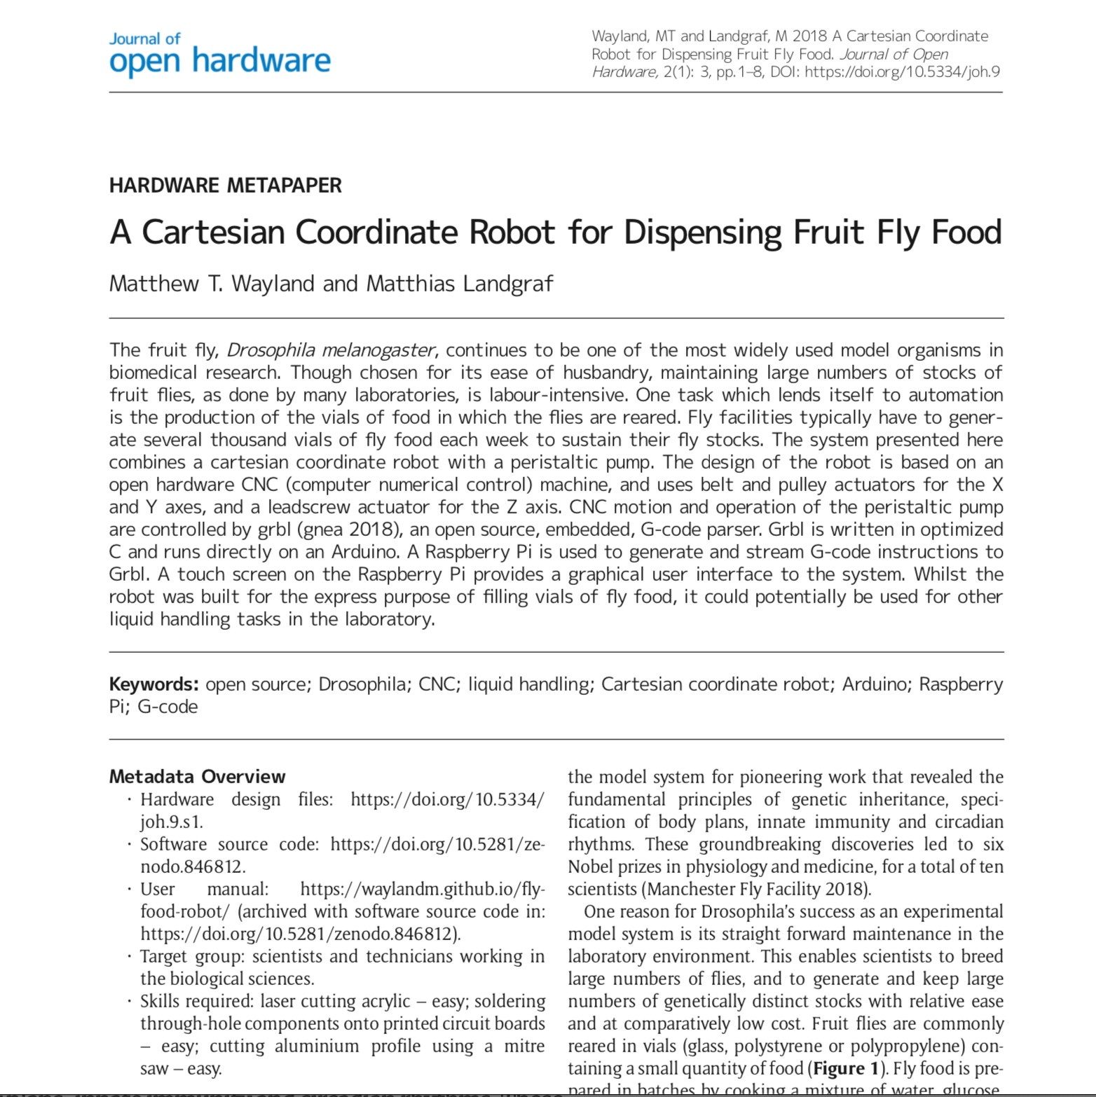
/dev/joh: open scientific instruments

Slide 7
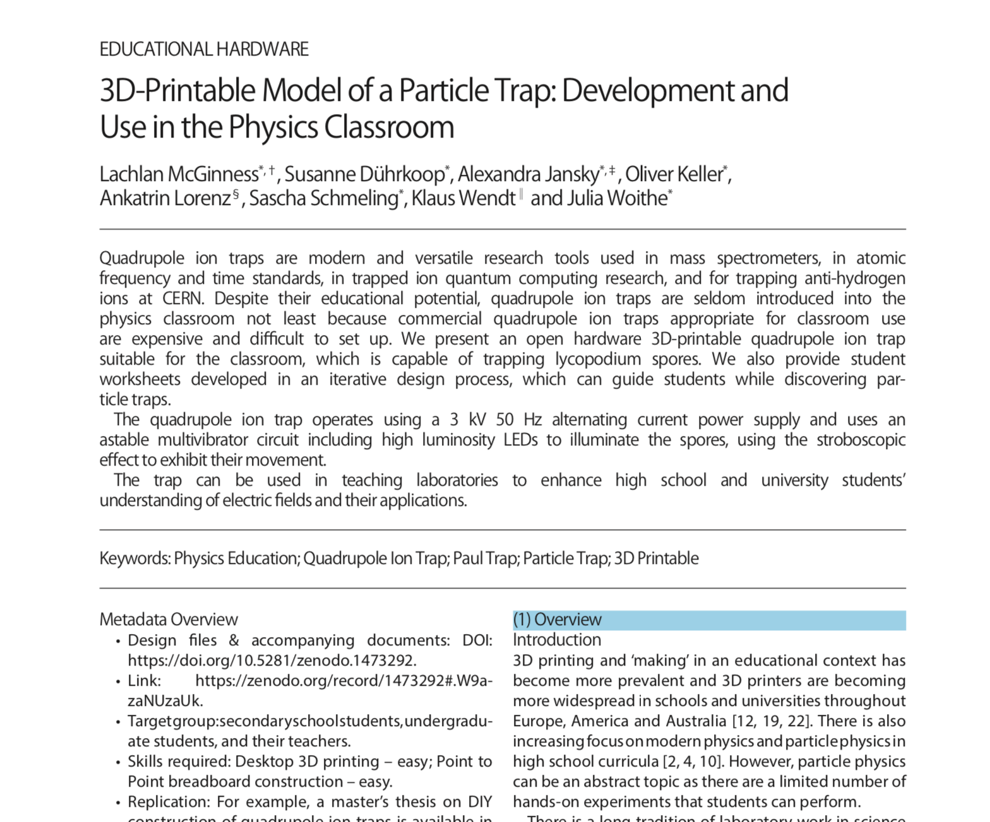
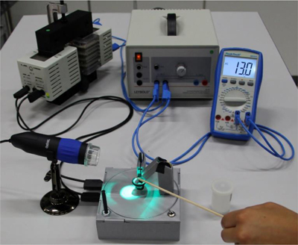
/dev/joh: educational hardware

Slide 8
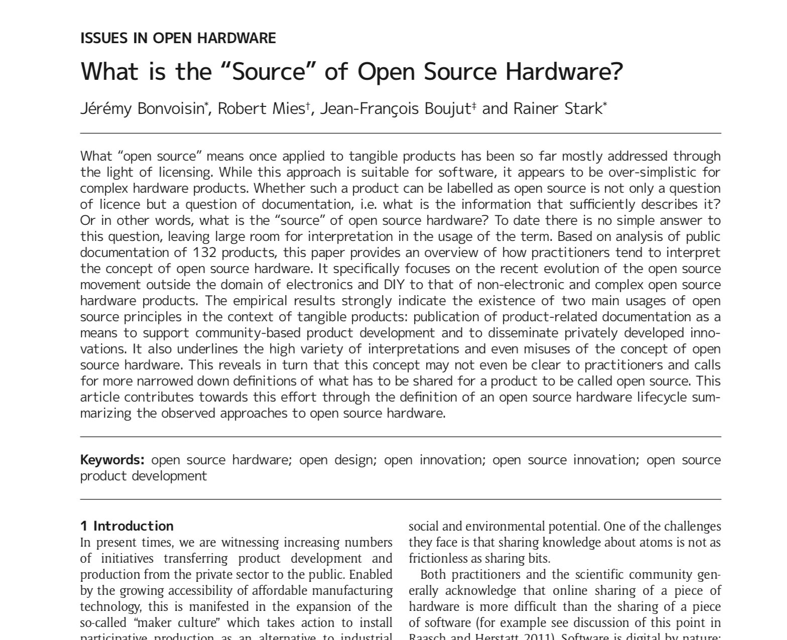
/dev/joh: empirical research

Slide 9
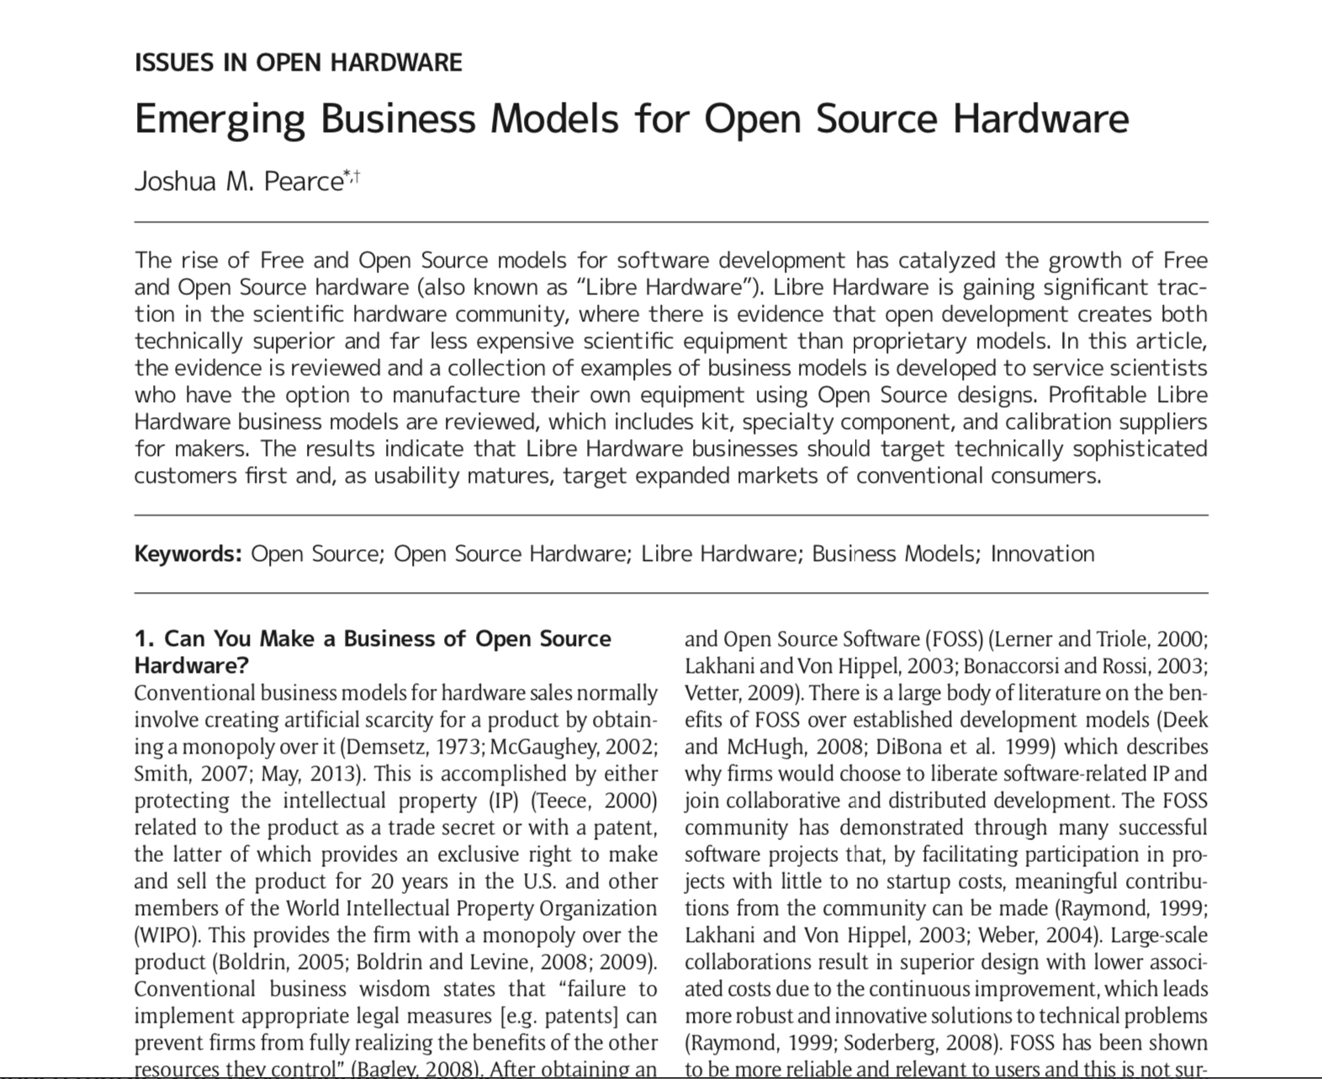
/dev/joh: economic studies

Slide 10
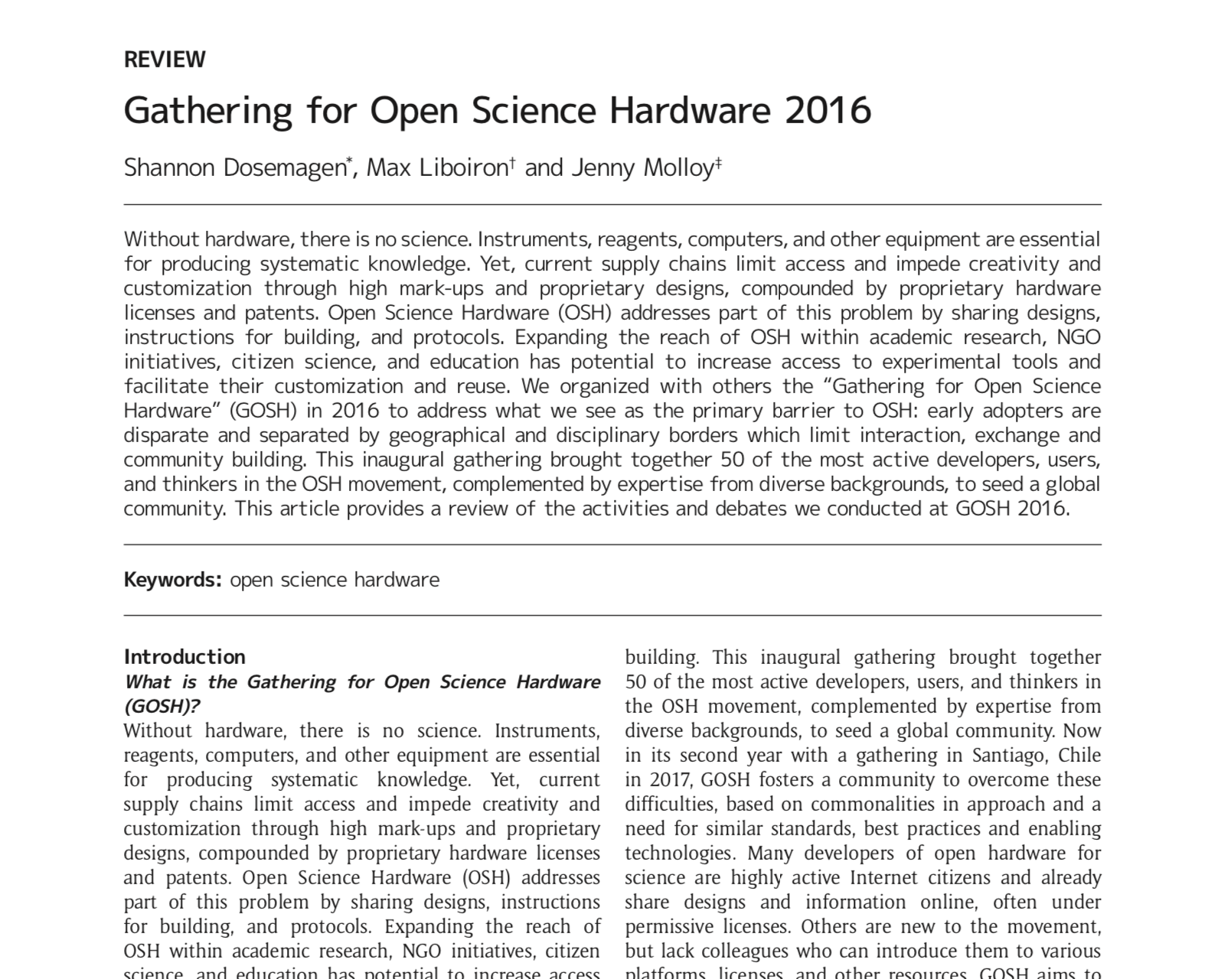
/dev/joh: conference reviews

Slide 11
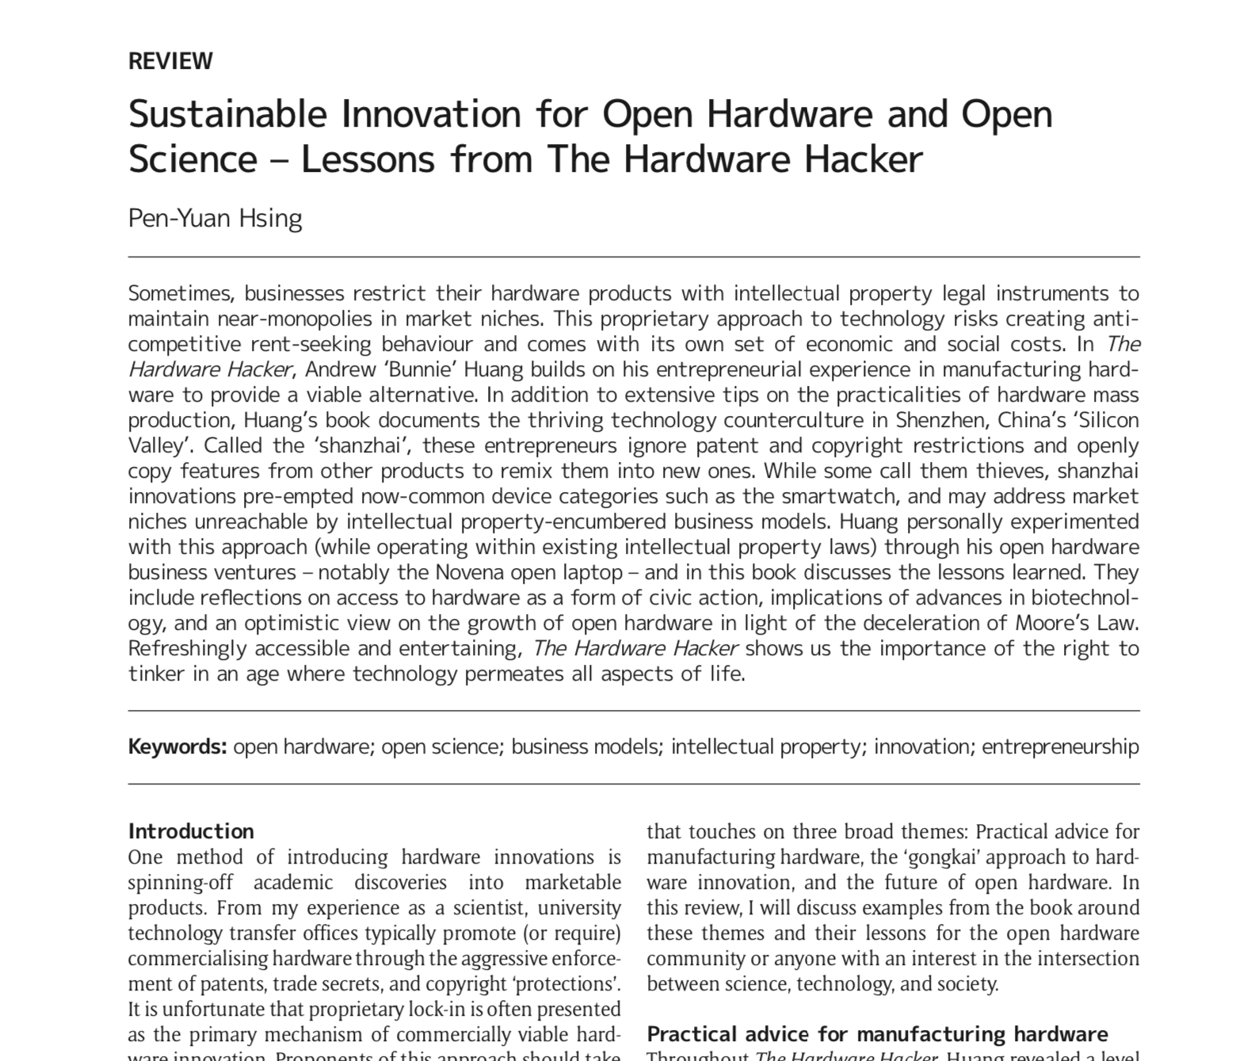
/dev/joh: book reviews

Slide 12
/dev/joh: conclusion ← CfP
Support FOSS and OH-focused research journals: one of the ways we can help create a culture of hardware sharing in academia!
If you know researchers working on scientific instruments or studying OH development, consider asking them to send us papers for peer-review:
Hardware Metapapers
Educational Hardware
Socioeconomic and legal issues in Open Hardware
Book and event reviews
Join us now and help liberate scientific hardware!
For more info, visit: journalofopenhardware.org

