Slide 1


Athanasia Katsouraki
09.10.2017

Slide 2
Signing up for service
Go to GitHub's page
To sign up for an account on the free plan, click Sign up for one of our free plans.
Follow the prompts to create your personal account.

Slide 3
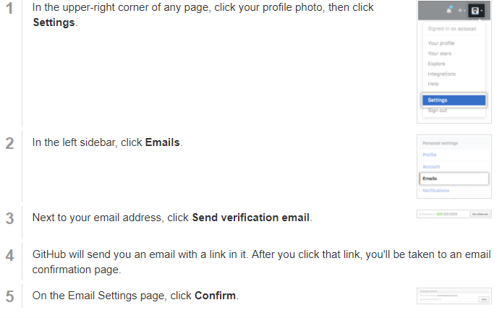
Verifying your email address
Verifying your primary email address ensures strengthened security and allows GitHub staff to better assist you if you forget your password.
You can verify your email address after signing up for a new account, or when you add a new email address.

Slide 4
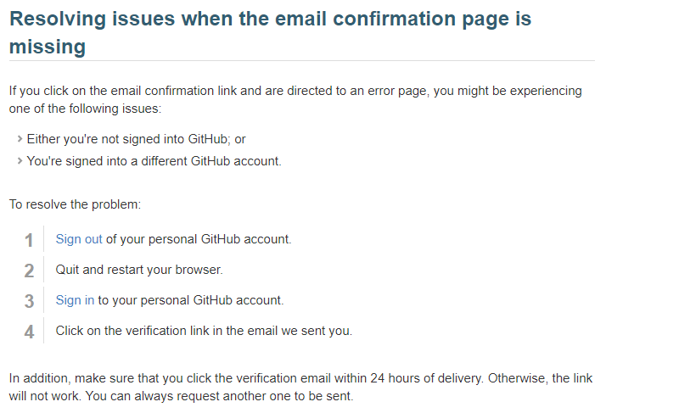

Slide 5
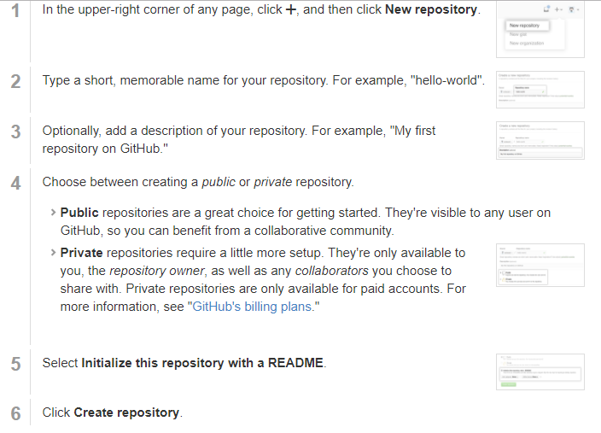
Create A Repo
To put your project up on GitHub, you'll need to create a repository for it to live in.
You can store a variety of projects in GitHub repositories, including open source projects.

Slide 6
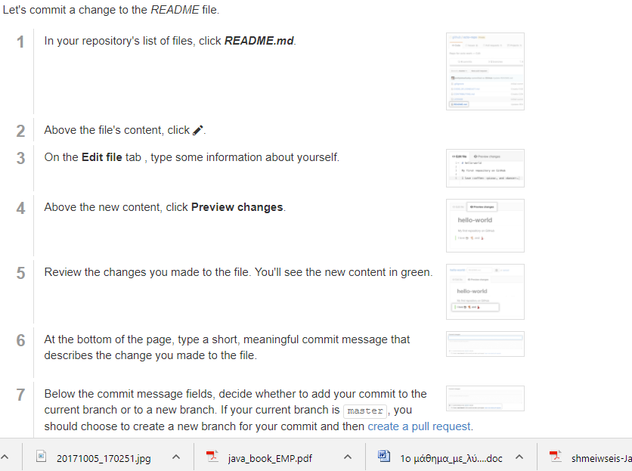
Commit your first change
A commit is like a snapshot of all the files in your project at a particular point in time.
When you created your new repository, you initialized it with a README file.
README files are a great place to describe your project in more detail, or add some documentation such as how to install or use your project. The contents of your README file are automatically shown on the front page of your repository.

Slide 7
https://guides.github.com/features/wikis/
https://help.github.com

Slide 8
Glossary
Blame
The "blame" feature in Git describes the last modification to each line of a file, which generally displays the revision, author and time. This is helpful, for example, in tracking down when a feature was added, or which commit led to a particular bug.
Branch
A branch is a parallel version of a repository. It is contained within the repository, but does not affect the primary or master branch allowing you to work freely without disrupting the "live" version. When you've made the changes you want to make, you can merge your branch back into the master branch to publish your changes.
Clone
A clone is a copy of a repository that lives on your computer instead of on a website's server somewhere, or the act of making that copy. With your clone you can edit the files in your preferred editor and use Git to keep track of your changes without having to be online. It is, however, connected to the remote version so that changes can be synced between the two. You can push your local changes to the remote to keep them synced when you're online.

Slide 9
Collaborator
A collaborator is a person with read and write access to a repository who has been invited to contributeby the repository owner.
Commit
A commit, or "revision", is an individual change to a file (or set of files). It's like when you save a file, except with Git, every time you save it creates a unique ID (a.k.a. the "SHA" or "hash") that allows you to keep record of what changes were made when and by who. Commits usually contain a commit message which is a brief description of what changes were made.
Contributor
A contributor is someone who has contributed to a project by having a pull request merged but does not have collaborator access.
Diff
A diff is the difference in changes between two commits, or saved changes. The diff will visually describe what was added or removed from a file since its last commit.
Fetch
Fetching refers to getting the latest changes from an online repository without merging them in. Once these changes are fetched you can compare them to your local branches (the code residing on your local machine).
Fork
A fork is a personal copy of another user's repository that lives on your account. Forks allow you to freely make changes to a project without affecting the original. Forks remain attached to the original, allowing you to submit a pull request to the original's author to update with your changes. You can also keep your fork up to date by pulling in updates from the original.
Git
Git is an open source program for tracking changes in text files. It was written by the author of the Linux operating system, and is the core technology that GitHub, the social and user interface, is built on top of.
Issue
Issues are suggested improvements, tasks or questions related to the repository. Issues can be created by anyone (for public repositories), and are moderated by repository collaborators. Each issue contains its own discussion forum, can be labeled and assigned to a user.
Markdown
Markdown is a simple semantic file format, not too dissimilar from .doc, .rtf and .txt. Markdown makes it easy for even those without a web-publishing background to write prose (including with links, lists, bullets, etc.) and have it displayed like a website. GitHub supports Markdown, and you can learn about the semantics.
Merge
Merging takes the changes from one branch (in the same repository or from a fork), and applies them into another. This often happens as a pull request (which can be thought of as a request to merge), or via the command line. A merge can be done automatically via a pull request via the GitHub web interface if there are no conflicting changes, or can always be done via the command line. For more information, see "Merging a pull request."
Open source
Open source software is software that can be freely used, modified, and shared (in both modified and unmodified form) by anyone. Today the concept of "open source" is often extended beyond software, to represent a philosophy of collaboration in which working materials are made available online for anyone to fork, modify, discuss, and contribute to.
For more information on open source, specifically how to create and grow an open source project, we've created Open Source Guides that will help you foster a healthy open source community.
Organizations
Organizations are shared accounts where businesses and open-source projects can collaborate across many projects at once. Owners and administrators can manage member access to the organization's data and projects with sophisticated security and administrative features.
Private repository
Private repositories are repositories that can only be viewed or contributed to by their creator and collaborators the creator specified.

Slide 10
Pull
Pull refers to when you are fetching in changes and merging them. For instance, if someone has edited the remote file you're both working on, you'll want to pull in those changes to your local copy so that it's up to date.
Pull request
Pull requests are proposed changes to a repository submitted by a user and accepted or rejected by a repository's collaborators. Like issues, pull requests each have their own discussion forum. For more information, see "About pull requests."
Push
Pushing refers to sending your committed changes to a remote repository, such as a repository hosted on GitHub. For instance, if you change something locally, you'd want to then push those changes so that others may access them.
Remote
This is the version of something that is hosted on a server, most likely GitHub. It can be connected to local clones so that changes can be synced.
Repository
A repository is the most basic element of GitHub. They're easiest to imagine as a project's folder. A repository contains all of the project files (including documentation), and stores each file's revision history. Repositories can have multiple collaborators and can be either public or private.
SSH key
SSH keys are a way to identify yourself to an online server, using an encrypted message. It's as if your computer has its own unique password to another service. GitHub uses SSH keys to securely transfer information to your computer.
Team
Teams are groups of organization members that reflect your company or group's structure with cascading access permissions and mentions.
Upstream
When talking about a branch or a fork, the primary branch on the original repository is often referred to as the "upstream", since that is the main place that other changes will come in from. The branch/fork you are working on is then called the "downstream".
User
Users are personal GitHub accounts. Each user has a personal profile, and can own multiple repositories, public or private. They can create or be invited to join organizations or collaborate on another user's repository.

