Slide 1


Athanasia Katsouraki
09.10.2017

Slide 2
What is Slack?
Slack is where work happens. It’s a digital workspace that powers your organization — all the pieces and the people — so you can get things done.

Slide 3
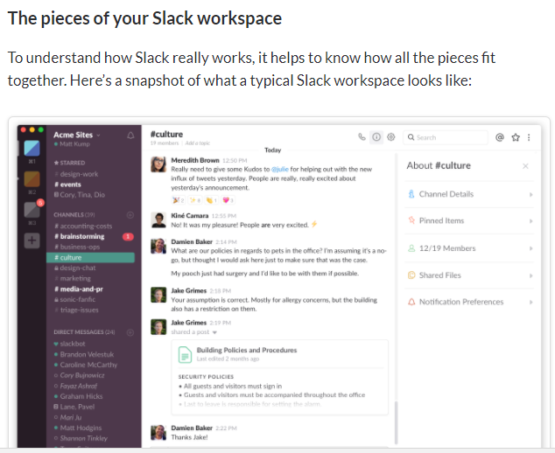
And here are the main components we'll break down for you, piece-by-piece:
teams and workspaces
channels
messages
search
notifications

Slide 4
Teams & workspaces
A team is a group of people that use Slack to communicate. Your team is likely comprised of the people you work with every day. Your Slack workspace is the digital space you and your teammates share to communicate and get work done.
Channels
Your Slack workspace is comprised of channels. You’ll use channels to hold most of your conversations with other members. They can be organized around anything — departments, projects, or even office locations — and you can create as many as you need. Every workspace starts with two channels by default: #general and #random.

Slide 5
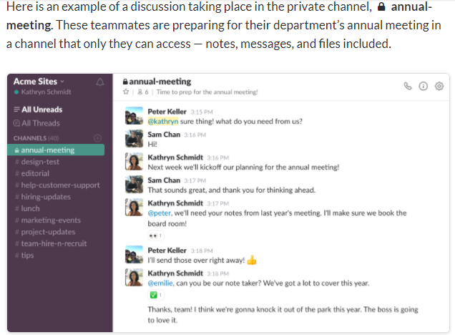

Slide 6
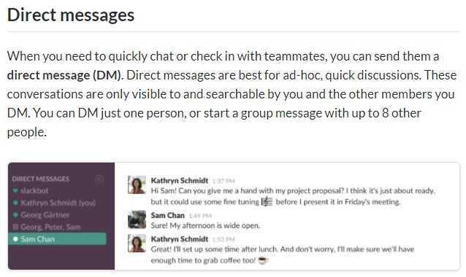

Slide 7
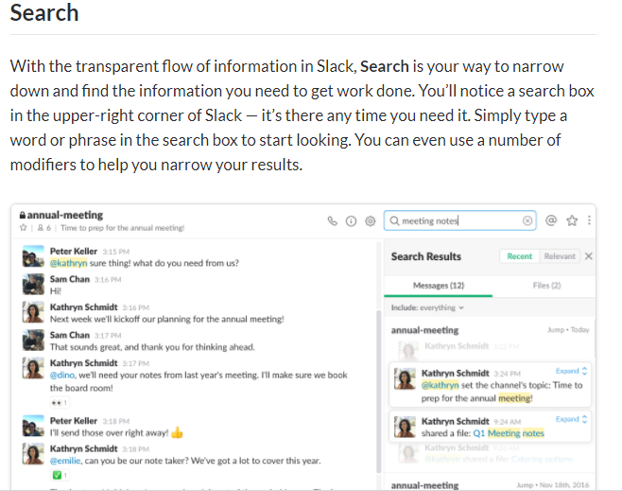

Slide 8
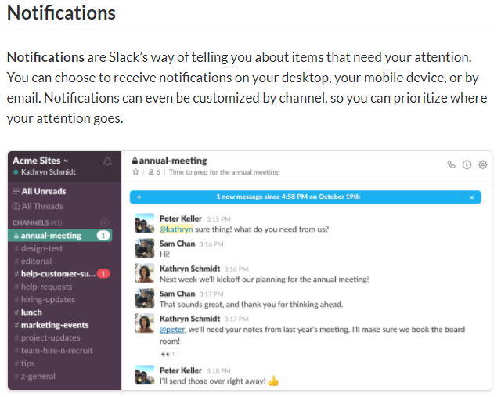

Slide 9
https://www.youtube.com/watch?v=9RJZMSsH7-g

