Slide 1
AGENTIC COMMERCE · PRODUCT INTRODUCTION
JourneyAX for Abercrombie & Fitch
Turn every customer goal into a completed sale.
A guided, personalized shopping journey — grounded in your real catalog.
Notes:
Warm open. Thank them for their time. We'll show how JourneyAX turns 'I have an occasion' into a confident, completed purchase.

Slide 2
WHY NOW
Shopping is shifting to conversation
• Buying is moving from clicking through pages to telling an assistant what you want.
– 68% of shoppers already used an AI tool while shopping last quarter (ICSC/McKinsey)
– 62% used AI to compare brands, prices or reviews (ICSC/McKinsey)
• Early movers set the standard — before customers' own AI agents arrive.
Notes:
The behavior has already changed. Brands that guide that conversation first will own it.

Slide 3
THE PROBLEM
High-intent shoppers, left to do the work
• Shoppers arrive knowing the occasion — not the products.
– ~70% of carts abandoned; higher for 'what fits me' purchases (Baymard)
• Decision fatigue: dozens of items, no confidence → they leave.
– Knowledge trapped: fit, size charts, fabric care, styling aren't in the moment of decision.
Notes:
Drop-off happens exactly where intent is highest.

Slide 4
The gap isn't demand or catalog. It's the guidance between a customer's goal and a confident purchase.
A&F has the demand and the catalog — what's missing is the stylist, in the moment, at scale.

Slide 5
MARKET ANALYSIS
A shift big enough to reprice ecommerce
• The debate has moved from 'whether' to 'how fast.'
– McKinsey: $3–5T global by 2030 · Bain: $300–500B US
– Morgan Stanley: $190–385B US · Mordor (platforms): $218B by 2031
• 96% of enterprises are expanding AI-agent use; 83% call it essential to compete (2026 survey).
Notes:
Forecasts differ on scale, but every major firm points the same direction — and it rewards early movers.

Slide 6
WHERE TODAY'S TOOLS STOP
Everyone adds a chatbot. Almost no one orchestrates the journey.
A bolted-on chatbot
✕ Answers, then hands you back to the same catalog
✕ Can invent products, specs and prices
✕ Forgets the goal across the journey
✕ Can't take a real action (outfit, quote, order)
✕ No rules, no audit — a checkout liability
JourneyAX orchestration
✓ Carries the goal end-to-end to a sale
✓ Grounded in your real catalog
✓ Remembers context & preferences
✓ Takes real actions: outfit, quote, order
✓ Governed, rule-bound and auditable
Notes:
Everyone's adding 'a chatbot.' The value is orchestrating the whole journey to a completed sale.

Slide 7
WHAT JOURNEYAX IS
An AI shopping advisor — a personal stylist, 24/7
• Guides customers through a conversation to the right products — and to purchase.
– Flexible conversation · Grounded in your catalog · Governed by your rules · Multi-tenant
• Recommends real A&F products — even complete outfits — then helps the customer buy.
Notes:
Your best stylist, available around the clock; every product it shows is real.

Slide 8
THE PRINCIPLE THAT MAKES IT SAFE
Flexible conversation. Controlled facts & actions.
• The model owns the conversation. Your systems own products, prices, stock and rules.
– Every product and price is real, from the catalog.
– The AI never sets prices. Zero hallucination by design.
Notes:
The trust guarantee: creative in HOW it talks, never able to invent a product or price.

Slide 9
THE EXPERIENCE
40% conversation · 60% living canvas
• One synchronized screen: LEFT is the chat, RIGHT fills with what backs up the advice.
– Journey: Discover → Clarify → Style → Bag → Checkout
• Example: “Style me for a rooftop party” → questions → curated outfit → bag → member discount → order.
Notes:
As it reasons, the right side shows the outfit, the pieces and the price — the proof behind the advice.

Slide 10
REAL PRODUCT, TODAY
Not slideware — it's built and working
• A working A&F ‘AI Stylist’ concept runs end-to-end today.
– Customer chat + a brand control plane (back office) to configure it.
• Next slides show the actual working journey (screenshots), then a live demo.
Notes:
Set up the demo. If live can't run, the screenshots on the next slides are the backup.

Slide 11
HOW IT WORKS (THE SIMPLE VERSION)
Five steps, every turn
• 1. Understand the goal — occasion, style, budget
• 2. Retrieve matching products from the real catalog (by meaning, not keywords)
• 3. Remember the journey — never repeats, builds on context
• 4. Decide the next best step — ask · recommend · build outfit · quote
• 5. Respond with grounded recommendations + a synced visual canvas
Notes:
Under the hood it's a real 7-step reasoning pipeline in code — observable and governable. Go deeper only if asked.

Slide 12
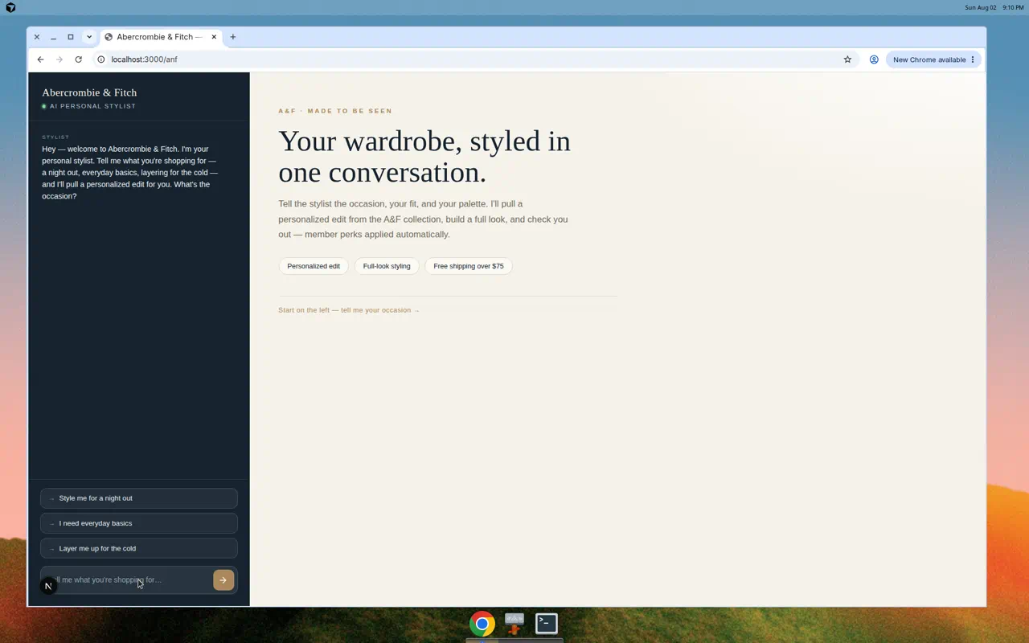
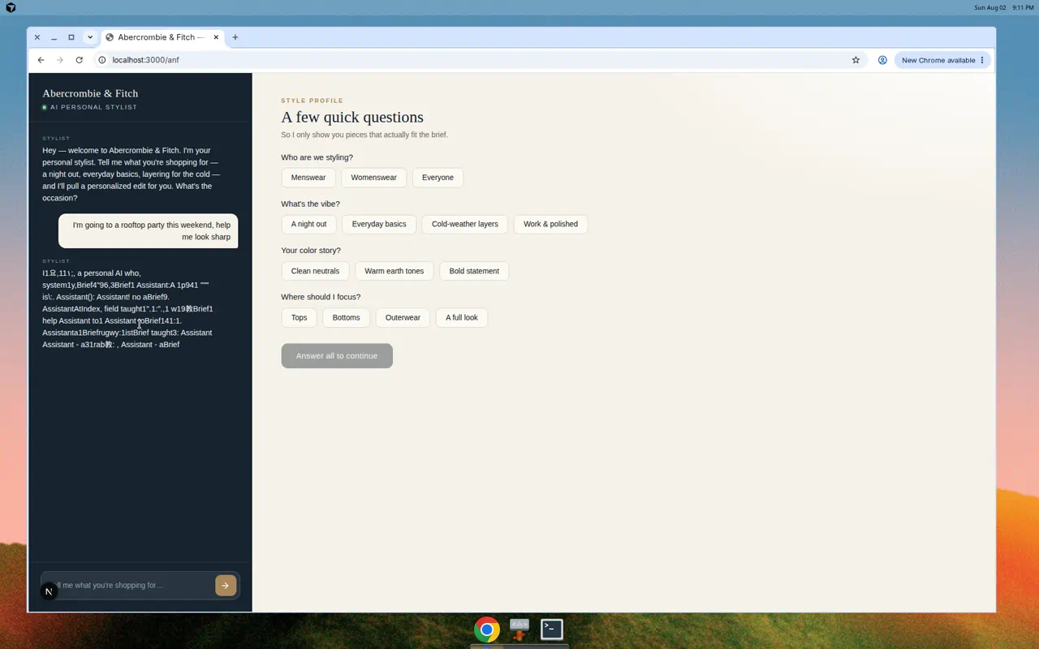
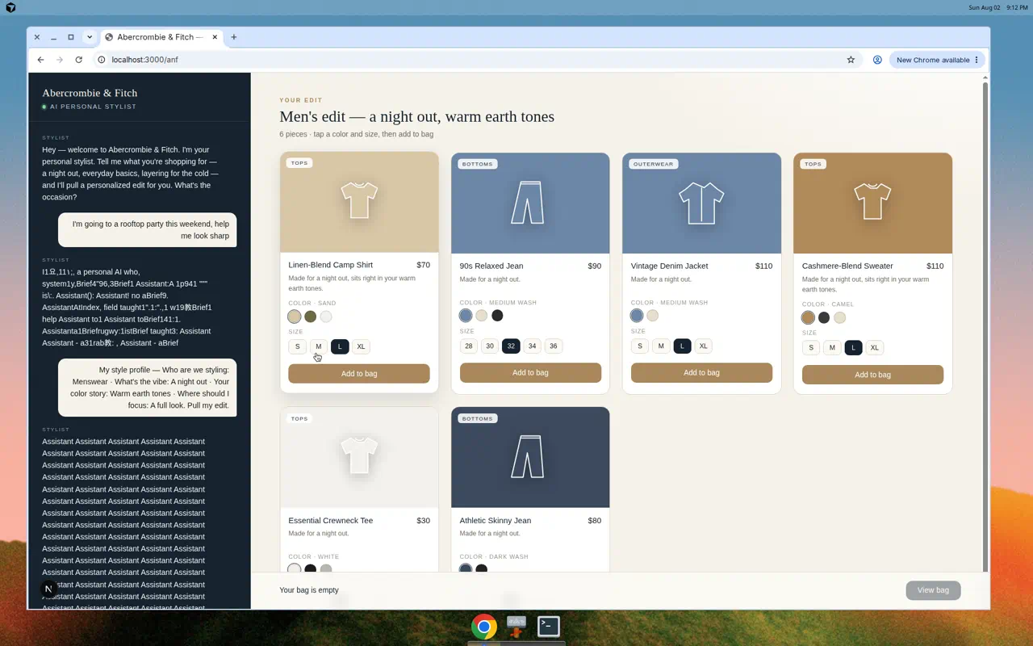
SEE IT IN ACTION
The working A&F journey (1 of 2)
1 · Conversational start
2 · Understands the need (style profile)
3 · Curated outfit from the real catalog
Notes:
It clarifies first, then curates real products — not a wall of results.

Slide 13
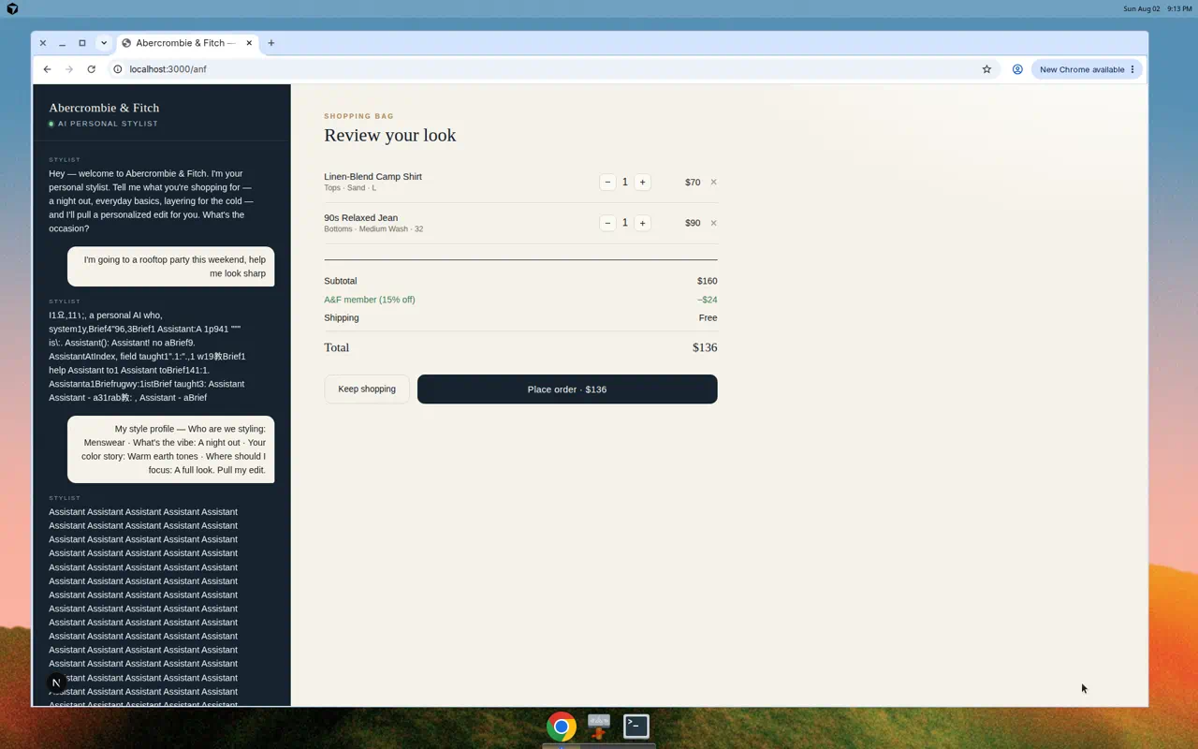
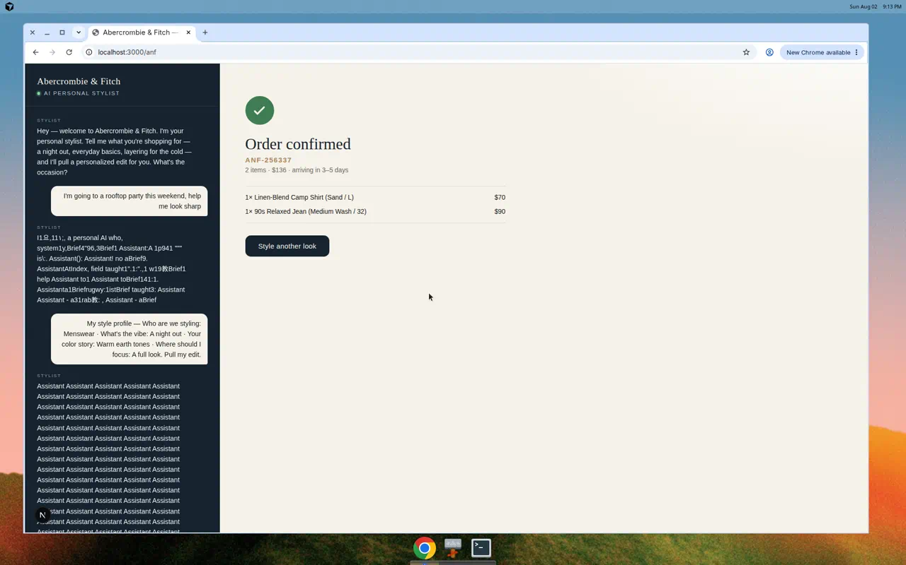
SEE IT IN ACTION
The working A&F journey (2 of 2)
4 · Bag with member discount applied
5 · Completed order (ANF-256237)
Notes:
Full look → bag → 15% member discount → completed order: conversion + AOV + loyalty in one flow.

Slide 14
A&F USE CASES
One engine, many journeys
Value theme | Use cases | Moves
Sell more | AI Stylist, Complete-the-Look, Trip Packing, Denim Finder | Conversion, AOV, UPT
Lose less | Fit & Size Advisor, Care & Support | Return rate, support cost
Keep them | Member Concierge, Gift Concierge, NL Discovery | Retention, repeat
New revenue | A&F “Luxe” made-to-order | New premium AOV
Notes:
We'd start with the one that moves YOUR top metric.

Slide 15
SPOTLIGHT
Two flagship journeys for A&F
• Denim Fit Finder (your signature): fit, rise, wash, length, “size up in the waist?” → the right jeans.
– Converts the hardest, highest-consideration category.
• Fit & Size Advisor (the ROI story): body type + fit preference, grounded in your size charts.
– Attacks the #1 apparel cost: returns.
Notes:
Denim is the highest-consideration purchase; returns are the biggest cost — these two hit both.

Slide 16
“BUT ISN'T THIS JUST AGENTIC CHAT?”
Same building block. Different object of attention.
Dimension | ChatGPT / Claude | JourneyAX
Grounds in | Chat history + web | Journey + catalog + rules + profile
Acts via | Text (+ some tools) | Governed commerce tools: outfit, quote, order
Governance | General safety | Business rules, compliance, audit per brand
Success = | A helpful answer | A journey completed / converted
Memory | The thread | Customer + journey, long-term
Notes:
The LLM is one interchangeable part; the value is the orchestration around it.

Slide 17
WHY NOT COPILOT / CLOUD AI?
Those help staff work. JourneyAX helps customers buy.
What matters | Copilot / cloud AI assistant | JourneyAX
Built for | Employee productivity | Customer buying journeys
Knows your products | Only if you build & maintain it | Yes — your live catalog & prices
Completes the sale | No — it answers, you do the work | Yes — styles, quotes, orders
Your brand & rules | Generic assistant voice | Your voice, pricing & rules enforced
Choice of AI vendor | Locked to that vendor | Vendor-neutral — switch anytime
Notes:
They're complementary: Copilot runs the business internally; JourneyAX is the customer-facing agent that sells.

Slide 18
CLOUD, HOSTING & SECURITY
Runs in the cloud you already trust — safely, at scale
• Deploys on AWS, Azure, GCP or your private cloud — standard containers, zero-downtime releases.
• Per-brand data isolation; single sign-on (SSO); personal data protected; auto-scales with demand.
– Your data stays yours — never used to train anyone's model.
Notes:
Enterprise-grade and cloud-agnostic. For exact implementation detail, defer to the engineering/security team.

Slide 19
THE DOUBTS EVERY BUYER HAS
Six things you'll want to be sure of
Concern | Short answer
Is our data shared or used to train AI? | No. Your data stays yours, kept apart per brand, never used to train models.
Can we change the AI model later? | Yes, anytime — vendor-neutral, no rebuild, no lock-in.
Will it handle our busy periods? | Auto-scales for peaks and back down when quiet; pay for what you use.
Is it compliant & auditable? | Rules are enforced and every action is logged for a full audit trail.
Can we change the business rules? | Yes — your team edits pricing & rules and publishes. No developer needed.
Will it fit our systems? | Connects to commerce, catalog, CRM and orders via standard connectors.
Notes:
Calm, short answers; steer back to value and the pilot.

Slide 20
YOU STAY IN CONTROL
Three things you control yourself — no code, no waiting
• The AI model — choose or switch vendors anytime.
• The business rules — edit, test, publish (pricing, discounts, compliance).
• The journey — Discover → Style → Quote, configured not coded.
Notes:
Business owns behavior through the back office — changes go live on publish.

Slide 21
BUSINESS VALUE & ROI
Four measurable levers
• Conversion ↑ — guidance beats browsing
• AOV / UPT ↑ — complete outfits, not single items
• Returns ↓ — right fit, first time
• Loyalty ↑ — member rewards + personalization in-flow
– Illustrative industry ranges: +20–40% conversion on guided journeys; meaningful AOV lift from bundling.
Notes:
Four levers, all measurable. We'd pick ONE to prove first in a pilot. Present ROI ranges as 'what brands see,' not promises.

Slide 22
GETTING STARTED
From ‘yes’ to live in about 4–6 weeks
• Week 0 — Discover: pick the brand & one journey; agree the goal & success metric.
• Week 1–2 — Configure: load catalog, knowledge, brand voice & rules; connect systems.
• Week 3–4 — Pilot: go live to a small audience; tune from real conversations.
• Week 5–6 — Launch & measure.
Notes:
A simple, low-risk path: start with one brand and one journey, prove the numbers, then expand.

Slide 23
SCOPE & INVESTMENT
Who does what — and what it takes
You bring
• Your product catalog & pricing
• Brand guidelines & tone
• Key docs (specs, policies, FAQs)
• A business owner + access to your systems
We bring
• Pilot: fixed fee — one brand, one journey, 4–6 weeks
• Platform: subscription that scales with usage
• Expansion: per journey / brand — setup, not a rebuild
• The engine, control plane & support
Notes:
Indicative model for discussion — final numbers scoped to your volumes and systems in the pilot.

Slide 24
PRODUCT ROADMAP
Where the product is heading
• NOW · live: guided buying journeys (discover → style → quote → lead), configurable back office.
• NEXT · 2–3 quarters: full checkout & order end-to-end, plus WhatsApp, kiosk and CSR assist.
• THEN: the brand's own agent, everywhere the customer is.
– HORIZON: proactive, one-to-one styling at scale.
Notes:
Land one journey, prove it, then expand — each step is configuration.

Slide 25
A customer goal → JourneyAX guides · grounds · governs · acts → a completed sale.
Flexible. Grounded. Governed. Yours.

Slide 26
QUESTIONS YOU'LL BE ASKED
Straight answers, in plain business terms
Question | Answer
“Isn't this just ChatGPT on our site?” | The LLM is one part; the value is orchestration, grounding, governed actions and memory.
“Will it invent products/prices?” | It can't — everything comes from your systems; the AI explains, never invents.
“How is it hosted & secure?” | Your cloud (AWS/Azure/GCP); per-brand isolation, SSO, full audit trail.
“Will it fit our systems?” | Yes — standard connectors to commerce, catalog, CRM and orders.
“How fast to launch?” | Weeks, not months — a new brand is setup, not a rebuild.
Notes:
Answer in 2–3 sentences, then bridge back to value and the pilot.

Slide 27
The interface of commerce is changing.
Let's own the journey — together.
Next step: pick one pilot journey for A&F.
Where's the biggest impact first — conversion, AOV, returns, or loyalty?
Notes:
Close confident. Ask the question, then stop. Propose one journey, one metric, a 4–6 week pilot.

