Slide 1
Assignment #2 Machine Learning and Data Science - ENCS5341

Slide 2
agenda
Part 1 – Non-Linear Regression:
A) Generate a set S = {(𝑥⃗!, 𝑦!): 𝑖 = 1,…, 25} of 25 data points
B) Using the generated set S in part A, apply non-linear regression (without regularization) using different numbers of RBF basis functions
Part 2 – Logistic Regression:
A) Logistic Regression with a linear decssion boundary
B) Logistic Regression with a non-linear decssion boundary using
polynomial features of the following degrees: {2, 5, 9}.

Slide 3
Part 1 – Non-Linear Regression:

Slide 4
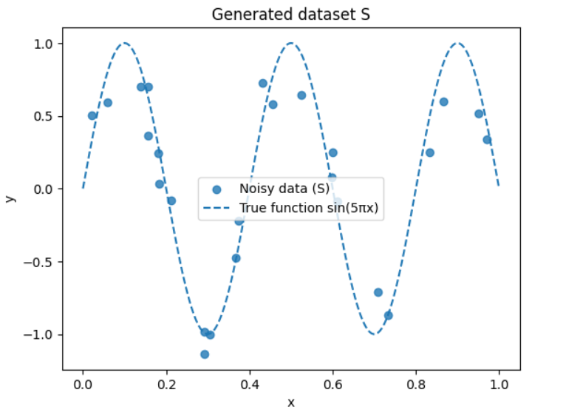
A) Generating the dataset S

Slide 5
Fitting Ridge regression models
We used degree 9 polynomial features and try these 5 λ values:
λ ∈ {0, 1e-12, 1e-10, 1e-8, 0.01}
If we only look at typical values like (0, 0.01, 0.1, 1, 10), the best model seems to be λ = 0.
But after testing very small positive values, I found that λ = 1e-10 gives the best generalization to the true function in my experiment.
In practice, λ = 1e-10 is extremely close to 0, so the model is almost unregularized, but this tiny regularization is enough to slightly improve the error.

Slide 6
Computing generalization error (MSE vs true function) for each λ
We used the same 5 λ values
If we only look at typical values like (0, 0.01, 0.1, 1, 10), the best model seems to be λ = 0.
MSE vs true function sin(5πx) for each λ:
λ = 0 -> MSE = 0.033519
λ = 1e-12 -> MSE = 0.030238
λ = 1e-10 -> MSE = 0.026710
λ = 1e-08 -> MSE = 0.121747
λ = 0.01 -> MSE = 0.417642
Best λ (smallest generalization error):
Best λ = 1e-10, MSE = 0.026710

Slide 7
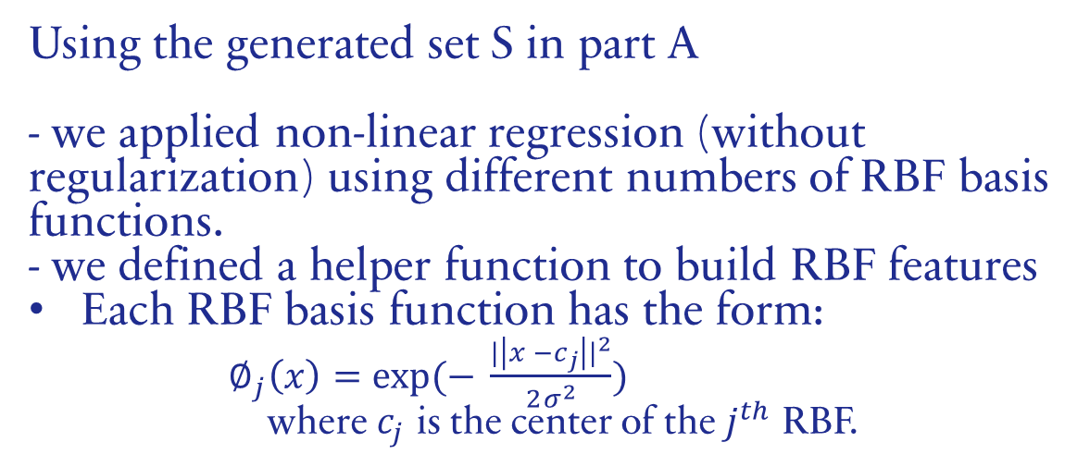
RBF Basis Functions
Using the generated set S in part A
- we applied non-linear regression (without regularization) using different numbers of RBF basis functions.
- we defined a helper function to build RBF features
Each RBF basis function has the form:
$∅_{j}\left(x\right)=exp⁡(− \frac{{|\left|x −c_{j}\right||}^{2}}{2σ^{2}})$ where $c_{j}$ is the center of the $j^{th}$ RBF.

Slide 8
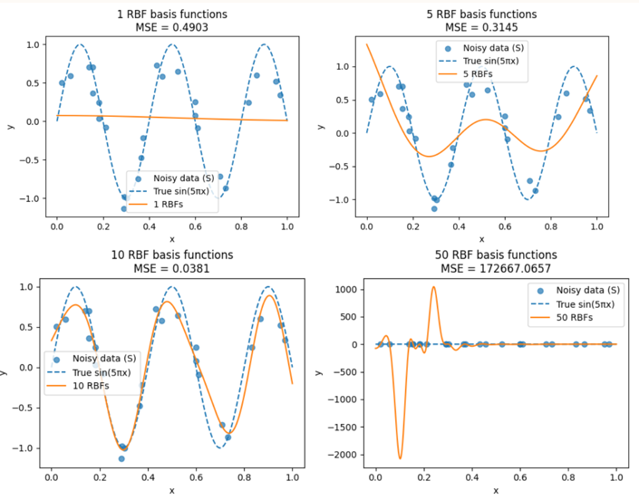
Non-linear regression using RBF basis functions
MSE vs true function sin(5πx) for different numbers of RBFs:
1 RBFs: MSE = 0.490323
5 RBFs: MSE = 0.314525
10 RBFs: MSE = 0.038104
50 RBFs: MSE = 172667.065698
Best number of RBFs (smallest MSE) is 10.
Best MSE = 0.038104
General idea:
Too few basis functions → underfitting.
Too many basis functions → overfitting.
A moderate number of RBFs usually gives the best generalization to the true function.

Slide 9

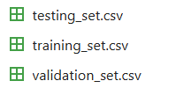
Part 2 – Logistic Regression:
1. Used the customer churn dataset from Assignment #1 to predict churn status using logistic regression.
2. Randomly split the dataset into:2500 training samples500 validation samples500 test samples

Slide 10
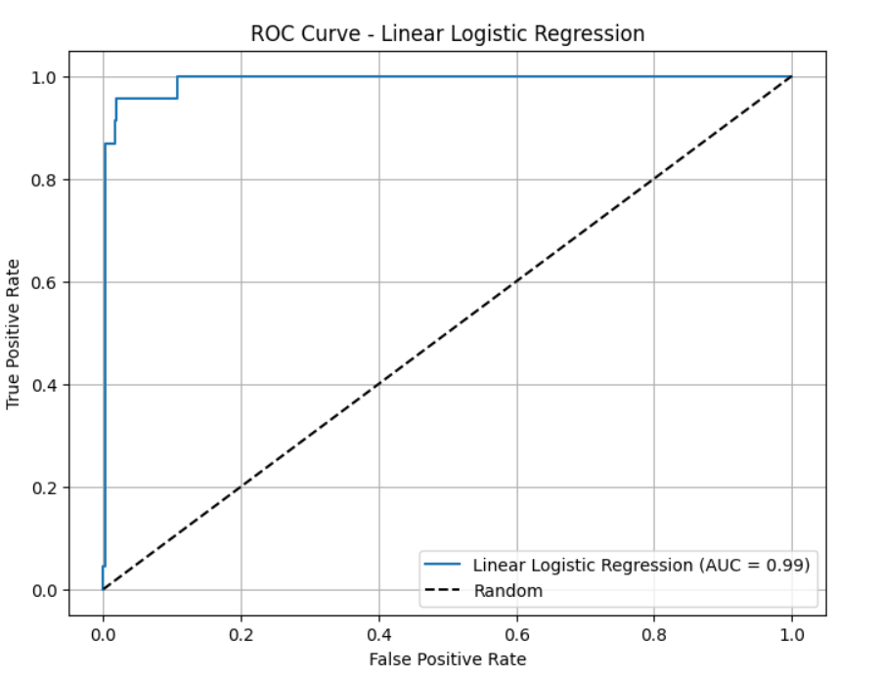
Fitting Logistic Regression with a linear decision boundary

Slide 11
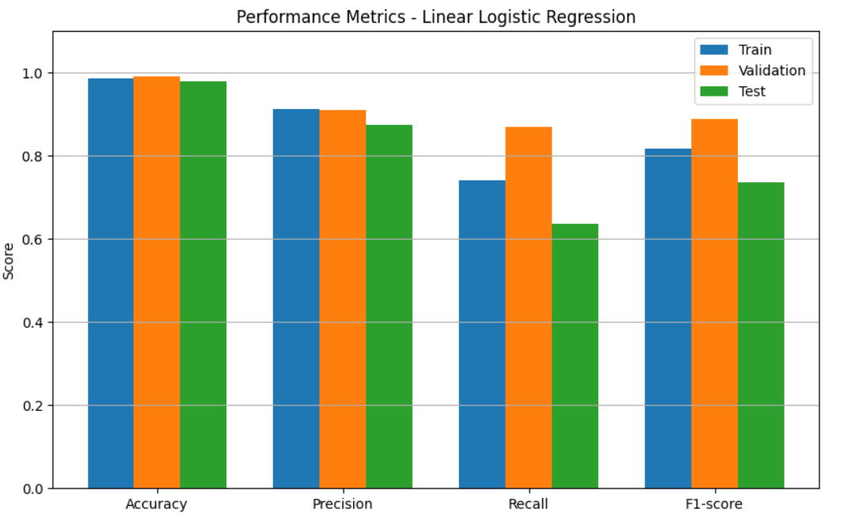
--- Training ---
Accuracy : 0.9852
Precision: 0.9120879120879121
Recall : 0.7410714285714286
F1-score : 0.8177339901477833
--- Validation ---
Accuracy : 0.99
Precision: 0.9090909090909091
Recall : 0.8695652173913043
F1-score : 0.8888888888888888
--- Test ---
Accuracy : 0.98
Precision: 0.875
Recall : 0.6363636363636364
F1-score : 0.7368421052631579

Slide 12
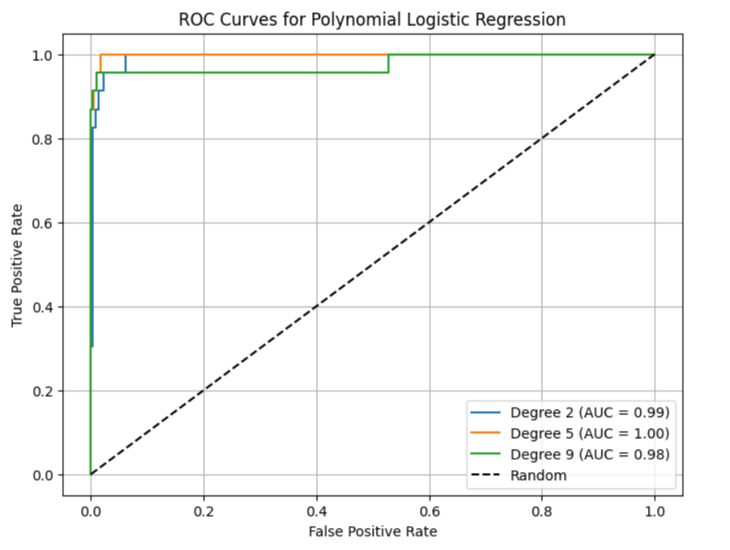
Logistic Regression with a non-linear decision boundary using polynomial features

Slide 13
Logistic Regression Model Evaluation
The logistic regression models were evaluated on the training, validation, and test sets using Accuracy, Precision, and Recall.
The results for linear and polynomial models are summarized
Model / Degree | Training | Validation | Test
Linear | Acc: 0.9852 Prec: 0.9121 Rec: 0.7411 | Acc: 0.992 Prec: 0.9130 Rec: 0.9130 | Acc: 0.980 Prec: 0.8750 Rec: 0.6364
Polynomial 2 | Acc: 0.9844 Prec: 0.8763 Rec: 0.7589 | Acc: 0.986 Prec: 0.8333 Rec: 0.8696 | Acc: 0.982 Prec: 0.8421 Rec: 0.7273
Polynomial 5 | Acc: 0.9972 Prec: 1.0000 Rec: 0.9375 | Acc: 0.992 Prec: 0.9524, Rec: 0.8696 | Acc: 0.978 Prec: 0.7391 Rec: 0.7727
Polynomial 9 | Acc: 1.0000 Prec: 1.0000 Rec: 1.0000 | Acc: 0.992 Prec: 0.9130 Rec: 0.9130 | Acc: 0.984 Prec: 0.7917 Rec: 0.8636

Slide 14
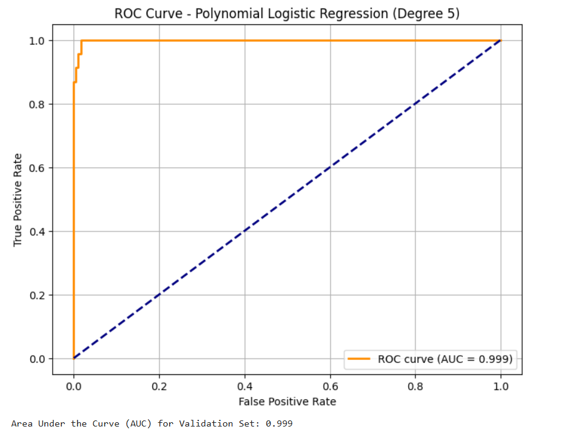
Selecting the best model based
Based on validation set performance, the degree 5 polynomial logistic regression is the best model offering the best trade-off between training performance and generalization.
the ROC curve is close to the top-left corner, indicating strong discriminative ability between churn and non-churn customers.
The AUC value (Area Under the Curve) is 0.99, confirming excellent performance on the validation set.

Slide 15
Thank you
Jouwana Daibes 1210123
Emil Khoury 1211223

