Slide 1
BEIJING HOUSING REPORT
By Group 25:
Bryan, Castelle, Jian Feng, Jovan, Samantha, Si Qi

Slide 2
Table of Contents
1. Background Information
2. Data Exploration
3. Data Cleaning
4. Data Analysis (Level I)
5. Data Analysis (Level II)
6. Data Analysis (Level III)
7. Recommendation

Slide 3
Background Information
We are given Beijing housing price information.
Through our presentation, we seek to:
Identify properties worth investing
Offer recommendations to management
Notes:
Cas & siqi

Slide 4
Data Exploration
Property Information
1. url
The URL of the property (house)
2. id
The ID of the transaction
3. Lng
Longitude of the property
4. Lat
Latitude of the property
5. Cid
The Community ID the property belongs to
6. constructionTime
When was the property constructed (Property age)

Slide 5
Data Exploration
Property Information
7. buildingType
What type of building
8. renovationCondition
What renovation is needed
9. elevator
Whether there are elevator
10. fiveYearsProperty
Whether there are policy applies
11. subway
Whether there are subway nearby

Slide 6
Data Exploration
Transaction Information
1. tradeTime
Transaction date of the transaction
2. followers
The number of people following or interested in the transaction
3. DOM
The number of days that a property has been listed
4. totalPrice
The total price of property (in ten thousands)
5. square
The size of property (in square meters)
6. price
The average price per square meters (in ten thousands)

Slide 7
Data Exploration
Room Details
1. livingRoom
The number of bedroom
2. drawingRoom
The number of living room
3. kitchen
The number of kitchen
4. bathroom
The number of bathroom

Slide 8
Data Exploration
Floor and Structure
1. floor
The number of floors and where is the unit located
2. buildStructure
What type of materials is used
Community Details
1. communityAverage
The number of people living in the community

Slide 9
Data Exploration
Data Details
Fields
Records
24
153,418

Slide 10

DATA CLEANING – Renaming of Fields
drawingRoom
LivingRoom
livingRoom
BedRoom

Slide 11
DATA CLEANING – Removing Null Values
buildingType
Null values removed for more accurate representation of the relationship between each building type, the property age and number of houses sold
constructionTime
Null values removed as they distorted the distribution of count of houses sold relative to the property age (derived from constructionTime)
Bedroom, Living Room, Kitchen, Bath Room
Null values removed for better visualisation of the distribution of each room with respect to the count of houses

Slide 12
DATA CLEANING – Removing outliers
Skewed data in price per SM caused by
outliers in totalPrice field
Retaining values within 3 standard deviation of the mean

Slide 13
LEVEL I QUESTION
What are the key factors influencing the demand for houses?

Slide 14
Why Demand?
Determine the type of houses that people are looking for
Make an informed decision on what houses to invest in

Slide 15
Justification of Key Factors
Location
Number of Rooms
Property Age
A desirable location includes:
Good school systems
Green spaces
Public transportation
Grocery and retail stores
Restaurants and food
A property with more livable space is more popular than a home with less space in the same market. More livable space may include more bedrooms, bathrooms and kitchens.
Many people looking for a new home are on the hunt for a newer, modernized property in top condition so that frequent repairs are not a concern. This makes a home's age and condition important factors that determines the demand of properties.

Slide 16
LEVEL II QUESTION
Does location affect demand for houses per property?

Slide 17
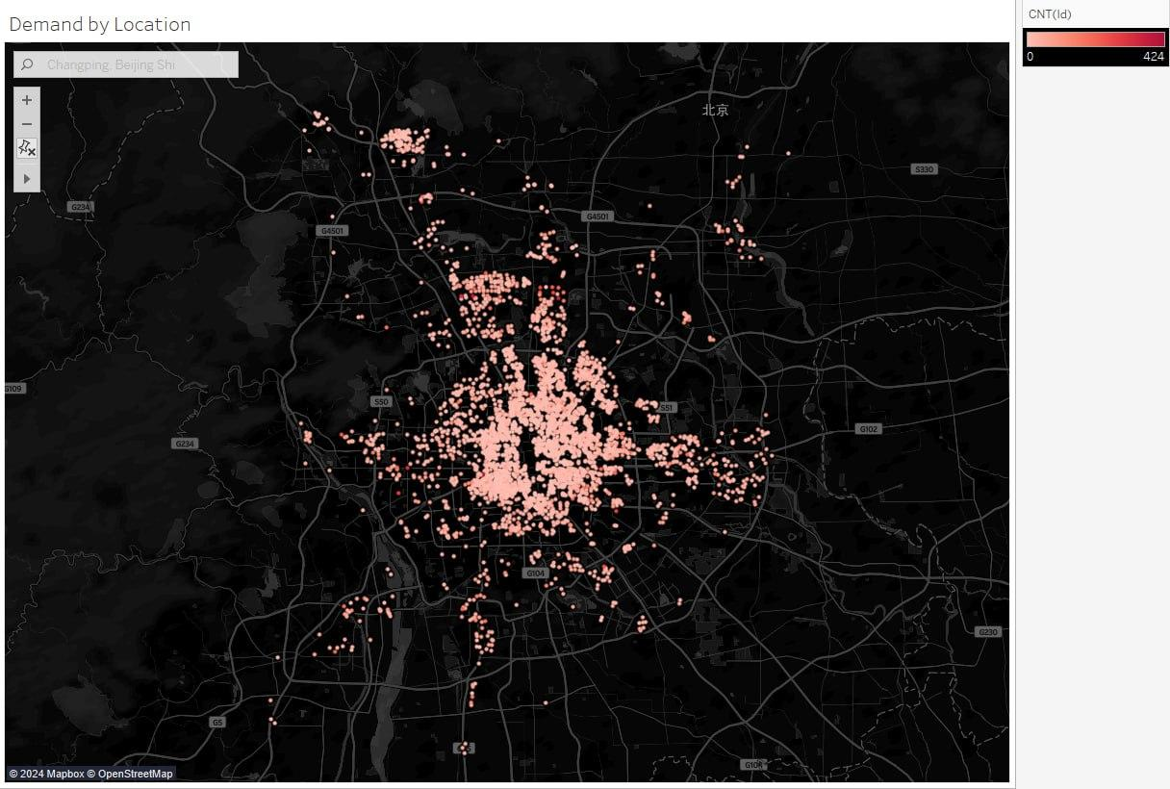
Demand
(Map Chart)
Observation and analysis on demand by location:
The color for most properties is light pink
Only few properties are a darker shade of pink
Most houses have similar demands per property.
The demand per property is either high or low

Slide 18
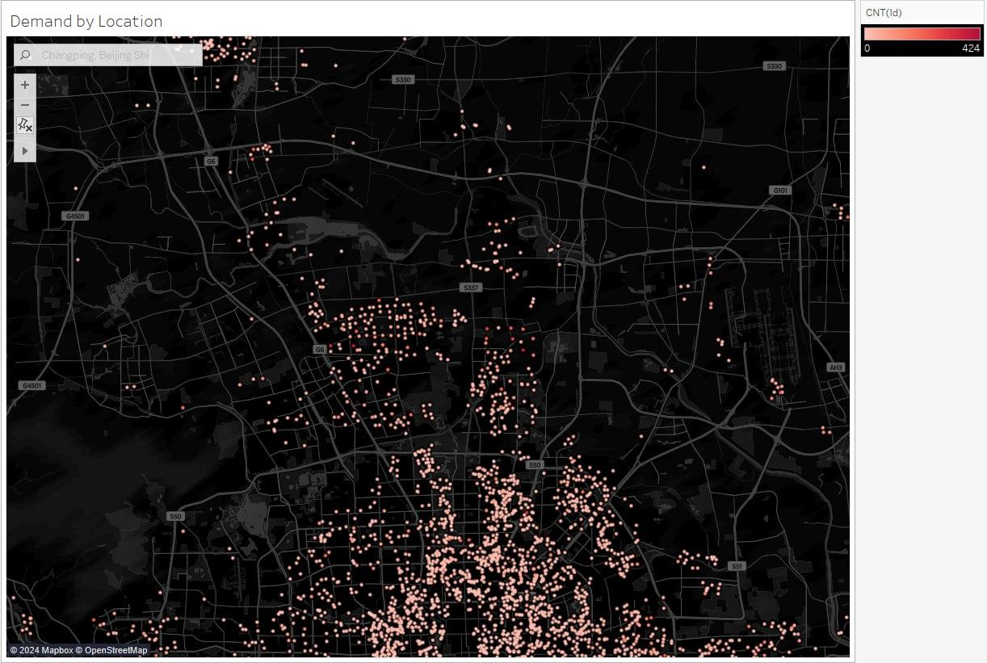
Conclusion
(Map Chart)
Observation and analysis on demand by location:
The houses with higher demand per property is concentrated in this district, Changping district.

Slide 19
LEVEL II QUESTION
Does the number of bedrooms, living rooms, bathrooms and kitchens affect the sales of houses?

Slide 20
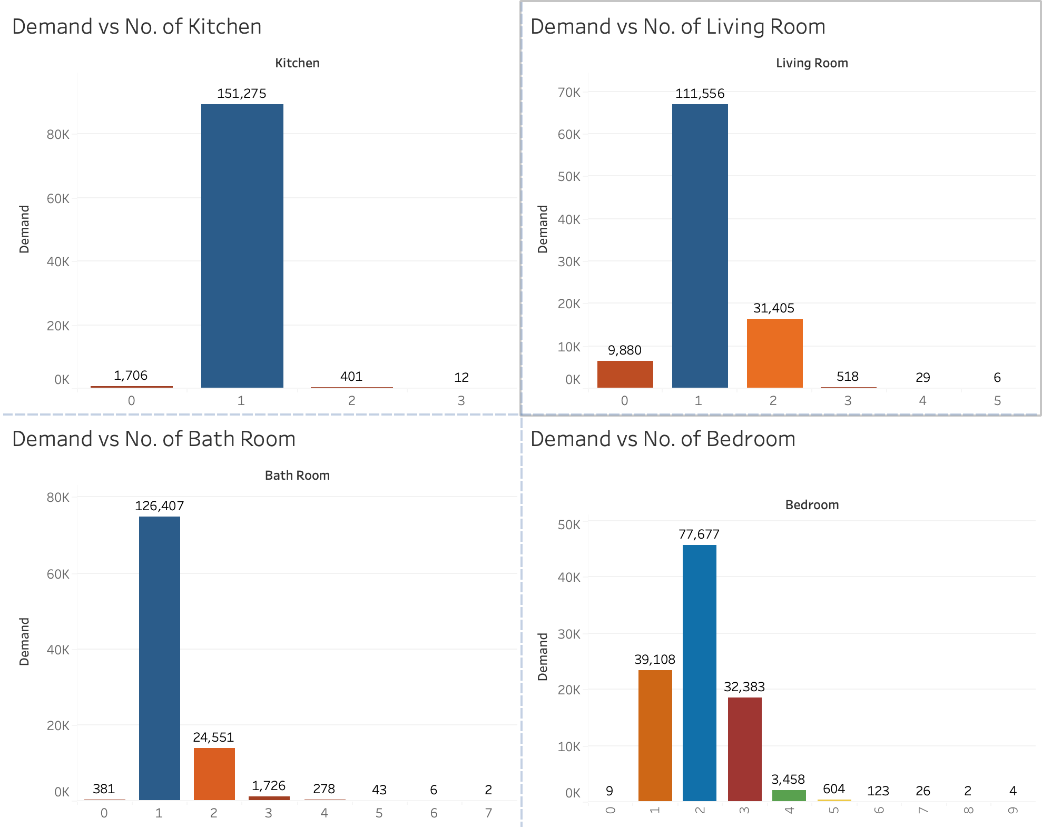
(Bar Chart)
Bedroom
Observation and Analysis
The highest number of houses that are sold have 2 bedrooms, followed by 1 bedroom and then 3 bedrooms.
The number of bedrooms chosen is highly dependent on household size and price stability

Slide 21
(Bar Chart)
Living Room
Observation and Analysis
The highest number of houses that are sold have 1 living room, followed by 2 living rooms, and then no living room.
This is due to the importance of having at least 1 living room

Slide 22
(Bar Chart)
Bath Room
Observation and Analysis
The highest number of houses that are sold have 1 bathroom, followed by 2 bathrooms.
This is due to the basic need for at least 1-2 bath rooms depending on household size and the unimportance of having 3 or more bath rooms

Slide 23
(Bar Chart)
Kitchen
Observation and analysis
The highest number of houses that are sold have 1 kitchen. The proportion of houses with 1 kitchen is significantly greater than those with 0, 2 or 3 kitchens
This is likely due to the significant necessity of having at least 1 kitchen and the unimportance of having 2 or more kitchens

Slide 24
Conclusion
 | Houses with highest sales have
Bedroom | 2
Living Room | 1
Bath Room | 1
Kitchen | 1

Slide 25
LEVEL II QUESTION
Does the property age (construction time) affect the demands of houses?

Slide 26
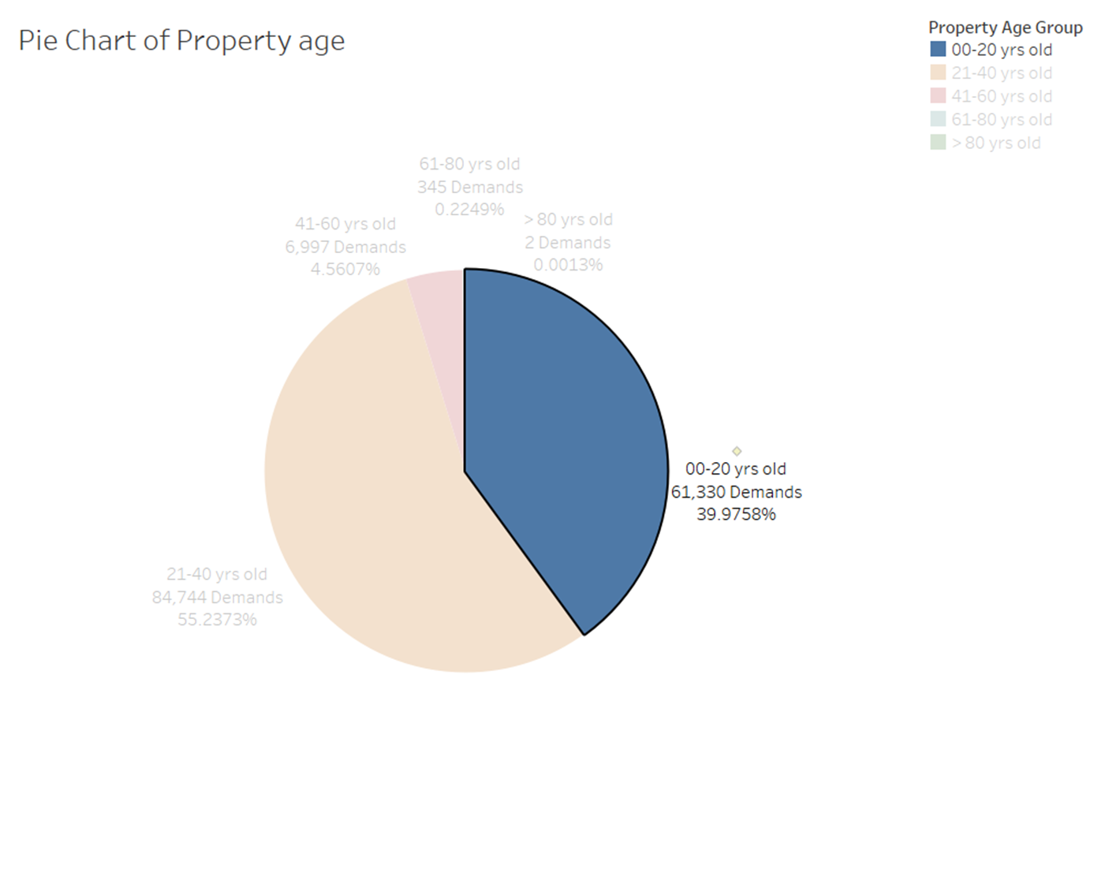
0 - 20 years
Observation and analysis on property ages:
Age group of 0 - 20 years olds is the second-largest segment of properties that with 61,330 demands.
This indicates a preference for properties that are modern amenities or less need for immediate maintenance.

Slide 27
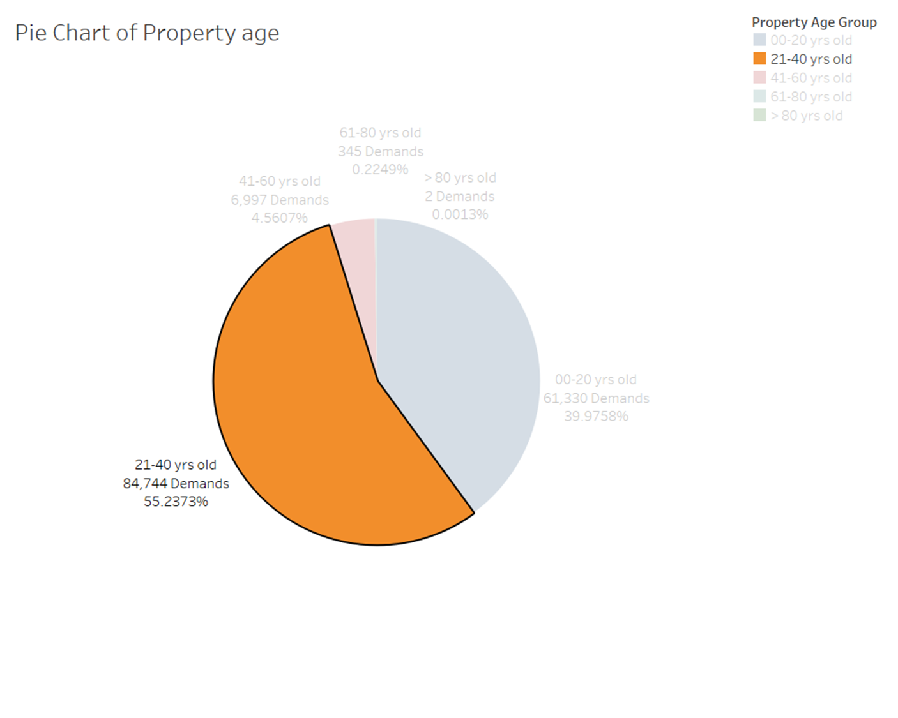
21 - 40 years
Observation and analysis on property ages:
Age group of 21 - 40 years olds is the largest segment of properties that with 84,744 demands.
This indicates a strong preference for properties that are not too old but have possibly undergone some depreciation, which might make them more affordable

Slide 28
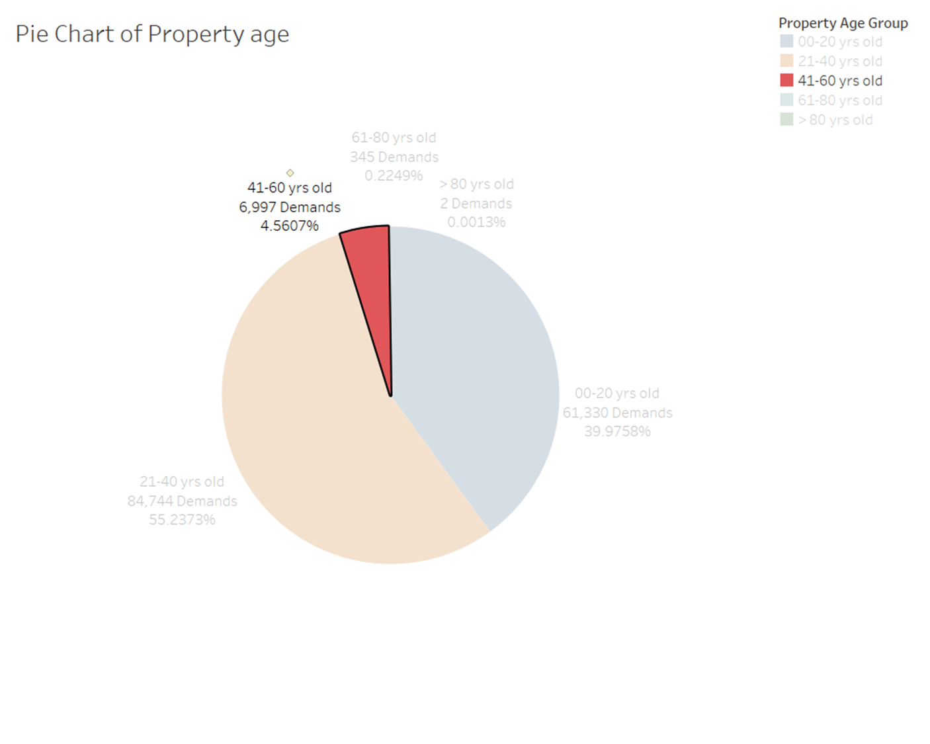
41 - 60 years
Observation and analysis on property ages:
Age group of 41 - 60 years olds shows a significant drop in demand with only 6,997 demands.
This suggests that properties of this age are less preferred, which might be due to the need for more maintenance or they might not meet the modern living standards without renovation.

Slide 29
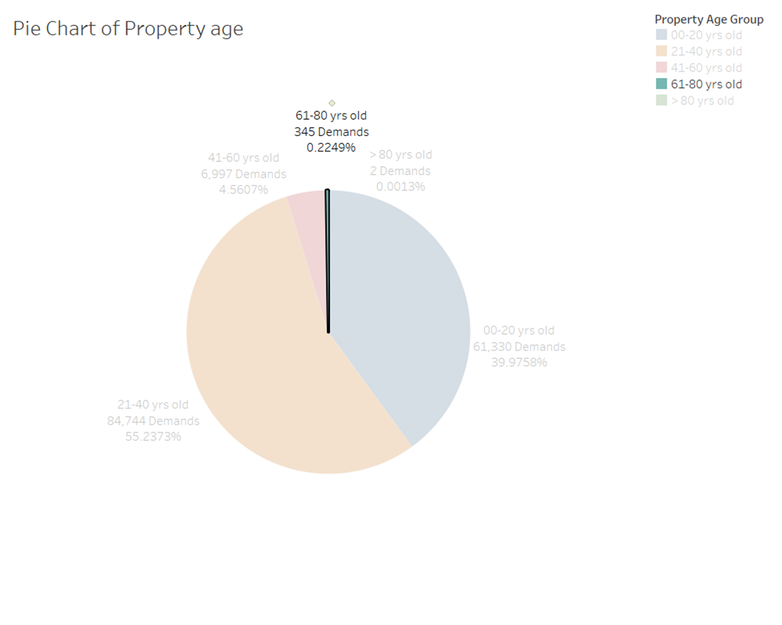
61 - 80 years
Observation and analysis on property ages:
Age group of 61 - 80 years olds shows a significantly little demand with only 345 demands.
The little demand could be attributed to the potential for higher maintenance costs and outdated designs

Slide 30
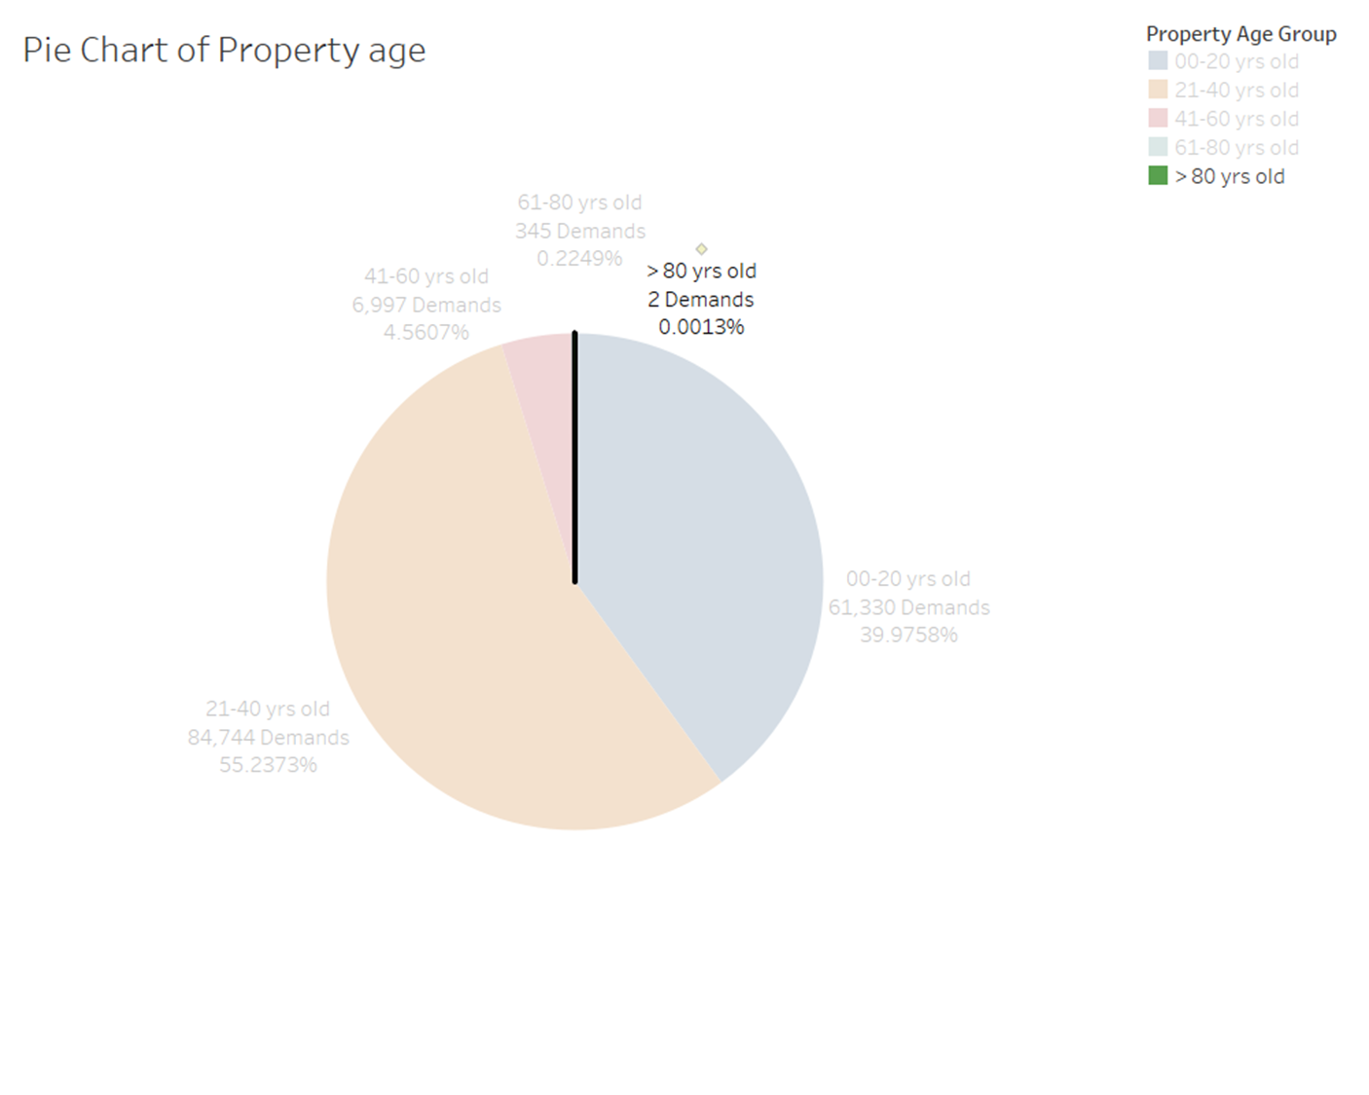
> 80 years
Observation and analysis on property ages:
Age group of more than 80 years olds shows the least demand with only 2 demands.
This suggests that properties of this age might be considered too old, possibly historic, and may require extensive renovation to meet current standards, thus making them less attractive to most buyers.

Slide 31
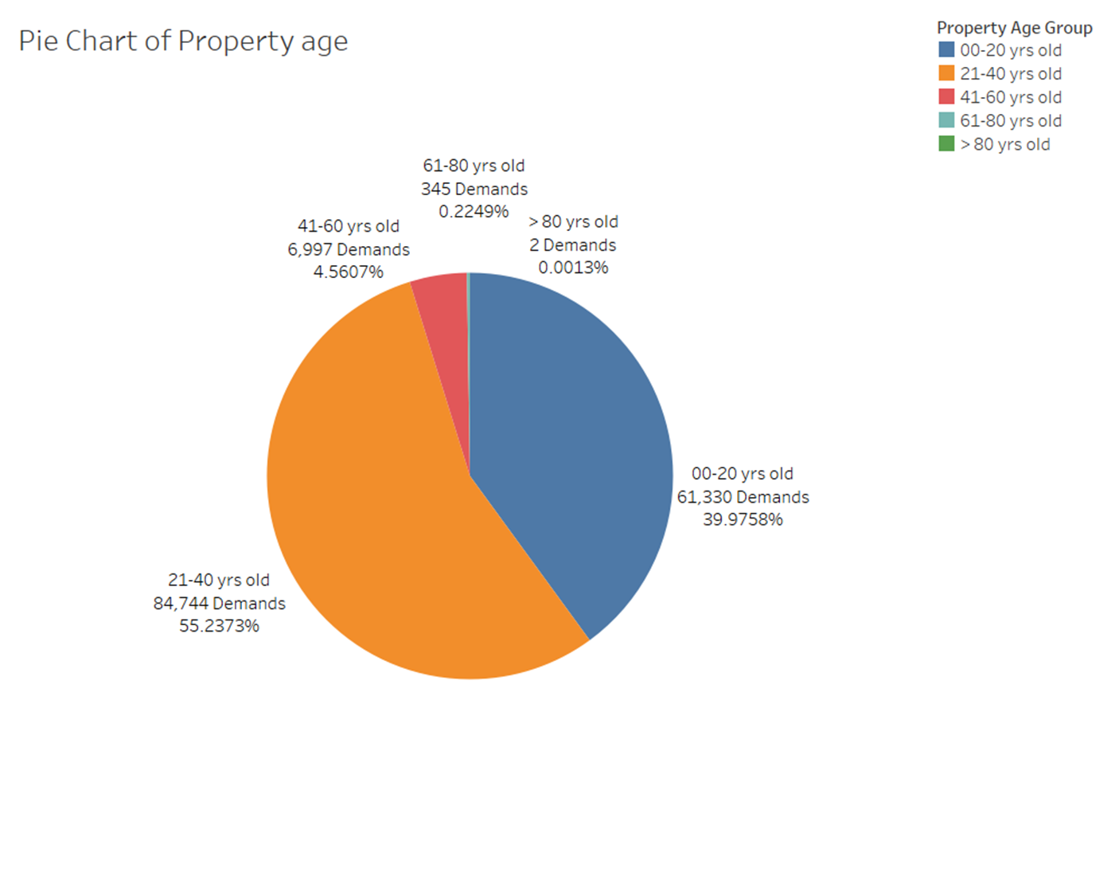
Conclusion
Observation and analysis on property ages:
There is a clear preference for properties that are less than 40 years old, with the demand sharply decreasing as the property age increases beyond 40 years.

Slide 32
LEVEL III QUESTION
What kind of houses should we invest in to minimise risk of investment loss?

Slide 33
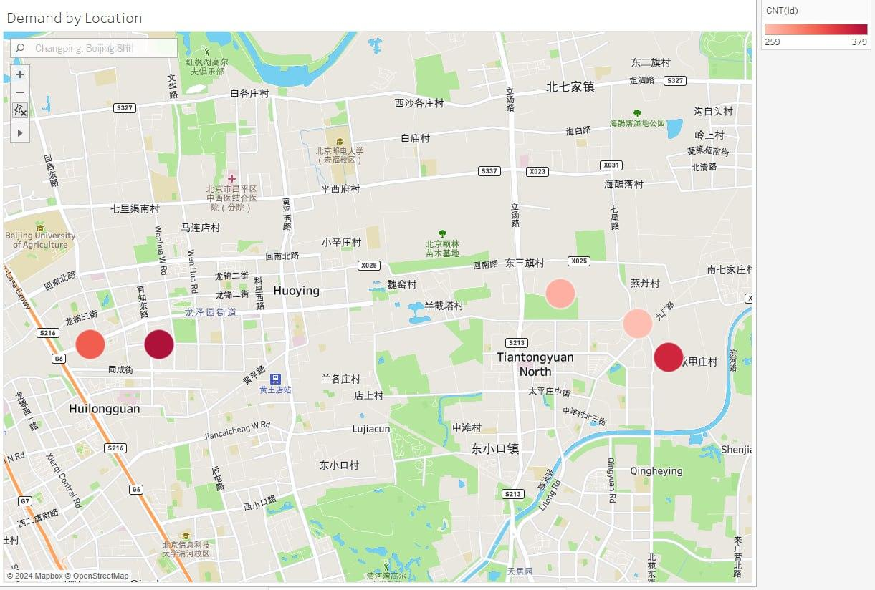
Location
Observation and analysis on demand by location:
Filtered to Top 5 properties with the greatest demand

Slide 34
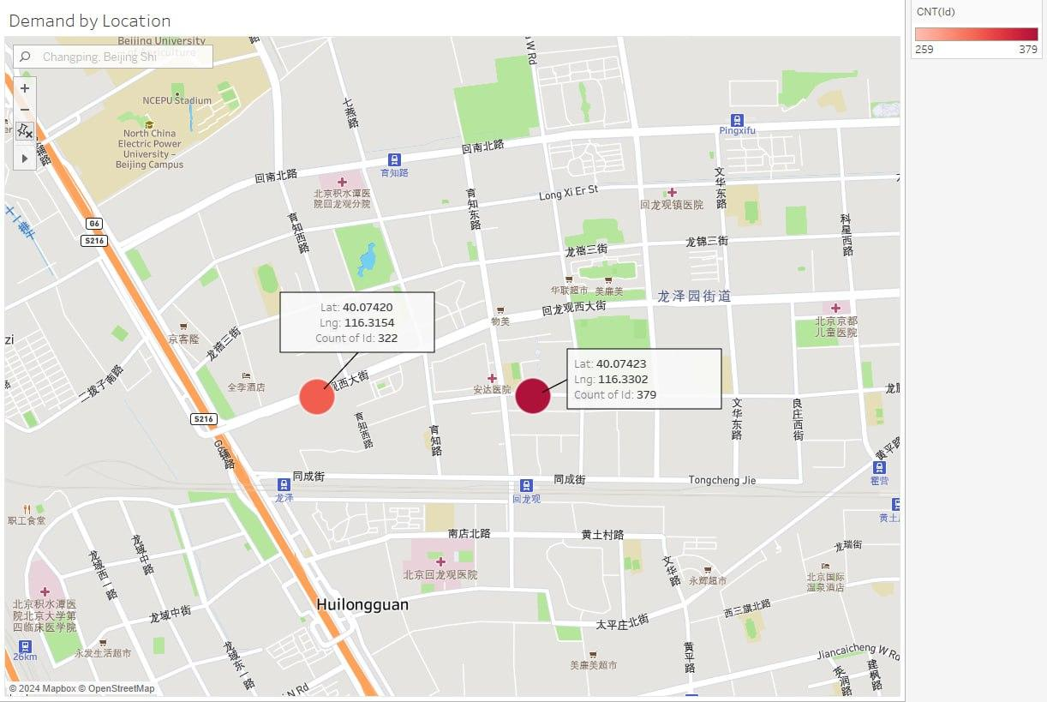
Location
Observation and analysis on demand by location:
Huilongguan
The property with the highest demand is near several facilities such as: - Supermarkets - Hospitals - Train stations
Hospital
Supermarkets
Hospital
Hospital
Train Station
Train Station
Hospital

Slide 35
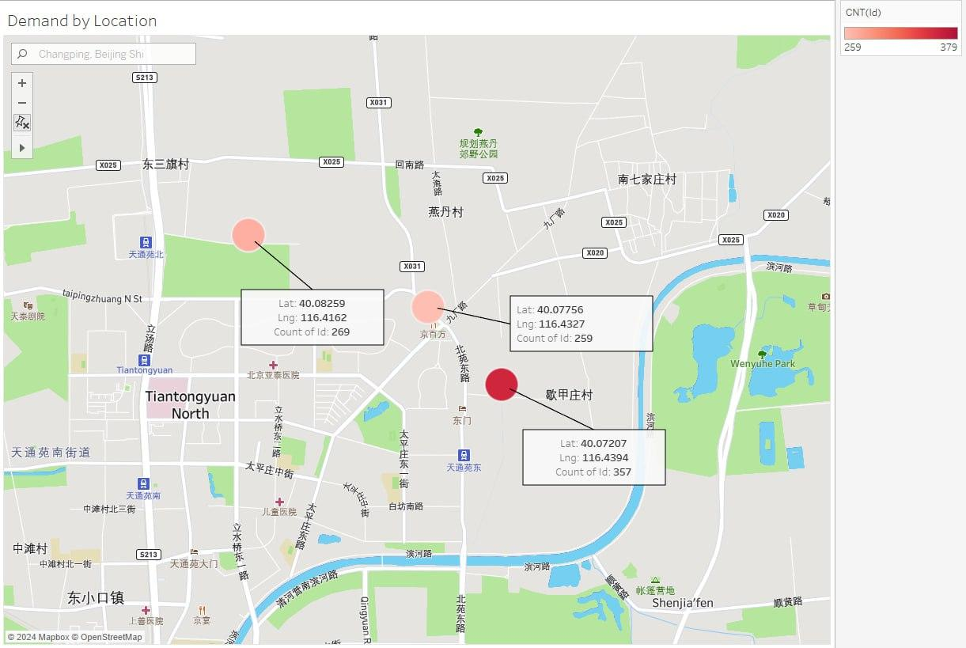
Location
Observation and analysis on demand by location:
The second area with high demand is Tiantongyuan
Nearby facilities include: - Hospitals - Train Stations - Park
Train Stations
Park
Hospital
Train Station
Hospital

Slide 36
Location
Further research:
“dilapidated condition … lack of infrastructure, both social and industrial, allied to heavy traffic congestion.”
“attracted its huge population as a result of its low property prices”
- China Daily
Bad environment
Bad reputation
Train Stations
Park
Hospital
Train Station
Hospital

Slide 37
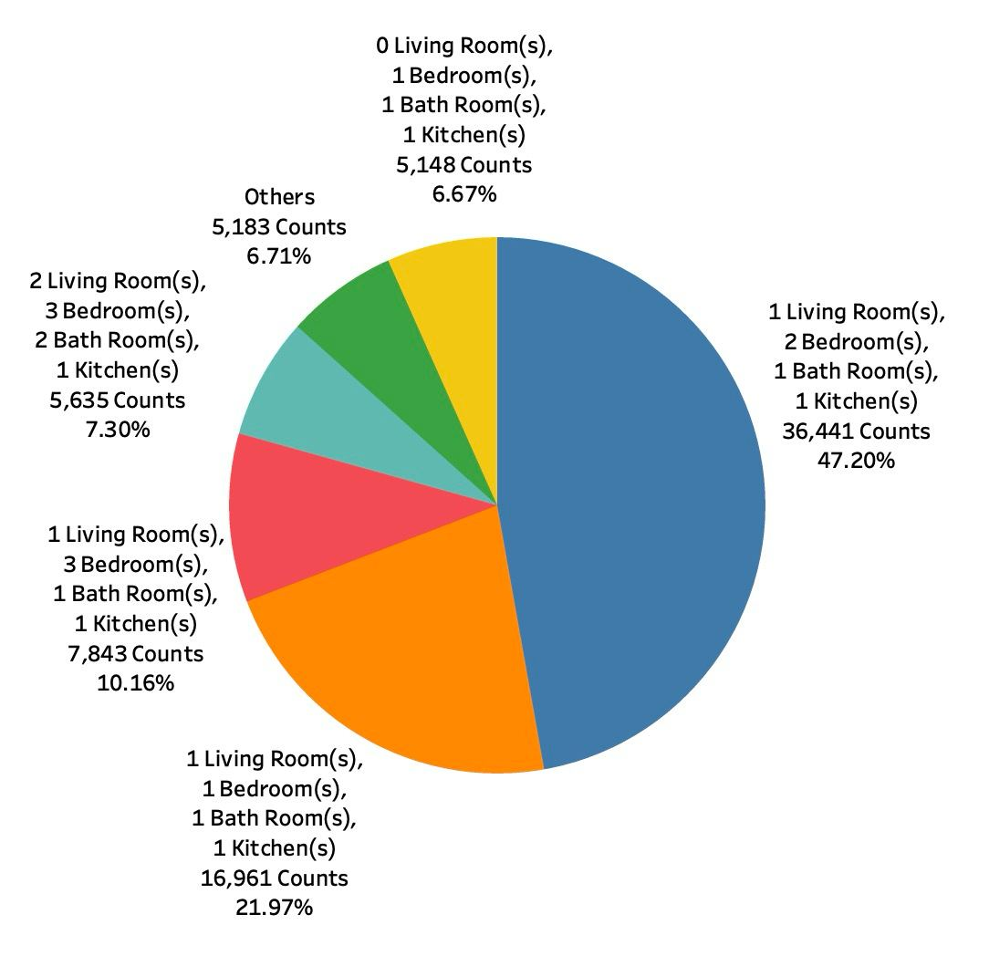
Types Of Houses – Room Combination
Pie Chart of the Types of Houses (Room Combination)
Observation and Analysis
Houses with 1 Living room, 2 Bedrooms, 1 Bathroom and 1 Kitchen (47.2%). It has the highest demand.
Houses with 1 bedroom (21.97%). Houses with 3 bedrooms (10.16%).
It seems like the number of bedrooms are the most important factor that people consider when buying their houses, which is highly dependent on the number of people living in the house.

Slide 38
Household Sizes in Beijing
Table of Household Sizes in Beijing
Observation and Analysis
1 member → 1 bedroom house.
2 members → 1 or 2 bedroom house depending on their incomes.
3 - 4 members → 2 bedrooms.
5 or more members → 3 or more bedrooms.
2, 3 and 4 household members is at 80.95%, this can be the reason why 2 bedrooms type are more popular.
Household Size | Average Percentage (%) of Households (2011 - 2017)
1 | 21.05
2 | 31.05
3 | 28.85
4 | 10.45
5 or more | 8.60
Data extracted from Beijing Statistical Yearbook (2012-2018)

Slide 39
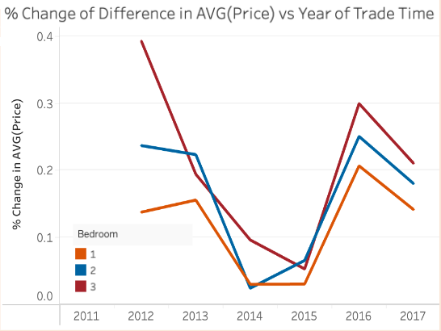
Price Stability and Profit
Observation and Analysis
The % change in Avg(Price) for 3 bedrooms → fluctuates → less stable in the market.
The % change in Avg(Price) for 1 bedroom < 2 bedrooms → higher profit in the long run for 2 bedrooms.
2 bedrooms are more price stable and more profitable.
(Line Graph)

Slide 40
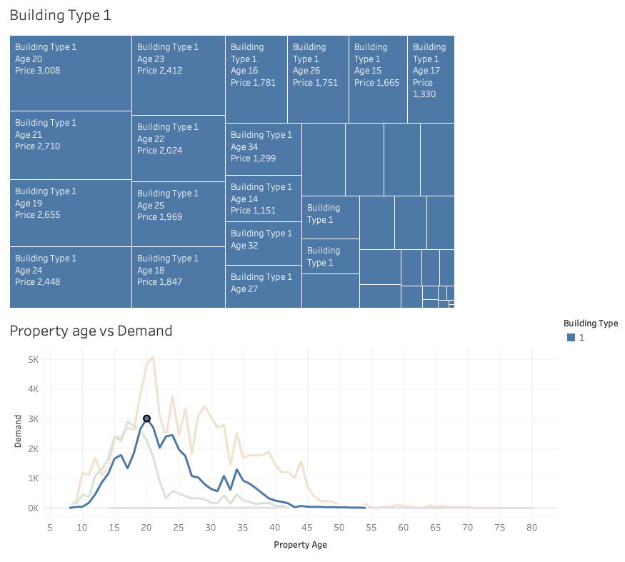
Property Age
(Tree Map)
Observation and analysis on Building type 1:
Building type 1 refers to tower.
From the tree map diagram and line graph, majority demands of type 1 are around the age of 17 to 25.
The demands of type 1 building decrease after the age of 20.

Slide 41
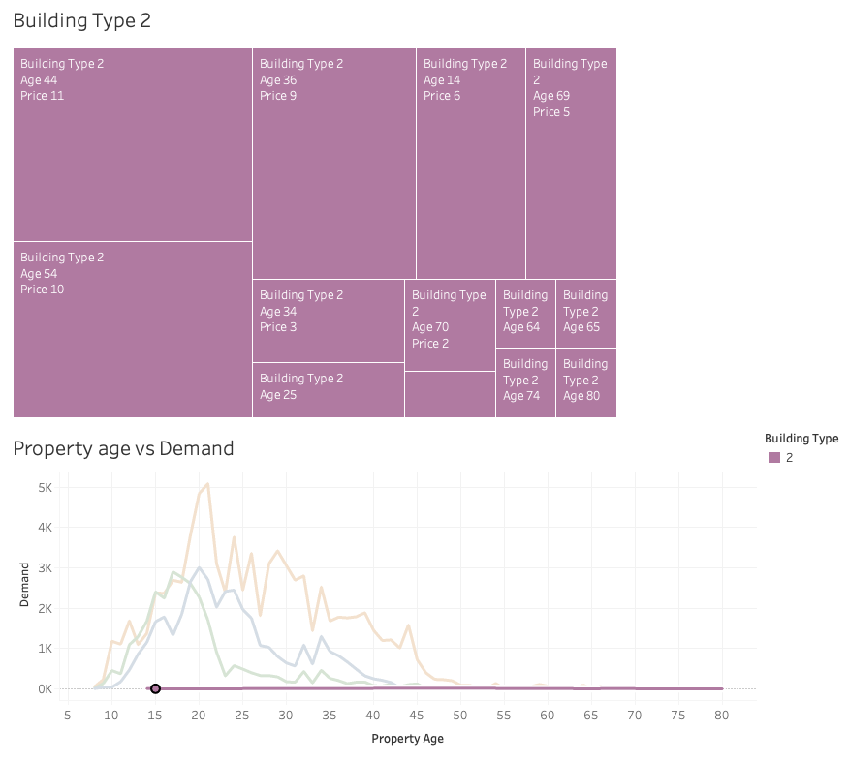
Property Age
(Tree Map)
Observation and analysis on Building type 2:
Building type 2 refers to bungalow.
From the line graph, we are able to tell that there are not enough data to identify how property age affect type 2 demands.

Slide 42
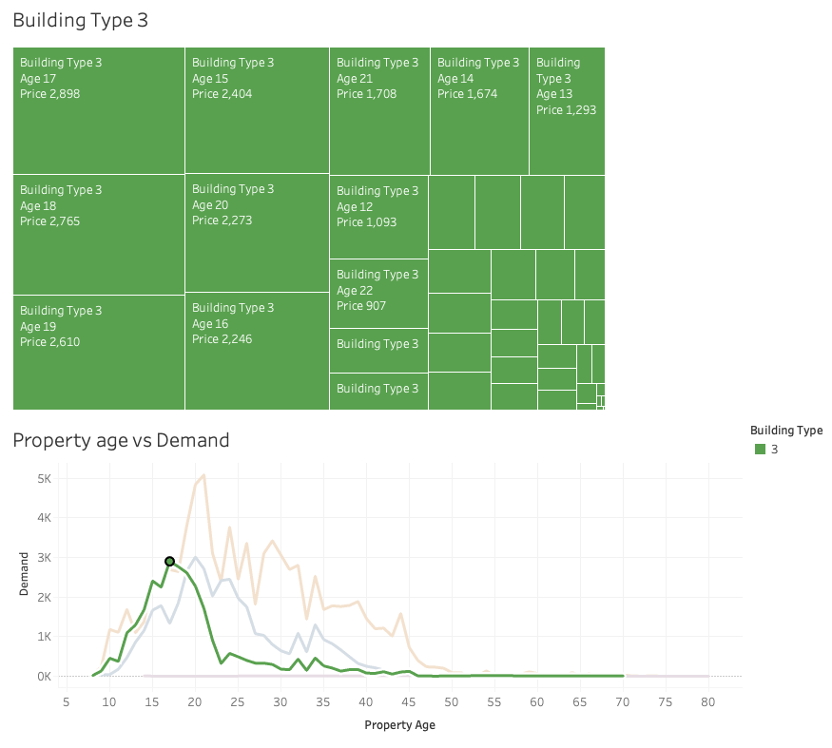
Property Age
(Tree Map)
Observation and analysis on Building type 3:
Building type 3 refers to a combination of plate and tower.
From the tree map diagram and line graph, majority demands of type 3 are around the age of 15 to 20.
The demand of type 3 building decreases after the age of 17.

Slide 43
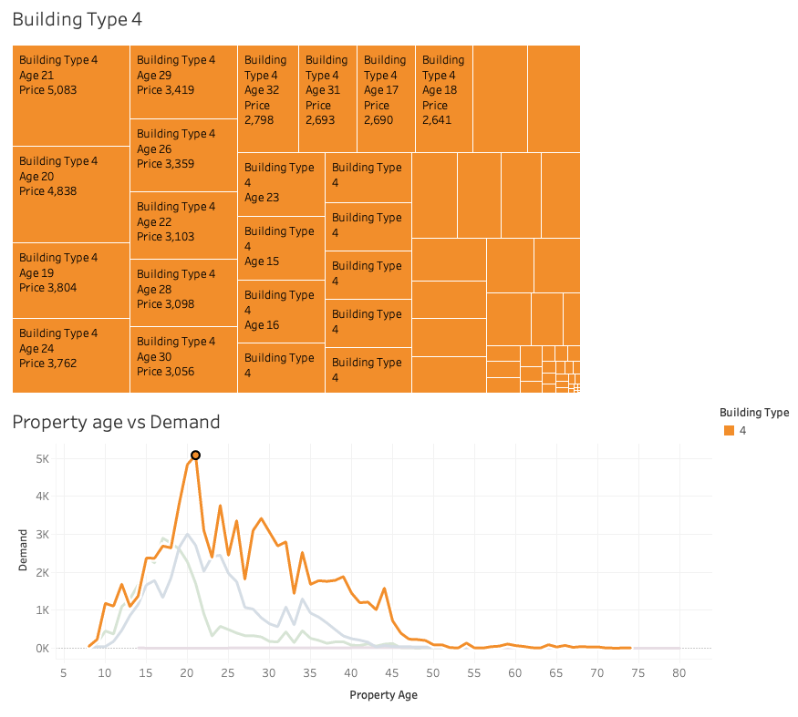
Property Age
(Tree Map)
Observation and analysis on Building type 4:
Building type 4 refers to plate.
From the tree map diagram and line graph, majority demands of type 4 are around the age of 19 to 30.
The demand of type 4 building decreases after the age of 30.

Slide 44
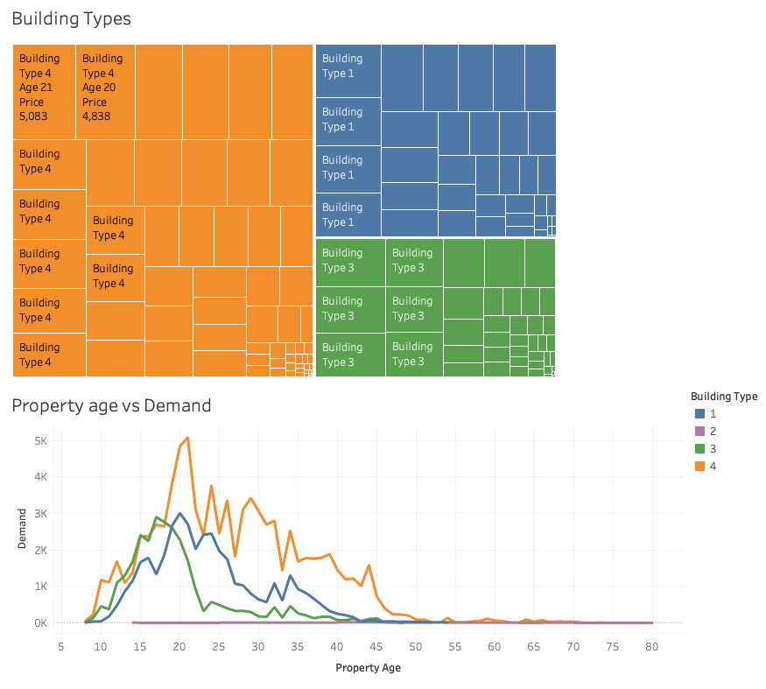
Property Age
(Tree Map)
Observation and analysis on Building type (Overall):
From the tree map diagram, majority demands comes from type 4 buildings that are around the age of 20.
From the line graph, the demands of type 4 building are generally more than the rest.

Slide 45
Recommendation for Investment
Location
Huilongguan
Near amenities such as hospitals and train stations
House type
2 Bedrooms
1 Living room
1 Bathroom
1 Kitchen
Property Age
Property age of 20
Building type 4

Slide 46
Thank You!

Slide 47
References
Beijing Municipal Bureau of Statistics. 2018, Beijing Statistical Yearbook 2018 https://nj.tjj.beijing.gov.cn/nj/main/2018-tjnj/zk/indexeh.htm
Beijing Municipal Bureau of Statistics. 2017, Beijing Statistical Yearbook 2017
https://nj.tjj.beijing.gov.cn/nj/main/2017-tjnj/zk/e/indexeh.htm
Beijing Municipal Bureau of Statistics. 2016, Beijing Statistical Yearbook 2016
https://nj.tjj.beijing.gov.cn/nj/main/2016-tjnj/zk/e/indexee.htm
Beijing Municipal Bureau of Statistics. 2015, Beijing Statistical Yearbook 2015
https://nj.tjj.beijing.gov.cn/nj/main/2015-tjnj/zk/indexeh.htm
Beijing Municipal Bureau of Statistics. 2014, Beijing Statistical Yearbook 2014
https://nj.tjj.beijing.gov.cn/nj/main/2014-en/index.htm

Slide 48
References
Beijing Municipal Bureau of Statistics. 2012, Beijing Statistical Yearbook 2012
https://nj.tjj.beijing.gov.cn/nj/main/2012-en/index.htm
China Daily Hong Kong. 2019. Tiantongyuan redevelopment set to improve lives. China Daily Hong Kong.
https://www.chinadailyhk.com/articles/254/57/32/1549963057795.html.
National Bureau of Statistics of China. 2013, China Statistical Yearbook 2013
https://www.stats.gov.cn/sj/ndsj/2013/indexeh.htm
Spooner, D. 2023. The Top 6 Factors Affecting Investment Property Value. Entrepreneur.
https://www.entrepreneur.com/starting-a-business/what-to-consider-when-determining-the-value-of-an/456653

