Slide 1


Empowering Developers with zkPass for Zero-Knowledge Verification
Welcome to the world of zero-knowledge proofs. This presentation will introduce zkPass, a tool that empowers JavaScript developers to verify data without revealing sensitive information.
by Joe Cot

Slide 2

zkPass Overview & Benefits
Simplified Verification
Enhanced Privacy
zkPass ensures privacy by verifying data without revealing sensitive information, protecting user data and enabling secure transactions.
zkPass simplifies zero-knowledge verification, making it accessible to developers without extensive cryptographic expertise.
Wide Applicability
zkPass is versatile and can be used for various applications, including identity verification, anti-cheating mechanisms, and Web3 interactions.

Slide 3
Introduction to Zero-Knowledge Proofs (zkPs)
What is a zkP?
Example
Imagine a cryptographic proof that allows a verifier to confirm the truth of a statement without revealing any sensitive details. That's the essence of a zero-knowledge proof (zkP). zkPs empower you to verify data, like user age or identity, without compromising privacy.
Let's say you want to verify someone's age for an online service. Using a zkP, you can confirm that they are 18 or older without needing to know their exact birthdate. This protects their privacy while still ensuring they meet the age requirement.

Slide 4

Why zkPass?
Simplified Verification
Enhanced Privacy
zkPass ensures privacy by verifying data without revealing sensitive information, protecting user data and enabling secure transactions.
zkPass simplifies zero-knowledge verification, making it accessible to developers without extensive cryptographic expertise.
Wide Applicability
zkPass is versatile and can be used for various applications, including identity verification, anti-cheating mechanisms, and Web3 interactions.

Slide 5
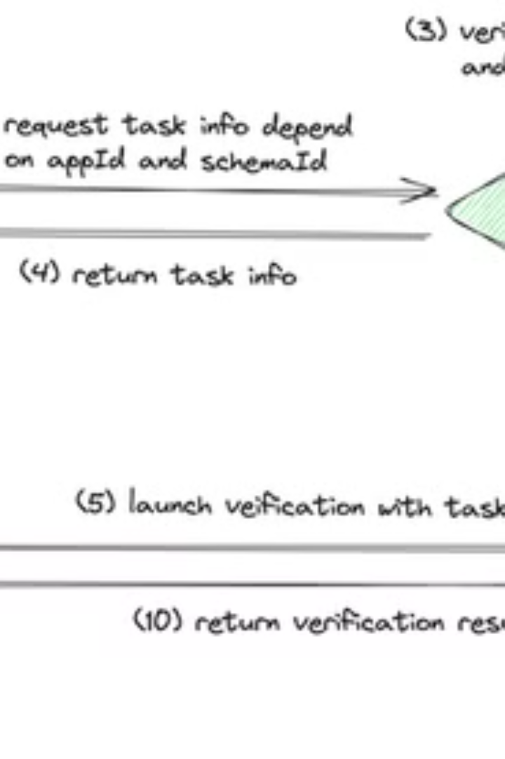
How it Works
1
1. User Request
The user initiates a verification request, such as proving they are 18 years old, without revealing their birthdate.
2
2. zkPass Verification
zkPass generates a zero-knowledge proof based on the user's data, demonstrating they meet the specified requirements without disclosing sensitive information.
3
3. Proof Submission
The user submits the proof to the verifier, allowing them to confirm the user's eligibility without accessing the actual data.
4
4. Verification Result
The verifier receives and evaluates the proof, granting access or providing the appropriate response based on the verification outcome.

Slide 6
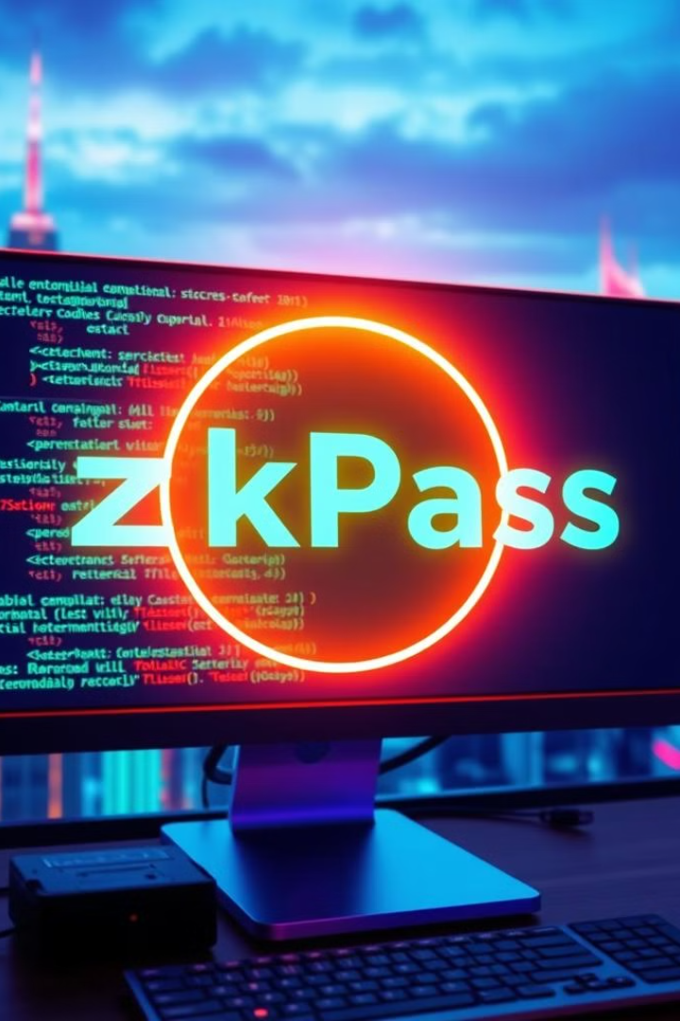




Getting Started with zkPass
Install zkPass Extension
zkPass Dev Center
Get started by downloading the zkPass Chrome Extension to your browser. It's your gateway to accessing zkPass features.
Sign up for a zkPass developer account to access the powerful tools and resources needed to create and manage your zero-knowledge verification projects.
Set Up Your Environment
Add zkPass SDK
Ensure your JavaScript development environment is ready to go. You'll need a code editor and a package manager to install the zkPass SDK.
Install the zkPass SDK (zkpass-sdk) to your project using your package manager. This provides the necessary tools for integrating zero-knowledge verification functionality into your applications.

Slide 7
Creating a Custom Schema
Inspecting Network Requests
Defining Intercept URLs
Open your target website (e.g., Upwork, UOB Bank) and inspect network requests using Chrome's "Network" tab to find APIs that provide the desired information. Capture Fetch/XHR requests to identify specific API endpoints.
Define the intercept URL, which is the API endpoint that will be used to retrieve data for verification. For dynamic URLs, use ?=? placeholders to represent variable parts of the URL.

Slide 8
Schema Validation
Paste Your Schema
Common Gotchas
After creating your custom schema, paste it into the zkPass developer center for validation. The platform will analyze your schema for errors and provide feedback to ensure accuracy.
Avoid leading or trailing slashes in your URLs.
Use placeholders like `?=?` for dynamic API intercepts.
Nested arrays or objects should use the `a|0|b` format for proper key representation.

Slide 9




Integrating the zkPass SDK
Include zkPass SDK
Start by adding the zkPass SDK to your project using npm install zkpass-sdk. This will provide the necessary tools for integrating zero-knowledge verification functionality into your applications.
Check Extension Availability
Use TransgateConnect to determine if the zkPass Chrome extension is available. This will ensure that the user has the necessary tools for verification.
Initiate Verification
Initiate the verification process using your schema ID and app ID. The code example provided demonstrates how to use the TransgateConnect object to launch the verification process.

Slide 10
Verifying the Proof
Verify Allocator Signature
1
This initial step ensures the proof originated from a trusted source.
Verify Validator Signature
2
This step confirms the integrity of the proof, guaranteeing it hasn't been tampered with.
On-Chain Verification
3
Optionally, record the verification result on a blockchain for greater transparency and trust.

