Slide 1
Decorators
&
What they are used for!

Slide 2
WHAT is a Decorator??
A decorator is a type of pattern called a structural pattern, We use it so that we can give new behaviour to a object in a dynamic way, these objects are called special wrapper objects or “decorators”.

Slide 3

You can also wrap a object any number of times because both the object and decorator follow the same interface which will result in a stacking behave with all the wrappers.

Slide 4
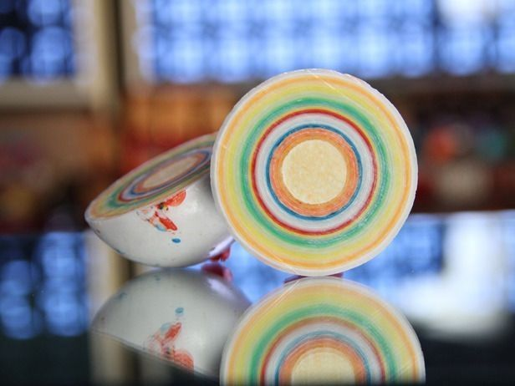
Its kind of like a jawbreaker, at the centre is the core functionality that will never change, but It tastes different because each layer can change as you eat it.

Slide 5
WHY should I care?
Decorators are great because they let us make our code more flexible by giving us the freedom to alter how a function or object may interact with something based of what it is.

Slide 6


HERES AN EXAMPLE!
If you make a IWeapon interface, and then used that for a object called BaseSword then we have are base("wrappee") that we can decorate or "Wrap", so now we can change the functionality of the sword to not only do damage, but we can also have it inflict a status effect like a bleed effect or something simulare.
So even after altering the way the sword works, it still keeps the basic functionality of a weapon by dealing damage.

Slide 7
“But how do we do this???” I hear you ask!!!

Slide 8
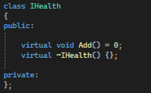
When creating a decorator, we will first need to creat a interface that will be the wrappee for our object.
(Don’t Forget the Destructor)

Slide 9
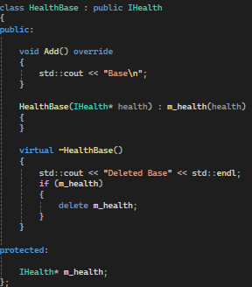
Next we will create are base, this is what we are putting are decorators on.
We do this by inheriting from are interface and using that as a contract to say what are object should be, then we add the functionality that we want it to have.
We also need the base to be able to store a object that is the same data type as are interface.
We do this so we can keep adding layers.

Slide 10
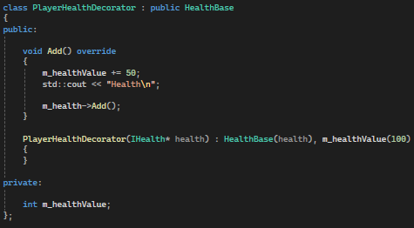
Finaly we can create are decorator that we will be using to layer over are base.
We do it by inheriting form are base and then overriding the function that we are wrapping, and after we call the original function in are base.
this changes the overall outcome but the base functionality stays the same.

Slide 11
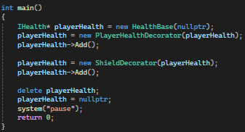
Now that we have finished with creating are decorator we can use them like this.

Slide 12
But why would I ever want to do this?
It can make creating object that are similar easier because instead of making lots of objects all with the same base functionality we can create one with all the functionality that we want layered on top.
Doing this also makes it easier for us when it comes to having to write the code, because instead of needing to call multiple functions for the same result, we can just call one giving us the result that we want.

Slide 13
Are there any downsides???
A big disadvantage is that when you use decorators you are still reserving pieces of memory when you new it again, meaning that even though we are not using multiple objects we are still using multiple spaces in are memory.
Also, the complexity of decorators can make code hard to follow through and debug when adding to many of them, which is why you should not create tones and put them on one object.

