Slide 1
Finite Element Approximation
Temperature in two dimensions

Slide 2
Problem Definition
On rectilinear domain from (0, 0) to (4, 4)
Boundary conditions

Slide 3
Finite Element Approximation
Goals
  Generality
    Any domain size, any rectangular or triangular grid
      Any step size in x or y
  Accuracy
  Compactness
    Don’t duplicate work

Slide 4
Finite Element Approximation
Square grid
  Becomes arbitrary rectangles
Structured and unstructured rectangular grid
  Structured grid of arbitrary step sizes
  Treat structured and unstructured identically

Slide 5
Step 1
Read problem configuration from file
  Arbitrary minima and maxima
  Arbitrary step size in x and y
    x, y step sizes separate
  Arbitrary k, f, T0
    k, f, T0 still constant across domain
      All a_{i,j} still just k
  Arbitrary boundary conditions
    Any boundary or boundary portion can be any boundary condition

Slide 6
Step 2
Read element maps and node coordinates from file
  For structured rectangle and triangle, write maps and coordinates to file for later reading
    Only need to do this once for each problem configuration
    x, y step sizes separate
    Same layout as unstructured triangle data
Removes need for local to global node mapping calculations
  All contained in a data structure read from the mapping file

Slide 7
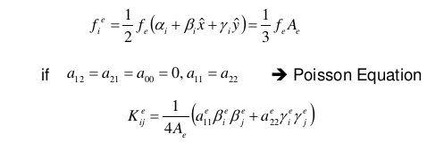
Step 3
Generate element-wise matrices
  Two functions instead of three
    Rectangles and triangles
      Structured vs unstructured is already decided by the mapping file, but be careful not to assume right angles in our triangles
      Instead, find area, α, β,γ for each triangle based on its node coordinates, then use these to generate
Removes need for local to global node mapping calculations
  All contained in a data structure read from the mapping file

Slide 8
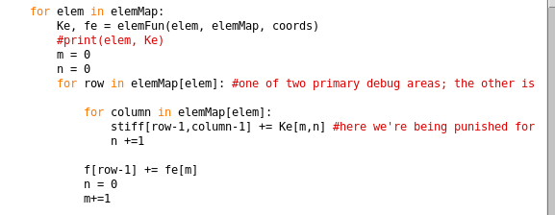
Step 4
Build global stiffness matrix and {F}
  Use element maps to choose the correct rows and columns
    Each element equation is done in terms of global nodes, so each entry in [K^{e}]{u^{e}} = {q^{e}} + {f^{e}} is coded by row and column in the global matrix equation

Slide 9
Step 5
Apply Boundary Conditions
  Check node coordinates data structure to see if a node qualifies for any boundary
  If so, apply the boundary
    Dirichlet: remove appropriate row, column from [K], add K_{i,j}*T_{j} to Q_{i}
    Neumann: Q_{i} += condition value

Slide 10
Step 6
Solve:
    [K]{T} = {Q} for {T}
Re-insert known nodes into {T}
  Indexed by global node number

Slide 11
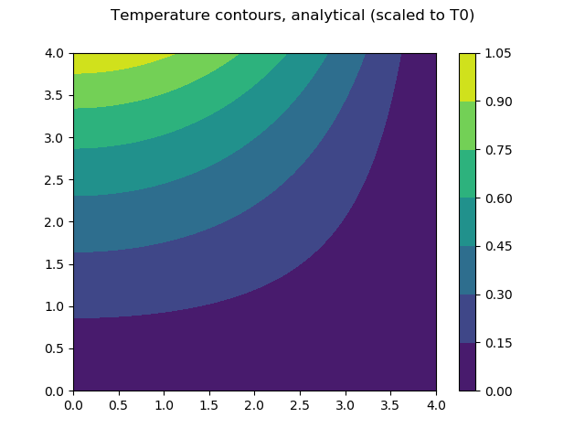
Results

Slide 12
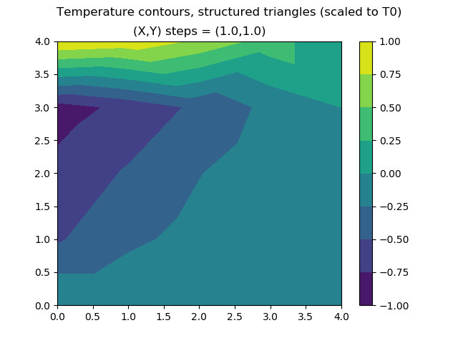
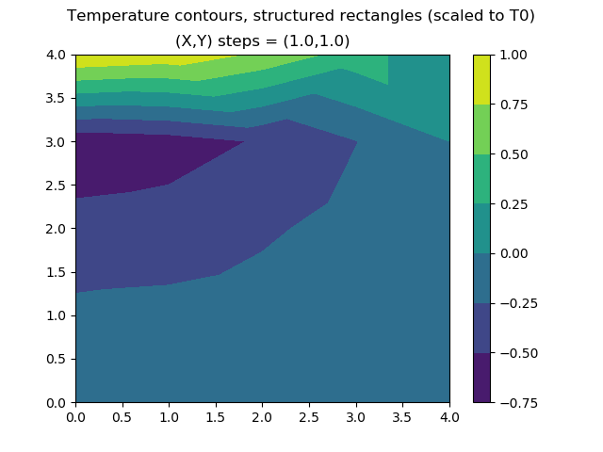
Results

Slide 13
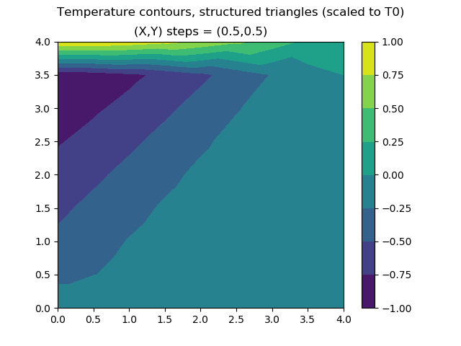

Results

Slide 14
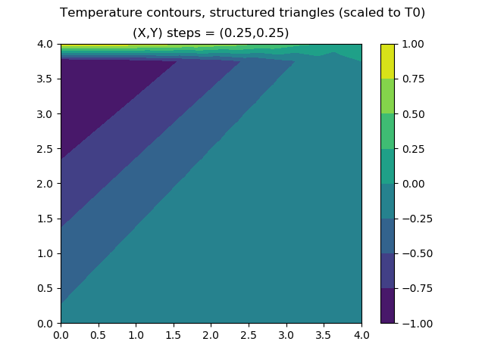
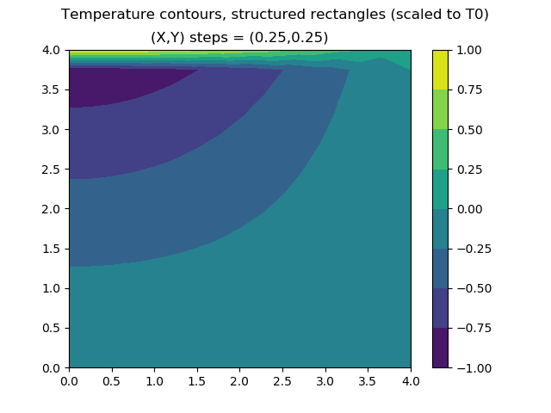
Results

Slide 15
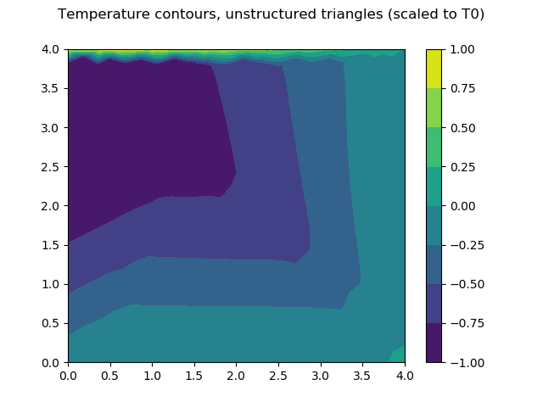
Results

Slide 16
Analysis
Possible sources of error:
  Building of individual element equations
    T(x,y) varies incorrectly in each element
    T(x,y) outcome depends sensitively on element type
  Building of global matrix equation
    T(x,y) not constrained correctly – elements do not mesh
      Lots of discontinuities
  Application of BCs
    T(x,y) flipped, stretched, or skewed
      Spikes/wells radiating from corners
  Reintegration of node vector
    Piecewise discontinuities from BCs tranlation

Slide 17
Analysis
Most likely?
  Error(s) building individual elements

