Slide 1
Finite Element Approximation
Temperature in two dimensions

Slide 2
Problem Definition
On rectilinear domain from (0, 0) to (4, 4)
Boundary conditions

Slide 3
Finite Element Approximation
Goals
Generality
Any domain size, any rectangular or triangular grid
Any step size in x or y
Accuracy
Compactness
Don’t duplicate work

Slide 4
Finite Element Approximation
Square grid
Becomes arbitrary rectangles
Structured and unstructured rectangular grid
Structured grid of arbitrary step sizes
Treat structured and unstructured identically

Slide 5
Step 1
Read problem configuration from file
Arbitrary minima and maxima
Arbitrary step size in x and y
x, y step sizes separate
Arbitrary k, f, T0
k, f, T0 still constant across domain
All a_{i,j} still just k
Arbitrary boundary conditions
Any boundary or boundary portion can be any boundary condition

Slide 6
Step 2
Read element maps and node coordinates from file
For structured rectangle and triangle, write maps and coordinates to file for later reading
Only need to do this once for each problem configuration
x, y step sizes separate
Same layout as unstructured triangle data
Removes need for local to global node mapping calculations
All contained in a data structure read from the mapping file

Slide 7
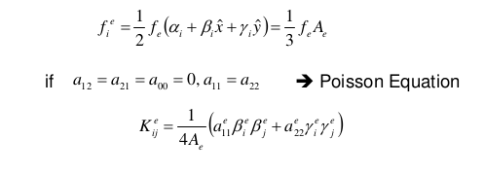
Step 3
Generate element-wise matrices
Two functions instead of three
Rectangles and triangles
Structured vs unstructured is already decided by the mapping file, but be careful not to assume right angles in our triangles
Instead, find area, α, β,γ for each triangle based on its node coordinates, then use these to generate
Removes need for local to global node mapping calculations
All contained in a data structure read from the mapping file

Slide 8
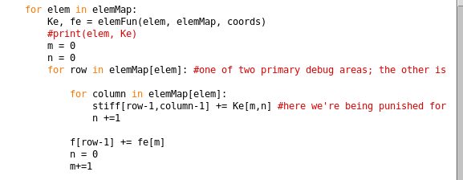
Step 4
Build global stiffness matrix and {F}
Use element maps to choose the correct rows and columns
Each element equation is done in terms of global nodes, so each entry in [K^{e}]{u^{e}} = {q^{e}} + {f^{e}} is coded by row and column in the global matrix equation

Slide 9
Step 5
Apply Boundary Conditions
Check node coordinates data structure to see if a node qualifies for any boundary
If so, apply the boundary
Dirichlet: remove appropriate row, column from [K], add K_{i,j}*T_{j} to Q_{i}
Neumann: Q_{i} += condition value

Slide 10
Step 6
Solve:
[K]{T} = {Q} for {T}
Re-insert known nodes into {T}
Indexed by global node number

Slide 11
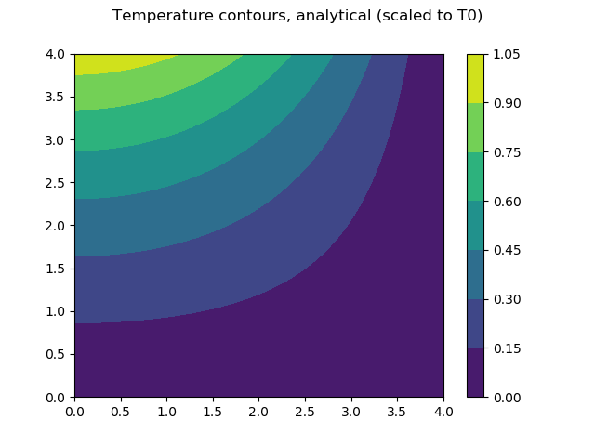
Results

Slide 12
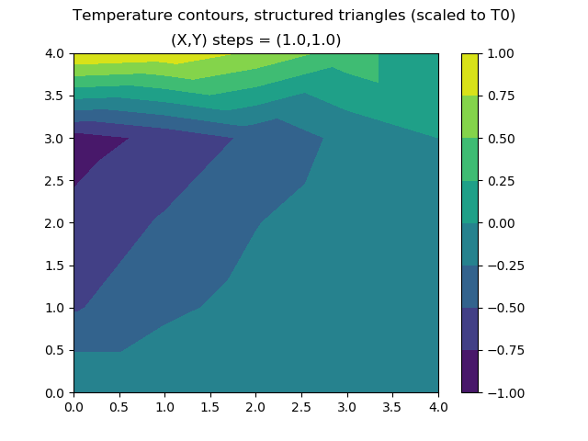
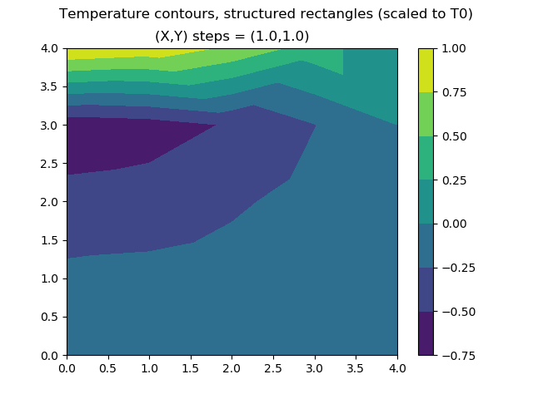
Results

Slide 13
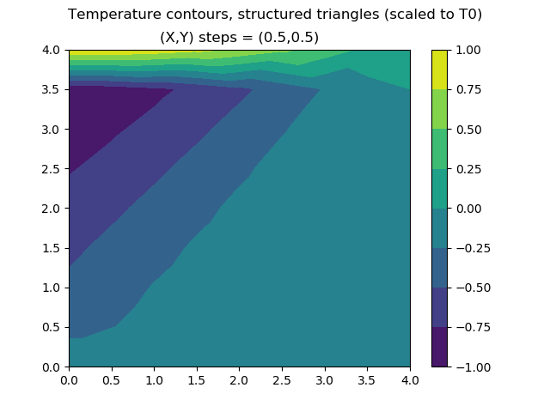

Results

Slide 14
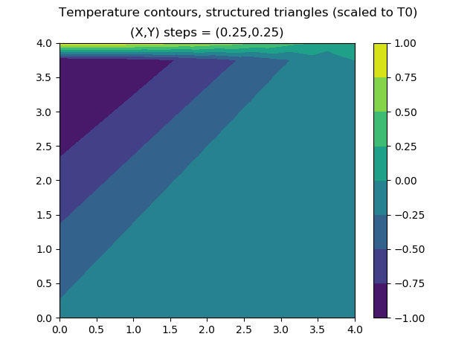
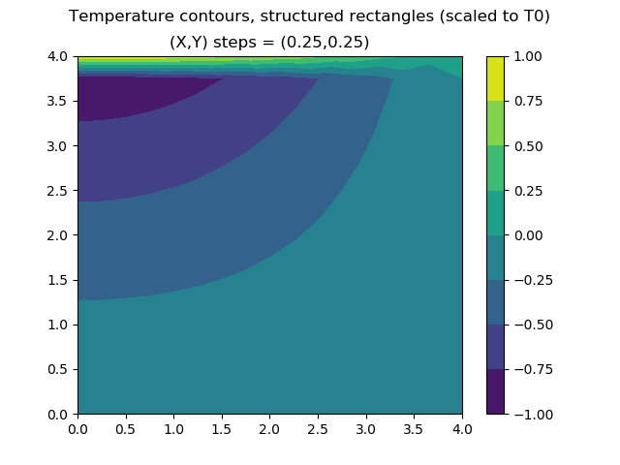
Results

Slide 15
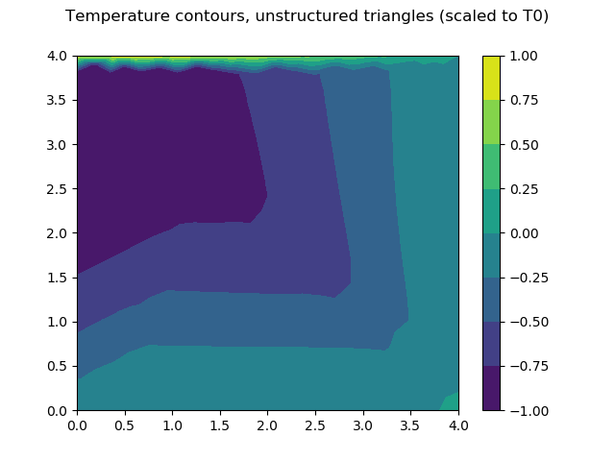
Results

Slide 16
Analysis
Possible sources of error:
Building of individual element equations
T(x,y) varies incorrectly in each element
T(x,y) outcome depends sensitively on element type
Building of global matrix equation
T(x,y) not constrained correctly – elements do not mesh
Lots of discontinuities
Application of BCs
T(x,y) flipped, stretched, or skewed
Spikes/wells radiating from corners
Reintegration of node vector
Piecewise discontinuities from BCs tranlation

Slide 17
Analysis
Most likely?
Error(s) building individual elements

