Slide 1
Wireless Scoreboard
Remote
By Joel Schaller
Notes:
Welcome

Slide 2
Table of contents
01
02
03
04
Demonstration
Hardware
Introduction to the Scoreboard
Remote PCB and Case.
Conclusion
Outlook
What I’ve learned and further improvements
Next steps to completion
PCB = Printed Circuit Board

Slide 3
01
Demonstration
Introduction to the Scoreboard
Notes:
Say what the project was supposed to do and demonstrate what it does at the moment.
Start Up
Stop
Charge
Pass the WSBR around

Slide 4
02
Hardware
Remote PCB and Case.
PCB = Printed Circuit Board

Slide 5
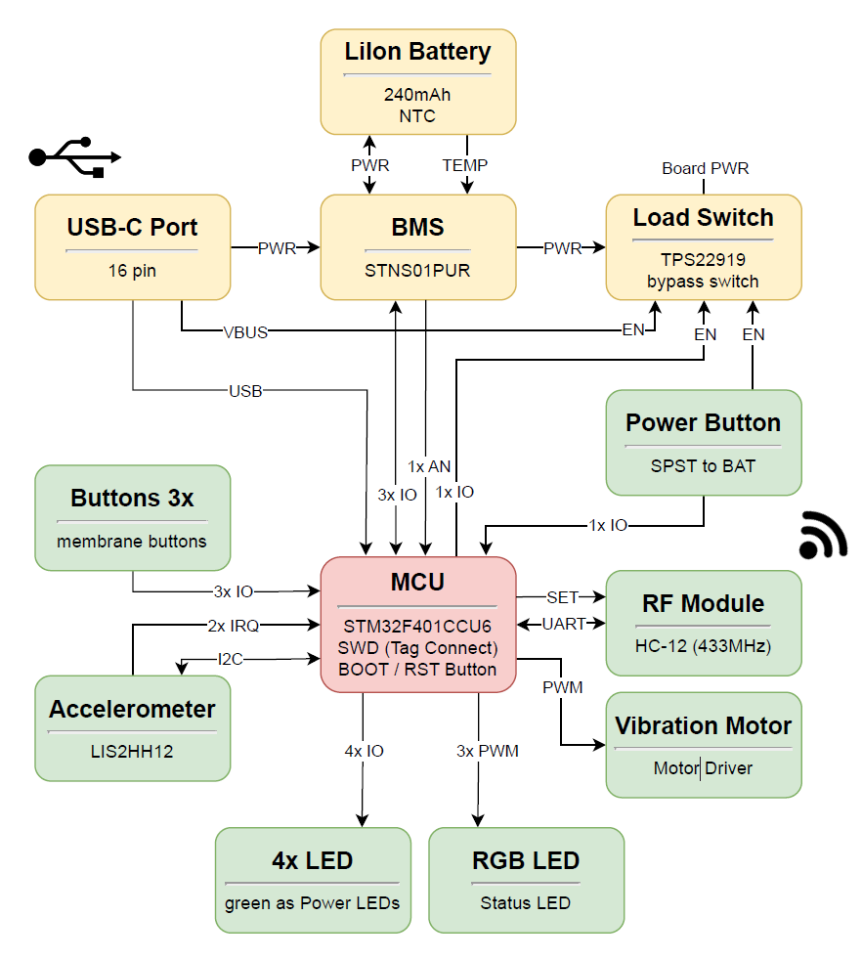

Slide 6
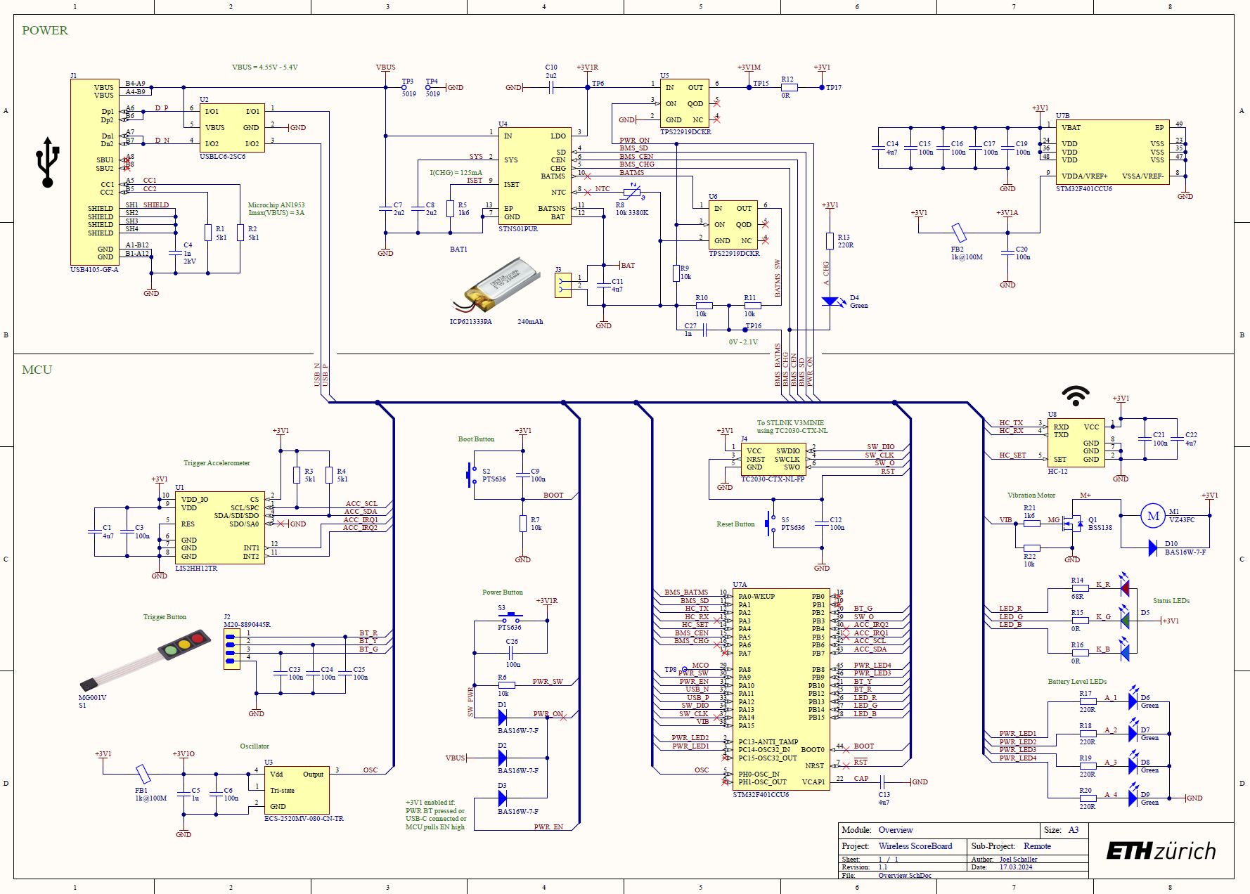

Slide 10
03
Conclusion
What I’ve learned and further improvements

Slide 11
Conclusion
PROs:
Optimized HW Design workflow
Low Power Application.
Battery management.
CONs:
To small Accelerometer (small deadbug)
Planned to much
Displays doesn‘t work by now.
HW = Hardware

Slide 12
04
Outlook
Next steps to completion
Notes:
FW Completion WSBR
Tap detection.
Haptic Feedback implementation
Display:
ePaper make work
Design case

Slide 13
Thanks!

