Slide 1



Matharon
The game with mathematical puzzles

Slide 2

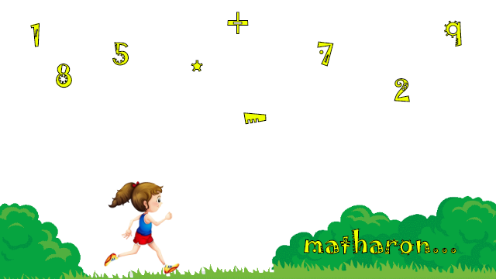
Game Description
Our goal is to create a game in which a player will try in a competitive way to accomplish a certain task
Player will control over a character and moves him in jump & run style through a flat map, collecting numbers, avoiding obstacles and solving math's.

Slide 3
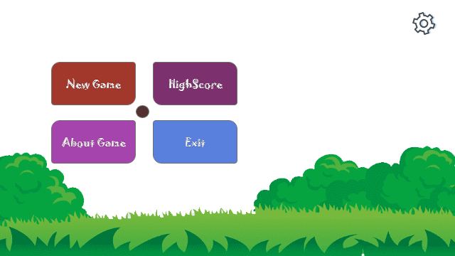
Main Menu
New Game
Leader Board
About Game
Settings
Exit

Slide 4
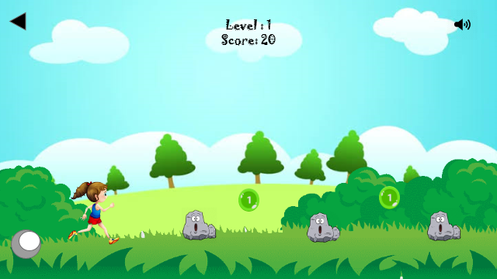
Game Play
The player has to do different things like jumping, avoiding obstacles, collecting only green coins, will take a major role in the gameplay.
This will be done with simple mechanics like player has to jump when obstacle will come.
But it will also incorporate more complicated situations where he has to solve a math within 30 seconds after collecting 3 red coins else it’s game over.

Slide 5
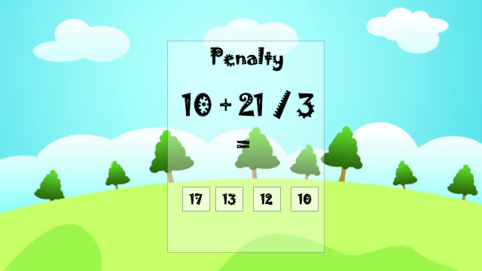
Math Puzzle
Mathematical task
Options

Slide 6
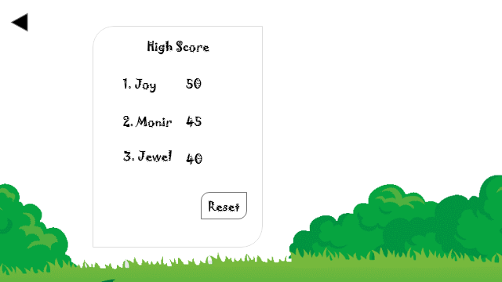
Leader Board
Highest score collector will be top of the table.
It shows the progress of the player.

Slide 7
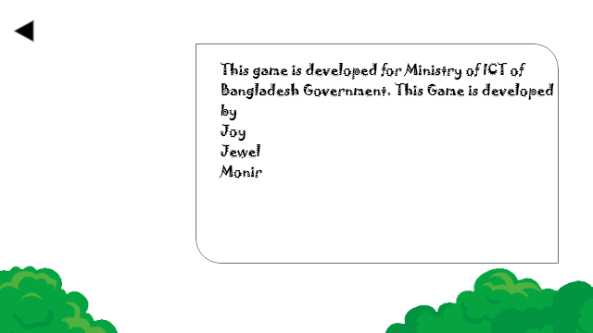
About Game
Description of how to play the game
Developers information
Game version
Rating

Slide 8
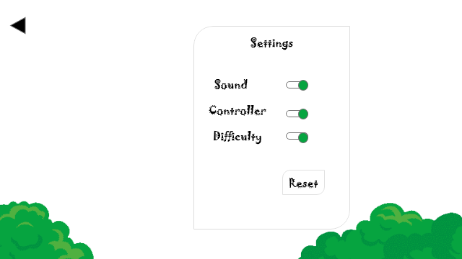
Settings
Sound
Controller
Difficulty

Slide 9



Our Team
Md. Mahmudul Haque Joy
Md. Mafuzur Rahman
Md. Monir Hossain

Slide 10
Thank You

