Slide 1
Big Data Assignment Report
NAMES:UWERA Joyeuse
ID:26074 Email:uwejoyce@gmail.com

Slide 2
Uber Fares Analysis Project
Power BI Dashboard & Report
INSY 8413 - Introduction to Big Data Analytics

Slide 3
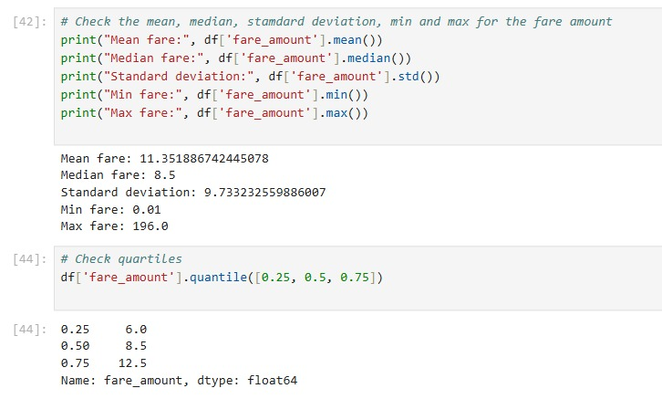
Python Code for Descriptive Statistics
Here is a Python code that calculates mean, median, standard deviation, and quartiles of the fare_amount column in the Uber dataset.
This Jupyter Notebook cell is analyzing the central tendency and spread of Uber fare data.

Slide 4
Power BI Dashboard View
Power BI dashboard presenting interactive visual analysis of Uber rides data, including fare stats, peak hours, and ride distributions.
Measure = $11.4 → Average fare (similar to Python output).
B.Hour = 19 → Most common (busiest) pickup hour.
P.Hour = 1.23M → Total rides during peak hours.
Total = 40.99K → Total number of distinct pickup days (possibly rows or grouped values).

Slide 5
Power BI Dashboard View
📊 Chart 1: “Sum of is_peak by Year”
A bar chart that shows how rides during peak hours have increased from 2009 to 2015.
Useful for visualizing yearly trends.
📊 Chart 2: “Busiest Hour by pickup_day_name”
A horizontal bar chart showing the average busiest hour by each weekday.
Helps understand which days have the most traffic and at what times.
📊 Chart 3: “Count of pickup_day_name by Year...”
This likely represents ride frequency over time grouped by day, month, and year.
Flat appearance might suggest consistent ride volume or a display error.
🔵 Chart 4: “Average Fare (Circle Visual)”
A circular KPI visual showing the average fare amount, emphasizing simplicity and summary.

Slide 6
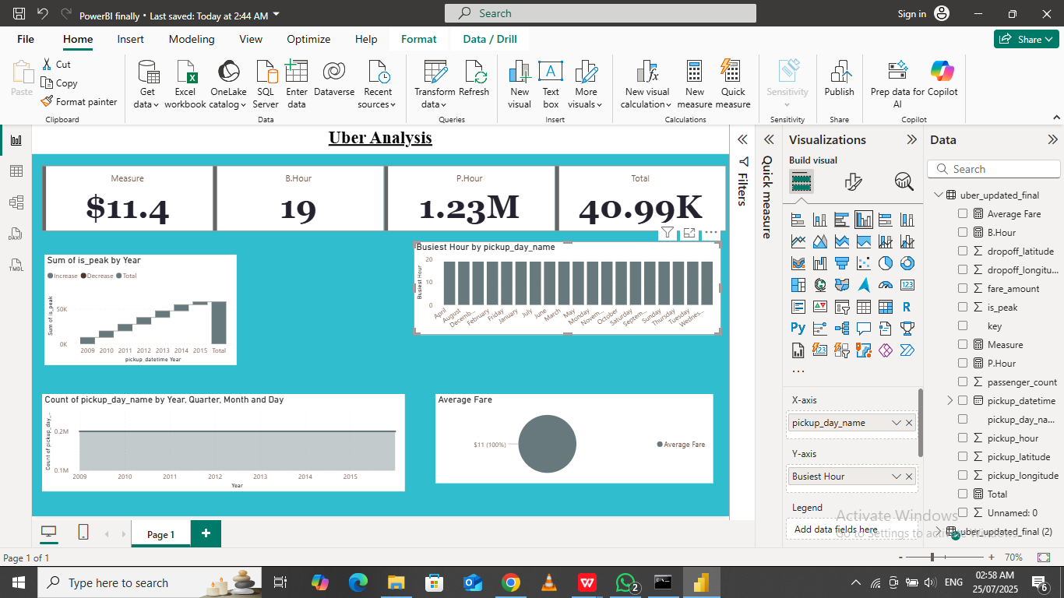
Screen shoot

Slide 7
Dataset Description & Source
Dataset: Uber Fares Dataset (200,000 rows)
• Source: Kaggle (https://www.kaggle.com/datasets/yasserh/uber-fares- dataset)
• Variables include fare amount, pickup/dropoff coordinates, passenger count, and timestamps.
• Focus area: New York City ride records

Slide 8
Data Cleaning Methodology
Removed rows with missing coordinates or invalid datetime
• Filtered out unrealistic fares (<= 0 or > 1000)
• Passenger count limited to 1–6
• Focused on valid NYC longitude/latitude ranges
• Created features: hour, day, month, day of week, peak vs off-peak

Slide 9
Key Visualizations
Fare Distribution Histogram
• Average Fare vs Hour (Line Chart)
• Fare Amount vs Distance (Scatter Plot)
• Rides per Day of the Week (Bar Chart)
• Peak vs Off-Peak Time (Pie Chart)

Slide 10
Insights and Outcomes
Most fares are short-distance and under $20
• Fare peaks occur during commute hours (8 AM, 5 PM)
• Higher average fares during peak hours
• Single passenger rides dominate the data
• Recommendation: allocate more drivers during peak hours

