Slide 1
WE FORTHEM & MUSIC
Capstone Project – Big Data Analytics
Student Name: [Your Name]

Slide 2
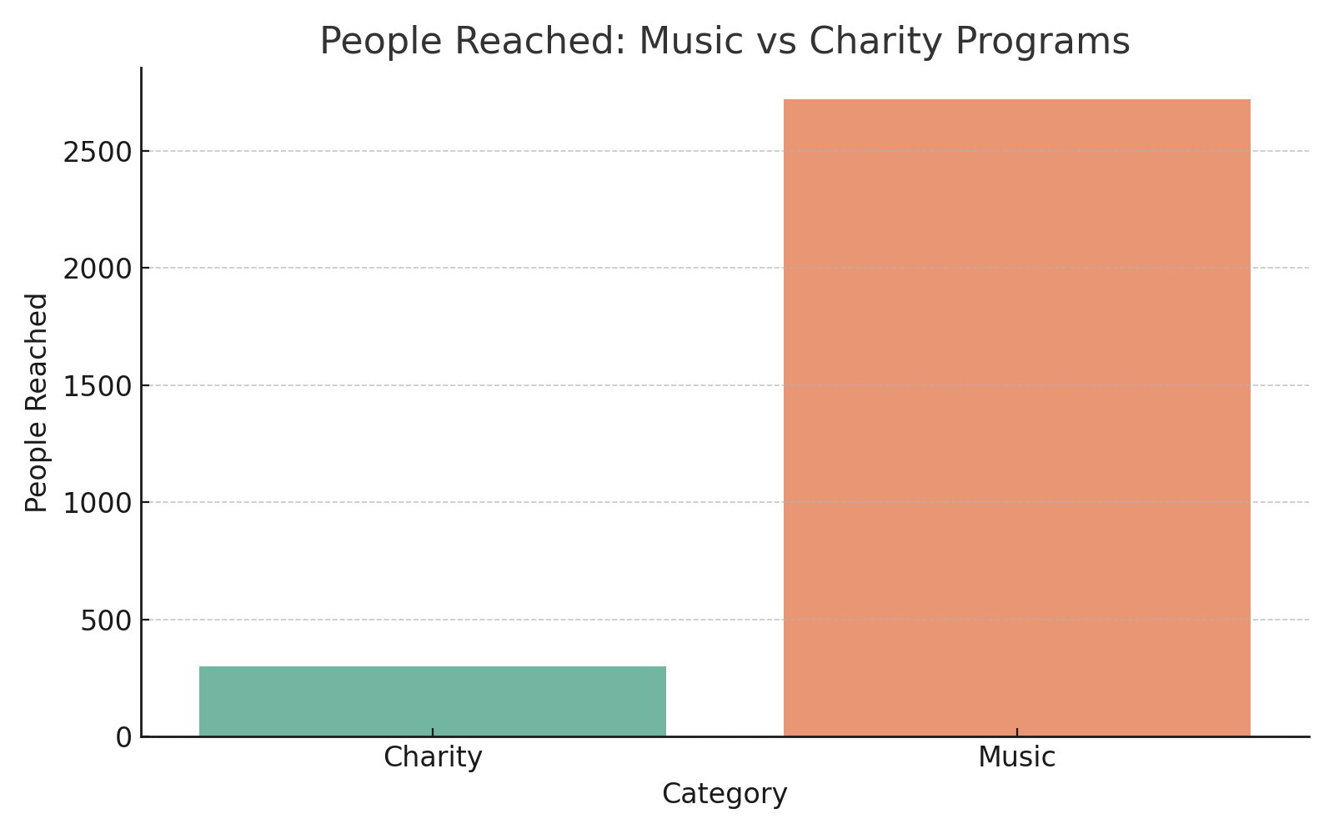
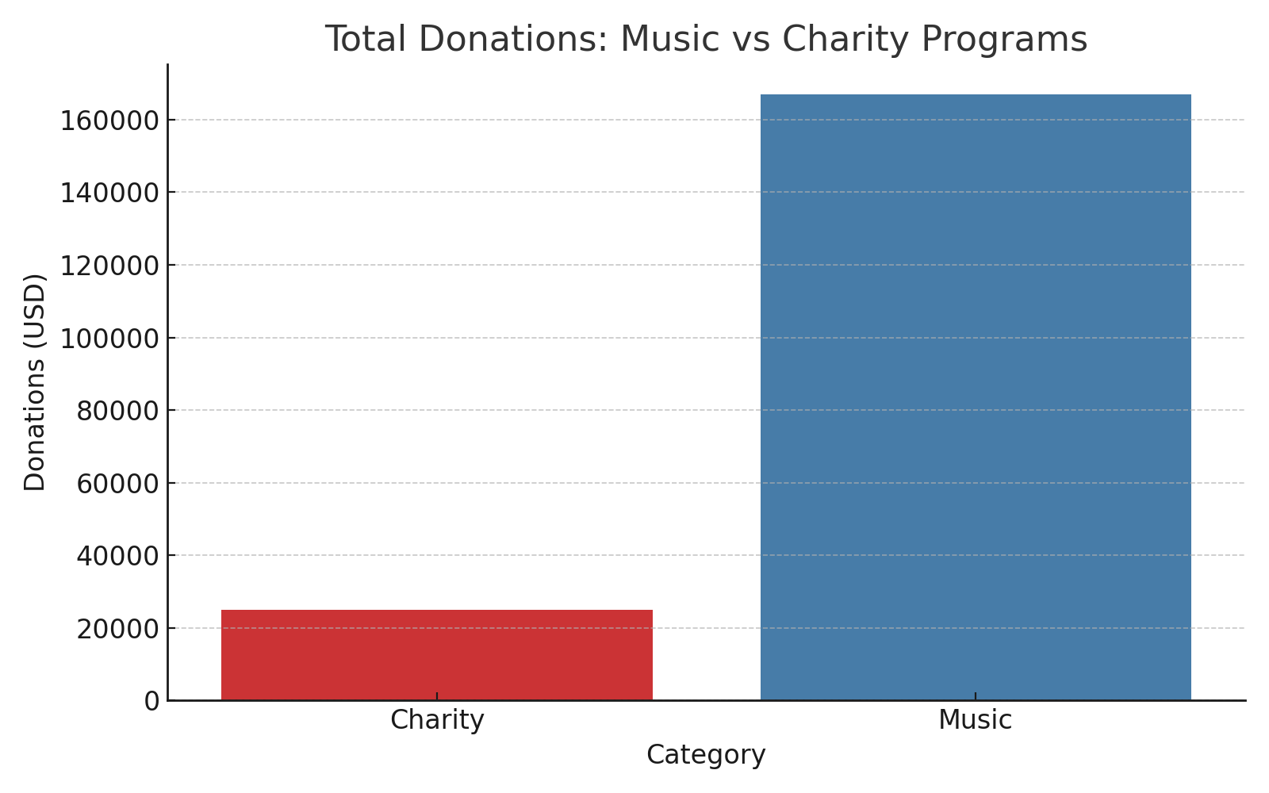
Music vs Charity Impact Summary

