Slide 1
Distributed Automated Driving with LLMs
A network of self-driving cars that think with a local LLM and coordinate over V2V radio
Distribution Analytics - Course Project
Presented by: ____________________
Notes:
Introduce the project in one sentence: we built a fleet of simulated self-driving cars where each car has its own local LLM brain and the cars coordinate by radio, with no central controller.

Slide 2
THE PROBLEM
Self-driving cars that drive alone can't see far, can't read minds, can't ask for help
Can't see far
Can't read minds
Can't ask for help
Sensors reach ~60 m. A broken-down car 500 m ahead is a surprise.
Two cars can pick the same empty gap at the same moment.
A car on a busy on-ramp may never find a gap alone.
• A central computer could control every car - but it is a single point of failure and a bottleneck.
• Our answer: every car decides for itself, and cars share only intentions, warnings and lessons.
2
Notes:
Explain the three everyday problems. Then: a central controller would fix them but is a single point of failure and a bottleneck. We want cars that think for themselves but share just enough.

Slide 3
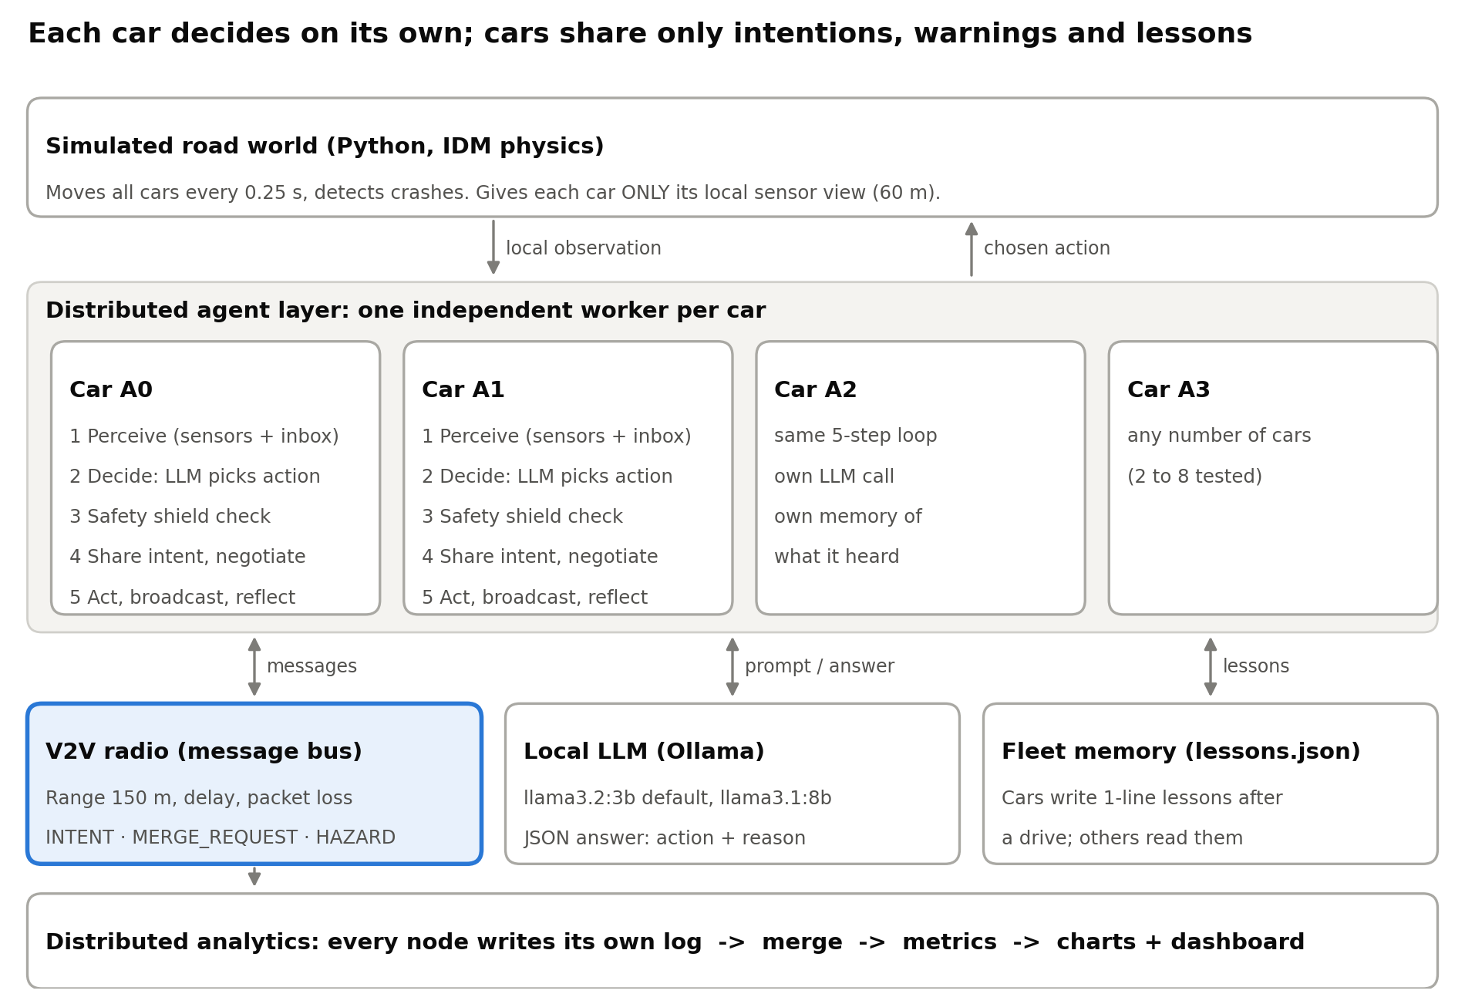
ARCHITECTURE
Our system: one LLM brain per car, a radio between them, no boss
3
Notes:
Walk top to bottom: the world gives each car only its local view; each car is an independent worker; they share the radio, a local LLM server (Ollama) and the fleet memory; every node logs for analytics.

Slide 4
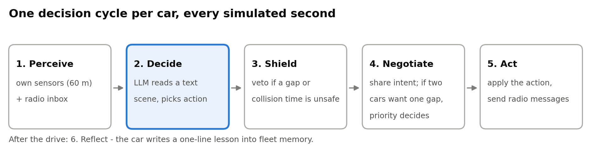
HOW A CAR DECIDES
Every second, each car runs the same five steps
• The LLM (Ollama, llama3.2:3b) reads a short text scene and answers JSON: {"action": "YIELD", "reason": "let A0 merge in front"}
• Bad or slow answers fall back to IDLE, so the car never freezes
• Actions: FASTER, SLOWER, IDLE, LANE_LEFT, LANE_RIGHT, YIELD
4
Notes:
Go through the steps. Emphasise: the LLM only proposes; the shield can veto; negotiation is between the cars themselves. After the drive the car writes a lesson.

Slide 5
COMMUNICATION
Cars talk with three short radio messages and agree with one shared rule
INTENT
MERGE_REQUEST
HAZARD
Every second: "I plan LANE_LEFT into lane 1 at x = 140 m, priority ..."
Ramp cars: "I need to get into lane 1, 80 m of ramp left"
"Stopped car in lane 1 at 560 m" - relayed once so it travels further
Conflict? Two cars aim at the same lane within 15 m -> priority decides
• Priority = (urgency, closeness to ramp end, lower car number)
• Urgency 3 = must merge now, 2 = escaping a hazard, 1 = normal lane change
• Every car applies the same rule to the same messages, so all agree; the loser waits one second
• Radio: 150 m range, 0.25 s delay, adjustable packet loss
5
Notes:
Explain the messages, then the priority rule. Key point: because every car applies the same rule to the same messages, they all reach the same decision - consensus without a leader.

Slide 6
SAFETY AND LEARNING
The LLM proposes, the safety shield decides what is allowed
Safety shield (rules)
Fleet memory (shared lessons)
• Gap in front and behind >= max(6 m, 0.3 s x speed)
• Time-to-collision >= 2.5 s
• Lane must exist; never into the on-ramp
• No speeding up if the car ahead is < 4 s away
• Unsafe -> replaced by a safe action, logged as a veto
• After a drive with trouble, the car's LLM writes one lesson
• e.g. "Check the rear gap before changing lanes."
• Saved in lessons.json; the 3 newest go into every car's prompt
• Knowledge is shared as text, not model weights
6
Notes:
LLMs are slow and can be wrong. The shield is a few strict rules. The fleet memory is our light-weight alternative to federated learning: lessons are shared as text.

Slide 7
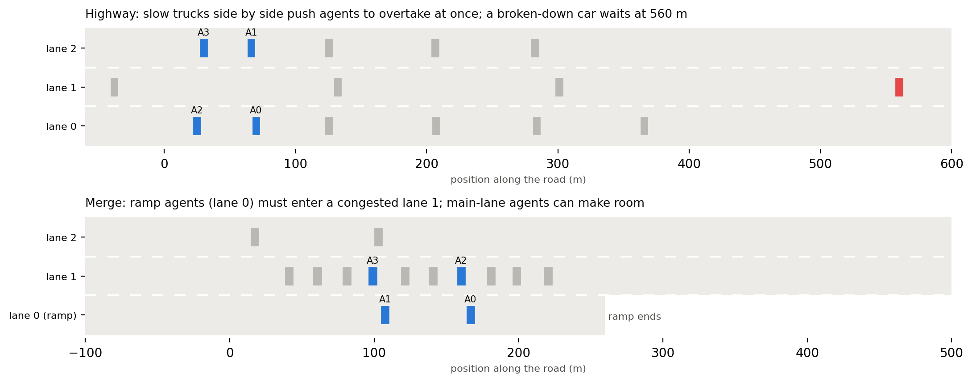
SIMULATION
Two scenarios designed so that cooperation matters
7
Notes:
Highway: trucks side by side make two agents want the middle lane at once; a stopped car at 560 m is beyond sensor range. Merge: the queue has 15 m gaps but a merging car needs about 17 m.

Slide 8
POSITIONING
Inspired by two reference projects - but distributed in a different way
Ref 1: Multi-UAV + LLM
Ref 2: Cars + Flower
This project
• LLM turns a mission into waypoints
• Often one central planner
• Safety layer under the LLM
• We borrow: LLM above a safe controller
• Each car trains locally
• A server averages the weights
• Data never leaves the car
• We borrow: fleet learning without central data
• One local LLM per car
• Peer-to-peer intents
• Leaderless priority rule
• Shared text lessons
• Per-node logs -> analytics
8
Notes:
Reference 1 plans centrally with an LLM for drones. Reference 2 shares model weights through a Flower server. We distribute the decisions themselves and share intents and text lessons peer-to-peer.

Slide 9
METHOD
Five experiments, each answering one question
ID | Question | What changes
E1 | Does talking help? | Rule-based vs LLM no radio vs LLM + radio
E2 | Does it scale? | 2, 4, 6, 8 cars
E3 | Bad radio? | 0-60 % of messages lost
E4 | Which parts matter? | Shield off, memory off
E5 | Bigger LLM? | llama3.2:3b vs llama3.1:8b
Metrics: collisions, success rate, merge time, shield vetoes, conflicts, messages and bytes per car, decision time
9
Notes:
Each setting ran with 10 random seeds; charts show means with 95% confidence intervals.

Slide 10
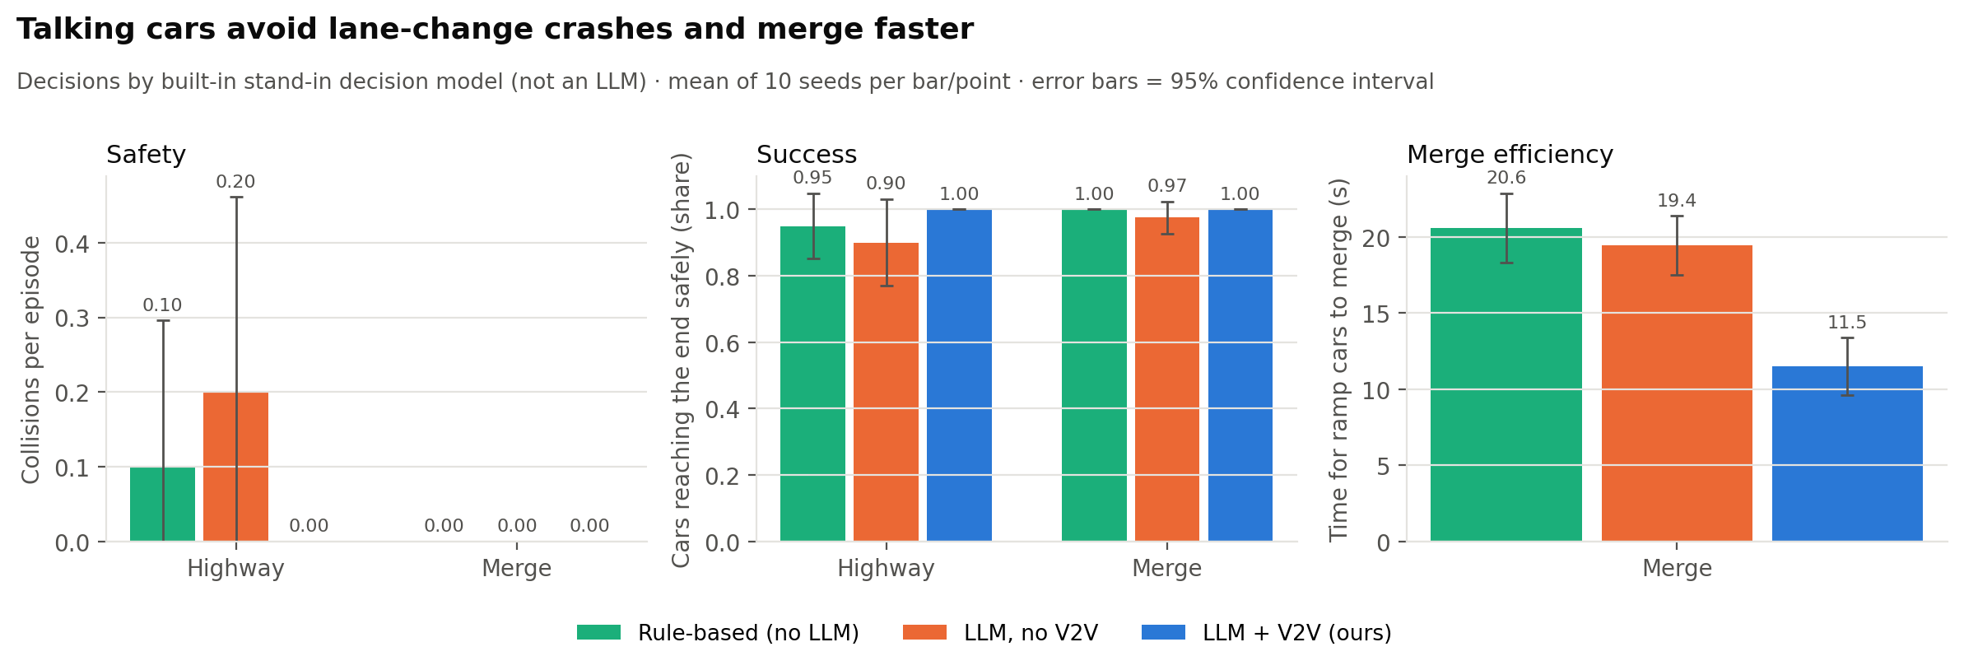
RESULTS
Talking cars avoid lane-change crashes and merge faster
0.00 vs 0.20
11.5 s vs 19.4 s
341 B/s
highway collisions per episode, with vs without V2V
time for ramp cars to merge, with vs without V2V
radio traffic per car - the cost of talking
Numbers from the built-in stand-in decision model (not an LLM) - rerun with Ollama for LLM results
10
Notes:
Highway collisions per episode: rule 0.10, no radio 0.20, ours 0.00. Merge time: 20.6 s, 19.4 s, 11.5 s.

Slide 11
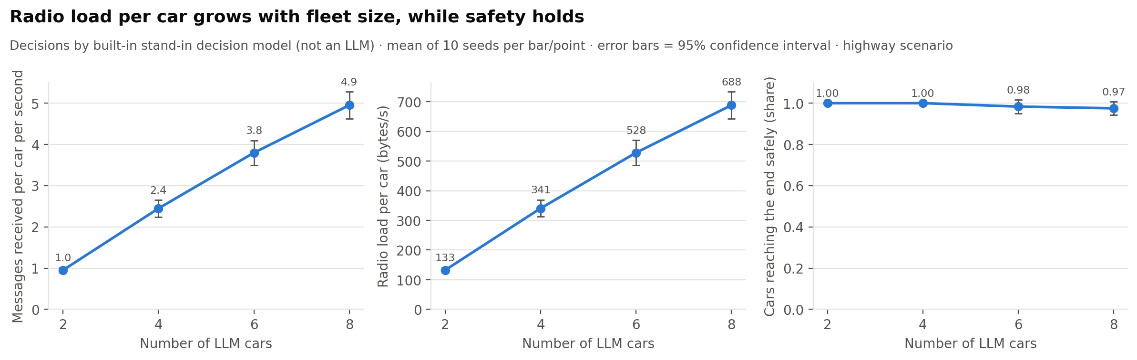
RESULTS
Radio load per car grows with fleet size, while safety holds
Numbers from the built-in stand-in decision model (not an LLM) - rerun with Ollama for LLM results
11
Notes:
Each car hears every neighbour in range, so load grows roughly linearly - but stays under 1 kB/s.

Slide 12
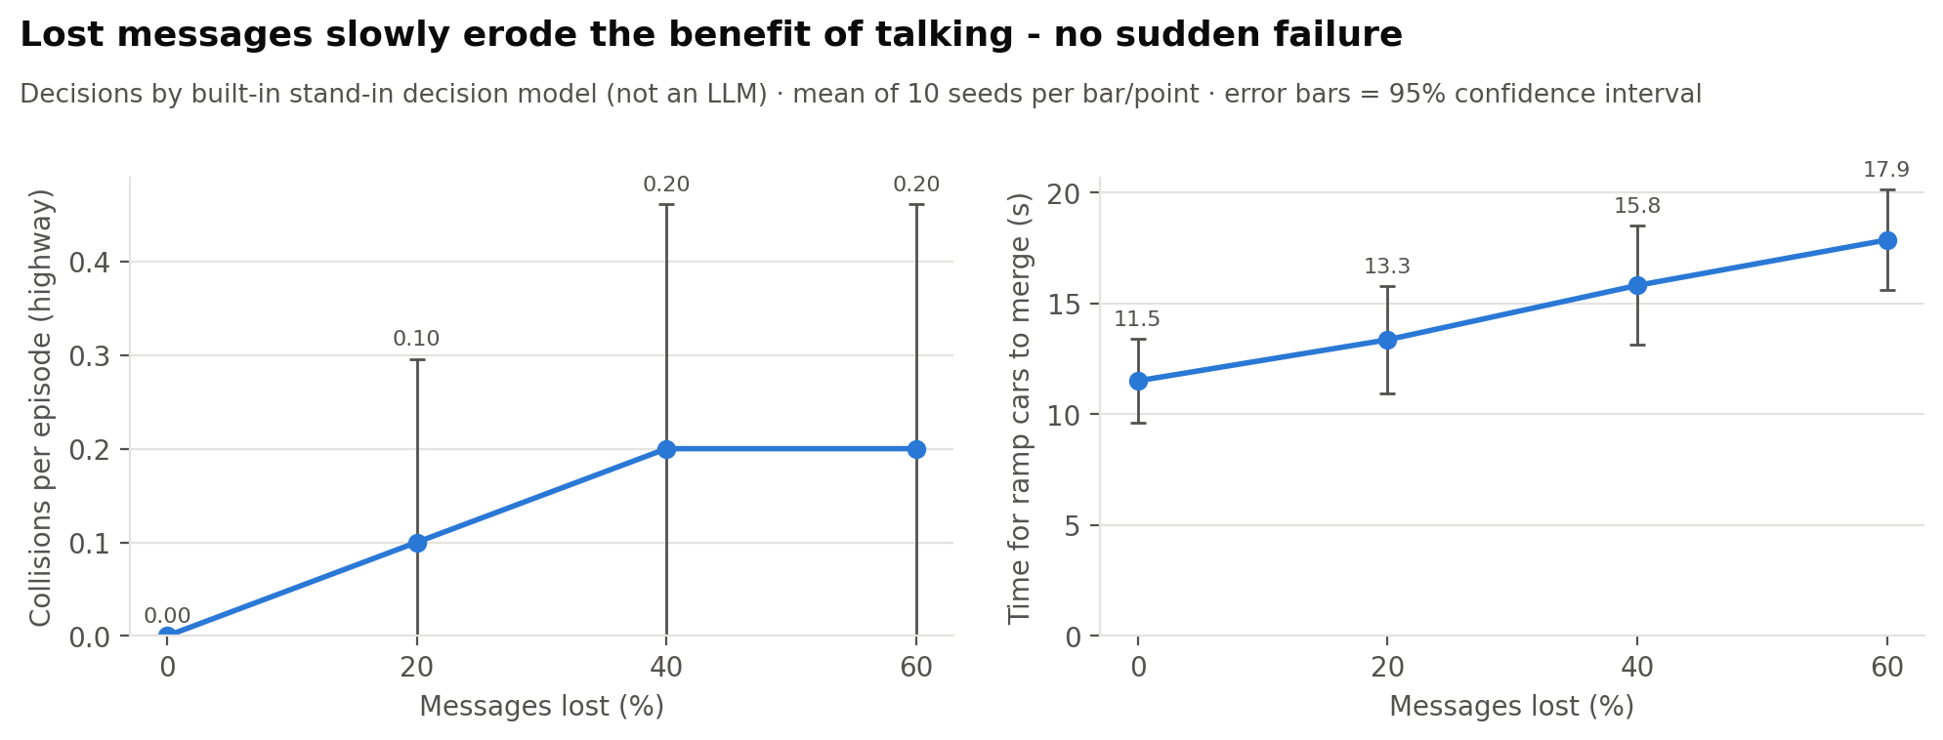
RESULTS
Lost messages slowly erode the benefit - no sudden failure
Numbers from the built-in stand-in decision model (not an LLM) - rerun with Ollama for LLM results
12
Notes:
A lost intent can make two cars think they both own the gap; a lost merge request means no yield. The shield still catches most problems.

Slide 13
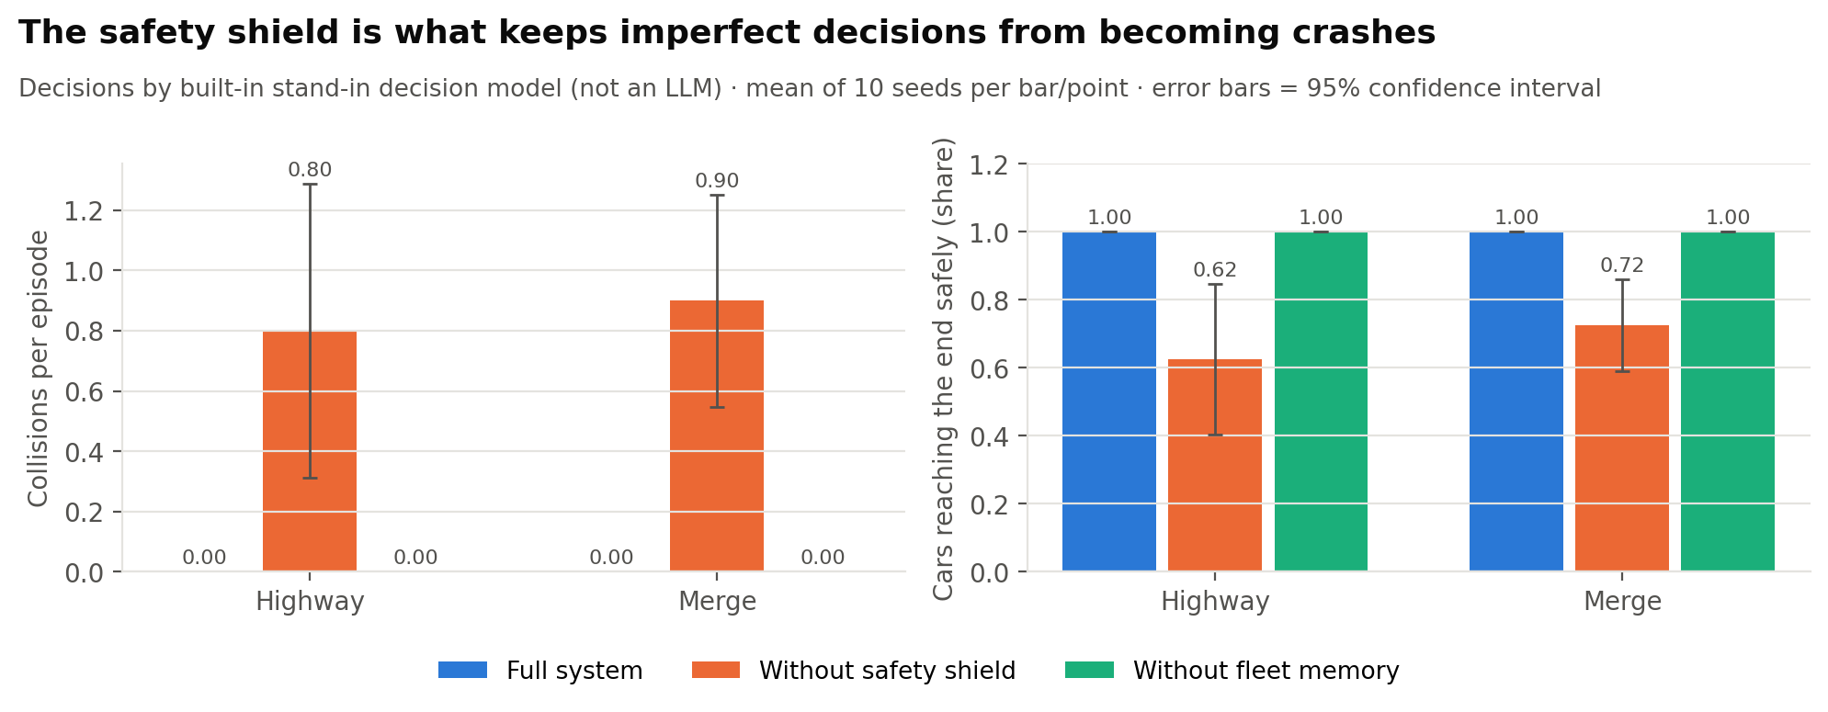
RESULTS
Without the safety shield, imperfect decisions become crashes
Numbers from the built-in stand-in decision model (not an LLM) - rerun with Ollama for LLM results
13
Notes:
Ablation: removing the shield causes collisions; removing memory has no effect with the stand-in (it ignores lessons) - measure it with the real LLM.

Slide 14
ANALYTICS
Distributed analytics: every node logs for itself, then we merge
1. Log
2. Merge
3. Metrics
4. Aggregate
5. Present
each node writes its own file: A0.jsonl, A1.jsonl, bus.jsonl
pandas collects and joins all node files
per episode: safety, success, radio, LLM time
mean + 95% CI over seeds
charts, HTML dashboard, this deck
• Everything is one command each: run_experiments.py -> make_figures.py -> make_dashboard.py -> make_report.py
• Rerun with the real LLM and the report and these slides rebuild with the new numbers
14
Notes:
Like log shipping in real distributed systems: no shared database. Show the dashboard live if possible (results/<tag>/dashboard.html).

Slide 15
DISCUSSION
Limitations and next steps
Limitations
Next steps
• Simplified road: instant lane changes, perfect 60 m sensors
• Cars run as threads on one PC
• Simulation waits for the LLM (0.5-2 s per decision)
• No message security
• Current numbers come from the stand-in model
• Cars as separate processes/machines (Ray, MQTT)
• Asynchronous LLM decisions
• Federated fine-tuning with Flower
• Intersections, SUMO city-scale traffic
15
Notes:
Be honest about simplifications; show you know the path to a real system.

Slide 16
WRAP-UP
Conclusion
• Every car thinks for itself with a local LLM - no central controller
• Sharing intentions prevents two cars from taking the same gap
• Asking for help (merge requests) makes hard merges easy
• The LLM proposes; a simple safety shield keeps it safe
• Talking is cheap (< 1 kB/s per car) and degrades gracefully
Thank you - questions?
16
Notes:
End with the four take-aways, then invite questions.

