Slide 1
Framework Flutter de Google
Chengjie ZHANG - IF26 - A19

Slide 2
Sommaire
Introduction
Feature
Open source community
Demo

Slide 3

1. Introduction
Google UI toolkit framework
2 mins de l’introduction
3 mins de l’introduction pour les nouveaux en 2019

Slide 4
2. Feature (Caractéristique)
Google UI toolkit framework
CrossPlateform: one single codebase for mobile, web and desktop
Fast development
programing language for flutter: Dart
efficiency & better quality:
Just-in-Time (JiT) vs Ahead-of-Time (AoT) compilation :
JIT for dev Improve dev efficiency: hot-reload without losing state
AOT for release Improve execution efficiency: meilleure performance
Dart SDK: (https://dart.dev/tools/sdk)
write once, run everywhere (dart VM)
compiles to native machine code (dart2native + dart2js)
others (dartanalyzer, dartaotruntime, dartdoc etc...)
framework with IDE plugin
VS Code example
Other tools
Blockly(visual programation)
Expressive + Flexible UI
Control every pixel on the screen
existing customizable, reactive workflow and tools:
widget, rendering, animation

Slide 5
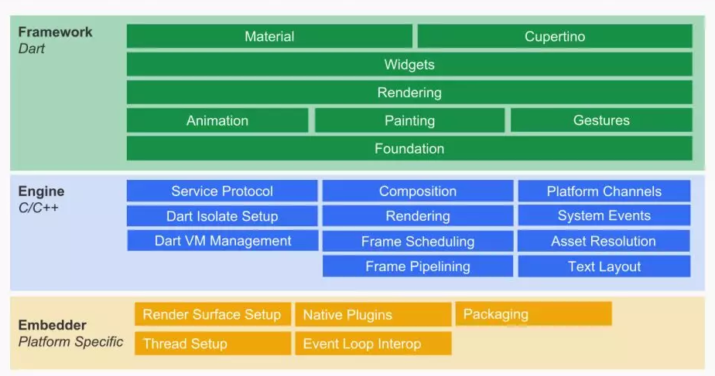
Flutter System Overview
The Framework layer:
Our application is built around this layer, which is also what we talk about.
The Engine layer :
Skia is an open source binary graphics library;
Dart includes runtime, Garbage Collection, compilation mode, etc ...
Text is for text rendering.
The Embedder layer :
Configuration to embedd your project on any platform

Slide 6
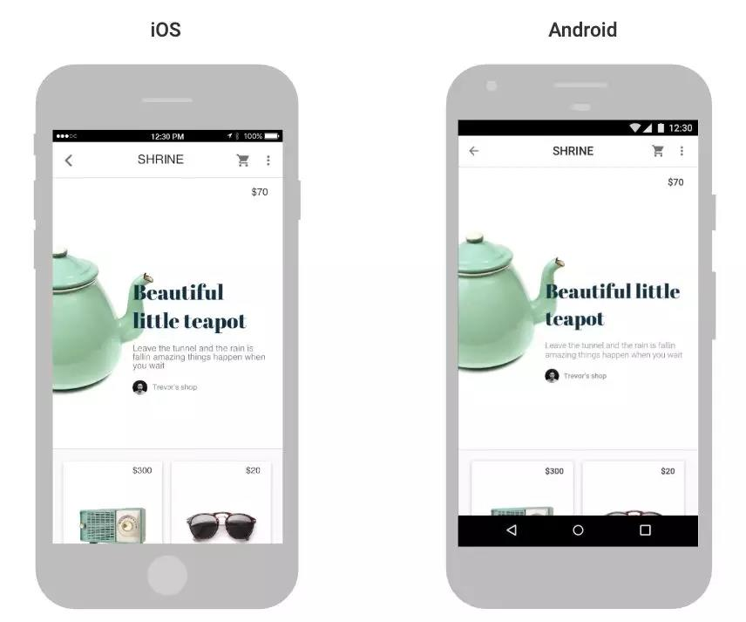
Existing UI theme:
Material（Android UI style）
In the later demo
Cupertino（iOS UI style）
https://www.youtube.com/watch?v=3PdUaidHc-E

Slide 7
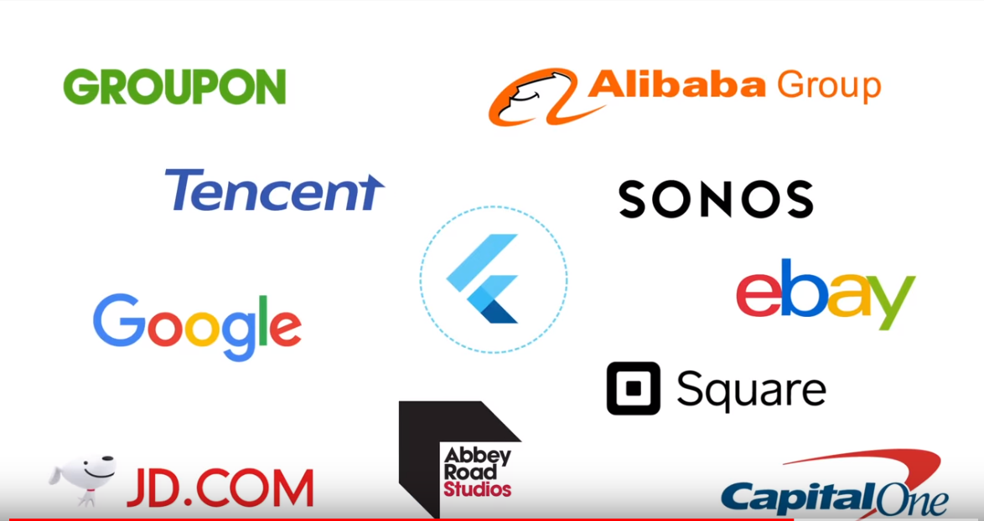
3. Open source community
https://flutter.dev/community

Slide 8

Blockly - visual programation
Support commes from
2 minutes video for creating a listview with Blockly

Slide 9
4. Demo
Step 1. Installation
Step 2. Create first app
Step 3. Bref analyse

Slide 10
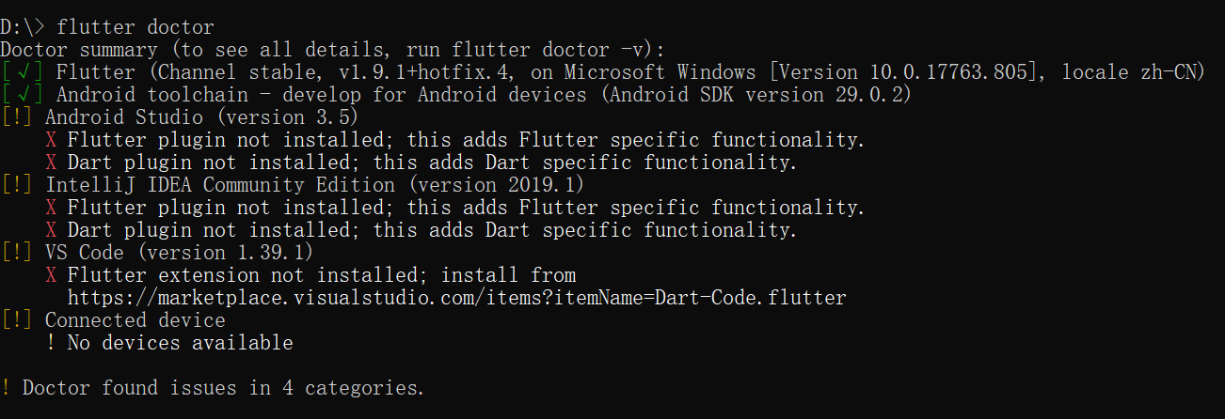
Step 1. Installation
Download：https://flutter.dev/docs/get-started/install
Dependency: flutter doctor (cmd-line tool)

Slide 11
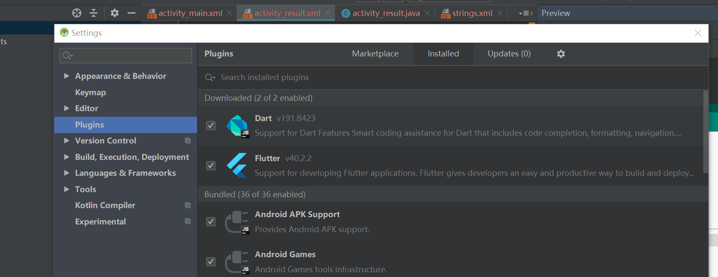
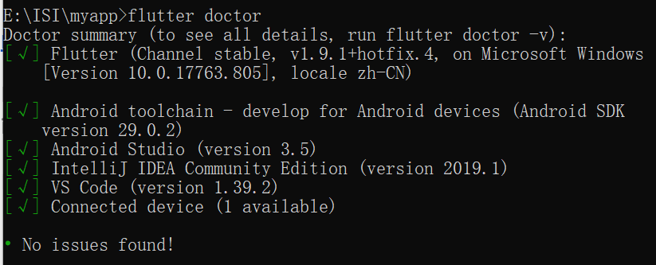
Add-in/plugin 2 plugins(Dart first, then Flutter) for IDE:
Collect all dependency on your PC

Slide 12
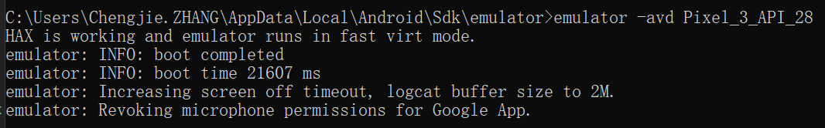
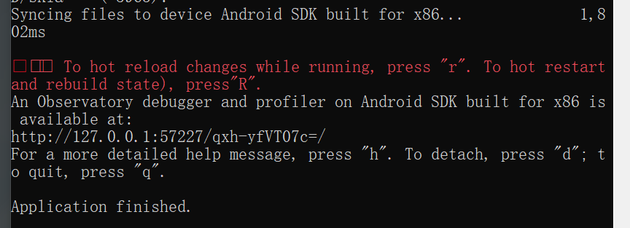
Step 2. Create demo app
Prepare device
flutter create myapp
cd myapp
flutter run

Slide 13
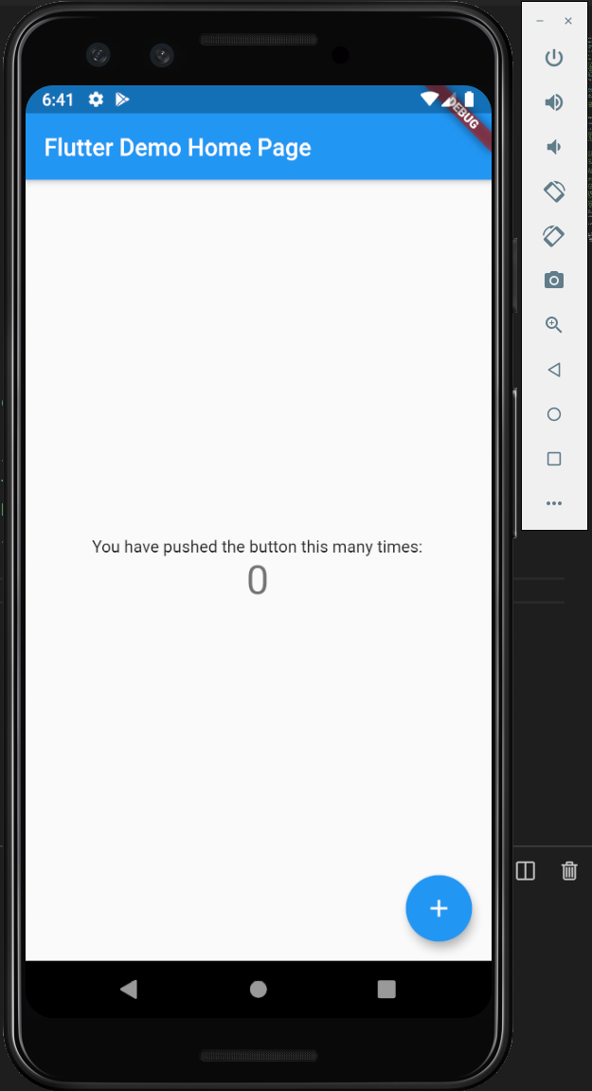
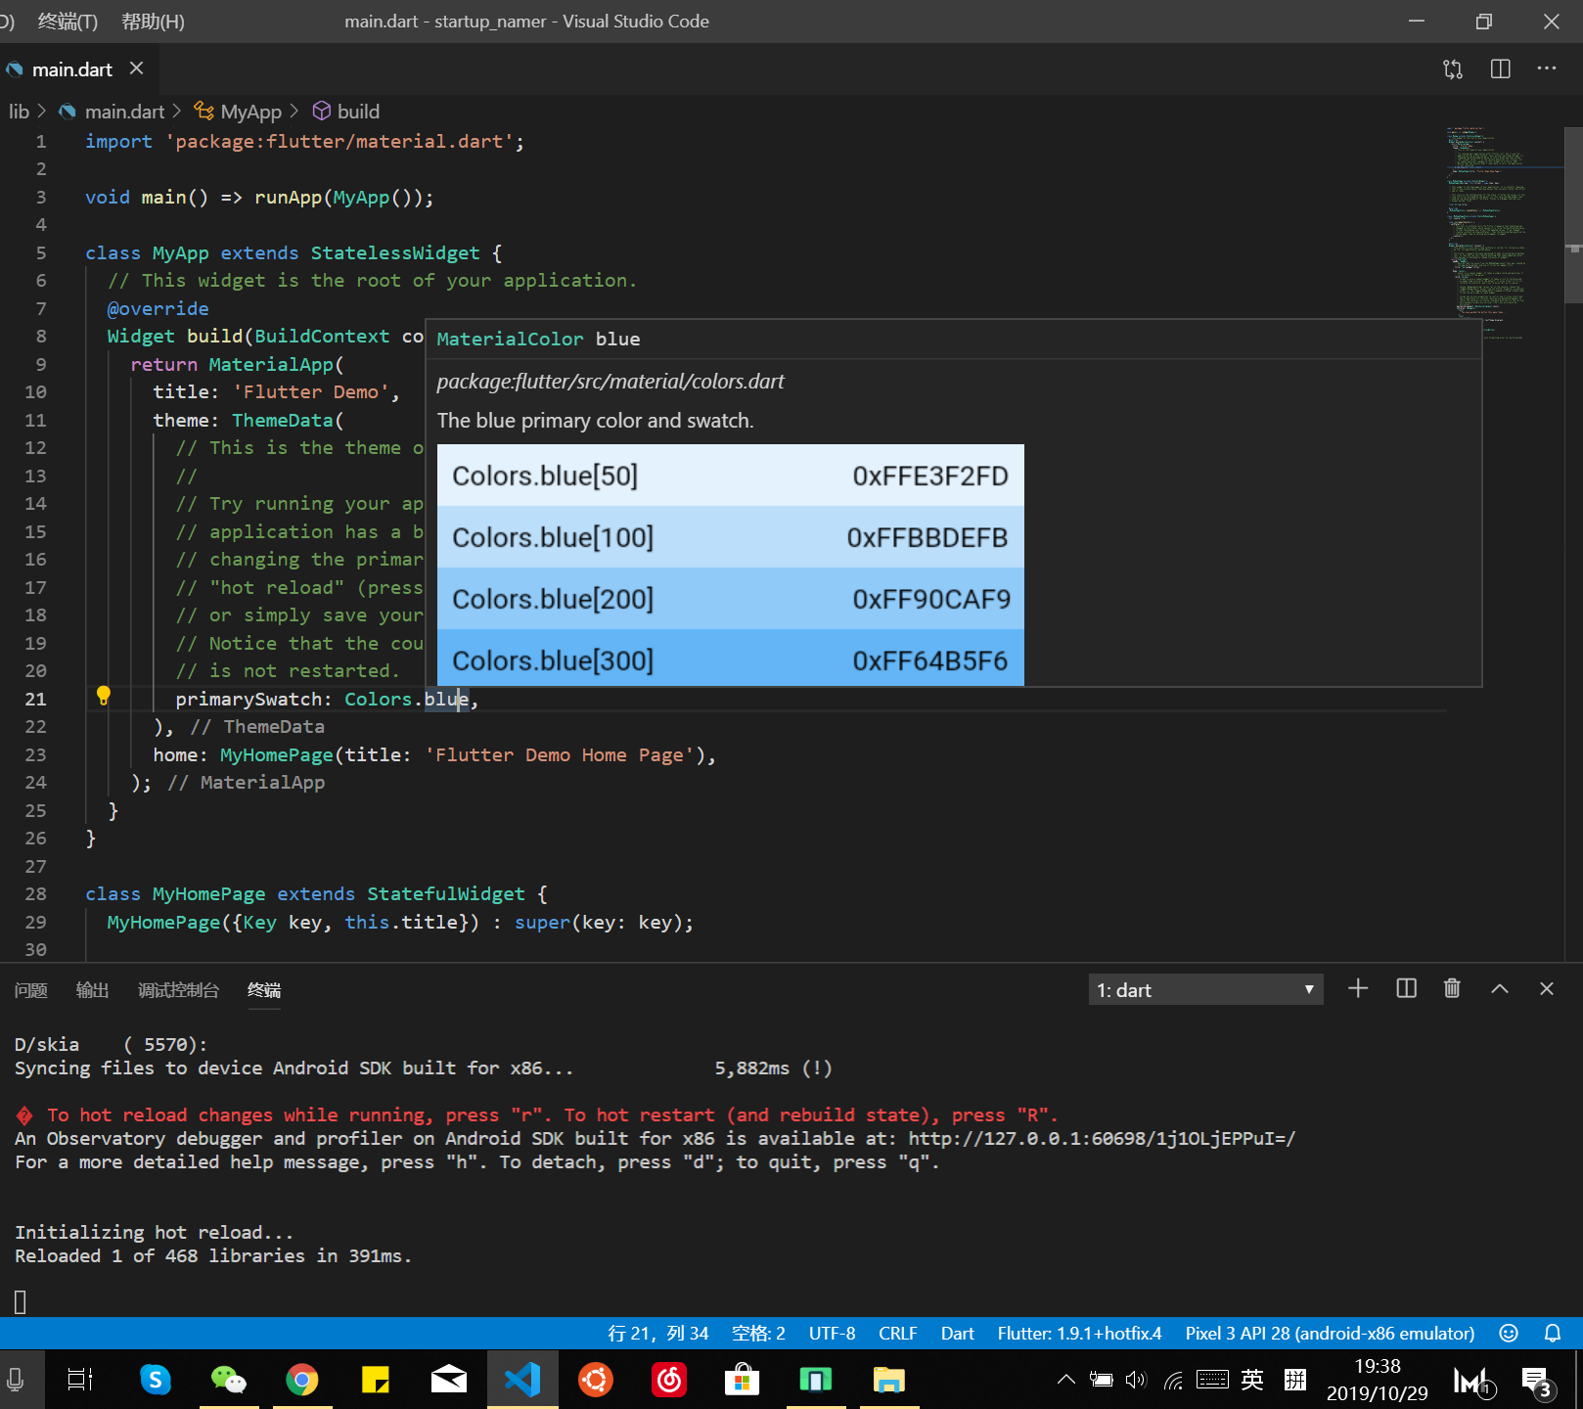

Slide 14
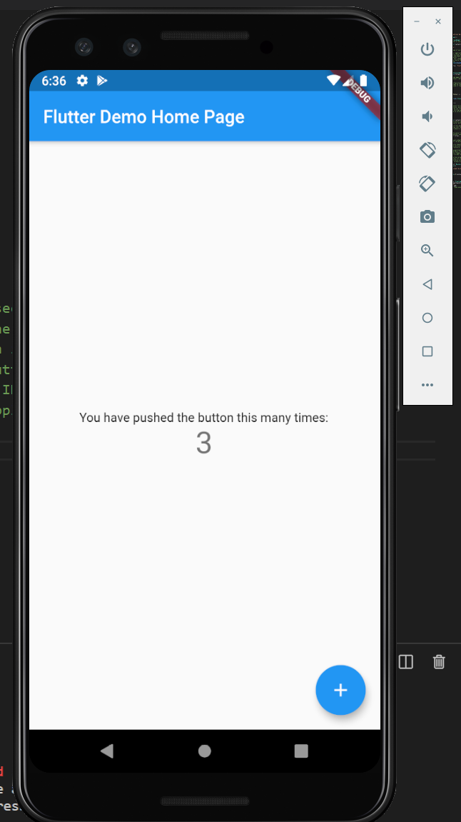
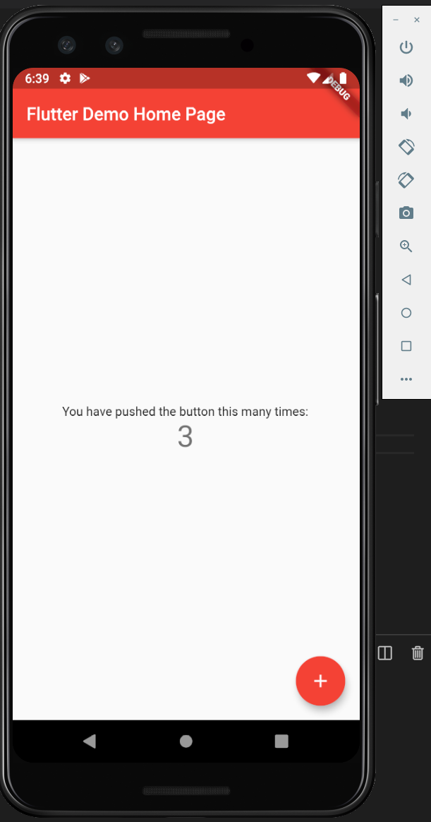
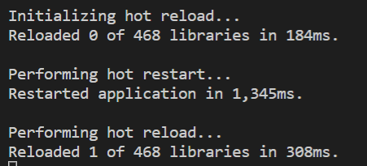
Step 3. Bref analyse
praimarySwatch: Colors.blue
=> praimarySwatch: Colors.red
-r
-R

