Slide 1
Société

Slide 2
Customer Problem
The POS don’t offer comprehensive inventory tracking. Some software is is up to $40 a month but misses key features such as cost per purchase on ingredients.
It is unruly to manage all inventory for over 400+ items and ingredients in multiple locations; and profit/cost are not accounted for.
Some retail products are purchased. Some are raw materials that are sold. Some are taken from raw materials to be made into new products. Packaging and such needs to not ever be sold. Profit needs to be managed and inventory alerts are managed and a cohesive supplier resource.

Slide 3
Customer Problem
Software costs are super high
Image of Spreadsheets
Managing Inventory
Squarespace
Shopify
Mailchimp integration
Hootsuite
FB
IG
Loyalty $25 a month

Slide 4
Features
Search by:
Name of herb
Essential oil
Latin Name – not mvp
Ailment
Action

Slide 5
Screens

Slide 6
Add Inventory Screen
Name (check name)
Auto-populate as type?
Error check to see if already there
Return results of similar names?
Supplier – auto-populated drop-down
SKU
Type – herb, essential oil, product,
Date purchased
Amount purchased
Cost
Discount
Qty purchased
Lot # - if herb
Inventory location/split
Channel – amazon, online, shop
Date added

Slide 7
Add New Product Screen
Name (check name)
Auto-populate as type?
Error check to see if already there?
Return results of similar names?
Raw Materials (join on multiple raw materials)
Adds unlimited materials from herbs, eos, packaging, other
Presents option of cost to select/purchased
Once selected – adds to list with cost and retail price
Calculates total price cost and retail
Output – qty, cost, retail, profit
Save for a custom tea?

Slide 8
Current Inventory Screen
Filters – All, Retail, Storage, Product Packaging
Name
Qty
Add button
Sorting by column

Slide 9
Product recipe report
What was in the recipe….
Add more inventory
Modify the inventory…

Slide 10
Low Inventory Alert Report Screen
Name
Supplier
Cost
Last Purchased
Qty Purchased

Slide 11
Customer Search Screen
Search by generic or by:
Name of herb
Essential oil
Latin Name
Ailment
Action
Tea

Slide 12
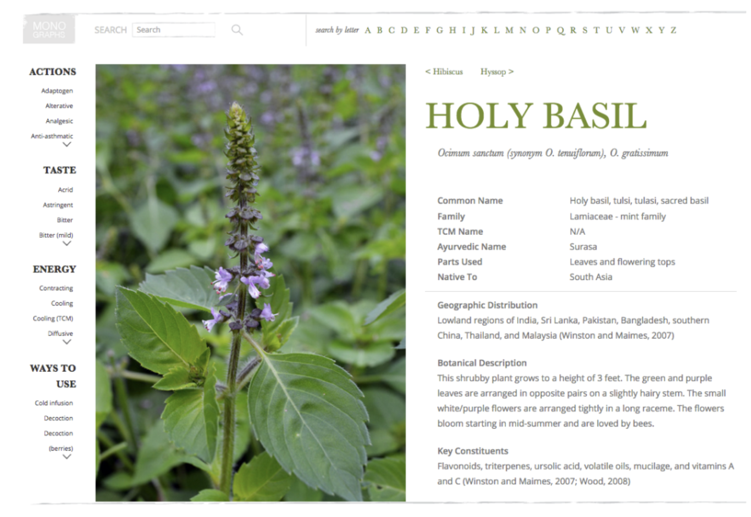
Customer: Herb Results Screen

Slide 13
Customer Results Herb Screen Fields
Search - Name of Herb, essential oil or Latin Name, Ailment. Action
CommonName herb
Latin Name
Action
Taste
Energy
Family
Ayurvedic Name
Parts used
Native To
Botantical Description
Key Consitutents
Image
Recipes – new database
Contra-indications
References

Slide 14
Customer Results Essential Oil Screen Details
Common Oil Name
Latin Name
Action
Taste
Energy
Family
Ayurvedic Name
Parts used
Native To
Botantical Description
Key Consitutents
Image
Ways to use it
Contra-indications

Slide 15
Customer Results
Option to email themselves info

Slide 16
Customer Results
Option to email themselves info

Slide 17
Cup of Joe screen – each month
What inventory was provided
Cost of each inventory
Total Cost
Total Profit for month minus cost report
Deduct operational expenses
60/40 split
Save feature

Slide 18
Profit Screen

Slide 19
Tables

Slide 20
Raw Materials
Essential Oils
Herbs
Labels
Packaging
Other – eg olive oil, carrier oils, vodka

Slide 21
herb_name
CoHerb

Slide 22
herb_location

Slide 23
Essential Oils (same as herb table?)

Slide 24
supplier_name
Supplier Name
Website
Wholesale Account Number
Minimum Inventory required
Shipping time
POC
email

