Slide 3
Target Customers
Not fancy and expensive
Not fast food
Cover average income
Goal: larger population and higher GDP is better

Slide 4
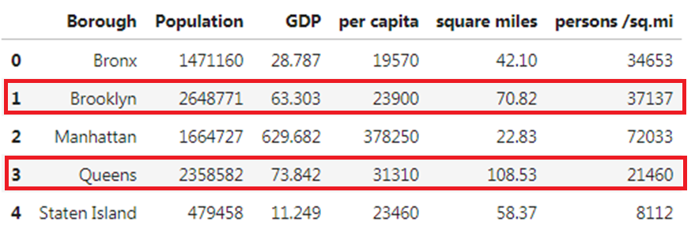
Population & Capita Dataset
Narrow down our option to 2 boroughs: Brooklyn and Queens
source from: https://en.wikipedia.org/wiki/Boroughs_of_New_York_City

Slide 5
Use FourSquare to get the restaurant map for both Brooklyn and Queens

Slide 6
Brooklyn

Slide 7
Queens

