Slide 1

MICROSOFT FILM

Slide 2
PROBLEM
Microsoft sees all the big companies creating original video content and they want to get in on the fun. They have decided to create a new movie studio, but they don’t know anything about creating movies. You are charged with exploring what types of films are currently doing the best at the box office. You must then translate those findings into actionable insights that the head of Microsoft's new movie studio can use to help decide what type of films to create.

Slide 3
Overview
Microsoft has seen that most companies are creating original video content which is giving them a tip over Microsoft.
They are trying to hop onto the wave and start creating videos as well, but they do not have the expertise, or any movie studio skill.
We need to look at different types of films that are more popular on Box Office and figure out what kind of films would thrive in their movie studio.
In this project, we will come up with ways in which we can translate our final conclusion of the analysis into something that the movie studio lead can use to decide on which type of films to make

Slide 4
Business Understanding
Microsoft needs to level up so as to reach the level required to match up other companies.
We needed to find out the state of the market so we can find out if it is a feasible business.

Slide 5
Process and Steps
In the notebook you'll see we load all the data and begin EDA.
We then group by budget and by worldwide gross.
Then we did a scatterplot of production budget compares to worldwide gross income It is evident that they are directly proportional.
When exploring the bom.movie_gross.csv data frame, It was evident that there are a lot of missing values, so I opted to drop them so as not to skew my results
I then grouped the data by studio and calculated the mean of domestic_gross load data from sq lite instance connect it to your database.
I will then translate those findings into actionable insights that can be used to help decide what type of films to create in Microsoft.

Slide 6
Process and Steps
Join the two tables based on the movie_id column
Convert the data to a pandas DataFrame
Check and Drop rows where genres column contains null values
Check for duplicated values
Group the data by genre and calculate the mean rating for each group
This helped us find out the highest earning genre

Slide 7
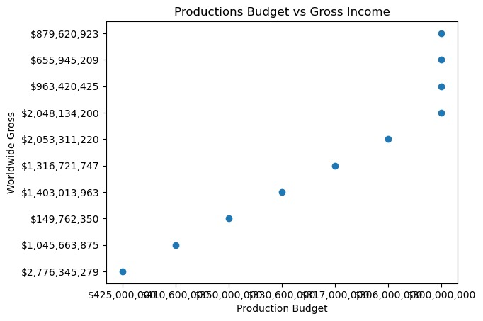
Data Analysis.
Graph showing Production Budget vs Gross Income.

Slide 8

Data Analysis.
Heat Map Showing Documentary genre vs rating

Slide 9
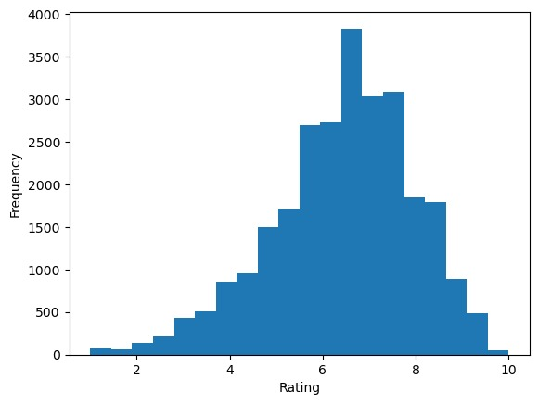
Data Analysis.
Graph showing the frequency of a ratings

Slide 10
Conclusions & Recommendations
Movies that had the most production_budget also had high worldwide gross returns. Investors should channel more to the invest in production budget.
You should concentrate on the documentary genre as most highly rated movies are documentaries.
Most Movies made 0$ both domestically and worldwide,so this is a risky business

Slide 11

Contact Information
Email: joy.kamau@student.moringaschool.com
Github: https://github.com/JoyKarey
Linkedin: https://www.linkedin.com/in/joy-wangari/

