Slide 3
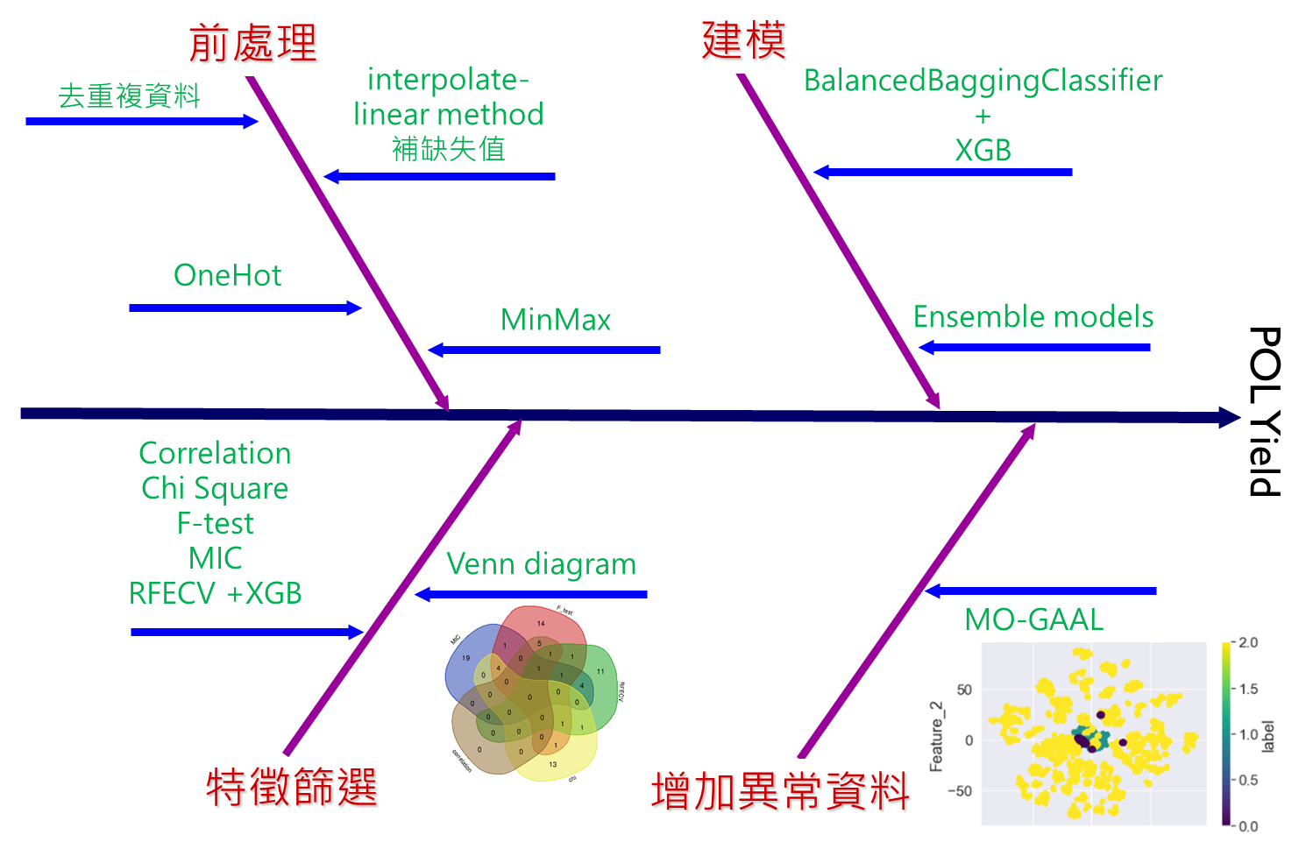
 | MO_data | TP | FN | FP | TN | F1 | RECALL
BalancedBaggingClassifier(XGBoost) |  | 2076 | 218 | 26 | 42 | 0.26 | 0.55
BalancedBaggingClassifier(XGBoost) | V | 2231 | 63 | 33 | 35 | 0.42 | 0.41
Eemble 5 models | V | 2170 | 124 | 28 | 40 | 0.35 | 0.58

Slide 4
統計方法 |  | Y的特性 | P-value
Pearson Correlation |  |  | >= 0.05 ,0.01
Chi-square |  | Label
F-test (ANOVA) |  | Label / Regression
Z-test
Maximal Information Coefficient (MIC) |  | Label / Regression

