Slide 1
https://www.kaggle.com/abhishek/same-old-entity-embeddings
https://www.kaggle.com/astrus/entity-embedding-neural-network-keras-lb-0-748
https://www.depends-on-the-definition.com/introduction-to-embeddings-with-neural-networks/
https://github.com/mmortazavi/EntityEmbedding-Working_Example/blob/master/EntityEmbedding.ipynb
https://www.sciencedirect.com/science/article/pii/S1877050919304867
https://github.com/rodrigobressan/entity_embeddings_categorical/tree/master/entity_embeddings
https://blog.csdn.net/u010412858/article/details/77848878
http://frankchen.xyz/2017/12/18/How-to-Use-Word-Embedding-Layers-for-Deep-Learning-with-Keras/
http://frankchen.xyz/2017/12/18/How-to-Use-Word-Embedding-Layers-for-Deep-Learning-with-Keras/
https://www.youtube.com/watch?v=51_mlYmcyJk&ab_channel=DataTalks
https://blog.csdn.net/u010412858/article/details/77848878
https://github.com/knathanieltucker/deep-learning-building-blocks/blob/master/notebooks/Categorical%20Data.ipynb
https://www.zhihu.com/question/45027109
https://www.youtube.com/watch?v=EATAM3BOD_E&ab_channel=AbhishekThakur
https://blog.csdn.net/program_developer/article/details/80853425
https://cloud.tencent.com/developer/article/1097483
https://towardsdatascience.com/deep-learning-4-embedding-layers-f9a02d55ac12

Slide 2
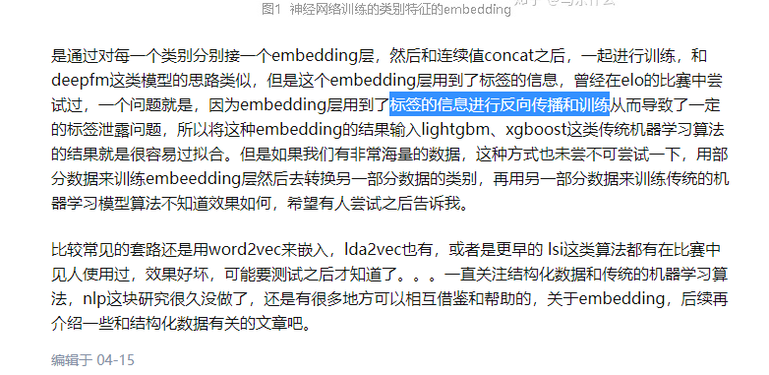
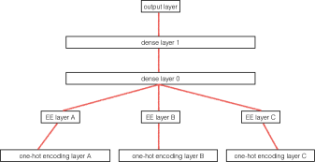
https://zhuanlan.zhihu.com/p/46016518

