Slide 1

Salinity

Slide 2
Salt in the ocean
Salt in the ocean comes from two sources: runoff from the land and openings in the seafloor.
Rocks on land are the major source of salts dissolved in seawater. Rainwater that falls on land is slightly acidic, so it erodes rocks.
This releases ions that are carried away to streams and rivers that eventually feed into the ocean.
Another source of salts in the ocean is hydrothermal fluids, which come from vents in the seafloor. The concentration of salt in seawater (salinity) varies with temperature, evaporation, and precipitation.
Salinity is generally low at the equator and at the poles, and high at mid-latitudes. The average salinity is about 35 parts per thousand. Stated in another way, about 3.5 percent of the weight of seawater comes from the dissolved salts.
Source: https://oceanservice.noaa.gov/facts/whysalty.html

Slide 3
Salinity Distribution in the Ocean
Salinity (S) conceptually grams of dissolved (<0.5 m) inorganic ions per kg of seawater. The average salinity of seawater is S = 35 which means that SW is 3.5% salt and 96.5% H₂O by weight.
Why is salinity important?
1. Salinity, along with temperature, determines the density of seawater, and hence its vertical flow patterns in thermohaline circulation.
2. Salinity records the physical processes affecting a water mass when it was last at the surface. a. precipitation/evaporation – salts excluded from vapor, b. freezing/thawing – salts excluded from ice
3. Salinity can be used as a conservative (unchanging) tracer for determining the origin and mixing of water types.
Notes:
3

Slide 4
Total amount of dissolved material in sea water is termed as salinity & has been defined as the total amount of solid materials “in grams” contained in 1kg of sea water when all the carbonate has been converted to oxide, iodine & bromine replaced by Cl & all organic matter, completely oxidised.
Chlorinity (Cl) (Absolute salinity): mass of chlorine equivalent to total mass of halogen in 1 Kg seawater. Salinity = 1.80655 Cl. This approach is fast, precise and not a bad approach.
Practical salinity (S): Based on the electrical conductivity of sea water because almost all salinity estimations are now made by determining this quantity which depends on salinity and temperature. The values are now written as eq.: S=35.00 or S=35.00 psu.
Notes:
4

Slide 5
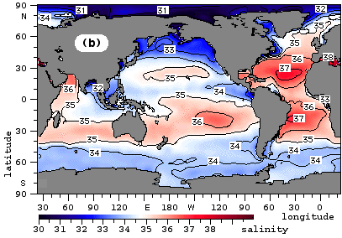
Surface seawater salinities largely reflect the local balance between evaporation and precipitation.
a. Low salinities occur near the equator due to rain from rising atmospheric circulation.
b. High salinities are typical of the hot dry gyres flanking the equator (20-30 degrees latitude) where atmospheric circulation cells descend.
c. Salinity can also be affected by sea ice formation/melting (e.g. around Antarctica)
Regional Oceanography: An Introduction – Tomczak & Godfrey

Slide 6
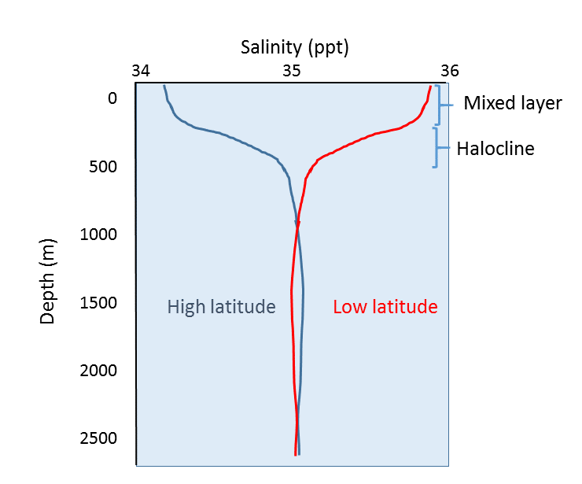
https://rwu.pressbooks.pub/webboceanography/chapter/5-3-salinity-patterns/

Slide 7
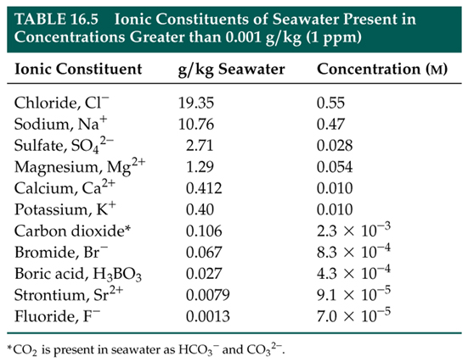
Notes:
7

Slide 8
Density
Not measured, but calculated:
The density dependence of seawater on salinity, temperature and pressure has been determined and formulated, and equations describing this relation can be used.
The density of seawater is a function of temperature, pressure and salinity and is a fundamental oceanographic property.
The average density σ of seawater is near 1.025gm cm⁻³.
The significant part of this number is generally in and beyond the third decimal. Thus, the convention is to report density as the function s,t,p = σ s,t,p – 1) x 1000. Thus, a density of s,t,p = 1.02544 gm cm⁻³ becomes s,t,p = 25.44.

