Slide 1
Alcohol Tracker CLI
A Python Command Line Application for Responsible Drinking

Slide 2
Key Features
Track alcohol consumption by type and volume
Set personal limits based on gender/weight
Visual indicators (✅/❌) for consumed drinks
BAC (Blood Alcohol Content) estimation
Warning system for excessive consumption
Unit conversion (oz/ml/l)

Slide 3
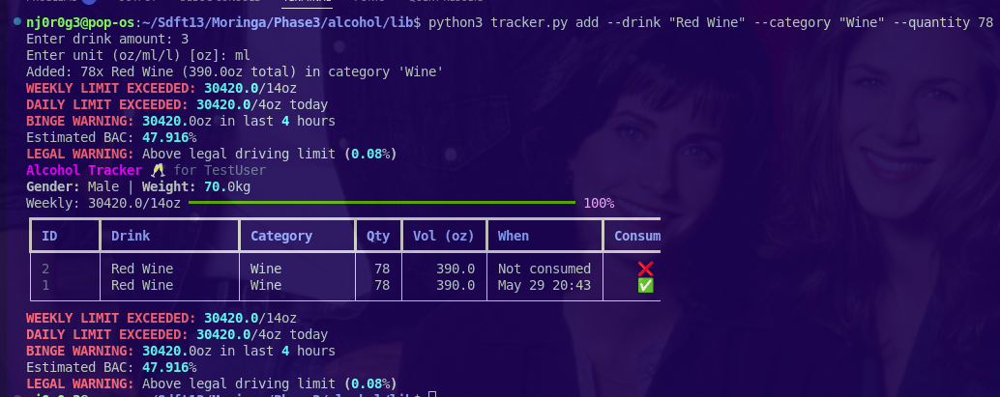
Adding Drinks

Slide 4
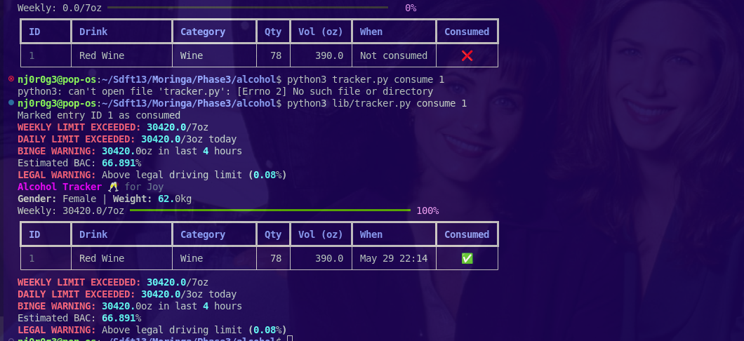
Viewing Consumption

Slide 5
Technology Stack
Python 3.x
Typer (CLI framework)
Rich (terminal formatting)
SQLAlchemy (database)
python-pptx (this presentation)

Slide 6
Key Benefits
Promotes responsible drinking
Easy-to-use command line interface
Personalized health warnings
Data-driven consumption insights
Privacy-focused (local database)

