Slide 1
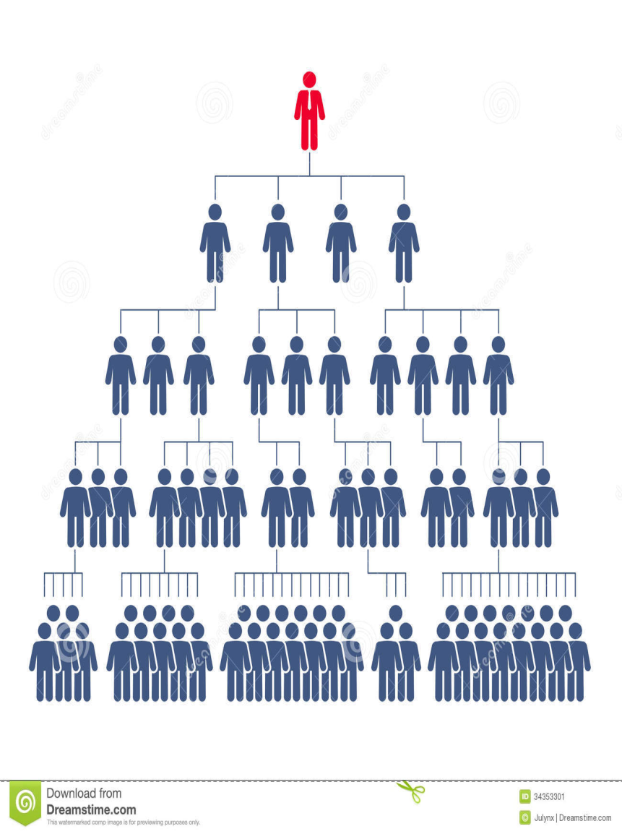
Workflow Management System
Chitraksh Sadayat (B16CS007)
Vishakh.S (B16CS038)

Slide 2

KEY FEATURES

Slide 3
Purpose
To create a convenient and easy-to-use environment for the users who are trying to apply for a leave or financial assistance.
To process the leave or financial assistance requests following a specific hierarchy.
To enable a user to check the status of his leave or financial assistance request.
To enable a user to approve the requests of those who are under him/her in the hierarchy pyramid.

Slide 4
Hierarchy
Research Scholar
Faculty
Administrator
Faculty
HOD
Director
HOD
Director
Administrator
Director
Administrator
Undergrads
Administrator

Slide 5
Software process cycle
Login
Application
Forwarding
Approval
Update

Slide 6
LIST OF USE CASES

Slide 7
APPLY LEAVE
LOGIN
APPLY FINANCE
REGISTER
CHECK LEAVE STATUS
USE CASES
UPDATE/ DEDUCT
CHECK FINANCE STATUS
APPROVE FINANCE
APPROVE LEAVE

Slide 8
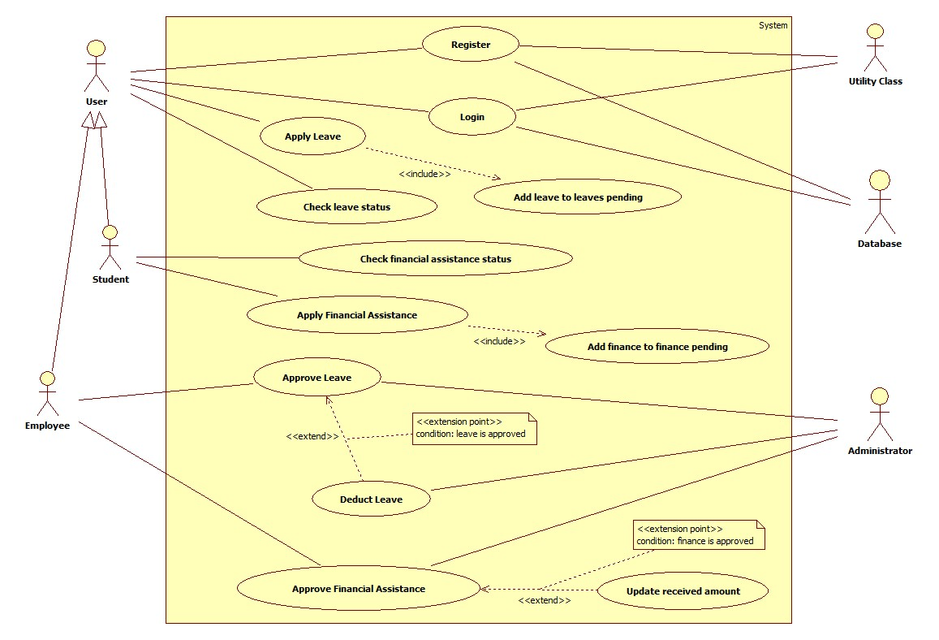
USE
CASE
DIAGRAM

Slide 9

SOFTWARE ARCHITECTURE

Slide 10
REPOSITORY ARCHITECTURE
Files
Utility
Administrator
Database
Undergrads
Director
Research
Scholar
HOD
Faculty

Slide 11
PIPE AND FILTER ARCHITECTURE
Source(Leave/financial application)
Application applied by the applicant
If valid application forwarded to higher authority as per hierarchy
Final approval by administrator
Application approved and upper limit specifications changed
DB
#

Slide 12
STRUCTURE OF DATABASE/ FILE SYSTEM

Slide 13
File Handling
Advantages
Avoids multiple file accesses during program execution reducing latency
Maintains data accuracy. Each data field handled separately.
Dis-advantages
In case of abrupt termination the progress is lost
Less structured than database system
Preliminary file handling
Line by line write into files from data structures before exiting program
Line by line read into data structures from files before entering the program
Preserves data integrity

Slide 14
Undergrads object data/application data
DIRECT
Maps/vectors
DIRECT
Ug.txt
INDIRECT
Research scholar object data/application data
DIRECT
Maps/vectors
DIRECT
Res.txt
INDIRECT

Slide 15
Faculty object data/application data/approval data
DIRECT
Maps/vectors
DIRECT
fac.txt
INDIRECT
Hod object data/application data/approval data
DIRECT
Maps/vectors
DIRECT
hod.txt
INDIRECT

Slide 16
Director object data/application data/approval data
DIRECT
Maps/vectors
DIRECT
dir.txt
INDIRECT
Administrator approval data
DIRECT
Maps/vectors
DIRECT
admleave.txt: leave approval admfinance.txt:finance approval
INDIRECT

Slide 17
Things that could not be implemented
Strings with whitespace: File handling issue
Rejection of application: Particularly trivial and less related
Database Management: An SRS scope objective

Slide 18
TEST PLAN
AND
TESTING ANALYSIS

Slide 19
Unit testing statistics
SERIAL NO. | USE CASE TESTED | NO. OF TESTS PERFORMED | NO. OF TESTS PASSED | NO.OF TESTS FAILED
1. | Leave processing: UG | 6 | 6 | 0
2. | Leave processing: Research scholar | 6 | 6 | 0
3. | Leave processing: Faculty | 8 | 8 | 0
4. | Leave processing: Hod | 8 | 8 | 0
5. | Leave processing_director | 10 | 10 | 0
6. | Finance processing: UG | 12 | 12 | 0
7. | Apply_finance:research scholar | 12 | 12 | 0

Slide 20
Unit testing statistics
SERIAL NO. | USE CASE TESTED | NO. OF TESTS PERFORMED | NO. OF TESTS PASSED | NO.OF TESTS FAILED
8. | Approve leave: Faculty | 6 | 6 | 0
9. | Approve leave: Hod | 6 | 6 | 0
10. | Approve leave: Director | 12 | 12 | 0
11. | Approve leave: Admin | 12 | 12 | 0
12. | Approve finance: Faculty | 6 | 6 | 0
13. | Approve finance: Admin | 6 | 6 | 0
14. | Check_leave status | 19 | 19 | 0
15. | Check_finance status | 7 | 7 | 0
16. | Register | 11 | 11 | 0
17. | Login | 15 | 15 | 0

Slide 21
System testing statistics
SERIAL NO. | USE CASE TESTED | NO. OF TESTS PERFORMED | NO. OF TESTS PASSED | Type
1. | Leave processing:UG to admin | 2 | 2 | End-to-end
2. | Leave processing: Research scholar to admin | 3 | 3 | Pairwise,End-to-end
3. | Leave processing: Faculty to admin | 4 | 4 | Pairwise,End-to-end
4. | Leave processing:Hod to admin | 3 | 3 | Pairwise,End-to-end
5. | Leave processing_director to admin | 2 | 2 | Pairwise
6. | Finance processing:UG to admin | 2 | 2 | Pairwise
7. | Appy_finance:research scholar to admin | 3 | 3 | Pairwise,End-to-end

Slide 22
Overall statistics

Slide 23
Testing Notes
Unit testing : CFG used: Branch Coverage Method – 182 test case
System testing: End-to-end/Pairwise technique – 19 test case
Cross-Project testing: 8 valid errors found( 12 Invalid)
Enhancement: 7 out of 8 errors rectified

Slide 24
Cross-Testing Analysis
Hostel Room
Allocation
- Group 17

Slide 25
List of Use cases tested
Main
Main handler
Login
Get room details
Get empty rooms
Put request
View my request
Get student details
Get empty rooms
View requests
Accept requests
Is room empty
Get room object
Change room status
Database functions
System testing
Database/File Correctness
Verification
Unfeasible use case: Test not done
Feasible use case: Tests Done

Slide 26
Cross testing statistics
Unit test
Pass:38(Pre-tested, Feasible)
Fail: 11(Cross-test, Feasible)
System test
Pass:10(Pairwise)
Fail:3(Pairwise)
Verification
Database :Pass

Slide 27
Suggestions: Dev team
Provide a scope for adding new students in the hostel.
Rectify the failed test cases. Alternatively remove them from the document.
For the intended results, avoid writing the pass/ fail criteria.
For the features to be tested, avoid writing function description.
User should not be allowed to put in multiple requests for the same room.
3.16.1.2 – Room 380 doesn’t exist.
Major error :
If a student (say B16CS003) puts in a request for any room, the
database is appropriately modified. But after 1 cycle of exiting
and logging in again, the database is corrupted by modifying
the request of B16CS003 to correspond to B16CS001

Slide 28
Conclusions
All the requirements as mentioned in the SRS are fulfilled.
Unit and System Testing have been carried out extensively.
Valid changes from cross testing report were implemented in enhancement phase.

Slide 29


