Slide 1

Start Learning Query
Writing

Slide 2
Why
To become a master of MongoDB
Enable us to write deep query
To manage relational data
To learn database related problem solving
To migrate SQL Database into MongoDB
Master

Slide 3
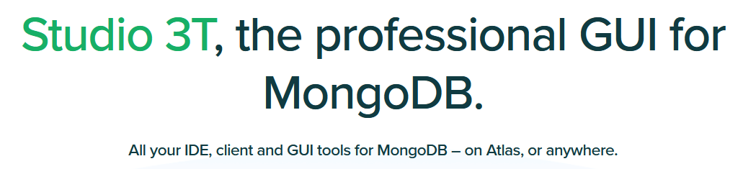
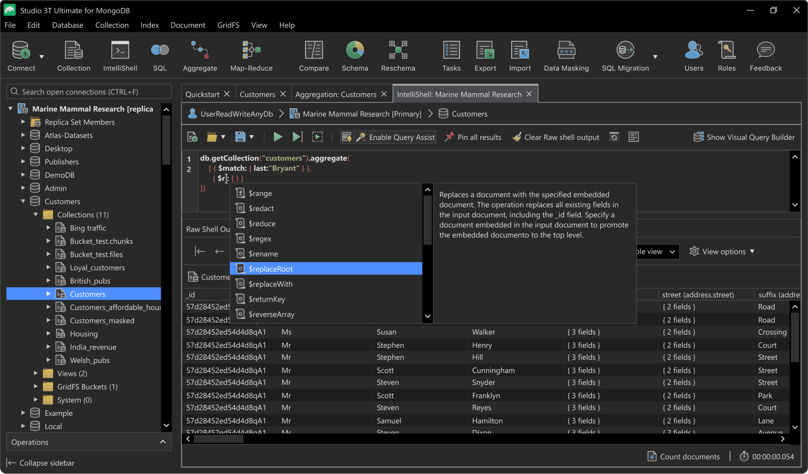
TOOLS
Master

Slide 4
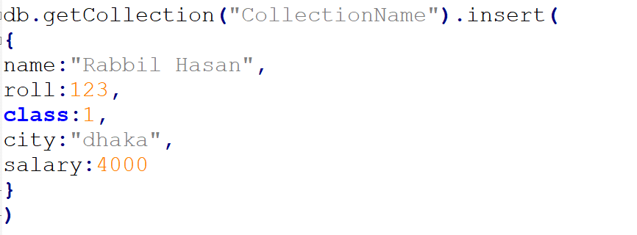
Insert One
Master

Slide 5
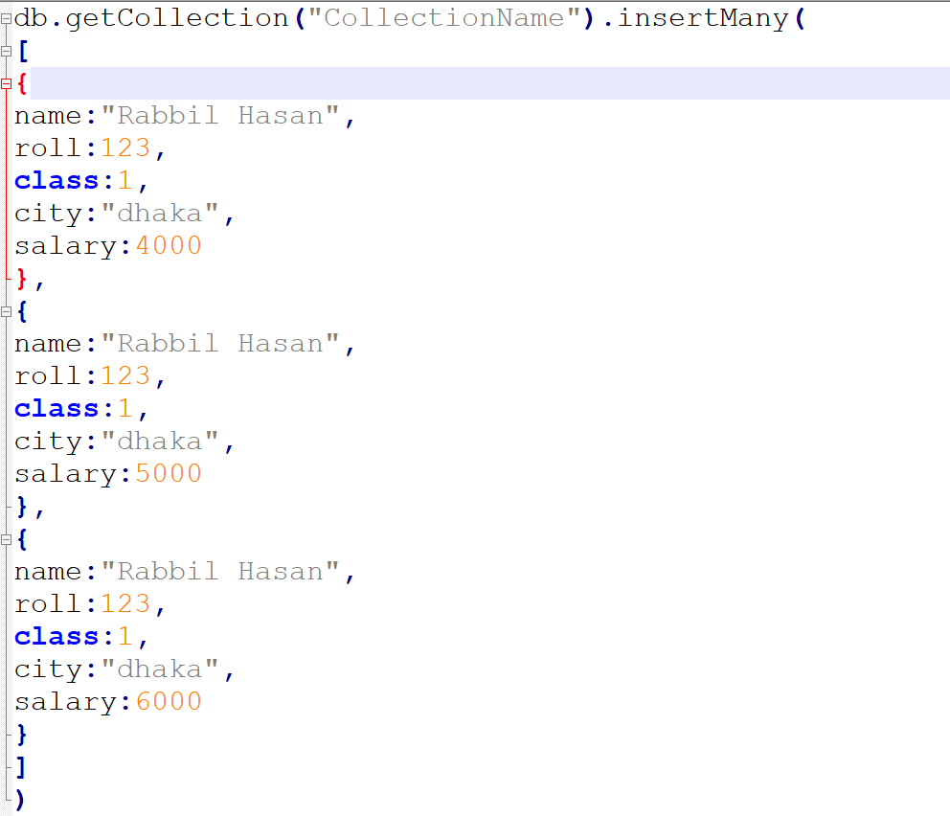
Insert Many
Master

Slide 6
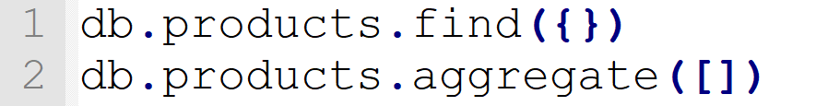
Select All Data
Master

Slide 7
Row Count
Master

Slide 8
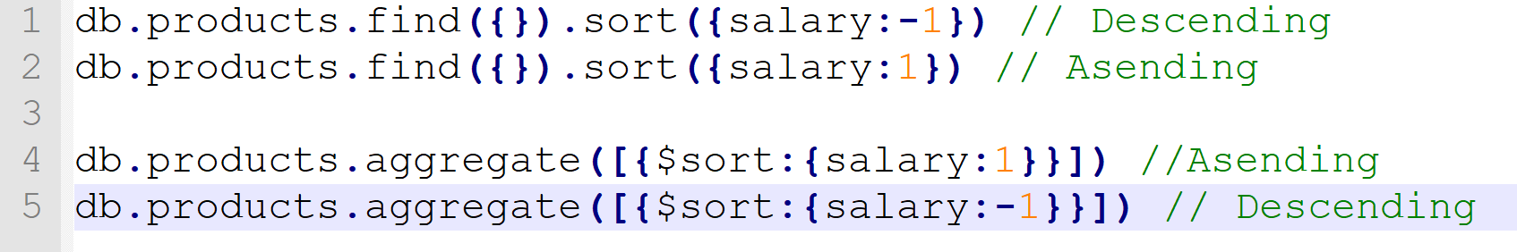
Sorting
Master

Slide 9
Limiting
Master

Slide 10
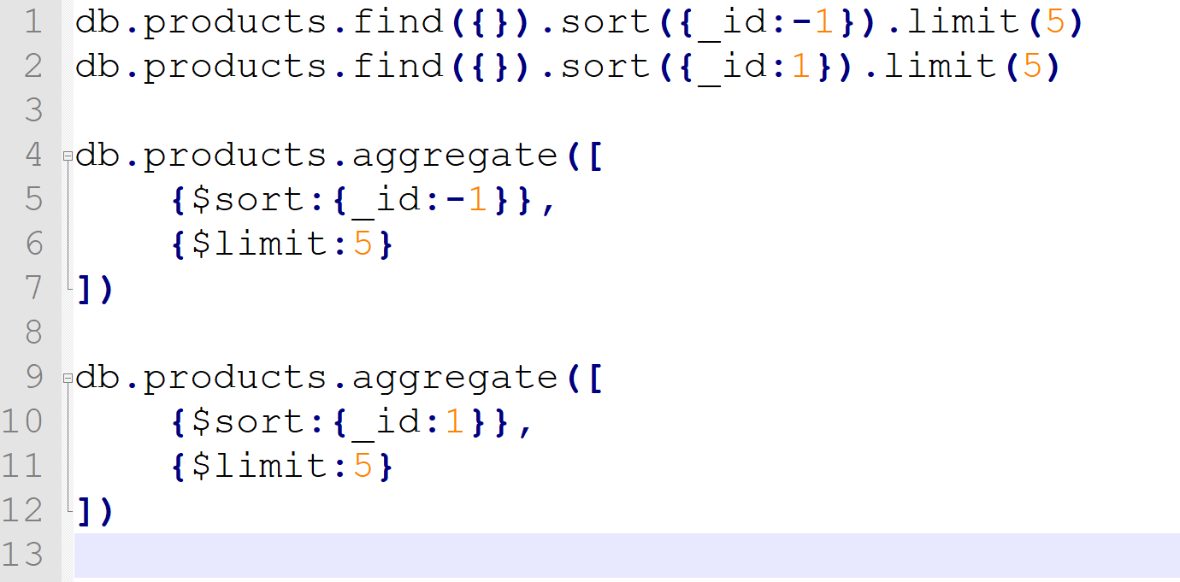
Select First 5 And Last 5
Master

Slide 11
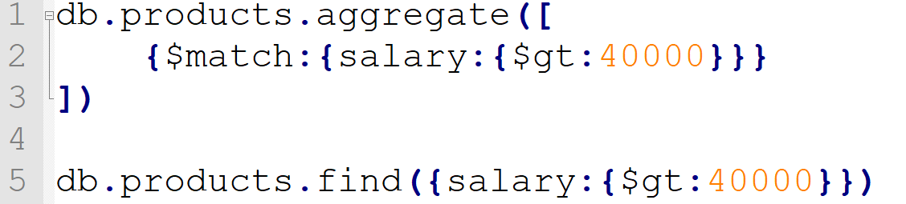
Select by match
Master

Slide 12
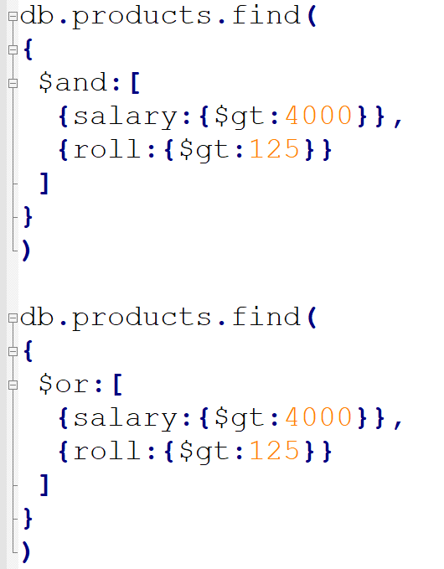
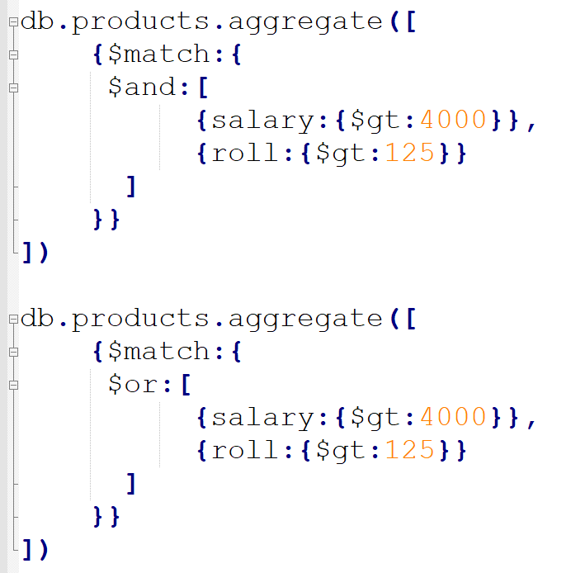
Select by match AND /OR
Master

Slide 13
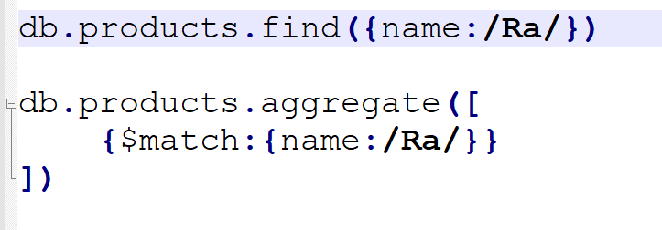
Select by match Like
Master

Slide 14
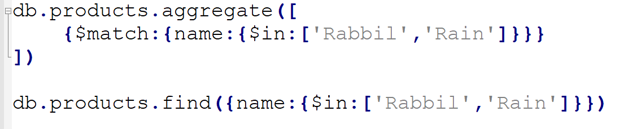
Select by match in
Master

